Slide 1

Remembering Mithras: Is VR an Effective Tool to Learn About the Past?
Twitter: @debmayers24​
Website: http://debmayers.com
Sketchfab: https://sketchfab.com/debmayers24
Notes:
Before I begin, I want to preface this talk saying that I will be talking a bit about storytelling, 3D models and (re)cronstruction. It is deliberately put into these parenthesis to denote that these reconstrcutions, are not portraying the ancient world exactly as it would have been, rather they are reflections of current knowledge about the past and based on someones interpretation, and in this case-my interpretation.

Slide 2
Overview
What is VR? Why use it?
Why Carrawburgh?
Building the experience
Experimental design
Lessons learnt
Results
Conclusions
Notes:
So today, I am going to go over my experiment about using VR for learning about the past. At the time I started this research there was relativyl little published about whether people could actually learn from using 3D models and VR and this new spatial layout of data and really wheterh or not it actually worked for people to remember content presented.

Slide 3
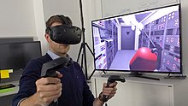
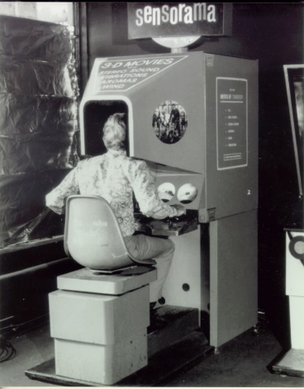
What is VR?
Notes:
How many people have heard of Virtual Reality? How many have tried it? Okay. For a really brief history, VR started off as this big machine built in the 1950s called the sensorama, a person would stick their head in and be able to see content and move with some hand controls, I would sort of equate it to the beginning of computers with the mainframe. Today, VR is typically known as a head mounted display seen here at the top. High end VR allows people to walk around a physical space and the virtual world reacts to their movements. This is the true power of VR. The virtual space reacts to my physical movements. I become embodied in the space and this is really important for certain types of learning.

Slide 4
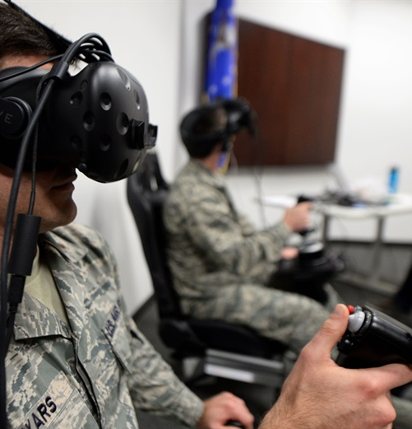
How is VR Used for Learning?
Training
Embodied Cognition
Direct Manipulation
Allows Mistakes
Allows Multiple Tries
Sensory Feedback
But Abstract Concepts???
Notes:
At the moment, VR is really good for training. Many studies have shown that when people use VR they are able to perform tasks, or their job better than when they use some other form of training. This is because it allows you to embody an avatar in the virtual space and psychologically, people treat this as a real experience. So when in VR people actually treat it like something truly happening. Which is great for training to do some sort of physical action. VR allows danger, without physical danger. So if I were to mix chemicals in VR and they exploded, I would not get hurt and I could try again. Because of these aspects, VR has started to become a tool used in academia. However, not much is known about whether students can actually learn from VR. And especially when we think about Ancient History, how we learn is by reading textbooks can this be translated into VR?

Slide 5
Bailenson’s Rules for Creating VR Experiences
Expensive
Impossible
Rare
Dangerous
Notes:
And the answer to that is sort of. Dr. Bailenson is a professor at Stanford and has one of the best VR labs in the world. His guidelines for putting something into VR is if it is expensive, dangerous, impossible, or rare. And of course, this relates very well to learning about the past. A lot of times, people are unable to travel to archaoelgoical sites, or museums. Some artifacts are unable to be handled, and are in glass boxes in museums, and we cannot see how sites would have functioned in the past, so VR is a great medium for this. It allows people to travel to sites, and imagine what it may have been like in the past, while holding and examining artifcats, and that is what I did for my experiment.

Slide 6
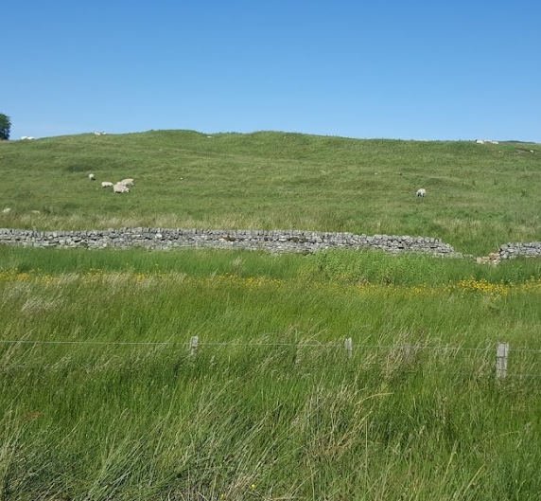
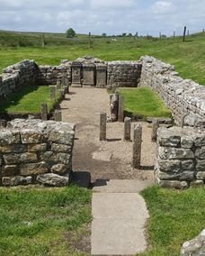
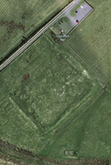
Why Carrawburgh?
Notes:
I decided to create my VR experience about the Temple to Mithras at Carrawburgh. This is because, the first time I went there, I was thoroughly unimpressed. I know, may be an unpopular opinon, but there were sheep grazing on the fort, I didn’t understand where the gates were, I could not imagine a wall or the fort, how people would be milling about and the vicus. And then there was this temple. Which had some artifacts, but not all of them, and there is a placard which gives some information, but really not a lot. So I chose Carrawburgh because it is hard to interpret, and not many people know of it. The first time I went there, the bus driver asked me twice if I was ‘sure’ I wanted to go there because there really wasn’t much to see.

Slide 7
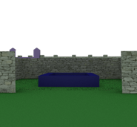
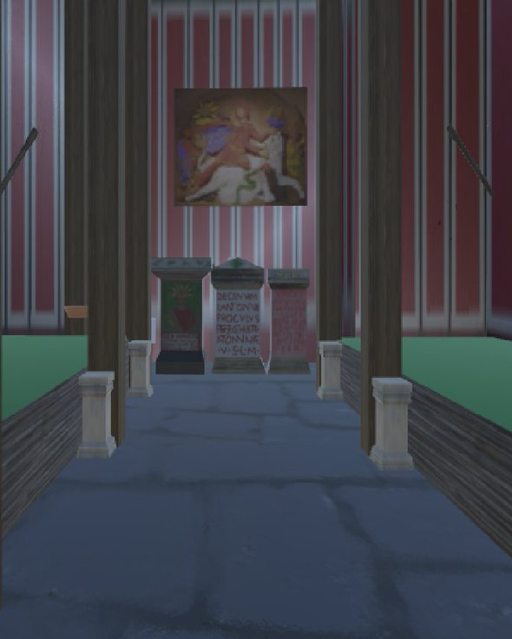
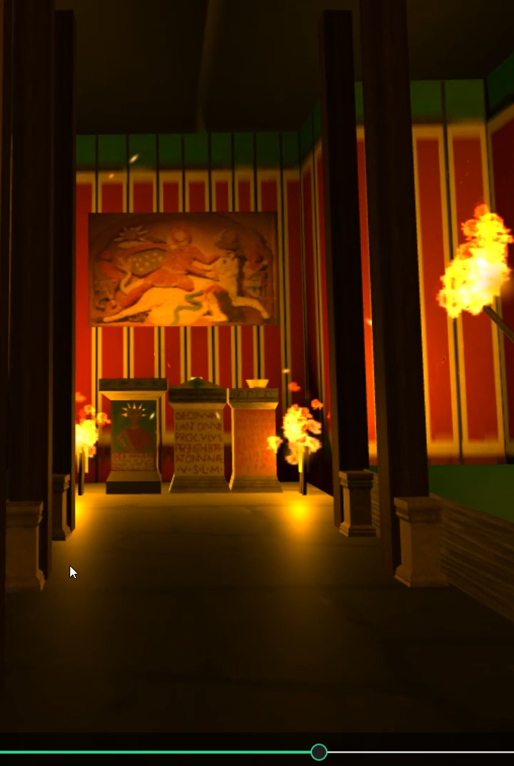
Building the Experience
Notes:
But as I read the archaeological reports, and dug a bit more into the history, I became fascinated with the site, and the temple to Mithras. I originally wanted to have people go through the whole fort, but ended up deciding that was to big of a task to build the entire fort, and decided to do an interpretation of the 4th century state of the temple. I had learned a bit of 3D modelling skills, and started to build up the temple to scale, and then also was able to use the models of Cautes and Cautopates curtosey of Newcastle University, and because the cult statue was not found at the site, I used the one from Housesteads and painted it using GIMP.

Slide 8
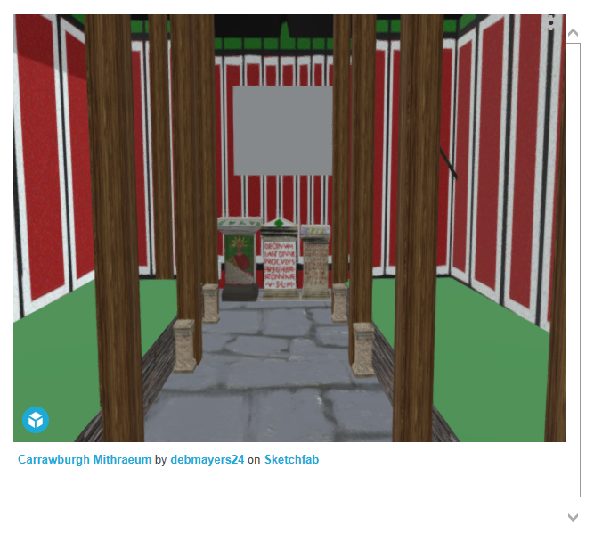
Modelling the Mithraeum
Notes:
At that point, I felt pretty good about how the temple was looking, and asked people to move around it in VR and give their initial impressions. People thought it was cool, but didn’t understand what everything was. So I decided to add some torches, and objects for the participant to use while in the space and decided to start storytelling.

Slide 9
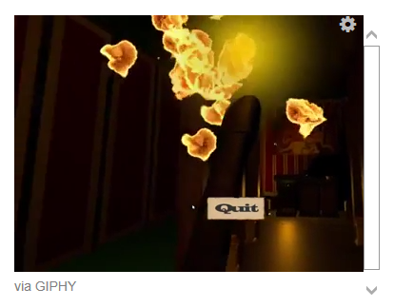
Experience Design
E-Learning and Experiential Learning
Voice of Mithras telling participants information
Light the torches for upcoming ceremony
Ability to move freely and grab objects
Notes:
Thus the 3d Model and being in the space, became more of an experience. I used parts of e-learning and epxeriental learning to guide my decisions about how to make the experience. I knew VR was very powerful for embodiement, so I had the partipant go through the experience as Prefect Marcus Simplicius Simplex, who’s name is on one of the altars in the temple. I gave participants a map of the temple before they put the headset on and allowed them to explore in their own time. I created a script so a person could be the voice of Mithras and relaying information about the temple and cult such as ‘smell the scent of pine’ or the ranks of the cult, and the symbolism of the iconogrphy. I had the participant light torches inside the temple, saying it was for the upcoming initiation ceremony. And participants were able to grab obejcts and do what they wanted in the space. I originally was going to test if people learned better in VR, in VR with scent of pine, or by video, but was not able to do all of these.

Slide 10
Experimental Design
Pseudo-Longitudinal, Between Subjects Design
Independent Variable: Time the Learning Questionnaire was Distributed.
Dependent Variable: Participant Score on the Questionnaire.
Pre-Experience, Post-Experience, and Learning Questionnaires
Notes:
The experiment tested particpants knowledge before they entered the experience, right after, and 10 days after. I asked them questions relating to the information the voice of mithras gave throughout the epxeriemtn and allowed them to add their own comments at the end. Before they started the experience I gave participants a pre-experience questionnaire which asked about hteir knowledge of the Romans, their profession, age, and how often they used VR. Most of the particpants had used VR less than 3 times. After the experience I also gave the post-experience questionnaire which asked them about their level of presence inside of the experience, or the psychological feeling of ‘being there’, and how their senses were involved. And acutally, this worked quite well.

Slide 11
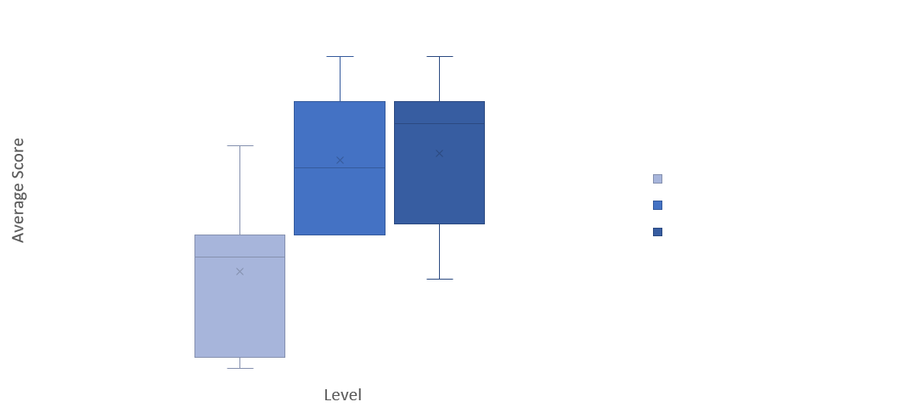
VR Average Score-Learning Questionnaire
Notes:
There was a significant difference between before taking part in the experience and directly after, as well as before and ten days later. There was no statistical difference between the two post experience questionnaires which does suggest that people remembered the content from the experience. There were 7 questions total, and on average people answered around 4-6 correctly on the post experiments. So this isn’t ground breaking, and I don’t think it really would go over well as a replacement for materials for an exam.

Slide 12
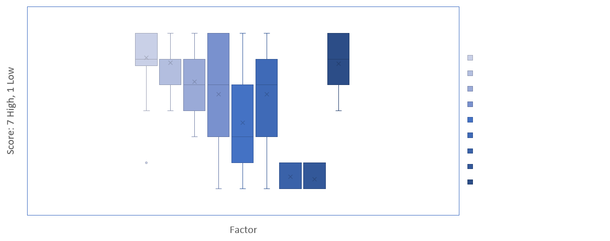
Factors Measured
Notes:
Positively, people thought the content was historically accurate, and that it was easy to use and understand the experience. There was a wide range in sensory, distraction and realism factors which could have been due to the environment (which was not always equal, my computer sometimes had a bit of lag or there were extraneous noises due to the construction going on outside). However, most interestingly was the sensory component. I asked a range of questions related to the senses, as I was going to see if people would learn more if they were in VR with the scent of pine.

Slide 13
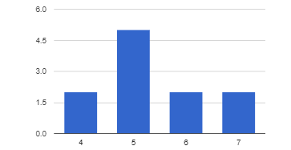
How Completely Were All of Your Senses Engaged? 5.36 avg.
Notes:
Here we can see that people had a relatively high score of how well they were involved inside the experience. As the sensory turn has come about, we know that senses do play quite a role in our learning and understanding of the world, so this was good. However, let’s look a bit deeper into this.

Slide 14
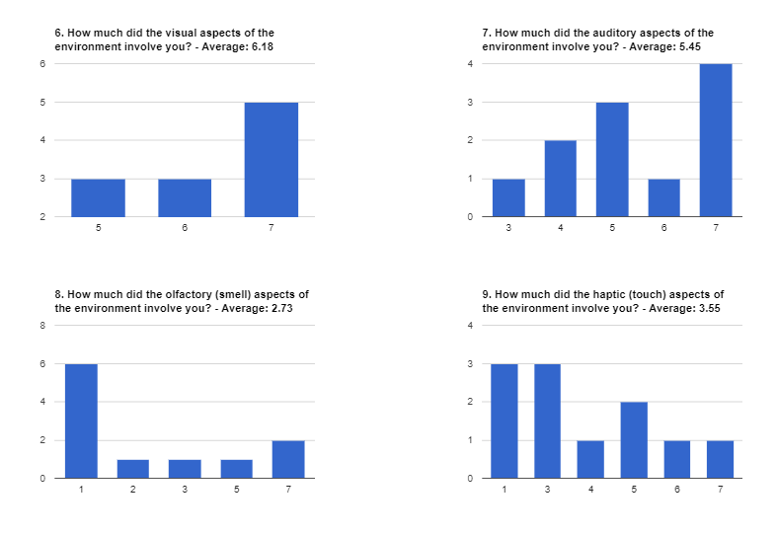
How much did the Visual aspects of the environment involve you? : Avg. 6.18
Notes:
VR is very visual. There is the 3D model that people can see, move around, and the environment responds to them. Unsurprisingly, this was the most engaging aspect.

Slide 15
How much did the auditory aspects of the environment involve you? 5.45 avg
Notes:
Audio is the second most important factor of a VR experience, and I worked hard to try and get the sound of the god and the torches working correctly so that the viewer was immeresed., however there was quite a variation of responses. Some of these could be because the audio was not loud, or that there was extraneious noise from the construction, or that they were not focused on the audio and rather ‘how do I work VR?’.

Slide 16
How much did the olfactory (smell) aspects of the environment involve you? 2.73 avg
Notes:
The olfactory aspects, was quite interesting as well. I had no scent in this experience, yet there were some people who said they were very involved. Perhaps they had overacvite imaginations, and were able to smell the torches as they heard them crackling?

Slide 17
How much did the haptic(touch) aspects of the environment involve you? 3.55 avg
Notes:
Also, for haptic feedback. I had one application of haptics, where the controller vibrated when the player picked up the torch, but that was it. So the results are a bit scattered and uncertain. And I wonder if some of this is due to the way that people can imagine, or allow themselves to be transported into a VR experience, or that they didn’t understand the questions I was asking.

Slide 18
Lessons Learnt
The story matters
Interaction matters
Realism isn't as important
Multiple Interpretations
Show the current site and the past
Allow free exploration
Notes:
So some of the lessons I’ve learnt, are up here, but I really want to focus a bit on the senses first. VR is a multisensory application, people treat experiences inside of VR as if they were reality. It is an extremely powerful tool for embodiement. If we can leverage,embodiment then VR is a great tool for learning. It gives free exploration about a space, understanding of how museum objects could have been used, and allows people to manipulate the objects. It also allows for multiple interpretations of sites. My interpretation of this temple, is likely vastly different to someone elses., and with 3D modelling and VR we are able to show that. We can also have time lapses, and show the change from the past to the present AND THE ability for lectures to be in VR where the lecturer can spend calucalted time based on an algorthim looking at each student in the eye, so they will pay attention, but that may be a little far off to have virtual teaching. However, most of the applications at the moment are something that do not take advantage of what VR offers, and aren’t really conducive to learning.

Slide 19
Is VR an Effective Tool to Learn About the Past?
Notes:
Overall, is VR an effective tool. To an extent. If we are trying to figure out sightlines, spatila orientation, what it was like to walk around a sculpture, or how far up Trajan’s column could you see from the ground, what it was like to live in the past, VR is a great medium. It allows us to put a person in a space, become embodied, increase empathy and change behaviour, but many applications are not ready to do this. I am currently running my study again to see if video or VR is more effective of people remembering details, and the preliminary results echo other studies that have recently been published, indicating that people remember more content from videos, but prefer to use VR. So at the moment it should really just be an enhancement to texts and lectures.

Slide 20
Image Sources
https://commons.wikimedia.org/wiki/File:Sensorama-morton-heilig-virtual-reality-headset.jpg ,
https://sco.wikipedia.org/wiki/Virtual_reality ​
https://www.af.mil/News/Article-Display/Article/1414771/researchers-test-virtual-reality-adaptive-flight-training-study/​

Slide 21
Remembering Mithras: Is VR an Effective Tool to Learn About the Past?
Twitter: @debmayers24​
Website: http://debmayers.com
Sketchfab: https://sketchfab.com/debmayers24
Github: https://github.com/dmayers340/unityMithraeum
Notes:
Hi all. I’m Deb, for a brief background on me before I begin. I did a bachelors degree in Classical civilization and Business. My main focus points in these were art, archaeology, and identity in the Roman Frontiers and Pscyhology of Consumers and entreprunship. Then I worked at a lab in Behavioural Economics, where I learned about psychology and beahviorual sciences and tried VR for the first time. Continued on to a Masters in Ancient Cultures looking at reconstructing ancient sites and am now finishing up a conversion Masters in computer science by writing a dissertation on the efficacy of VR as a tool to learn about ancient sites while working as part of the Tech Connect grad program here.
Before we dive in, I want to quickly point out this word (re)create. It is deliberately put into these parenthesis to denote that these reconstrcutions, are not portraying the ancient world exactly as it would have been, rather they are reflections of current knowledge about the past. Because we will never know things about the ancient world with 100% cerntatinty, we must always rembemer that reconstructions are contingent on research and someone’s point of view and interpretations while we continually find out more about ancient civilizations. Of course, this does not differ from what you see in museums already. Where many artifcacts have been restored to show a more complete object.

