Slide 1
Roboticorp: Implementation Planning
Morgan, Laura
Miaw, Jireh
Hauser, Steven
Dworak, Catherine
Bertoglio, David

Slide 2
New Project Development Risks
1. Inability to implement specified requirements because of feasibility
2. Inability to complete all specified parts in allotted time frame
3. Miscommunication

Slide 3
Milestones, Schedule, & Work Breakdown Structure
Receive Specification (Feb 25)
Read over specification
Develop positive critique
Develop questions
Implementation Planning (Feb 25)
Cost Estimate
Management Scheduling
Development Tool/Protocol (March 4)
Design (March 18)
Discuss initial design possibilities
Discuss criteria for design
Discuss alternatives

Slide 4
Milestones, Schedule, & Work Breakdown Structure
End-to-end Prototype (March 25)
Testing
Discuss changes for improvement
Enhanced Prototype (March 8)
Implement improvements
Final professional changes
Inspection (March 15)
Formal Methods
Formal Specification
Formal Verification
System Delivery (March 29)

Slide 5
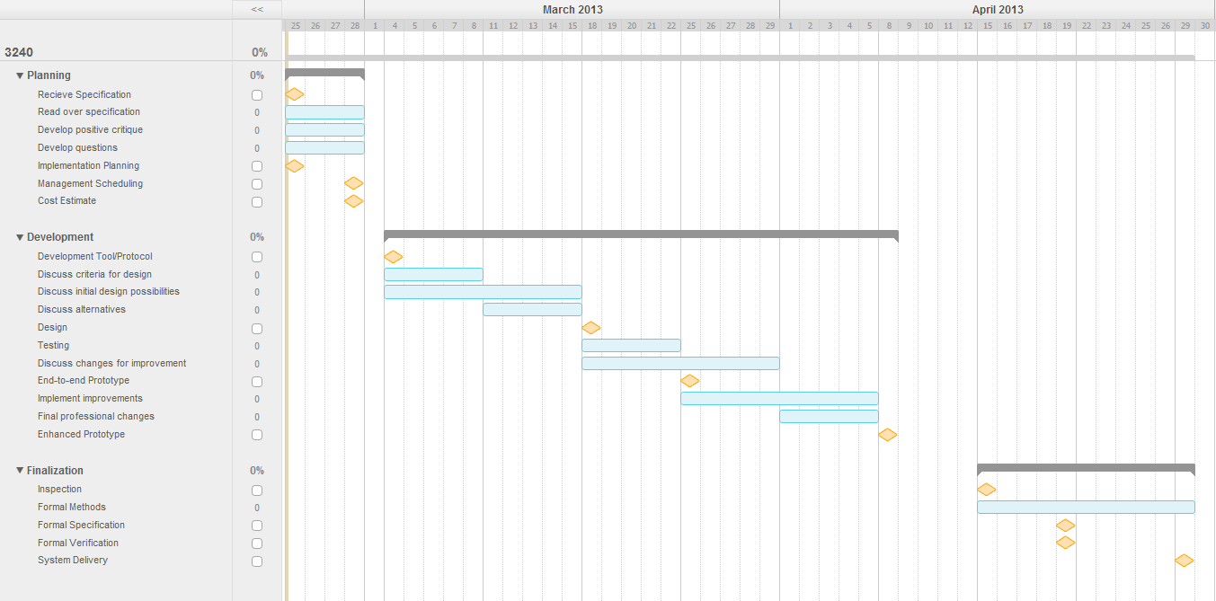
Gantt Chart

Slide 6
Process Report: Successes
Initial Specifications document completed
Verification of specifications completed
Draft communications protocol specifications document completed
Made contact with partner group
Have a consistent meeting time every week

Slide 7
Process Report: Problems
Work scheduling differences with partner group
Difficult to manage what work needs to be done and what has been completed
Full meeting attendance is getting harder to achieve

Slide 8
Process Report: Process Refinement
We believe we are currently at a “defined” stage of maturity based on the SEI Capability Maturity Model. Our work is documented and we have templates and standardized formats for documenting our work. These templates and formats are being applied to all aspects of our project as it develops. We are currently improving our process by developing methods and standardizations for measuring the quality of our work. We are also creating methods to manage and schedule our work

Slide 9
Positive Critique
List of Questions:
Why are the modes not defined?
Is it possible to have an error somewhere other than the motors and sensors? What if it’s a software malfunction rather than a hardware malfunction?
Are you sure the event table covers all possible errors? Can there be motor errors other than speed?
Should //ERROR// display what the error is rather than just which component is in error? How does the user know what the actual error is?
Are you sure the only input and output items are the desired and actual motor speeds? What about sensor data?
No mode transition table?

Slide 10
Positive Critique
List of Good Points
Good job giving examples of errors and what the output reads for each
Good job giving values to the errors to be displayed
Symbolic Constants and Text Macros look comprehensive
Good intro / description of the document

Slide 11
Positive Critique
Additional
Input Data Items definitions all say motor 1
Seems to focus a little much on speed, not enough on other potential errors
Software errors not mentioned

Slide 12
CoCoMo Effort Estimate
Effort = 2.4 * (KLOC) ^1.05
KLOC = .95
Effort = 2.274 man-months

