Slide 1
Roboticorp: Robot Control
David Bertoglio, Catherine Dworak, Steven Hauser, Jireh Miaw,
and Laura Morgan

Slide 2
User Interface: Control
direction of robot (front, back, right, left)
speed of robot (up, down), speed modes (low, medium high)

Slide 3
User Interface: View
data from sensors
touch
light
sound
camera view
location of robot on map
robot status
motor status (3 motors)
data log (info about robot movement)

Slide 4
User Interface: Set
robot status (on/off)
robot route
autopilot (on/off)

Slide 5
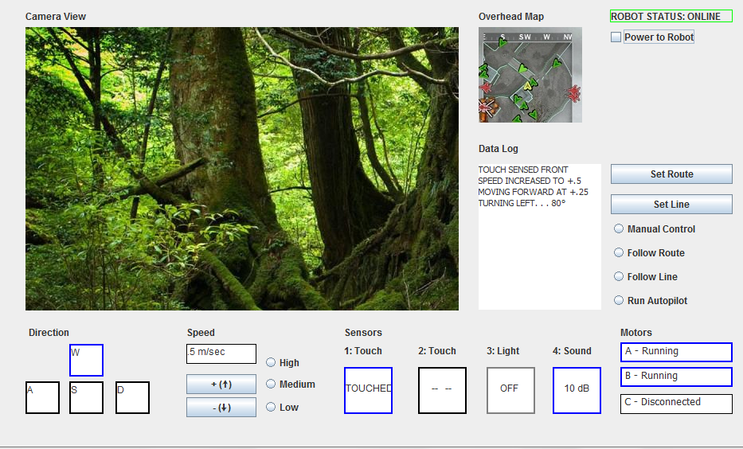
Visual Basic Mock Up

Slide 6
Use Cases
Set Route
a. Goal: Create sequence of steps for robot to follow from current position
b. Actors: driver, robot
c. Success Scenario
Enter Set Route mode
Set starting speed and direction
Set distance (or time) for robot to continue current movement (speed and direction)
Set change in motion (change in speed or direction) once distance/time is reached
If necessary: set changes in sensors
Repeat iii., iv., and v. for every step, until intended destination is reached
d. Possible Failure Scenarios
i. Robot does not follow steps indicated
ii. Obstacles in robot’s path
iii. Robot loses communication
iv. Software or hardware failure

Slide 7
Special Capabilities
set route
autopilot
map of current location (possibly including where it has been)

Slide 8
Process to Develop Requirements Specification
made list of user tasks
developed use cases
developed list of requirements that GUI needs to fulfill

Slide 9
Functional Description
Feature: Capability to Control Speed
Two buttons capable of increasing or decreasing the speed at preset intervals
Feature: Capability to Control Direction
Direction is controlled by two keyboard keys that turn the robot at the set speed
Feature: Ability to Display Data from Sensors
Displays to show current settings of each sensor
Data log screen to display data acquired by each sensor

Slide 10
Functional Description
Feature: Ability to Determine Approximate Location
Data log of changes in speed, direction, and movement to track and determine location
A mini-map that will track where the robot has been and display its location relative to its path
Feature: Capability to Run Autonomously
Can create a combination of movement instructions and follow them
Can follow lines automatically
Can move autonomously based on built in specifications through autopilot

Slide 11
Management Report
Group meetings
Difficulties

