Slide 1
Robitcorp: Robot Control
David Bertoglio, Catherine Dworak, Steven Hauser, Jireh Miaw,
and Laura Morgan

Slide 2
User Interface: Control
direction of robot (front, back, right, left)
speed of robot (up, down), speed modes (low, medium high)

Slide 3
User Interface: View
data from sensors
touch
light
sound
camera view
location of robot on map
robot status
motor status (3 motors)
data log (info about robot movement)

Slide 4
User Interface: Set
robot status (on/off)
robot route
autopilot (on/off)

Slide 5
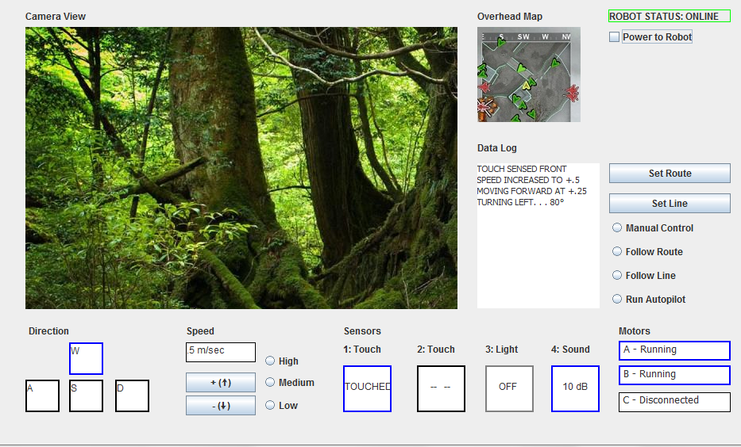
Visual Basic Mock Up

Slide 6
Use Cases

Slide 7
Special Capabilities
set route
autopilot
map of current location (possibly including where it has been)

Slide 8
Functional Description

Slide 9
Management Report
Group meetings
Difficulties

