Slide 1



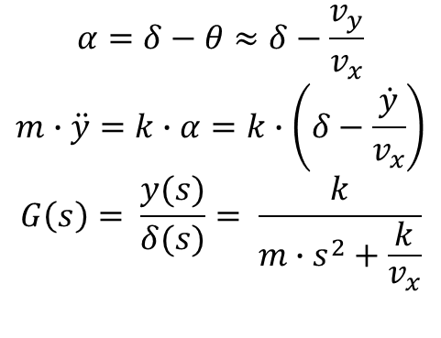









$$α=δ−θ≈δ−\frac{v_{y}}{v_{x}}$$
$$m∙\ddot{y}=k∙α=k∙\left(δ−\frac{\dot{y}}{v_{x}}\right)$$
$$G\left(s\right)= \frac{y(s)}{δ(s)}= \frac{k}{m∙s^{2}+\frac{k}{v_{x}}}$$
$$v_{x}$$
$$v$$
$$δ$$
$$θ$$
$$α$$
$$v_{y}$$
$$yDesired(s)$$
$$cte(s)$$
$$C\left(s\right)$$
$$δ(s)$$
$$G\left(s\right)$$
$$y(s)$$
+
-

