Slide 1

🚌
WeGo Nashville
We analyzed 338,000+ bus crossings
so you didn’t have to.
Bus Performance Analysis
Team: Axel Rose
You're welcome, Nashville. 🎸
NewForce Cohort 12 • 2026
Notes:
Michelle

Slide 2



The Big Picture: Are We On Time?
79.7%
17.4%
2.9%
On Time
Late
Early
Notes:
Michelle - First, the headline number: WeGo buses are on time about 80% of the time — roughly 4 out of every 5 crossings. That's actually pretty respectable for a mid-sized city transit system. About 17% of crossings are late, and less than 3% are early. So the system is generally running on schedule, but there are some clear patterns in where and when things go wrong — which is what the rest of this is about."

Slide 3
Does Direction Matter? (Spoiler: Yes.)
FROM Downtown
TO Downtown
75% on time
85% on time
22% late • 3% early
12% late • 2% early
🚌💨 (running FROM downtown gets messy)
🎯 Heading into downtown = more punctual
Notes:
Michelle - When we split the data by direction, something interesting shows up. Buses heading INTO downtown are on time 85% of the time. But buses running FROM downtown? Only 75% on time, and 22% late. That's a meaningful gap. Our theory is that once a bus leaves downtown and hits regular traffic and longer routes, delays start stacking up. The further from downtown, the harder it gets to recover.

Slide 4

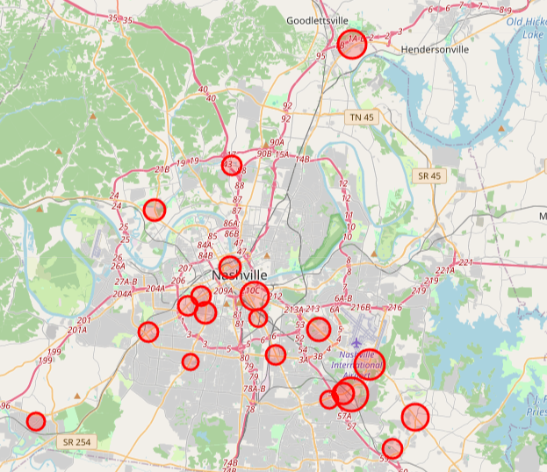
Where Does Nashville Bus Service Struggle?
Key Findings
🔴 Downtown core
Worst late clusters
🔴 Murfreesboro Pike
South corridor hotspot
🟡 Goodlettsville
Surprising outlier way up north
🟢 Route edges
Better performance
at outer stops
Notes:
Kellen - Geographically, the worst performance clusters right around downtown Nashville — which makes sense given what we just saw about direction. Murfreesboro Pike to the south is another hotspot. One outlier that surprised us was a stop way up north near Goodlettsville — we weren't expecting that one. On the flip side, stops at the outer edges of routes tend to perform better, which lines up with the idea that buses run cleaner when there's less congestion.“
DON’T FORGET BOATS

Slide 5
Rush Hour: The Great Bus Villain
😩 4–5pm: ~28% of buses are late
Afternoon rush is the enemy of schedules
😌 Sunday is the GOAT: only 11.4% late
Fewer people, fewer problems
Notes:
Kellen - Time of day matters a lot. The afternoon rush — 4 to 5pm — is the worst, with nearly 28% of buses running late. There's also a smaller morning spike around 7 to 8am. The best time to ride? Early morning, and especially Sunday — only 11.4% late on Sundays compared to about 18% on weekdays. Fewer people, fewer problems.

Slide 6


The Driver Effect: It's Real, Y'all
219
Drivers Analyzed
18%
Average Late Rate
🏆 Best driver: only 0.6% late
Somebody's getting a gold star sticker
😬 Worst driver: 54.4% late
Half the time. Every time. Bless their heart.
Notes:
John - Here's one that surprised us a little: the individual driver is actually a significant factor. We looked at 219 drivers with at least 500 timepoint crossings. The average late rate was 18%, which matches our overall numbers. But the range was enormous — the best driver was late only 0.6% of the time, while the worst was late over 54% of the time. If lateness were purely about routes and traffic, all drivers on the same route would look similar. That spread tells us individual performance genuinely matters."

Slide 7

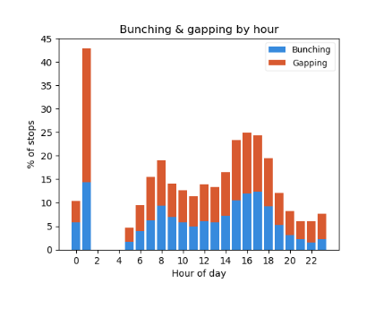
Headway: The Bunching Problem
Headway = time between buses at the same stop.
Bunching = buses clump together.
Gapping = huge gaps between buses.
Acceptable range: 50%–150% of the scheduled headway.
Notes:
John - Now let's talk about headway — which is just the time between one bus and the next bus at the same stop. Bunching is when buses clump together, and gapping is when there's a long wait between them. The generally accepted range is 50% to 150% of the scheduled headway. Using that threshold, we found that 91.7% of crossings technically fall into the bunching category — which sounds alarming, but most of it is mild. The threshold is strict, and the median deviation is actually very close to zero."

Slide 8
The Domino Effect: First Stop → Everything Else
🚨 Start 6+ minutes late?
You'll probably stay late.
Buses that start very late average -5.9 min downstream — nearly at the threshold.
⏱️ Drivers who take their full layover time
produce more stable headways downstream.
The schedule isn't magic — drivers using their buffer time is.
Notes:
Leo - One of the more actionable findings: how a trip starts really matters for how it finishes. Buses that start slightly late — under 6 minutes — actually recover pretty well downstream. But buses that start more than 6 minutes late average nearly -6 minutes of adherence at subsequent stops. They almost never recover. On the headway side, we found that drivers who actually use their full layover time at the start of a trip produce more stable headways for the rest of the route. The scheduled layover time doesn't matter as much as whether the driver actually takes it."

Slide 9
✅ 79.7% on-time overall — better than it sounds!
🌆 Downtown & rush hour are the biggest trouble spots
So, What Did
We Learn?
🚌 FROM downtown is rougher than heading in (22% vs 11% late)
tl;dr — Nashville buses are
pretty solid, but rush hour
and downtown are tough.
😴 Sunday is the best day to ride — only 11.4% late
🧑‍✈️ Drivers matter a lot — 0.6% to 54% late range!
🎸 Nashville's still got rhythm.
🎛️ Layover time = headway stability — use the buffer!
Notes:
Leo - So what's the takeaway? WeGo is doing pretty well overall — 79.7% on time is solid. The biggest controllable factors are rush hour scheduling, downtown route management, and driver performance. And one practical insight for the transit agency: encouraging drivers to use their full layover buffer could meaningfully improve headway stability without changing a single schedule. Nashville's still got rhythm — the buses are mostly keeping up with it."

