Slide 1
Between Narrator Analysis in Frankenstein
By Dwight Britton

Slide 2
Introduction
Frankenstein is told through multiple narrators
Goal: determine if Mary Shelley created measurably distinct voicing between each narrators
Data source: Frankenstein_1831.txt

Slide 3
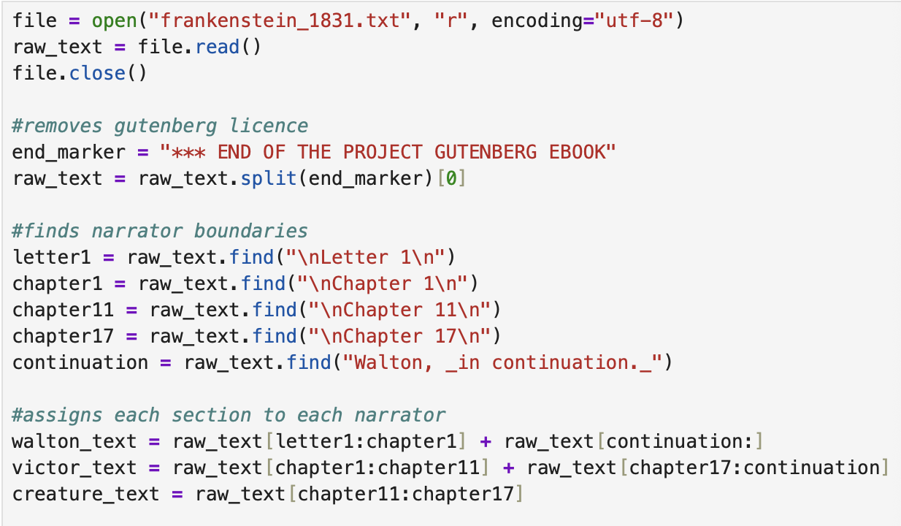
Dividing by narrator

Slide 4
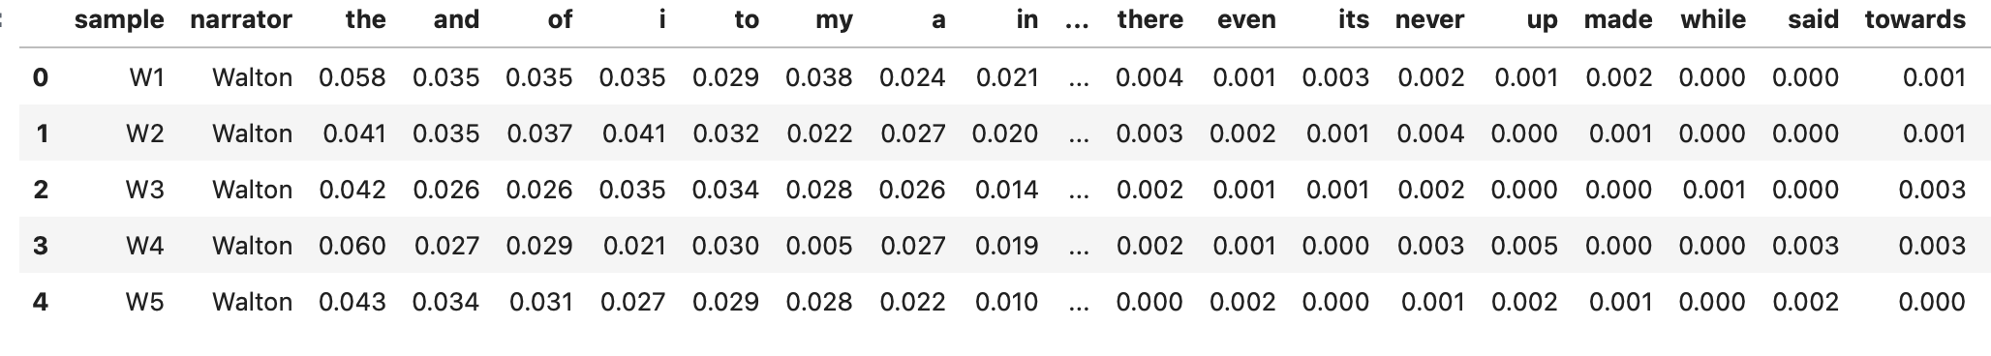
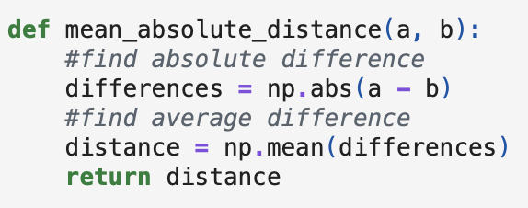
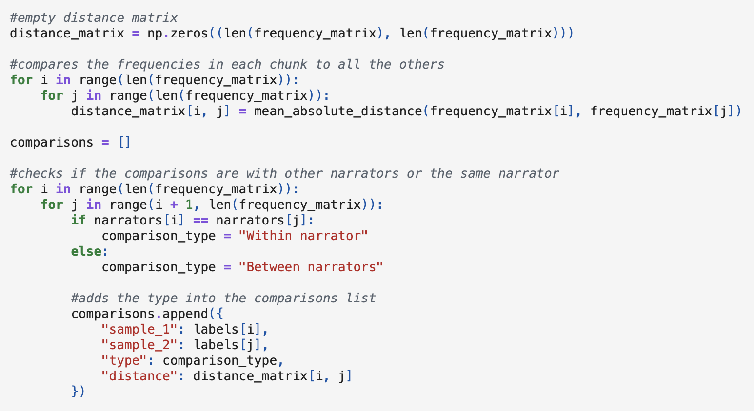

Finding distance between narrators

Slide 5
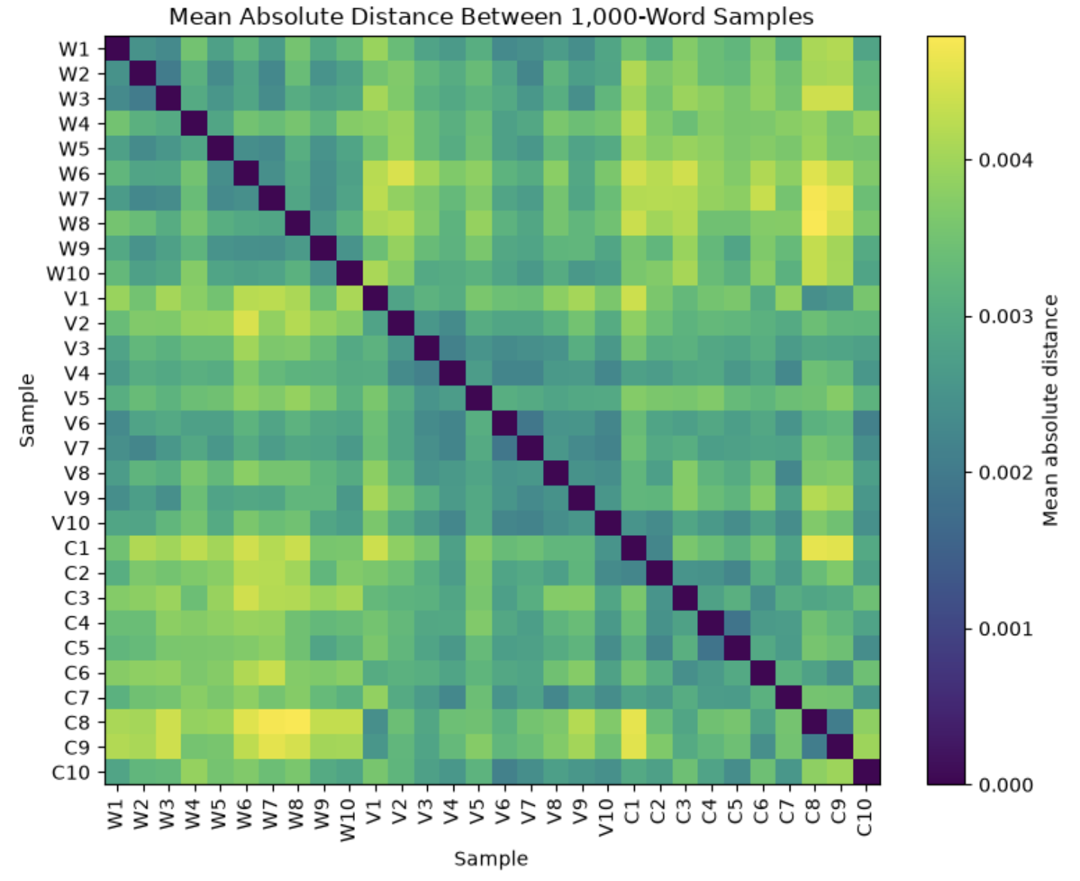
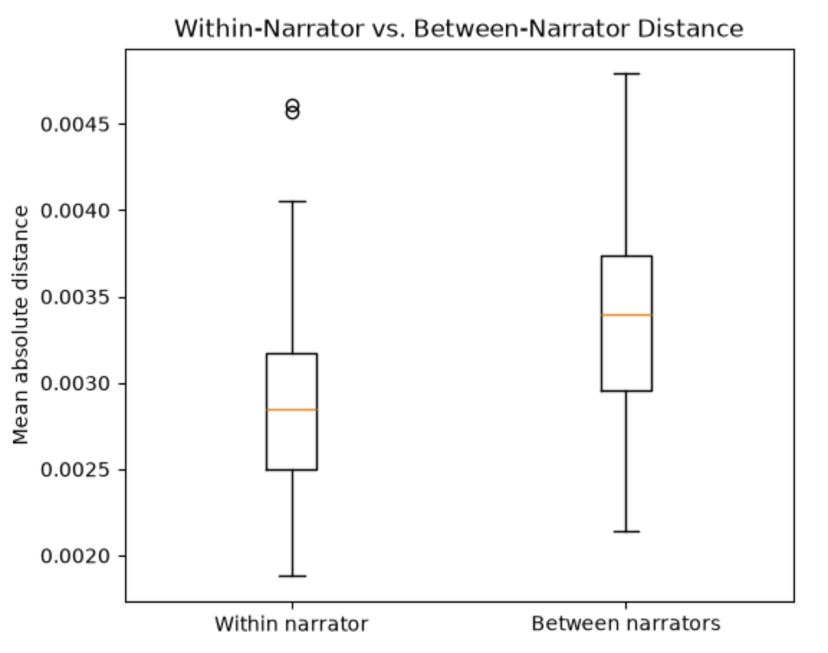
Visualizing the data

Slide 6
Conclusion and Further Investigation
There are measurably different word-frequency patterns
The difference is very small (0.0005)
Different distance algorithms and different methods of splitting the data could be used to potentially get further insights on the voicing patterns.

Slide 7
The End

