Slide 1
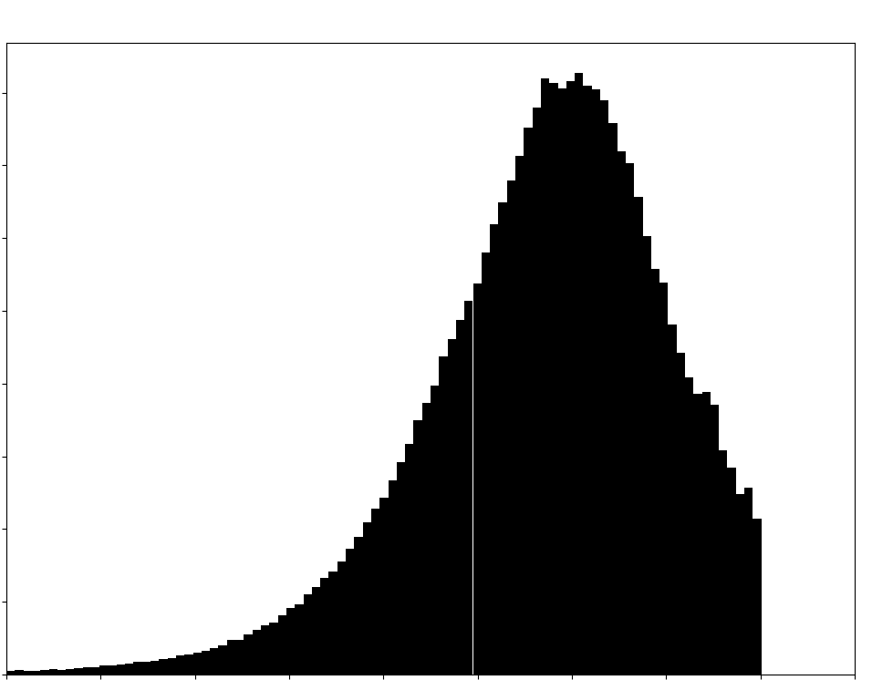
40000
30000
20000
10000
0
Number of Significant Pairs
100 bp 1 Kb 10 Kb 100 Kb 1 Mb
eQTL-TSS Distance

