Slide 1
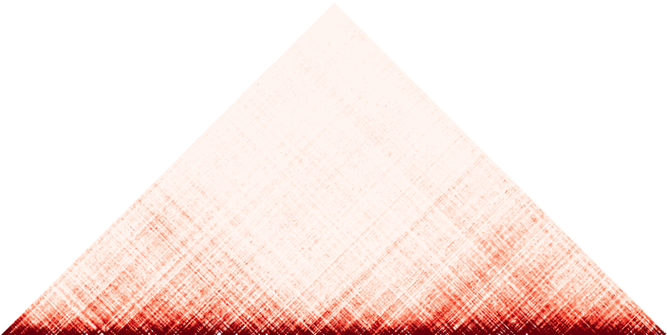


IMR90 chr1
Enhanced
Contact Map
ENSG00000171612.6
Original
Hi-C
9,535,000
9,545,000
9,535,000
9,545,000

Slide 2
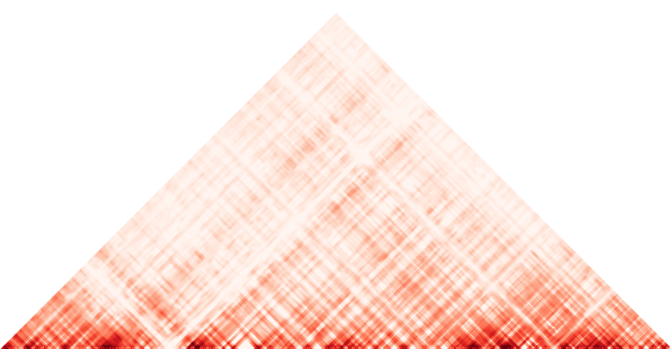

IMR90 chr1
Enhanced
Contact Map
145.91 Mb
145.97 Mb
ENSG00000211451.12
Original
Hi-C

Slide 3
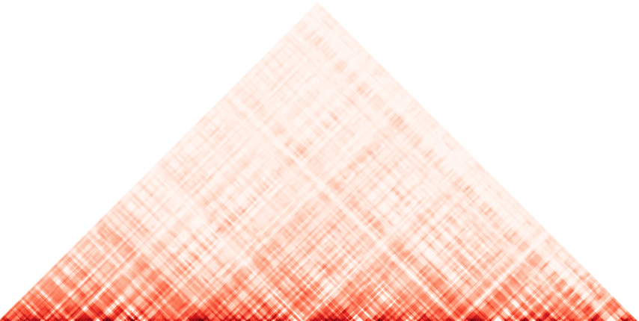

IMR90 chr1
Enhanced
Contact Map
153.615 Mb
153.675 Mb
ENSG00000160679.12
Original
Hi-C

