Slide 1
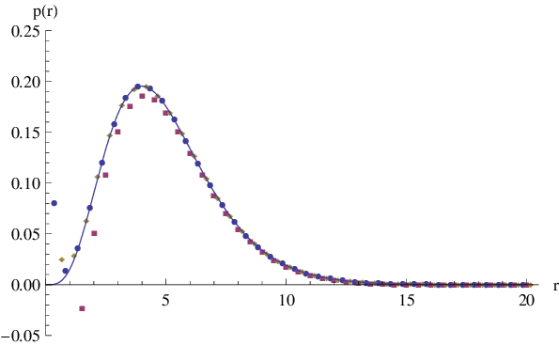
Previous Versions:
The mean value of the background regions: a
If we don’t know anything about the central region, we would estimate it is similar with the background, which follows a Poisson distribution with expected value = a.
But we observed a larger value b.
The prob. of observing a value larger than b from Poisson(a) is:
p = 1 – cdf(b)
(which is a common method in loop callers.)
Calculating this is slow!

Slide 2
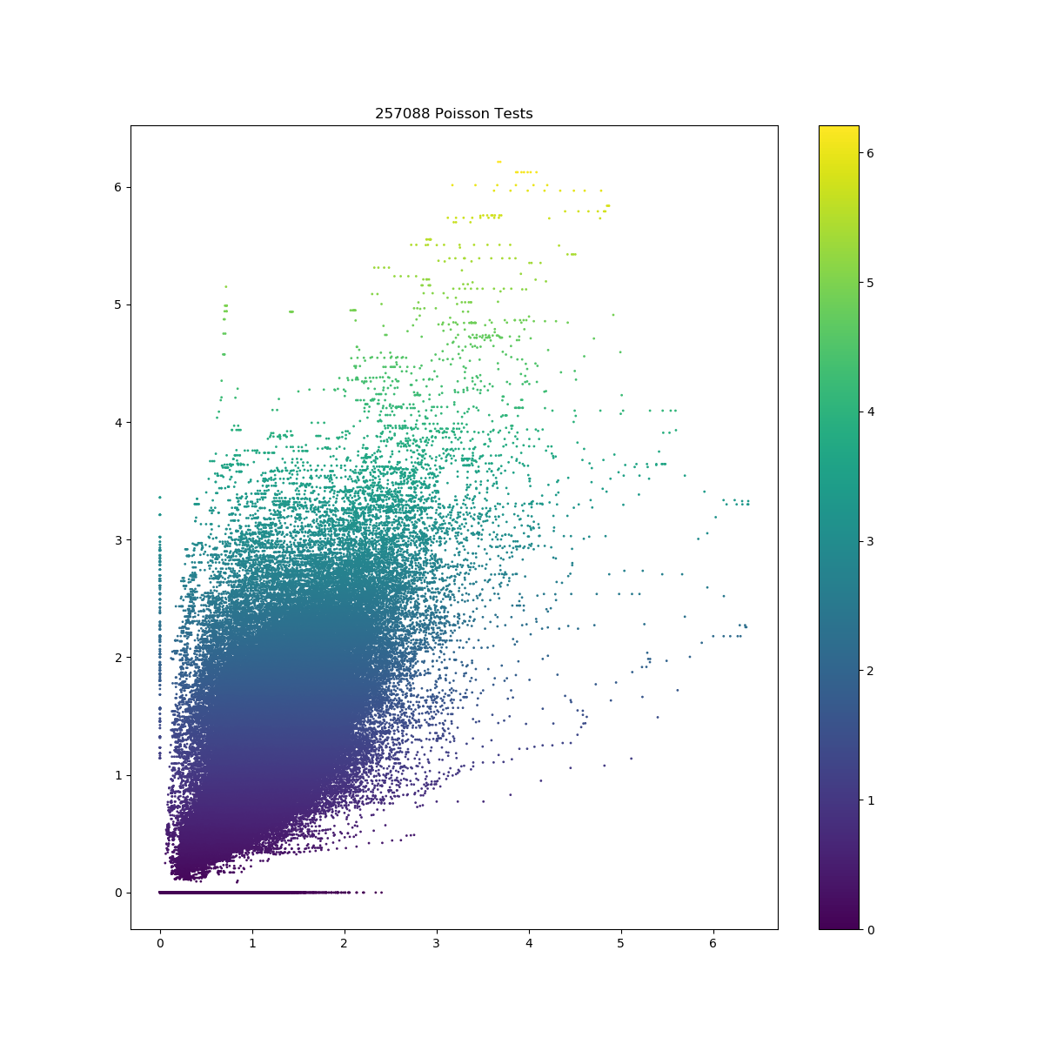
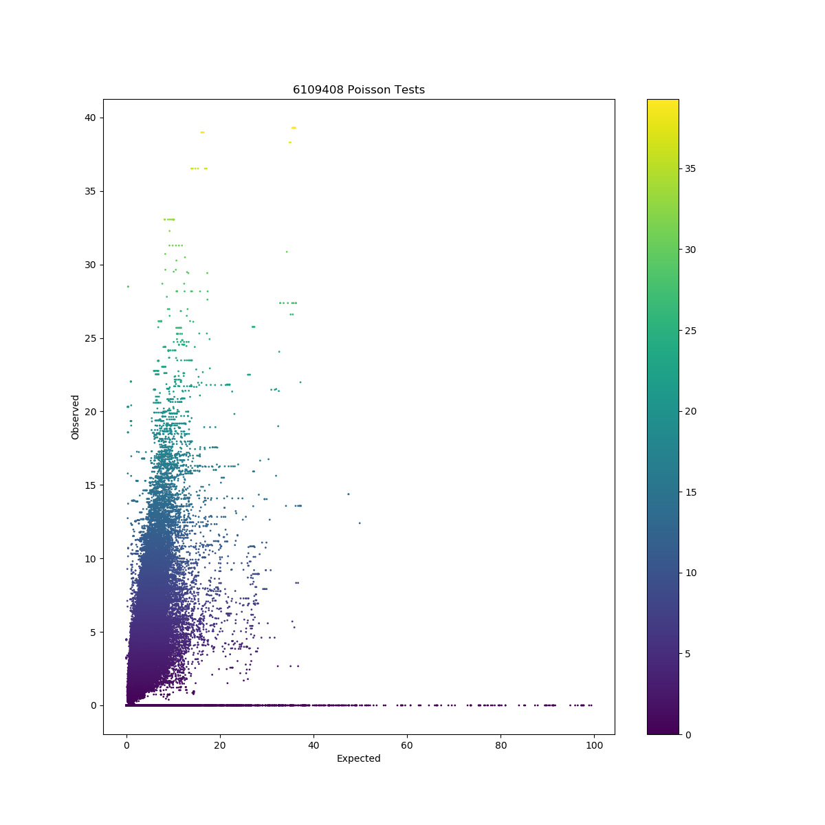
* Let x~Poission(a) and f(a,b) = -log₁₀[P(x > b)] = -log₁₀[1 – cdf(b)].
GM12878 chr1 25Kb resolution
257,088 calculations of f(a, b)
Time: 219s (the entire program)
8 stripes
HFF chr1 1Kb resolution
6,109,408 calculations
3960s
207 stripes
b
f(a,b)
a

Slide 3
Strategy:
Record the “expected-observed” pair and their p value results for each calculation
If a new pair (e.g., 4.99-9.05) is similar to a calculated pair (e.g., 5.00-9.00), we direct use the p value from the previous pair
There should be a “tolerance level”
Let x~Poission(a) and f(a,b) = -log₁₀[P(x > b)] = -log₁₀[1 – cdf(b)].
Based on the definition of Poisson dist.
f(a, b) = f(a, floor(b)). E.g., f(5, 10) = f(5, 10.5) = f(5, 10.99) = 1.863
f(a, b) ≈ f(a+Δa, b) when Δa is small. E.g., f(5, 10) = 1.863, f(5.05, 10) = 1.835, f(5.1, 10) = 1.807

Slide 4
Strategy:
b
b
A new point
(a1, b1)
Step 1: project it to an integer floor(b1)
2
2
(a0, b0)
1
1
These points were calculated before and results were stored.
a
Step 2: Find the closest point and calculate the distance
a

Slide 5
Strategy:
b
b
2
(a1, b1)
(a0, b0)
2
(a1, b1)
(a0, b0)
1
1
a
a
If the distance is shorter than (tolerance * a1), we directly use f(a0, b0) to estimate f(a1, b1).
Do not save f(a1, b1).
If the distance is longer than (tolerance * a1), we calculate the accurate value of f(a1, b1), i.e., f(a1, b0), and save this result for future use.
* The searching-inserting operation can be further accelerated by balanced binary tree.

Slide 6
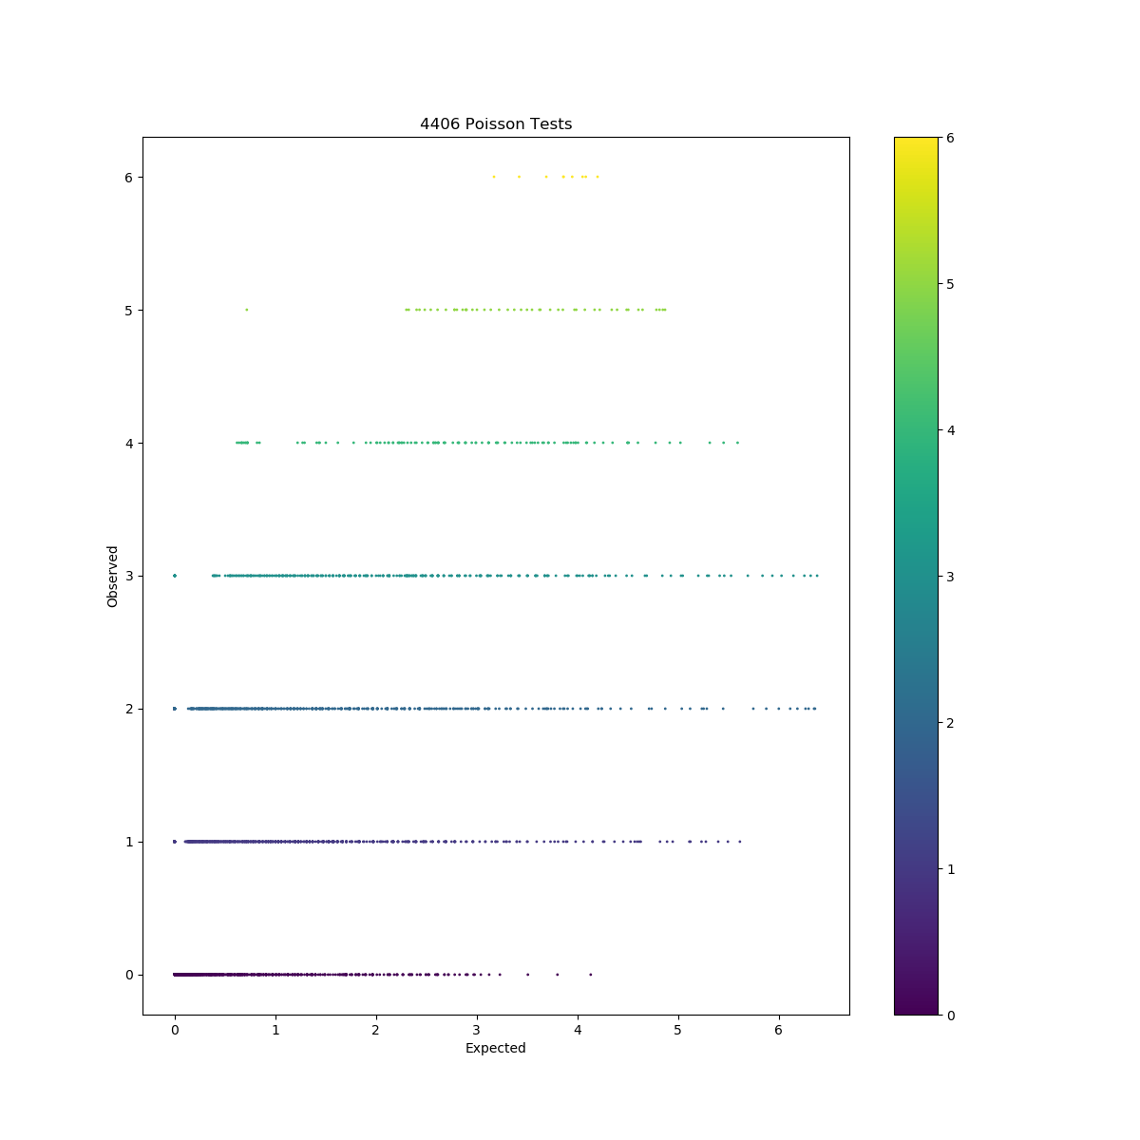
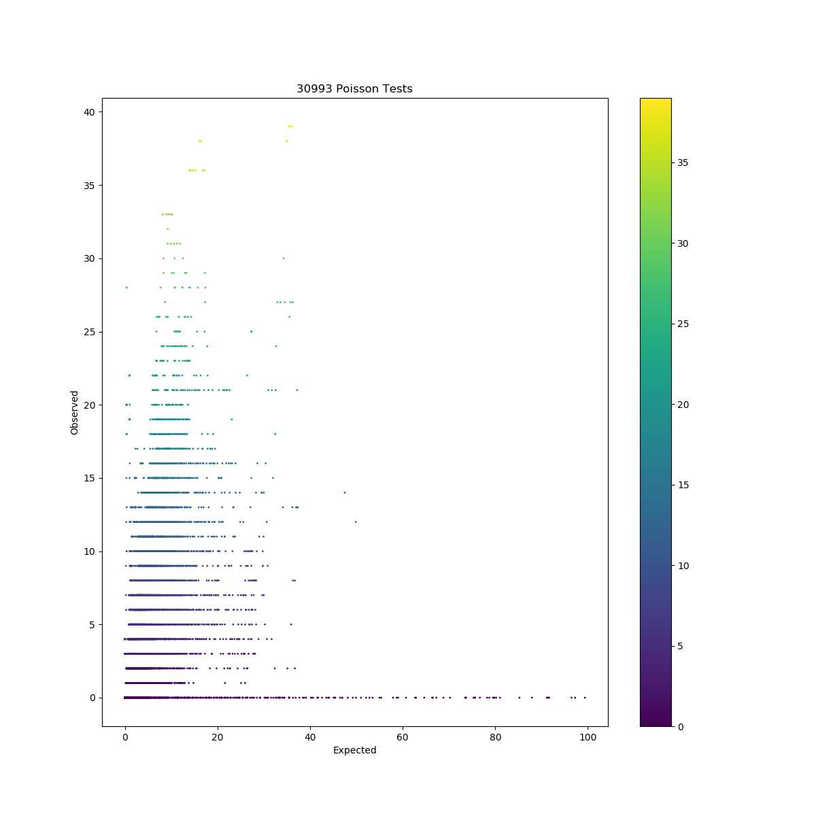
Result (tolerance = 0.02):
GM12878 chr1 25Kb resolution
4,406 calculations
87s
9 stripes
HFF chr1 1Kb resolution
30,993 calculations
843s
201 stripes
The stripes also match quite well.

