Slide 1

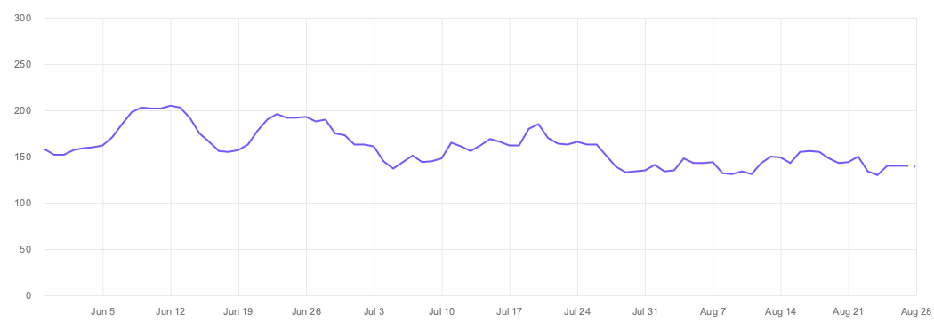
Why isn’t this working

