Slide 1
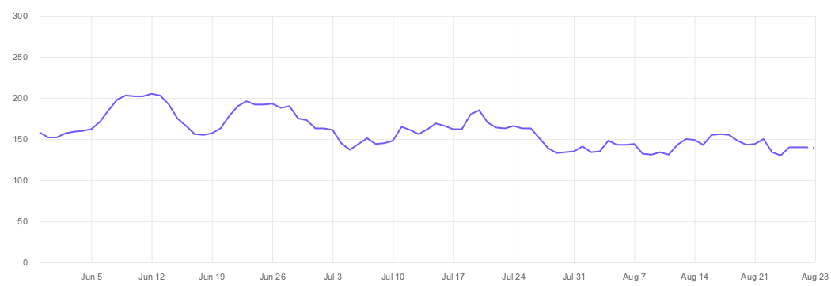
Why isn’t this working

