Slide 1
CEC 2021
Team Saint John
Nathan Tozer
Evan Fitzgerald
Danny McCardle
Greg Kean

Slide 2
The Problem
The NB provincial government wants to ensure they are making the best use of their renewable energy product while still minimizing costs.
Develop a program that can read previous years’ sets of data and predict future energy demands.
Use this forecasted data to optimize power use between zones while minimizing costs.

Slide 3
Constraints
Few datasets are available. Multi-year predictions must assume previous predictions to be correct.
A zone’s monthly cost is calculated with a provided formula:
(formula)
Documentation stated h_{emissive} and h_{non-emissive} to be in regards to the zone in which the power was produced, and the program is implemented as such.
A tax is placed on emissive power generation. A financial incentive is offered on non-emissive power generation.
Power generation and transport has a fixed cost depending on zoning.
Plants are fixed in their location and generation potential. No plants may be added, removed, or altered.
Notes:
H is a variable related to power generation
C = Cost
Pzone = matrix of energy generation/transport per zone
Hzone = matrix of power sent per zone
E = emissive penalty
B = non-emissive incentive
hemissive/non-emissive = total emissive/non-emissive energy generated in the selected zone

Slide 4

Approach
Reduce complexity through smart algorithm design
Work in parallel as much as feasible
Pomodoro method
Use tools for fast, simple application development
Python3
GitHub
Use tried and tested frameworks and libraries
Flask
PyTorch
Scikit-Learn
numpy
pandas

Slide 5

Proposed Solution
Machine Learning Algorithm:
Data was divided into train and test sets
A Recurrent Neural Network (RNN) leveraging Long Short Term Memory (LSTM) modules was trained on the training data
The RNN was then tested for accuracy against the test data
When suitable accuracy was reached a copy of the RNN was saved to a file to be used for forecasting
Benefits:
Future data can be added to the train and test sets further increasing accuracy
Considers province wide usage trends
Could identify cross Zone power usage effects and forecast accordingly

Slide 6
Proposed Solution
Genetic Algorithm:
Computes the leftover power in each provincial Zone based on production rates and forecasted usage.
Creates an initial set of random solutions to the province wide cost minimization problem.
The cost for each solution is evaluated and the best solutions are identified.
The best solutions are kept and the others are removed.
New solutions are created from the solutions that have been kept.
Steps 3 through 5 are repeated until the province wide cost has stabilized.
Benefits:
As new forecasts are created they are automatically included in the genetic algorithm
Considers transfers between all Zones and thoroughly explores the solution place

Slide 7
Assumptions
Renewable power is given precedence in power distribution. Power taken from any zone will be taken from renewable sources before non-renewable sources.
Power cannot be drawn from external zones

Slide 8
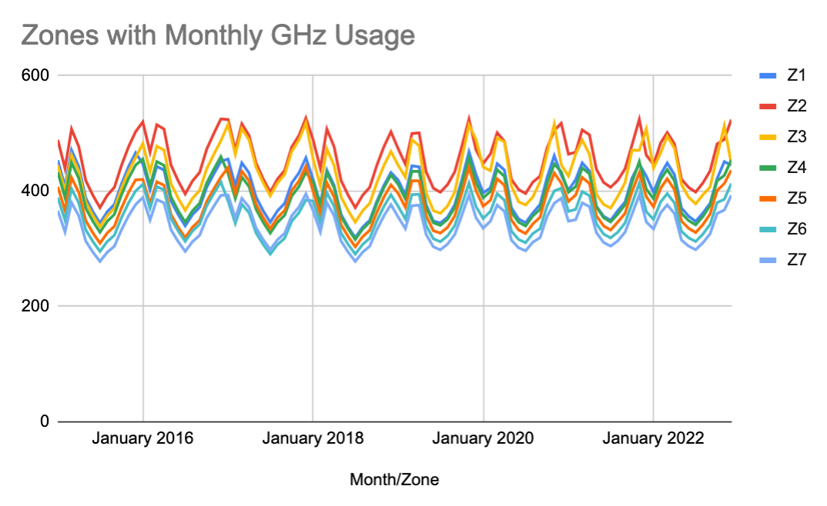
Output for Level 1
*Created using Google Sheets
Notes:
Note that this is just a visualization, not the actual output. Output is matrix of numbers.

Slide 9
Deliverables
Python Back-end
System back-end
Machine Learning and Genetic Algorithm techniques
Object Oriented Software
Python API
Python Flask

Slide 10
Strength Analysis
Portable
Object Oriented
Scalable
ML: more data drastically improves performance
API Capabilities
Adaptable
Genetic Algorithm: can easily incorporate new transfer rates
Low CPU and Memory usage (once initial machine learning model has been created)

Slide 11
Our 7 Design Principles
Seek Purpose
Creating a solution to solve a problem
Take Responsibility
Each member had guidelines of what they were expected to do and expected to manage time properly
Expand Involvement
Team members were each given tasks, but collaborated with other members when able
Widen Approaches
Many algorithms were considered before coding began
Advance Understanding
All team members worked on technologies that were new to them
Realize Diversity
Previous experiences and strengths were considered when assigning tasks
Deliberate Values
Team discussion held on whether having a fast or robust solution was more important

Slide 12
Bugs/Issues
Level Two Output:
Framework for level two is in place.
This deliverable was not met due to integration issues and time constraints.
Level two formulas:
The monthly zone power cost would be implemented by putting the given cost equation into a nested for-loop. These zones would be summed to create a provincial cost. Values would then be pulled from the genetic algorithm to find the cost of the power that must be sold. Summing these gives a final monthly provincial cost.
The province’s monthly power usage would be implemented by summing zone results from level one.
Percent of renewable energy used would be implemented by taking the renewable power generated as a percentage of total power used. The earlier assumption of renewable precedence factors into this implementation.
Notes:
Level one’s output and the genetic algorithm have created the necessary values.
To implement fully, all that is required is accessing these values and plugging them into formulas.

Slide 13
Opportunities
Finish and optimize algorithm to limit time taken
Show visual, informational heat-map
Implement a dynamic file-upload process through a browser which would return the output files
Provide per month predictions instead of per annum predictions to increase prediction accuracy

Slide 14
Summary
Powerful and Modular Python Back-end
With respect for Software Engineering Principles
Scalable dynamic design can work with new data files
Developed adaptable solutions that produce solutions to complex tasks
Potential to be used as an API

Slide 15
Are there any questions?

