Slide 1
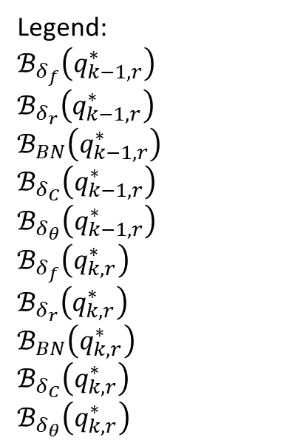
Legend:
$$ℬ_{δ_{f}}\left(q_{k−1,r}^{∗}\right)$$
$$ℬ_{δ_{r}}\left(q_{k−1,r}^{∗}\right)$$
$$ℬ_{BN}\left(q_{k−1,r}^{∗}\right)$$
$$ℬ_{δ_{C}}\left(q_{k−1,r}^{∗}\right)$$
$$ℬ_{δ_{θ}}\left(q_{k−1,r}^{∗}\right)$$
$$ℬ_{δ_{f}}\left(q_{k,r}^{∗}\right)$$
$$ℬ_{δ_{r}}\left(q_{k,r}^{∗}\right)$$
$$ℬ_{BN}\left(q_{k,r}^{∗}\right)$$
$$ℬ_{δ_{C}}\left(q_{k,r}^{∗}\right)$$
$$ℬ_{δ_{θ}}\left(q_{k,r}^{∗}\right)$$

