Slide 1


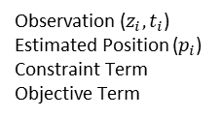
$$z_{i},t_{i}$$
$$p_{i}$$
Observation ($z_{i}, t_{i}$)
Estimated Position ($p_{i}$)
Constraint Term
Objective Term
Legend:

