Slide 1





$${\hat{b}}_{1}={\tilde{b}}_{1}^{a}={\tilde{b}}_{1}^{b}={\tilde{b}}_{1}^{c}$$
$${\hat{b}}_{1}≠{\tilde{b}}_{1}^{c}$$
$${\hat{b}}_{1}={\tilde{b}}_{1}^{a}={\tilde{b}}_{1}^{b}$$
$b_{0}=r\left(x_{0}^{a},E\right)=r\left(x_{0}^{b},E\right)=$ $r\left(x_{0}^{c},E\right)$
$b_{0}=r\left(x_{0}^{a},E\right)=r\left(x_{0}^{b},E\right)=$ $r\left(x_{0}^{c},E\right)$

Slide 2

$$b_{0}$$

Slide 3

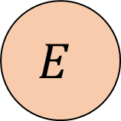

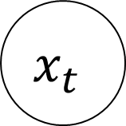




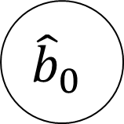

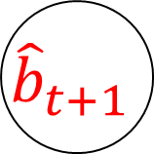

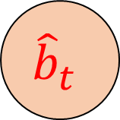


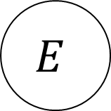
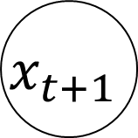

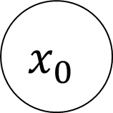
$$x_{0}$$
. . .
$$x_{t}$$
$$x_{t+1}$$
. . .
$$Γ$$
$$Γ$$
$$E$$
$$E$$
$$r$$
$$r$$
$$r$$
$$u_{0}^{b}$$
$${\tilde{b}}_{t}$$
$$u_{t}^{b}$$
$${\tilde{b}}_{t+1}$$
$${\hat{b}}_{0}$$
. . .
$${\hat{b}}_{t}$$
$${\hat{b}}_{t+1}$$
. . .
$$g$$
$$g$$

Slide 4
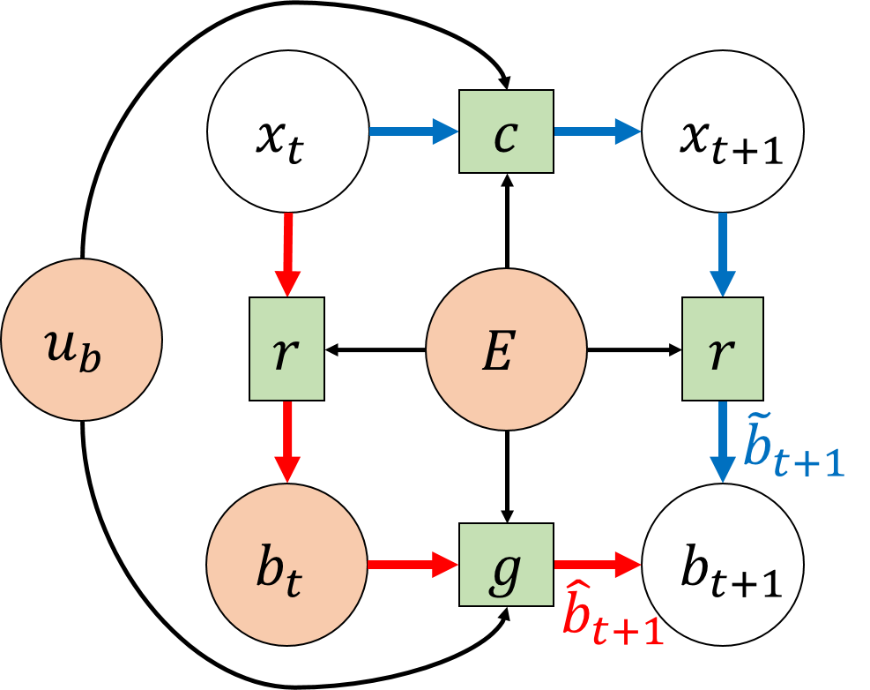

Slide 5
