Slide 1
Class Figures

Slide 2
Agentic Workflows
Start
Initial Prompt
Send to LLM
Response OK?
Loop
Yes
Finish
No
New Prompt

Slide 3
Things to Note
The LLM is trained on public knowledge but does not know anything about your goals, your products or your customers
A human decides if the response is OK
The human is “trained” to write better prompts

Slide 4
Start
Initial Prompt
Enrich Prompt
Knowledge
Base
Send to LLM
Response OK?
Yes
Finish
No
New Prompt

Slide 5
Start
Initial Prompt
Knowledge Graph
Enrich Prompt
Send to LLM
Similarity Index
Response OK?
Yes
Finish
No
New Prompt

Slide 6
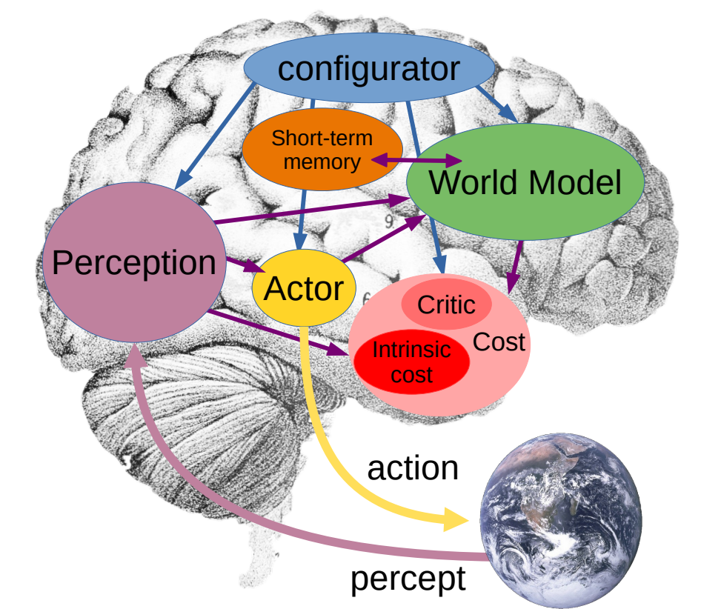
Yann Lecun's Modular Cognitive Architecture
World Models are used to predict the future state based on your actions
Planning is about understanding how actions change world models in the future
Source: https://openreview.net/pdf?id=BZ5a1r-kVsf
YouTube: https://youtu.be/MiqLoAZFRSE?si=KvFwiDTgt0bUMo0H&t=1288

Slide 7
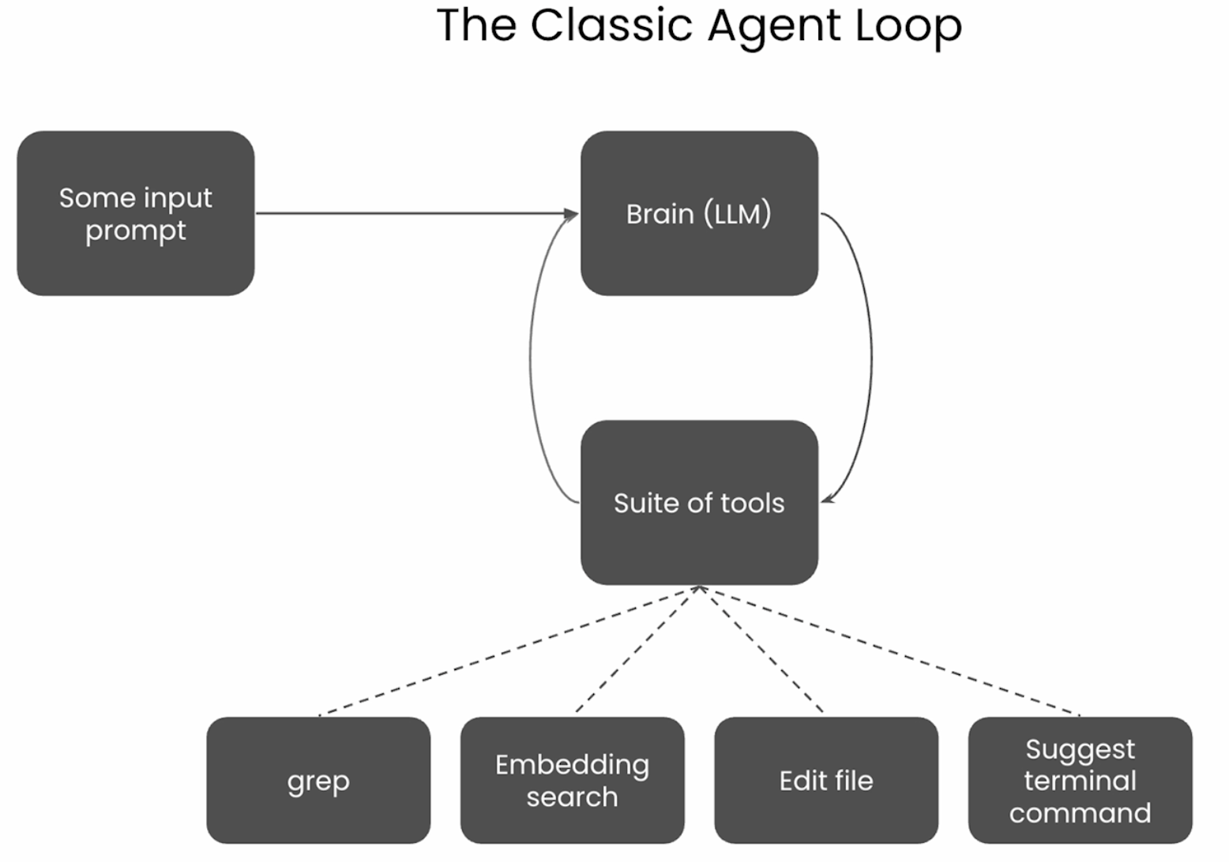

Slide 8
Developer Prompt
Start
Initial Prompt
Knowledge Graph (Codebase)
Enrich Prompt
Classify Prompt
Send to LLM
Rules
Tool Matcher
Tool Library
Create
Modify
Search
Debug
Copy
Move
Delete

Slide 9
Developer Agents Matching Workflows
Start
Initial Prompt
Knowledge Graph (Codebase)
Enrich Prompt
Classify Prompt
Send to LLM
Rules
Workflow Matcher
WF1
WF2
WF3
WF4
WF5
WF6
WF7

