Slide 1
ATAM for Database Selection
Using Architecture (Not Products) to Guide Database Selection
Prepared for:
Decision Sciences
Dan McCreary
Kelly-McCreary & Associates

Slide 2
Selection Process
Select Top
Architectures
Business Unit
Architecture
Gather All
Business
Requirements
Find Architecturally
Significant Requirements
Score Effort for Each Requirement for Each Architecture
Total Effort for
Each Architecture
Marketing

Slide 3
Suggested Process
Define high level Requirements
Consider all six major architectures (SQL and NoSQL)
Select database architecture first
Select products that support the architecture second
Key

Slide 4
ATAM Process Flow
Business
Drivers
Quality
Attributes
User
Stories
Analysis
Architecture Plan
Architectural
Approaches
Architectural
Decisions
Tradeoffs
Impacts
Sensitivity
Points
Non-Risks
Distilled info
Risk Themes
Risks
This process defined by CMU's Software Engineering Institute

Slide 5
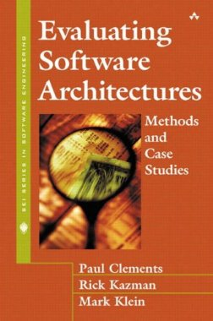
Key Book for ATAM
Evaluating Software Architectures: Methods and Case Studies
by Paul Clements, Rick Kazman, and Mark Klein
Addison-Wesley, 2001
We need "Evaluating Database Architectures"!

Slide 6
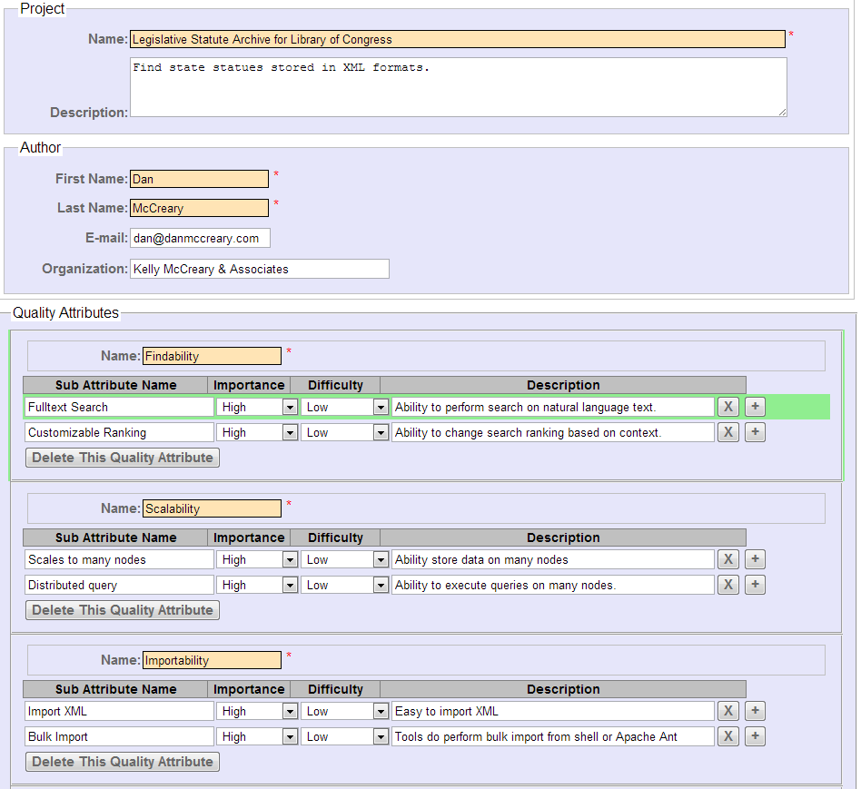
Quality Attribute Utility Tree Application

Slide 7
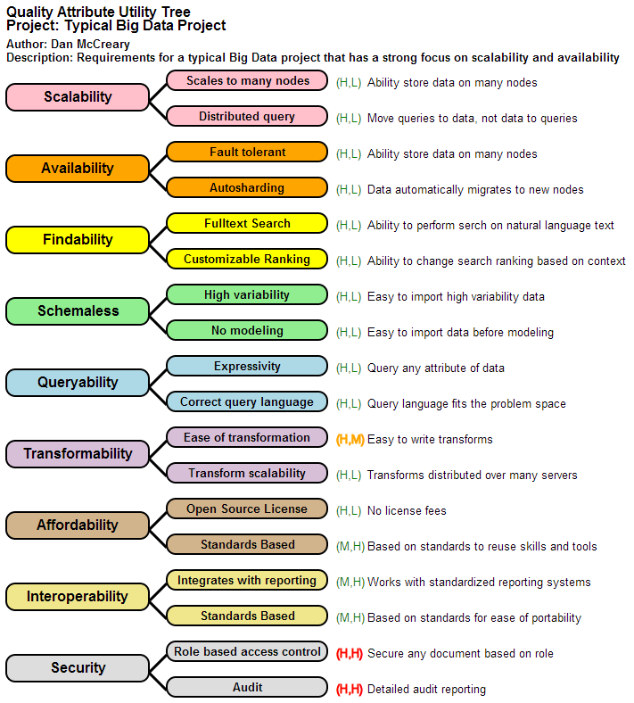

Slide 8
How Important is the Database?
User Interface
10%-20%
Database
80%-90%

Slide 9
Architecturally Significant Features
R
R
R
R
R
R
R
Normal
Requirement
R
R
R
R
R
R
R
R
R
R
Architecturally
Significant
Requirement
R
R
R
R
R
R
R
R
R
R
R
R
R
R
R
R
R
A requirement that drives overall architecture
Requires experts to know when a requirement is significant

Slide 10
Before NoSQL
Relational
Analytical (OLAP)

Slide 11
After NoSQL
Relational
Analytical (OLAP)
Key-Value
key
value
key
value
key
value
key
value
Column-Family
Column-Family
Graph
Document
11

Slide 12
The "Hash Mod"
Customer ID
Hash
MD5
Hash "ring"
Create a hash of the "key"
Example:
9e107d9d372bb6826bd81d3542a419d6
Use the initial bits or the "modulo" of the hashed value
Use this to distribute the item to the cluster
Allows even distribution of data over a cluster

Slide 13
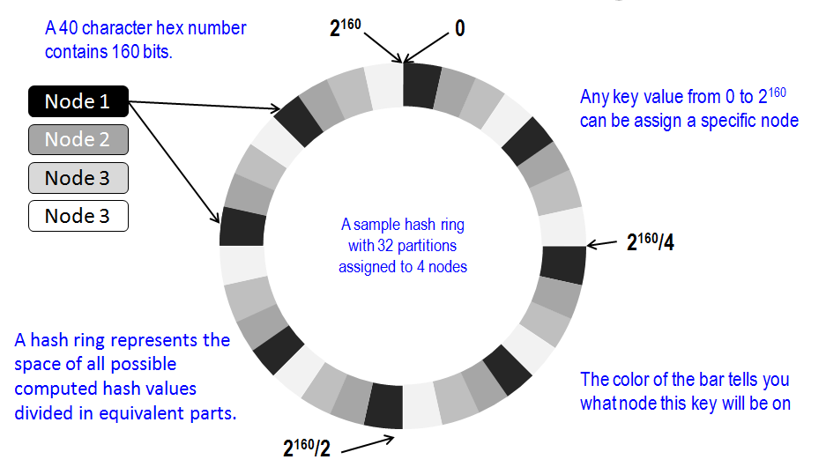
Hash Ring

Slide 14
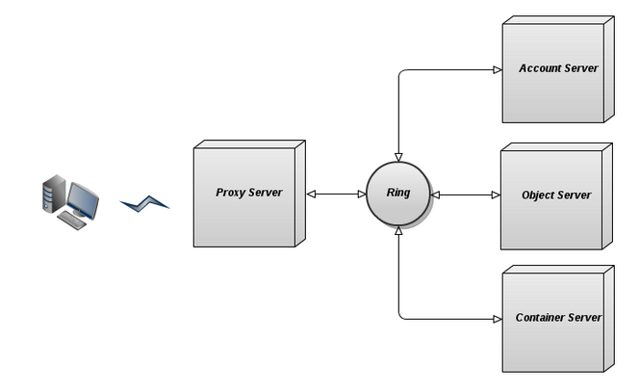
Swift File System Example
http://www.mirantis.com/blog/object-storage-openstack-cloud-swift-ceph/

Slide 15
REST API
Objects in Swift are accessed via the REST interface, and can be stored, retrieved, and updated on demand. The object store can be easily scaled across a large number of servers.

Slide 16
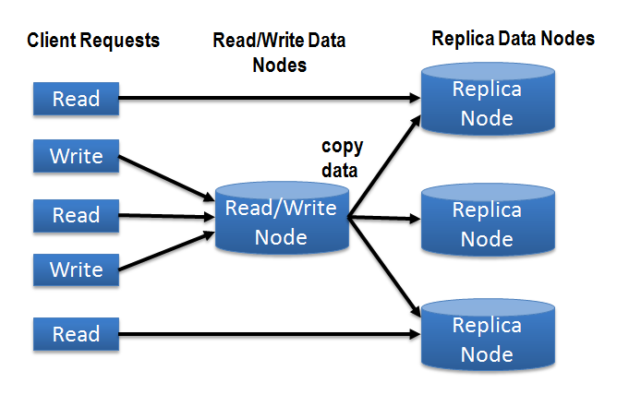
Replicas Increase Read

Slide 17
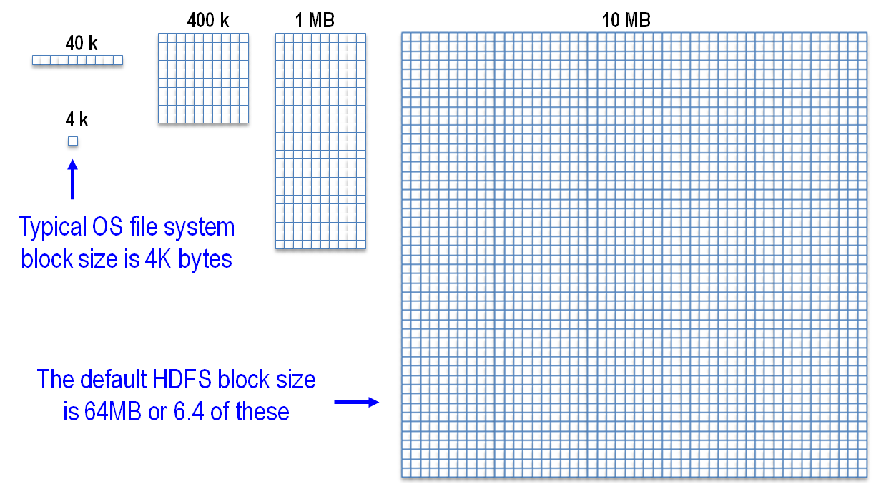
Files System Block Sizes
Figure 6.9

Slide 18
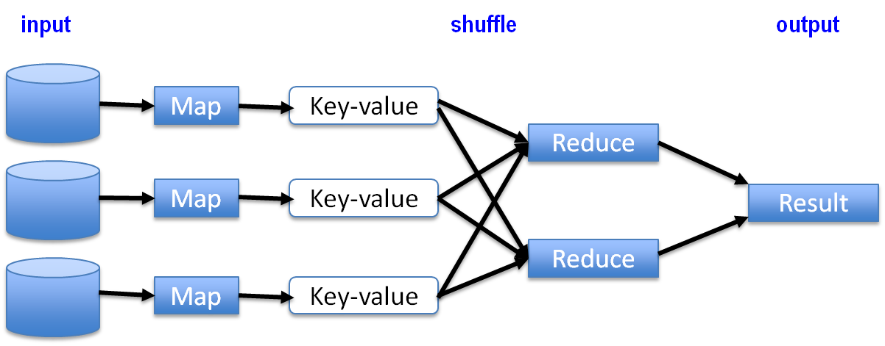
Map Reduce Transforms
Figure 6.10

Slide 19
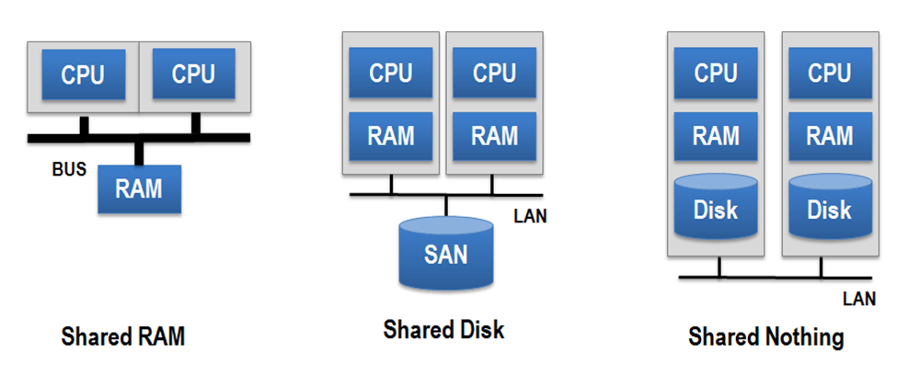
Shared Nothing Architecture

Slide 20
Key Value Store Examples
Key | Value
image-12345.jpg | Binary image file
http://www.example.com/my-web-page.html | HTML of a web page
N:/folder/subfolder/myfile.pdf | PDF document
9e107d9d372bb6826bd81d3542a419d6 | The quick brown fox jumps over the lazy dog
view-person?person-id=12345&format=xml | <Person><id>12345</id>….</Person>
SELECT PERSON FROM PEOPLE WHERE PID="12345" | <Person><id>12345</id>….</Person>
Image name
Web page URL
File path name
MD5 hash
REST web service call
SQL Query
Figure 4.2

Slide 21
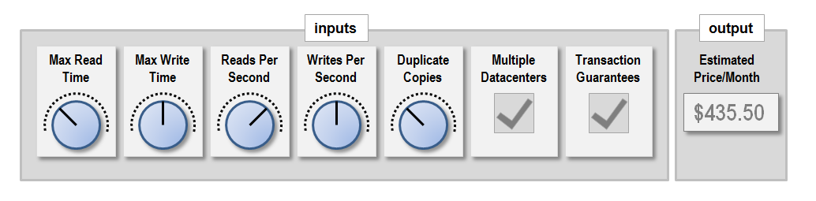
Tunable Reads and Writes
Figure 4.3

Slide 22
Portability and APIs
portability-from-simple-apis.png
Low Portability
High Portability
Application
Application
Database
Database
Complex and Non-Standard APIs
Simple and
Standard APIs
Figure 4.5

Slide 23
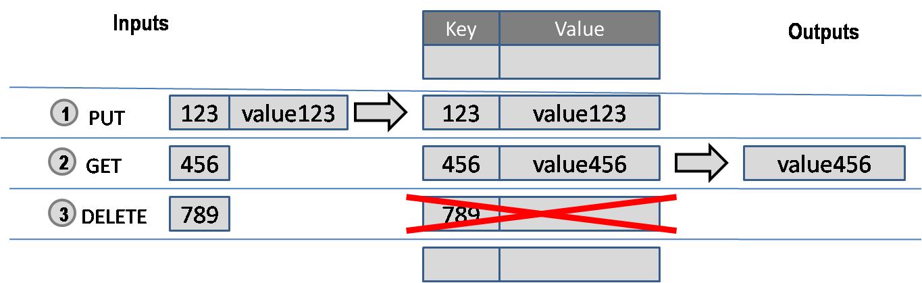
Simple Operations
Although key-value store APIs can be simple, the security policy may be complex!
Figure 4.6

Slide 24


Key Value Store Operations
put(' /images/my-image.png', $image-data)
get(' /images/my-image.png')
Key-value store
delete(' /images/my-image.png')
figure 4.7

Slide 25
Selection on Values
Traditional Relational Model
Result set based on row values
Value of rows for large data sets must be indexed
Values of columns must all have
the same data type
Key-Value Store Model
All queries return a single item
No indexes on values
Values may contain any data type

Slide 26
Web pages in key-value store
Key
Value
http://www.example.com/index.html
<html>…
http://www.example.com/about.html
<html>…
http://www.example.com/products.html
<html>…
http://www.example.com/logo.png
Binary…
figure 4.8

Slide 27
Automatic Sharding
Warning processor at 90% capacity!
Time to "Shard" – copy ½ data to a new processor
Before
Shard
After
Shard
Each processor gets ½ the load
Original processor
New processor
When one node in a cluster has too much of a load

Slide 28

Four Translations
T1
T2
T3
T4
Web Browser
Object Middle
Tier
Relational
Database
T1 – HTML into Java Objects
T2 – Java Objects into SQL Tables
T3 – Tables into Objects
T4 – Objects into HTML

Slide 29
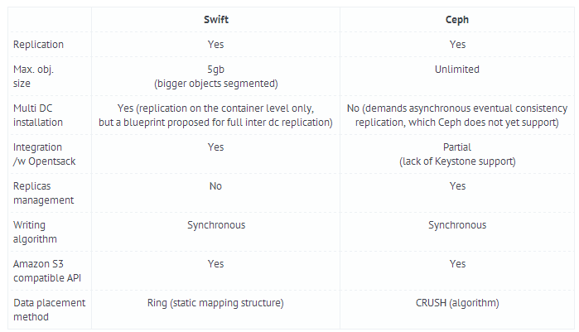
Sample Comparison

Slide 30

Zero Translation
XForms
Web Browser
XML database
XML lives in the web browser (XForms)
REST interfaces
XML in the database (Native XML, XQuery)
XRX Web Application Architecture
No translation!

Slide 31
Database Tradeoff Analysis
Java/RDBMS/SQL Way
NoSQL Way
10,000 lines of code to break CRV XML document into Java component and use Hibernate to store each element into columns of tables
45 SQL inserts store
20 joins to extract
Six months
Four developers (Java, SQL, DBA, Project Manager)
One line of codes to store CRB
One day to write
One week to test
100x increase in agility

Slide 32
The Paradigm Shift
2006
RDBMSs are the only
way to store enterprise
data
There are many ways to store enterprise data and if you pick the right one your agility can go up x1,000

Slide 33
Reality Sets In
What I wanted
What I got
Objective architecture analysis
Fairly weigh the pros and cons of each alternative
Be surrounded by people that know the strengths and weakness of many alternatives
Architecture decisions driven by an RDBMS license
Architecture decisions made by one person with limited exposure to alternatives
Architecture decisions made by lack of knowledge
Architecture by fear of the unknown

Slide 34
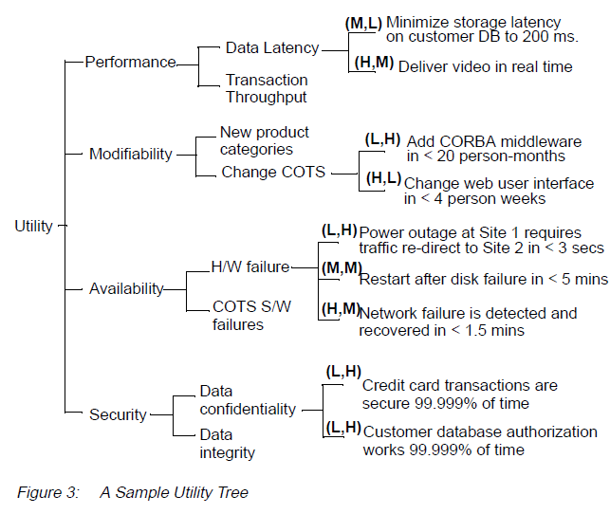
Reference Utility Tree from Book
Note: Mostly Database Issues

Slide 35
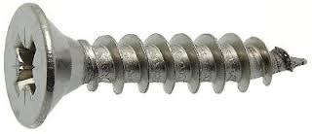





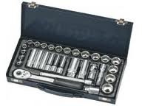

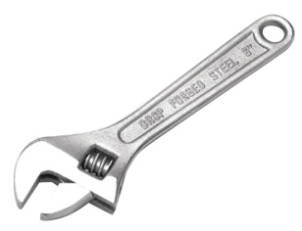
Finding the right tool for the job
The Problem:
Many possible Solutions:
What tool will have the best fit? Multiple tools? One item vs. many?

Slide 36
Architecture Selection
Make it easy to
use and extend
Architecture
Make it easy to
create and maintain code
Developers
Business Unit
Provide long-term competitive advantage
Architecture Selection
Team
Make it easy to
monitor and scale
Marketing
Operations
Don't underestimate the role of marketing to promote good architecture!

Slide 37
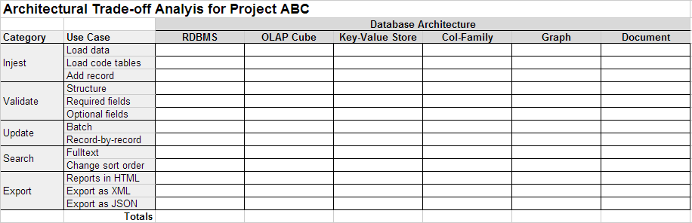
Use Case Driven Difficulty Analysis
architecture-score-card, not a product score card!

Slide 38
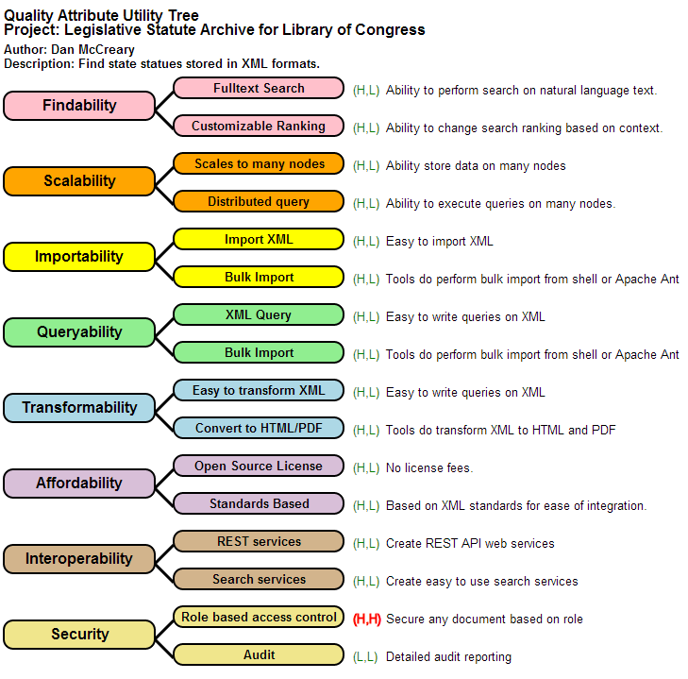
Quality Attribute Utility Tree

Slide 39
Variations Used
Change focus from "Performance" to "Scalability"
Change "Modifiability" to "Agility"
Increased emphasis on:
Big Data
Searchability
Monitorability
Supportability
Affordability

Slide 40
Sample Utility Tree
Availability
Each topic (Quality Attribute) helps focus the discussion of a selection team
The topics vary from project to project
Big Data projects focus on "Scalability" and "Findability" etc.
Objective ranking of requirements before you begin talking about architecture alternatives
Scalability
Maintainability
Affordability
Interoperability
Sustainability
Security
Portability
Findability

Slide 41

Hand in Glove
The quality of the fit is driven by the quality of each finger's fit
If one finger doesn’t fit the entire glove has a poor fit
"Quality trees" help us evaluate the overall fitness of a problem and solution
Removes focus on a single dimension

Slide 42
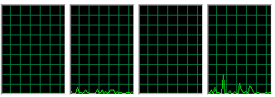
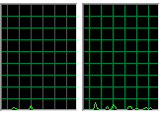


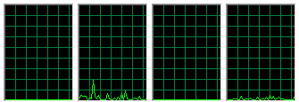
Finding the right metaphor
CPU Utilization
Airline Checkin
Customer A
Customer B
Customer C
This is like the situation when many people are forced to go to the longest line even when other agents are not busy.
This customer is running a report that takes a long time to run on a single system. If we used a NoSQL solution the report would be evenly distributed on all servers and runs in 1/12 the time.

Slide 43
Change in focus of Security
Requirements by threat type (DOS, Injection, Internal, Social Engineering)
Authentication
Validating users
Security
Authorization
Granting access rights to resources
Audit
Who changed what and when
Encryption
Encrypting/signing data within a database

Slide 44
The Big Problem: Standards
Port to other DB
Ability to port applications to other NoSQL databases
Portability
Share code
Ability to share code with other databases
Reuse
Ability to reuse code from other databases
Training
Ability to reuse training from other databases
The ability to share code between other NoSQL databases (even within the same type) is very limited

Slide 45
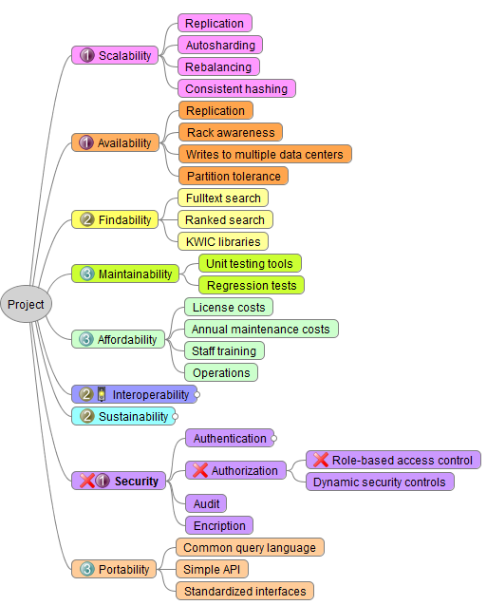

Slide 46
Using Quality Trees to Communicate Risk
Availability
A solid green border indicates no problems – our architecture and product meet the requirements of the project
Scalability
This quality has been ranked as a medium level of importance to the project but the architecture has low portability to other databases
The highest warning rolls up to each parent node
Maintainability
Portability
Alternate DBs
Code can be ported to other databases (M, L)
Affordability
A dashed red line indicates architectural risk
This quality has been ranked as a high level of importance to the project, but the implementation being considered has been evaluated as a low compliance. This helps us rank project risks.
Interoperability
Sustainability
Authentication
Authorization
Only some roles can update some records (H, L)
Security
Audit
Encryption

Slide 47
Maintainability
"…is the ability of the system to undergo changes with a degree of ease. These changes could impact components, services, features, and interfaces when adding or changing the functionality, fixing errors, and meeting new business requirements."
Business Agility
winner!
The "big win" for many NoSQL converts
"We came for the scalability, we stayed for the agility"
SAAM has a stronger focus on change impact analysis

Slide 48
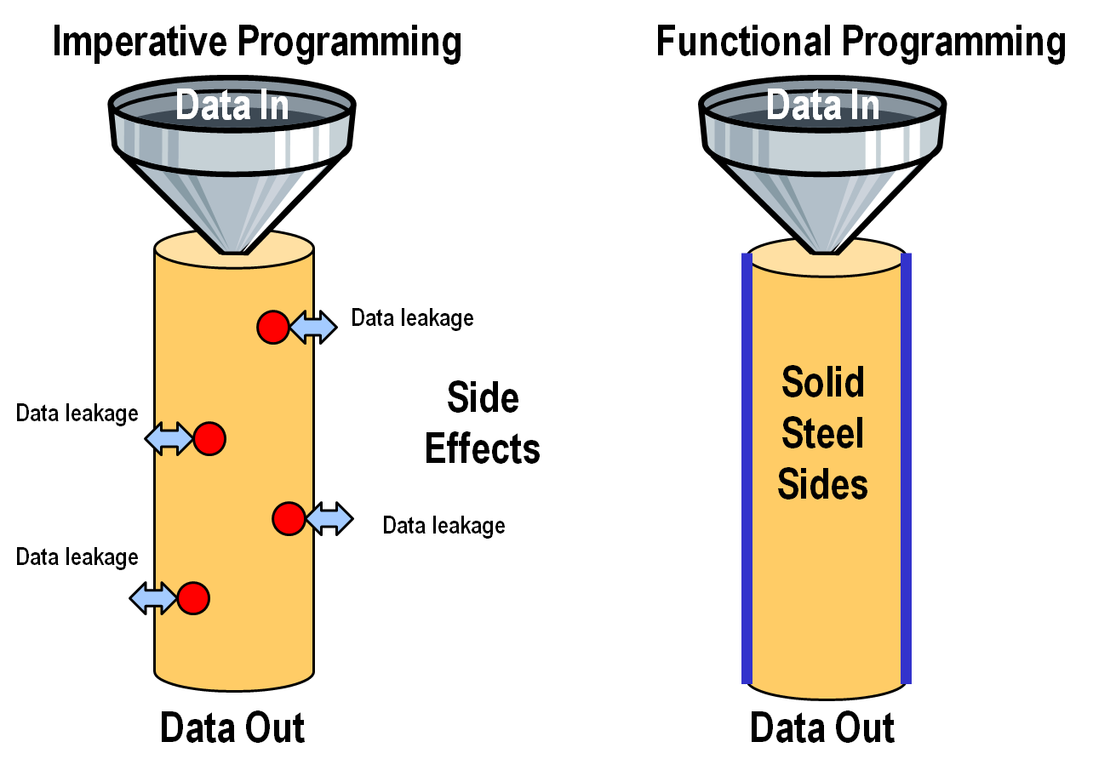

Slide 49
Reusability
defines the capability for components and subsystems to be suitable for use in other applications and in other scenarios. Reusability minimizes the duplication of components and also the implementation time.
Reusability
Maintainability
Take Home: reusing transforms (MapReduce etc.) is the key to agility in Big Data

Slide 50
Summary
We need solution architects that are trained in the pros and cons of multiple database architectures
Select a database architecture first, then select a product
"One size fits all" will not keep organizations competitive
ATAM (and SAAM) are great processes to help understand the alternatives and objectively weigh the consequences of architectural decisions

Slide 51
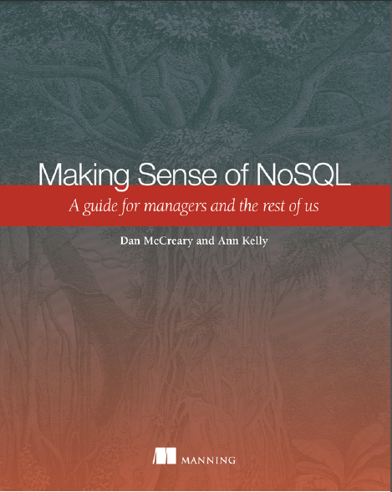


Reference
Making Sense of NoSQL
Manning Publications
Nov. 2013
Available in PDF, ePub and print
http://manning.com/mccreary
Ann Kelly
Dan McCreary

