Slide 1
ATAM Quality Tree Tool
Implemented with NoSQL

Slide 2
Goals
Graphically edit quality trees with web interface
flexible web forms for data entry
Assign importance, difficulty scores to each node
Expand/Collapse Regions
Transform to multiple outputs
HTML, XML, DocBook, SVG, Concept Maps, PowerPoint

Slide 3
Sample Quality Tree
Fulltext Search
Fulltext search on document data. (H, H)
Searchability
XML Search
Fast range searching. (H, H)
Solution support
Custom Scoring
Score rank via XQuery. (M, H)
How Important to this project?
XML Importability
Drag-and-drop
Easy to add new XML data. (C, H)
Bulk Import
Batch Import tools. (M, M)
XQuery
Easy to transform XML data. (H, H)
Transformability
Transform to HTML or PDF. (VH, H)
XSLT
Works with web standards. (VH, H)
Affordability
No License Fees
Use Open Source Software. (H, H)
No complex languages to learn. (H, H)
Standards Based
Staff training. (H, M)
Sustainability
Standards
Use established standards. (VH, H)
Use declarative languages. (VH, H)
Ease of Change
Customizable by non-programmers. (H, H)
Interoperability
Web Services
Use W3C Standards. (VH, H)
Mashups with REST Interfaces. (VH, H)
No DB Translations
Works with W3C Forms. (H, M)
Security
Fine Grain Control
Prevents unauthorized access. (H, H)
Role-based
Collection-based access. (H, M)
Centralized security policy. (H, M)

Slide 4
Quality Tree Icon
Searchability
Fulltext Search
Custom Ranking
Importability
Drag-and-drop
Bulk Import
Transformability
XQuery
Typeswitch
Affordability
No License Fees
Standards Based
Sustainability
Standards Based
Ease of Change
Interoperability
Web Services
No DB Translations
Security
Fine Grain Control
Role-based

Slide 5
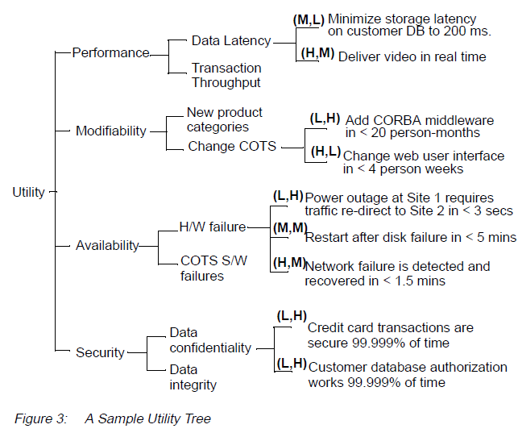

Slide 6
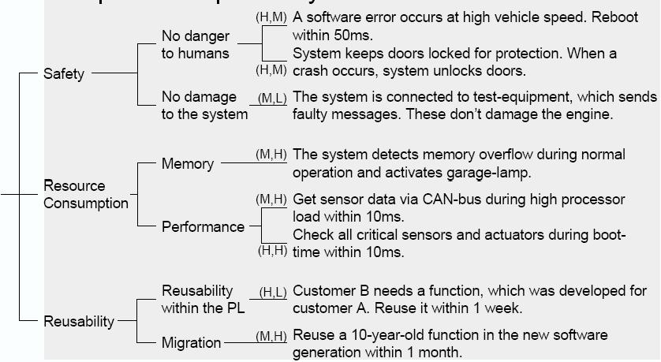

Slide 7
Business
Drivers
Quality
Attributes
User
Stories
Analysis
Architecture Plan
Architectural
Approaches
Architectural
Decisions
Tradeoffs
Impacts
Sensitivity
Points
Non-Risks
Distilled info
Risk Themes
Risks
figure-cmu-atam-process

