Slide 1


RGB LED Circuit
LED
+
+
+

Slide 2
Positive + (anode)
Negative - (cathode)

Slide 3
Testing
+
+
+
3 volts
GND
+
+

Slide 4
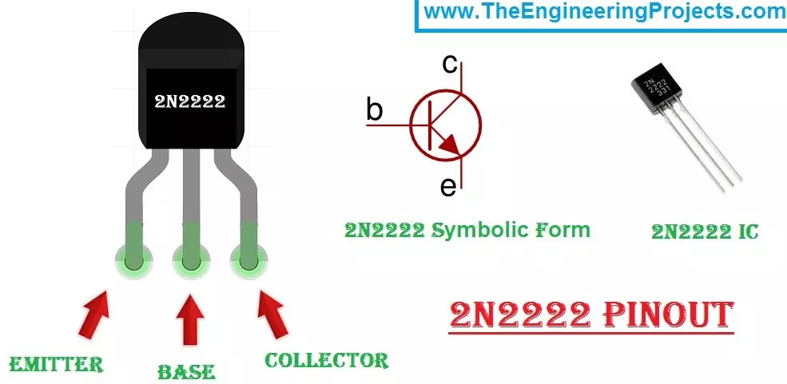
C
2N2222
B
E
C
E
B

Slide 5


5V
2N2222
LED
5 ma
10K Pot
6.2 Ohm
100 milliamp limiting resistor
GND

Slide 6
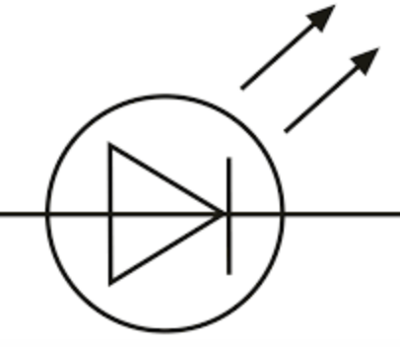
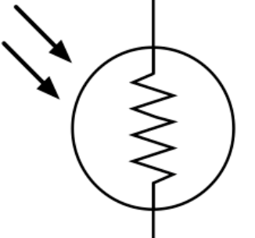
Dark Detector
5V
10K Ohm Pot.
LED
10K Ohm
C
330 Ohm
Photo
Resistor
B
2N2222
E
GND

