Slide 1


RGB LED Circuit
LED
+
+
+

Slide 2
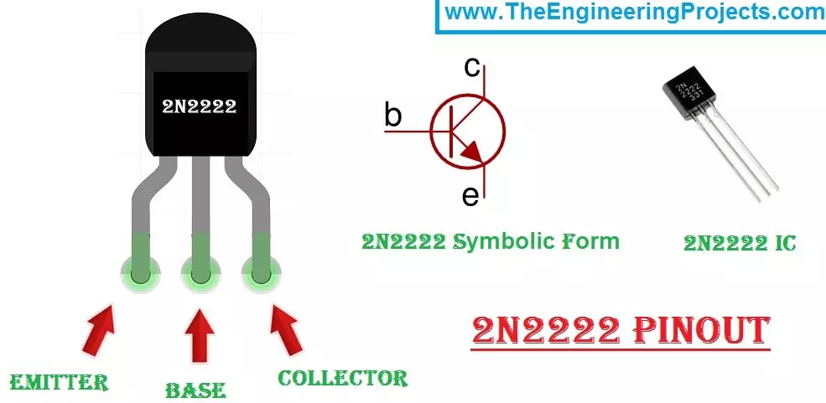
C
2N2222
B
E
C
E
B

Slide 3
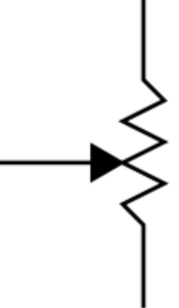

5V
2N2222
LED
5 ma
10K Pot
6.2 Ohm
100 milliamp limiting resistor

