Slide 1
Breadboard Basics

Slide 2
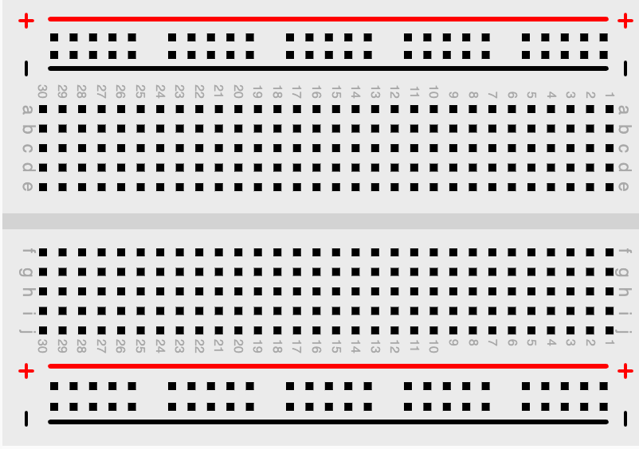
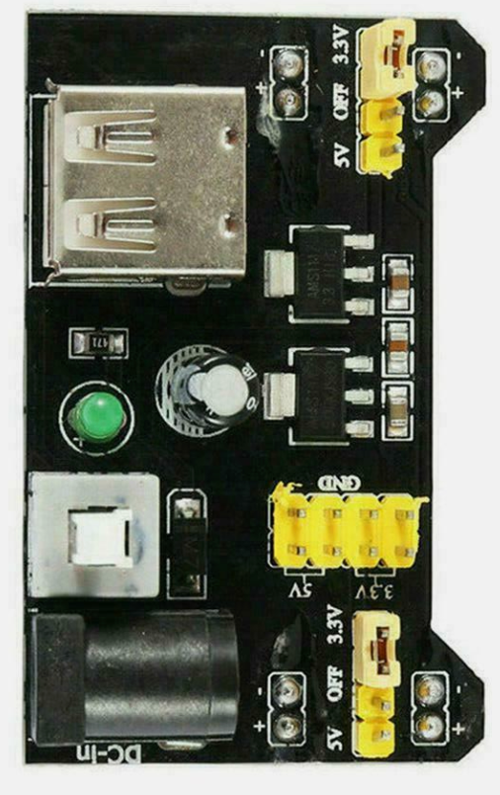
USB

Slide 3
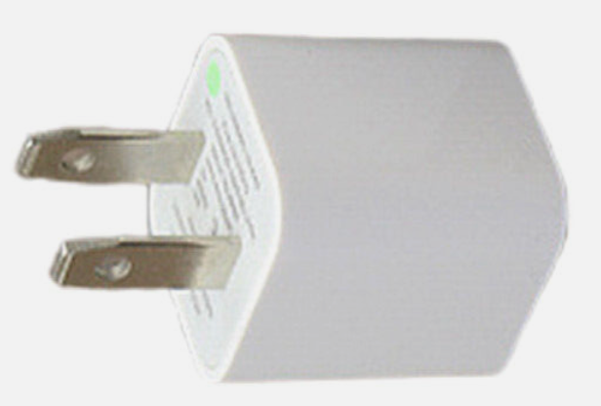
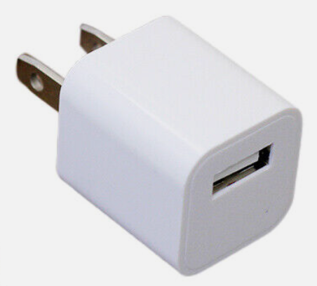
USB Power Adapters

Slide 4

Breadboard Power
BATTERY
BATTERY

Slide 5
LED Circuit
BATTERY
BATTERY

Slide 6
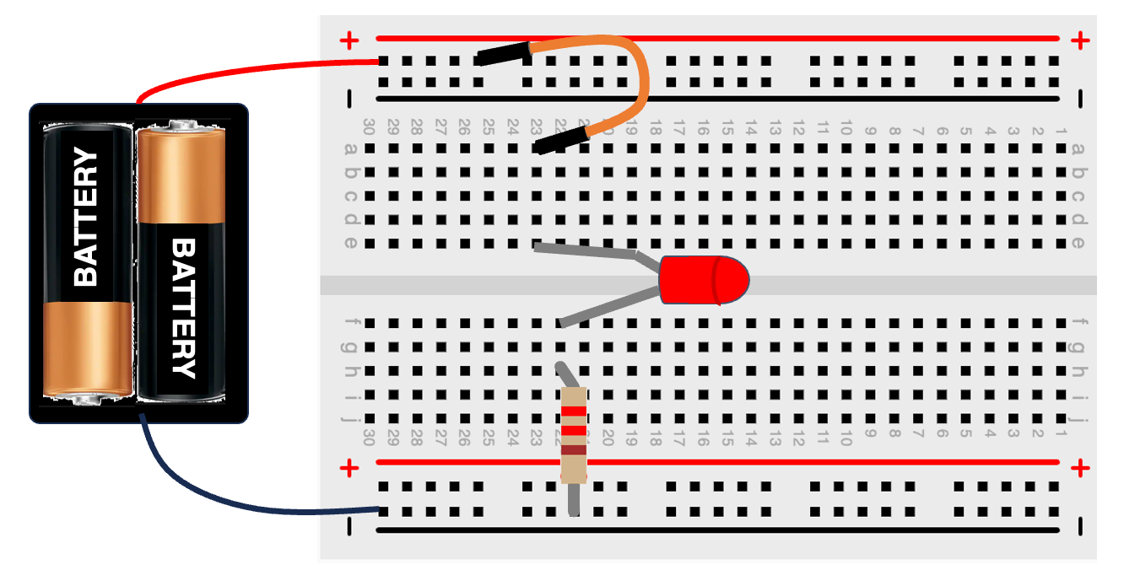
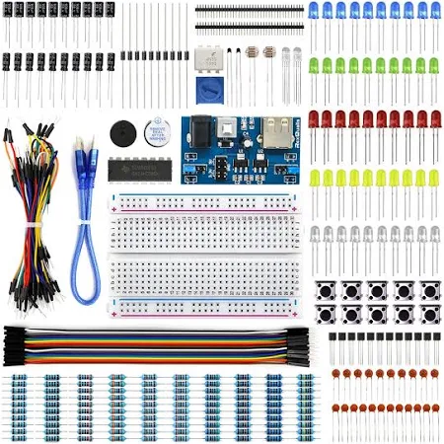
LED Circuit

Slide 7
LED Circuit
BATTERY
BATTERY

Slide 8
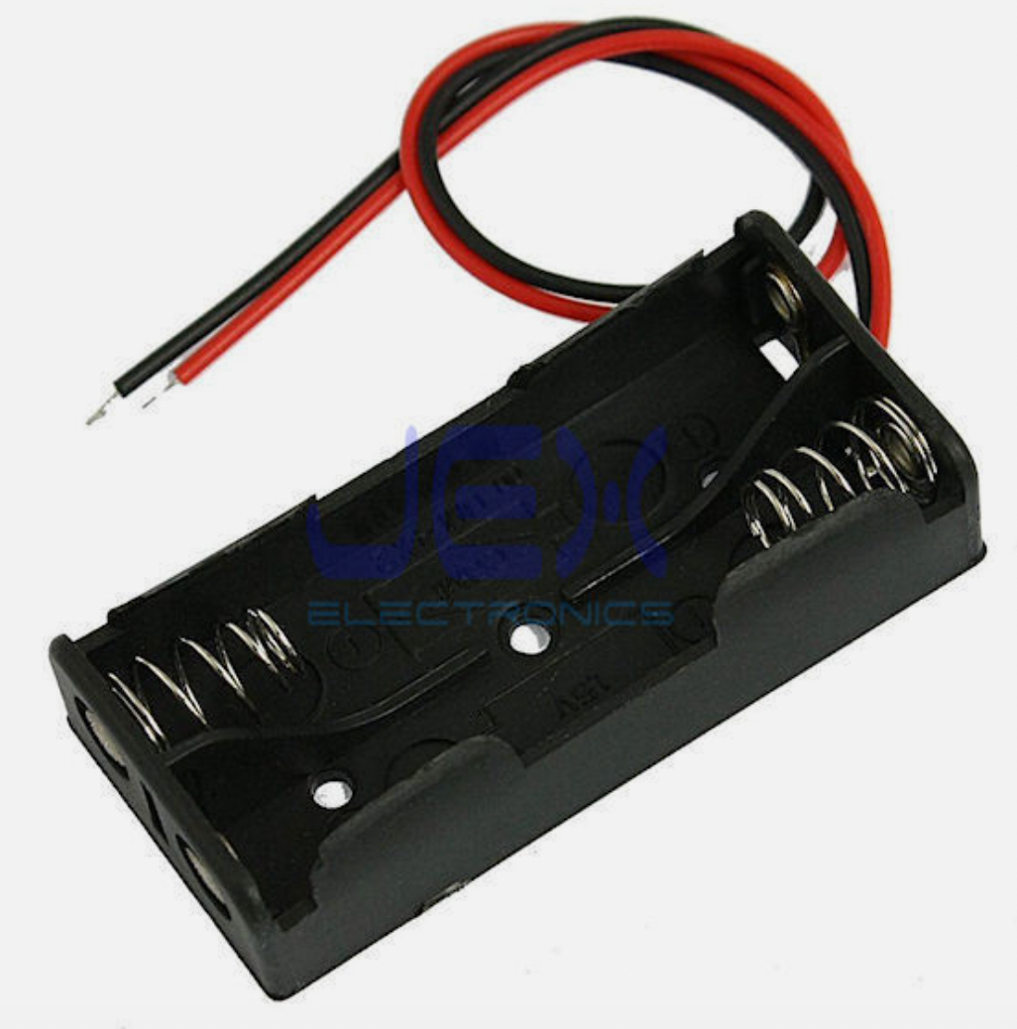

Slide 9
