Slide 1
Components

Slide 2
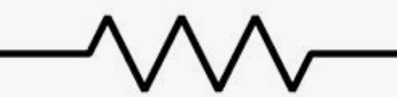
Resistor

Slide 3
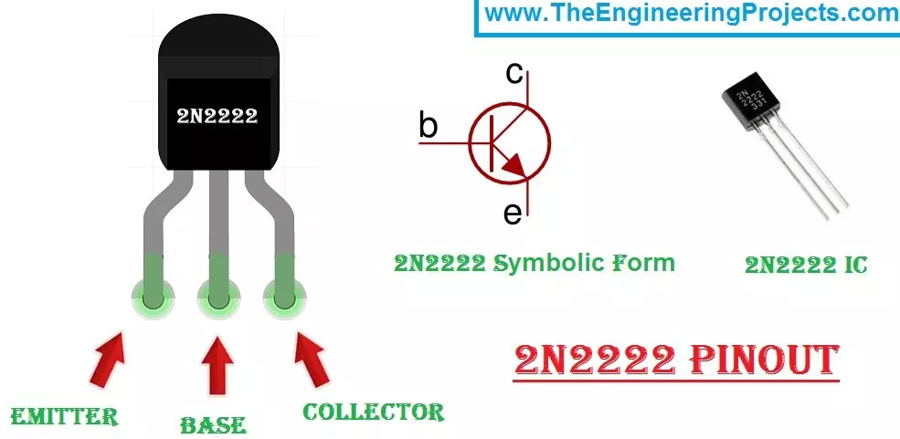
C
2N2222
B
E
C
E
B

Slide 4
2N2222
2N2222
E
C
10K Ohm
B
B
C
E

