Slide 1
Transistor Boolean Logic

Slide 2
Transistor Components
C
2N2222
B
E
C
E
B

Slide 3
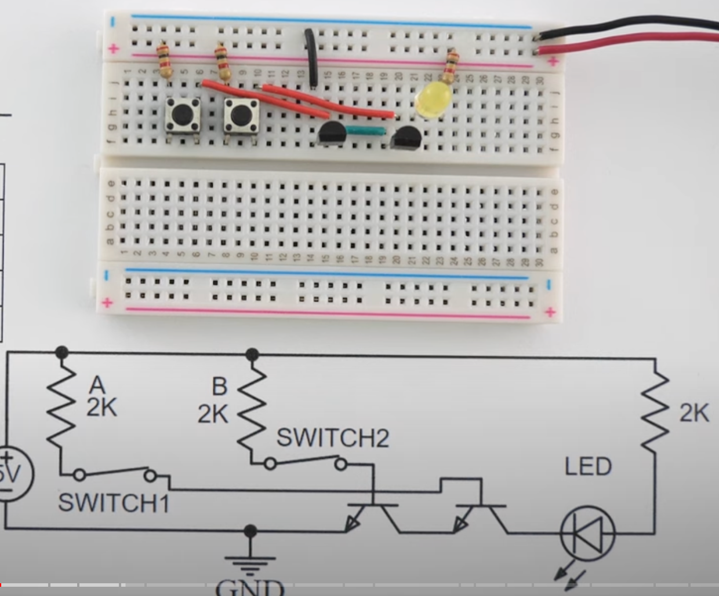

Slide 4

GND

