Slide 1
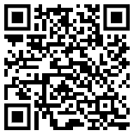
Busy Board Use only under adult supervision https://dmccreary.github.io/beginning-electronics/kits/busy-board/
Busy Board Use only under adult supervision https://dmccreary.github.io/beginning-electronics/kits/busy-board/

