Slide 1
Solar Night Light

Slide 2
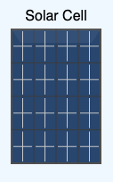

C
Rechargeable
Battery
B
10K Ohm
E
1N4007 Diode

