Slide 1
5v Regulated

Slide 2
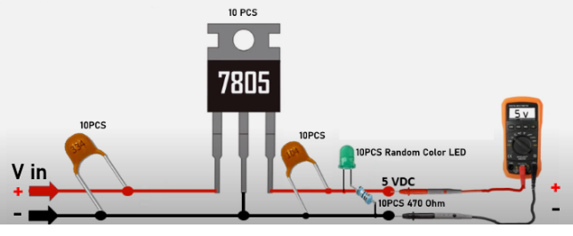
334
104
LED
470 Ohm

