Slide 1
Breadboard Basics

Slide 2
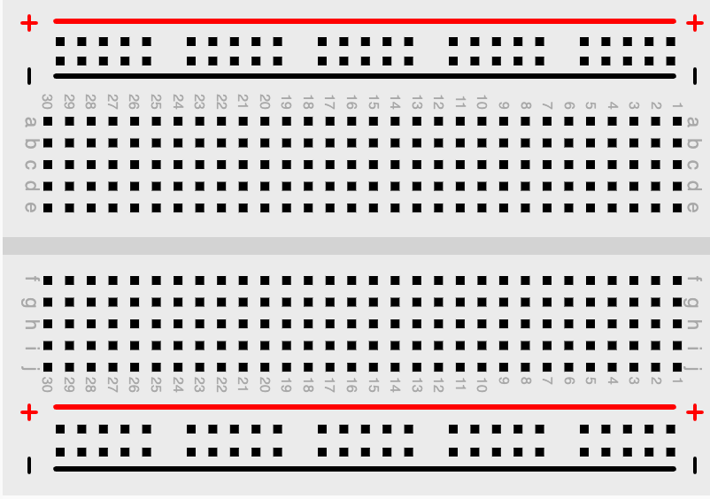
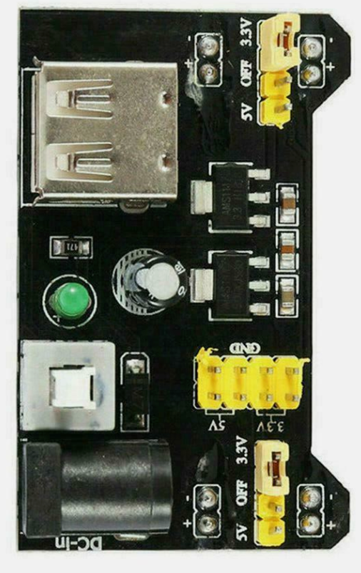
USB

Slide 3
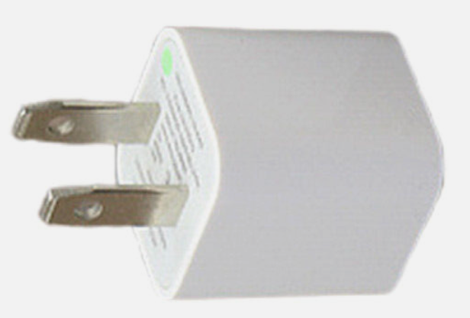
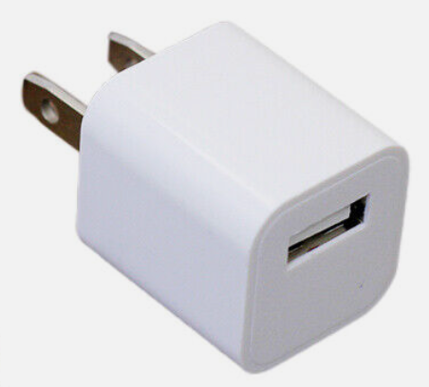

Slide 4

Breadboard Power
BATTERY
BATTERY

Slide 5
LED Circuit
BATTERY
BATTERY

Slide 6
LED Circuit
BATTERY
BATTERY

