Slide 1
Cell Drawings

Slide 2
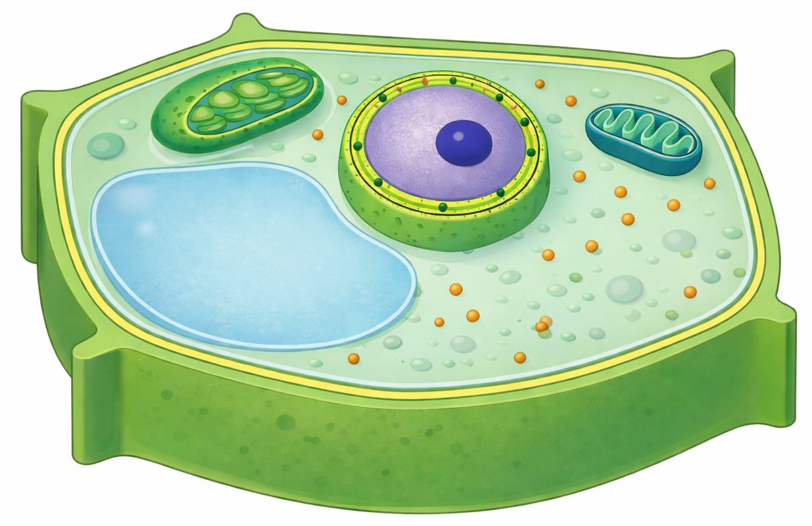
Plant Cell

