Slide 1
Mascot Poses

Slide 2
Seven Poses
Neutral – also the logo in the upper left
Welcome
Tup

Slide 3

Neutral

Slide 4

Welcome

Slide 5

Tip

Slide 6

Warning

Slide 7

Encouraging

Slide 8
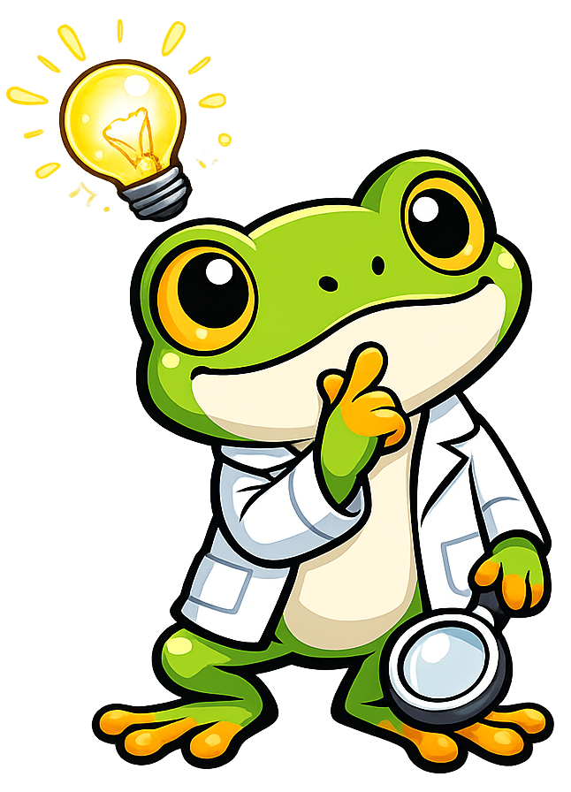
Thinking

Slide 9

Celebration

