Slide 1
Claude Skills for Intelligent Textbooks
Dan McCreary
December 1st, 2025
Wifi (952) 217-5682

Slide 2

Course Description
Intelligent Textbook

Slide 3
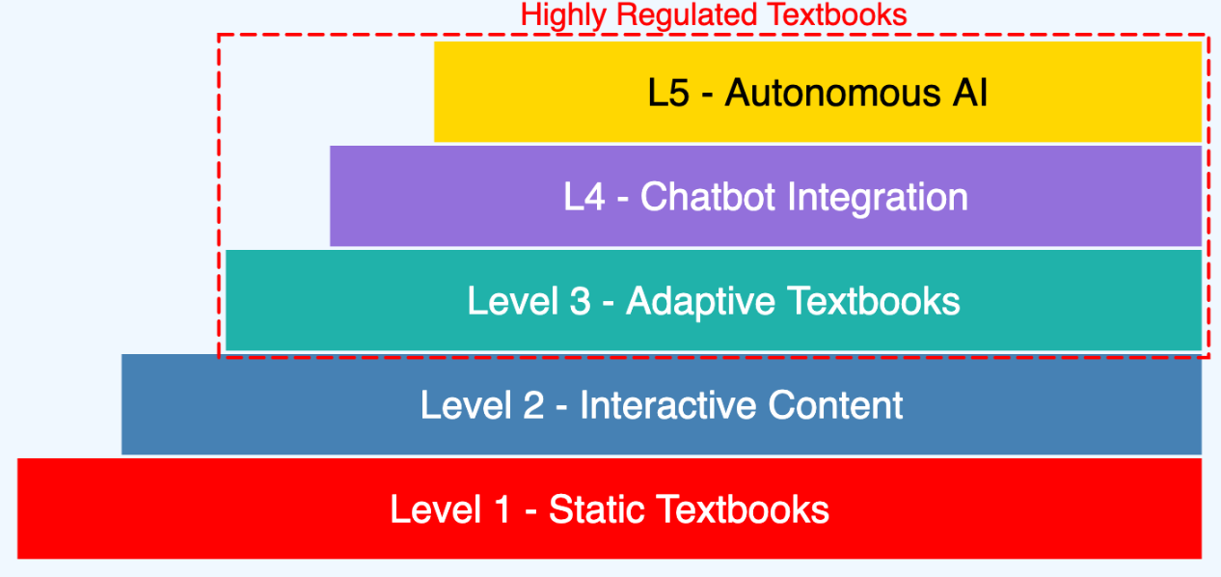
Five Levels of Intelligent Textbooks
Today

Slide 4
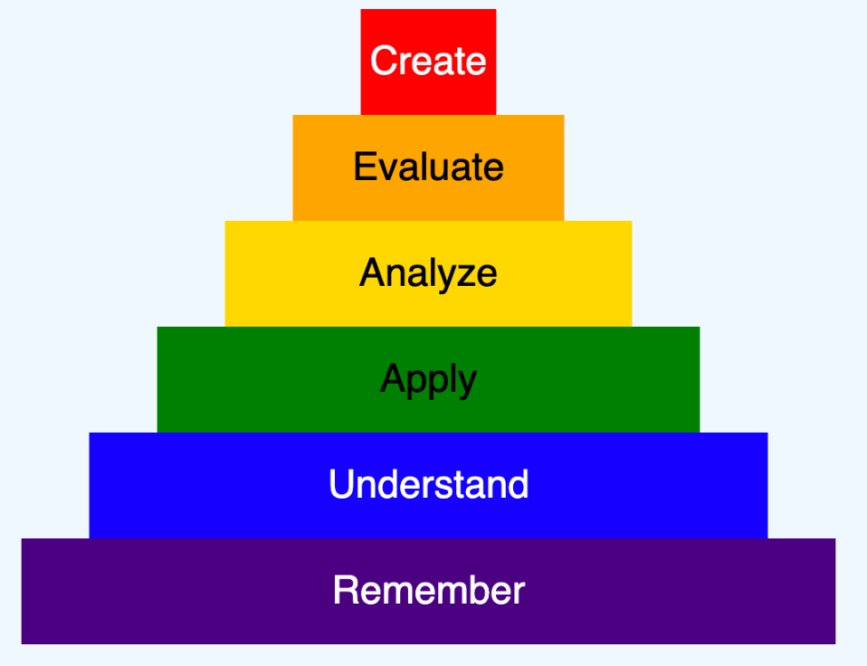
Bloom 2001 Taxonomy

Slide 5
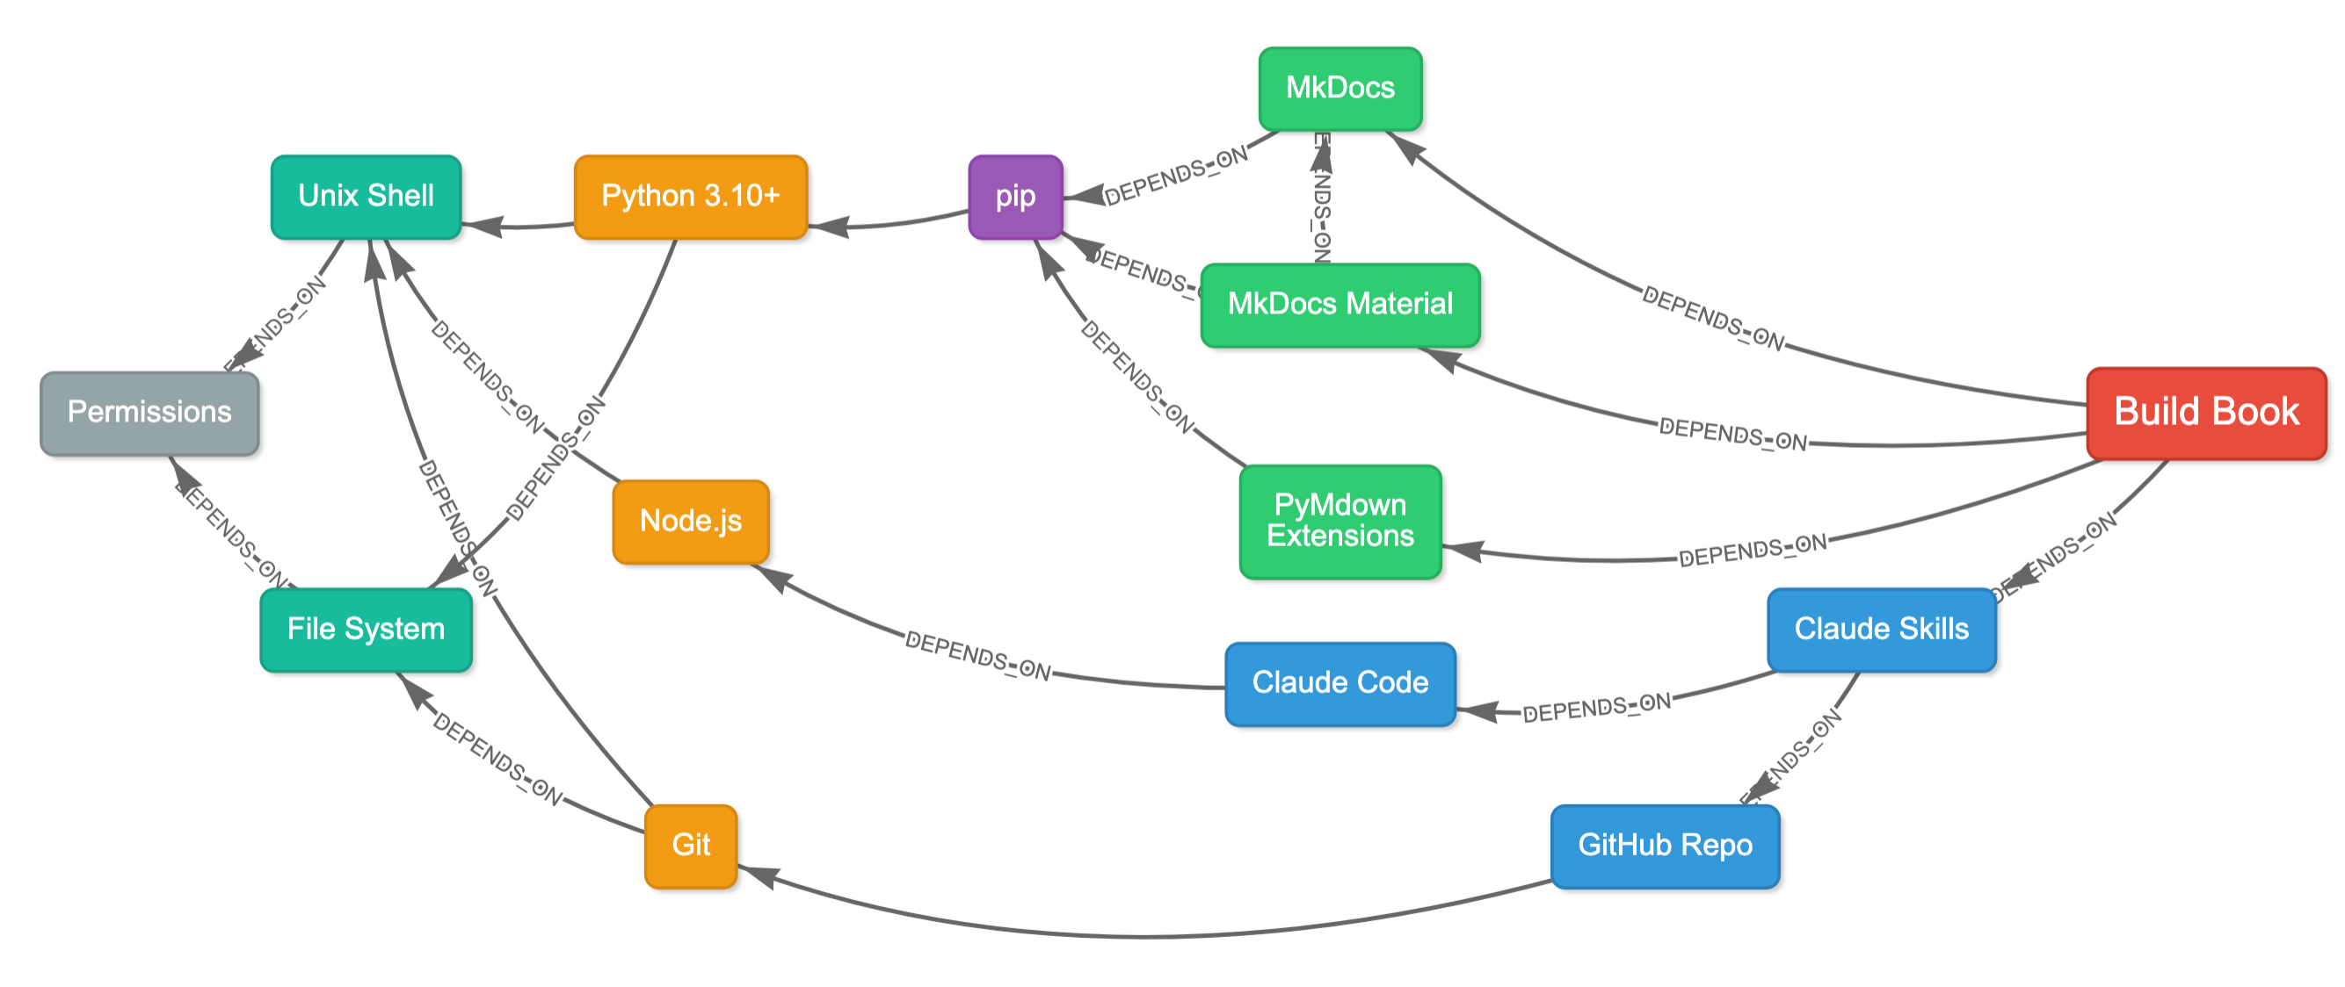
Installation Dependency Graph

Slide 6
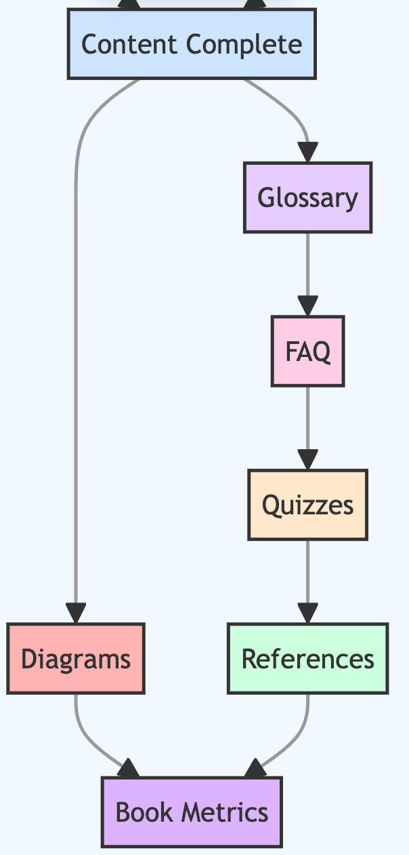
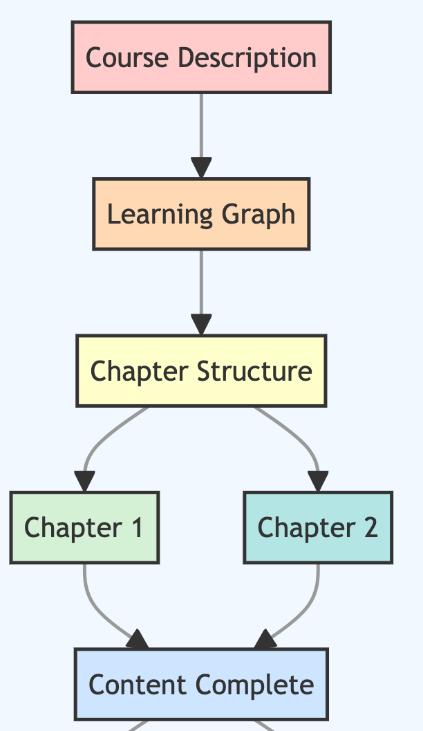
Book Build Workflow

Slide 7
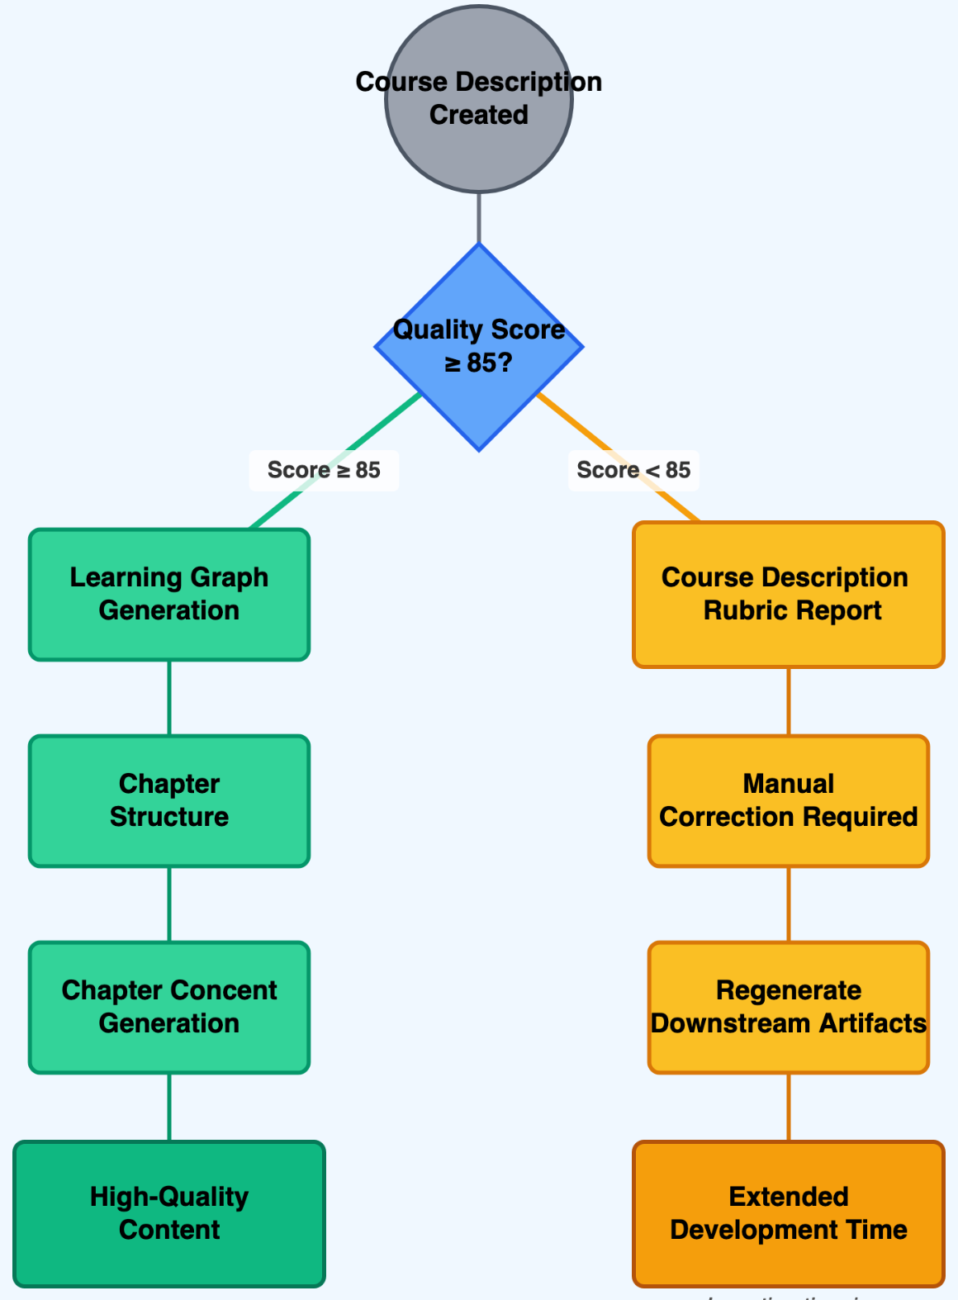
Course Description Quality
https://dmccreary.github.io/claude-skills/course-description/

Slide 8
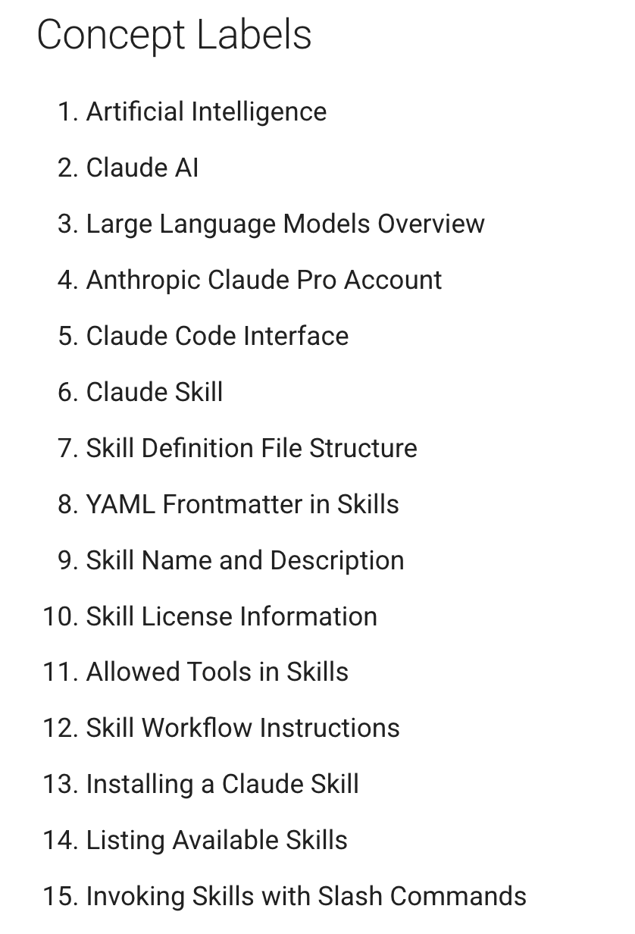
List of Concepts
https://dmccreary.github.io/claude-skills/learning-graph/concept-list/

Slide 9
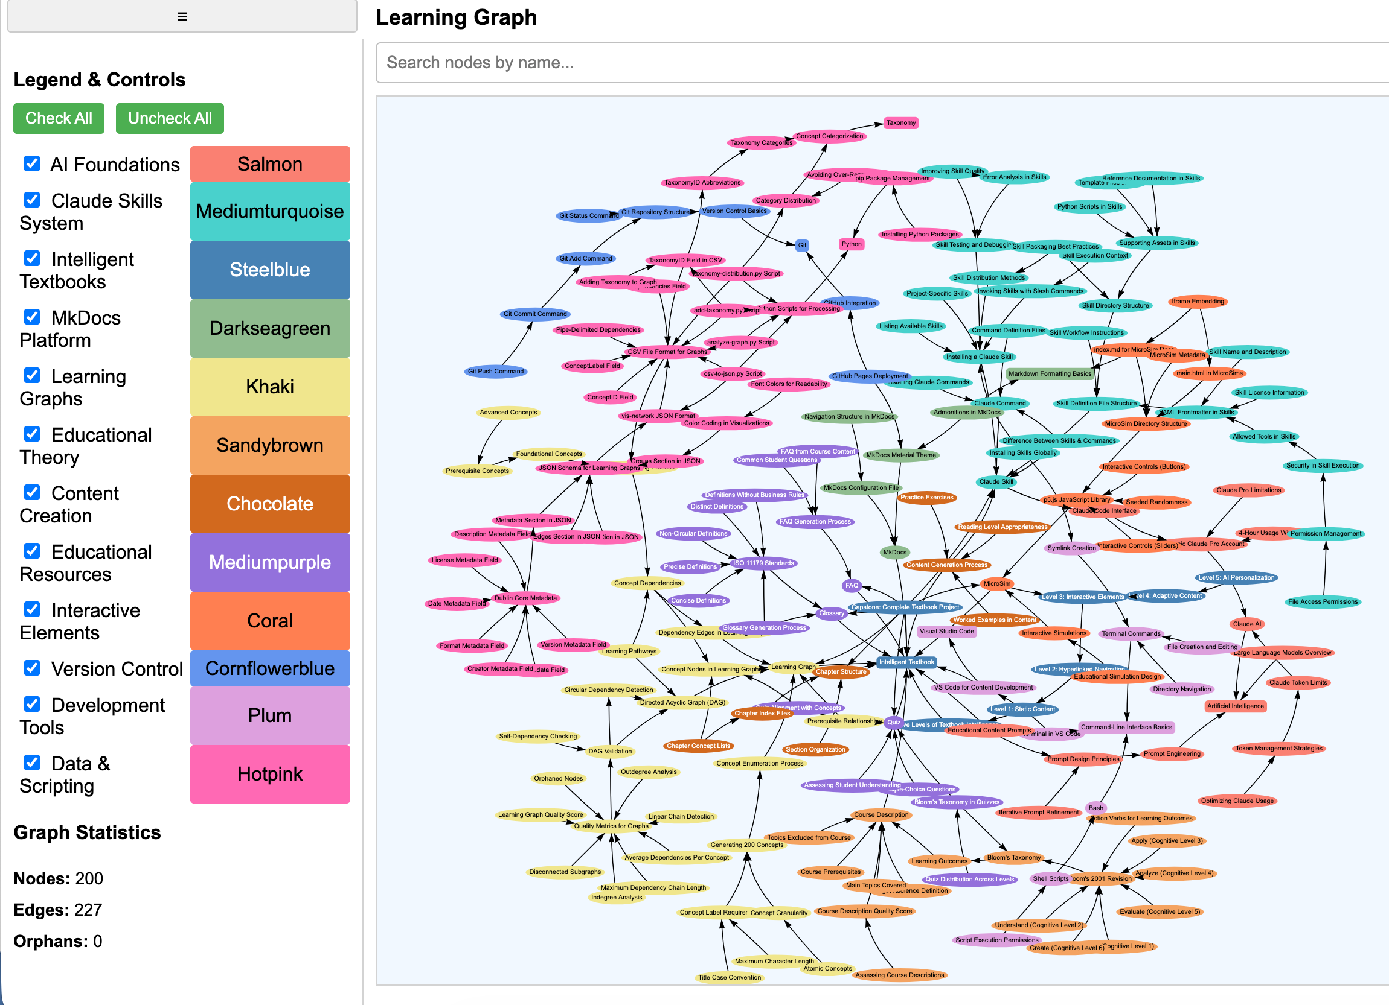
Learning Graph
https://dmccreary.github.io/claude-skills/sims/graph-viewer/main.html

Slide 10
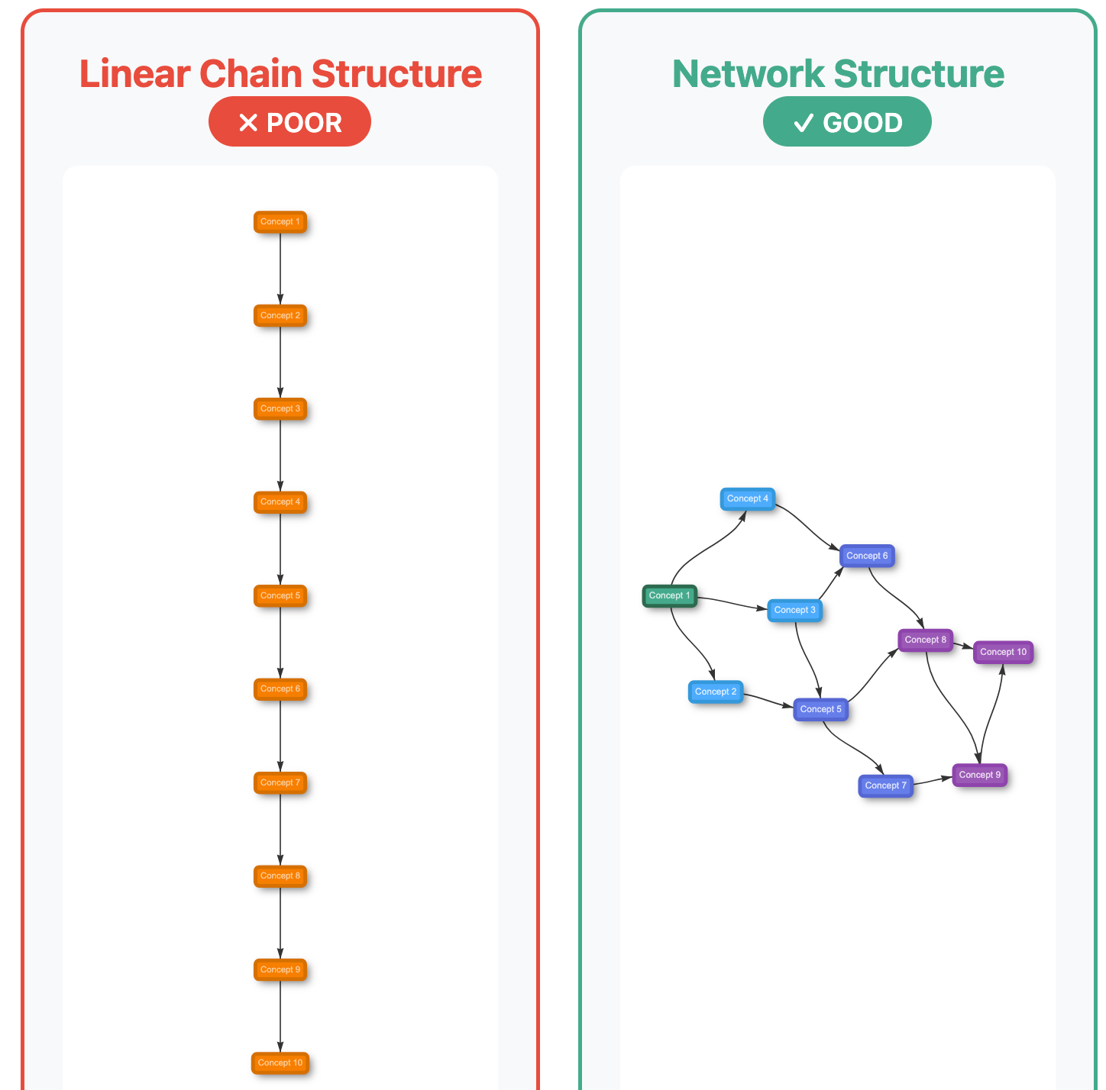
Knowledge Graph Quality

Slide 11
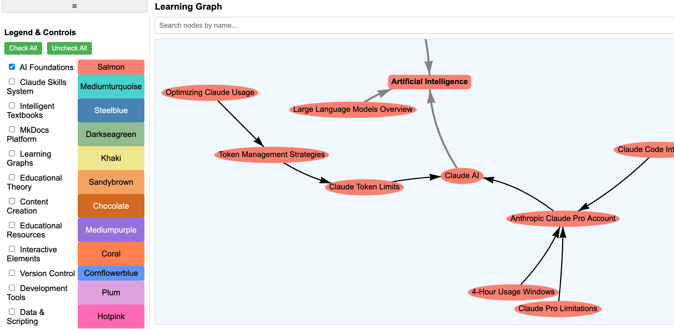
Concept Dependency (Enablement)

Slide 12
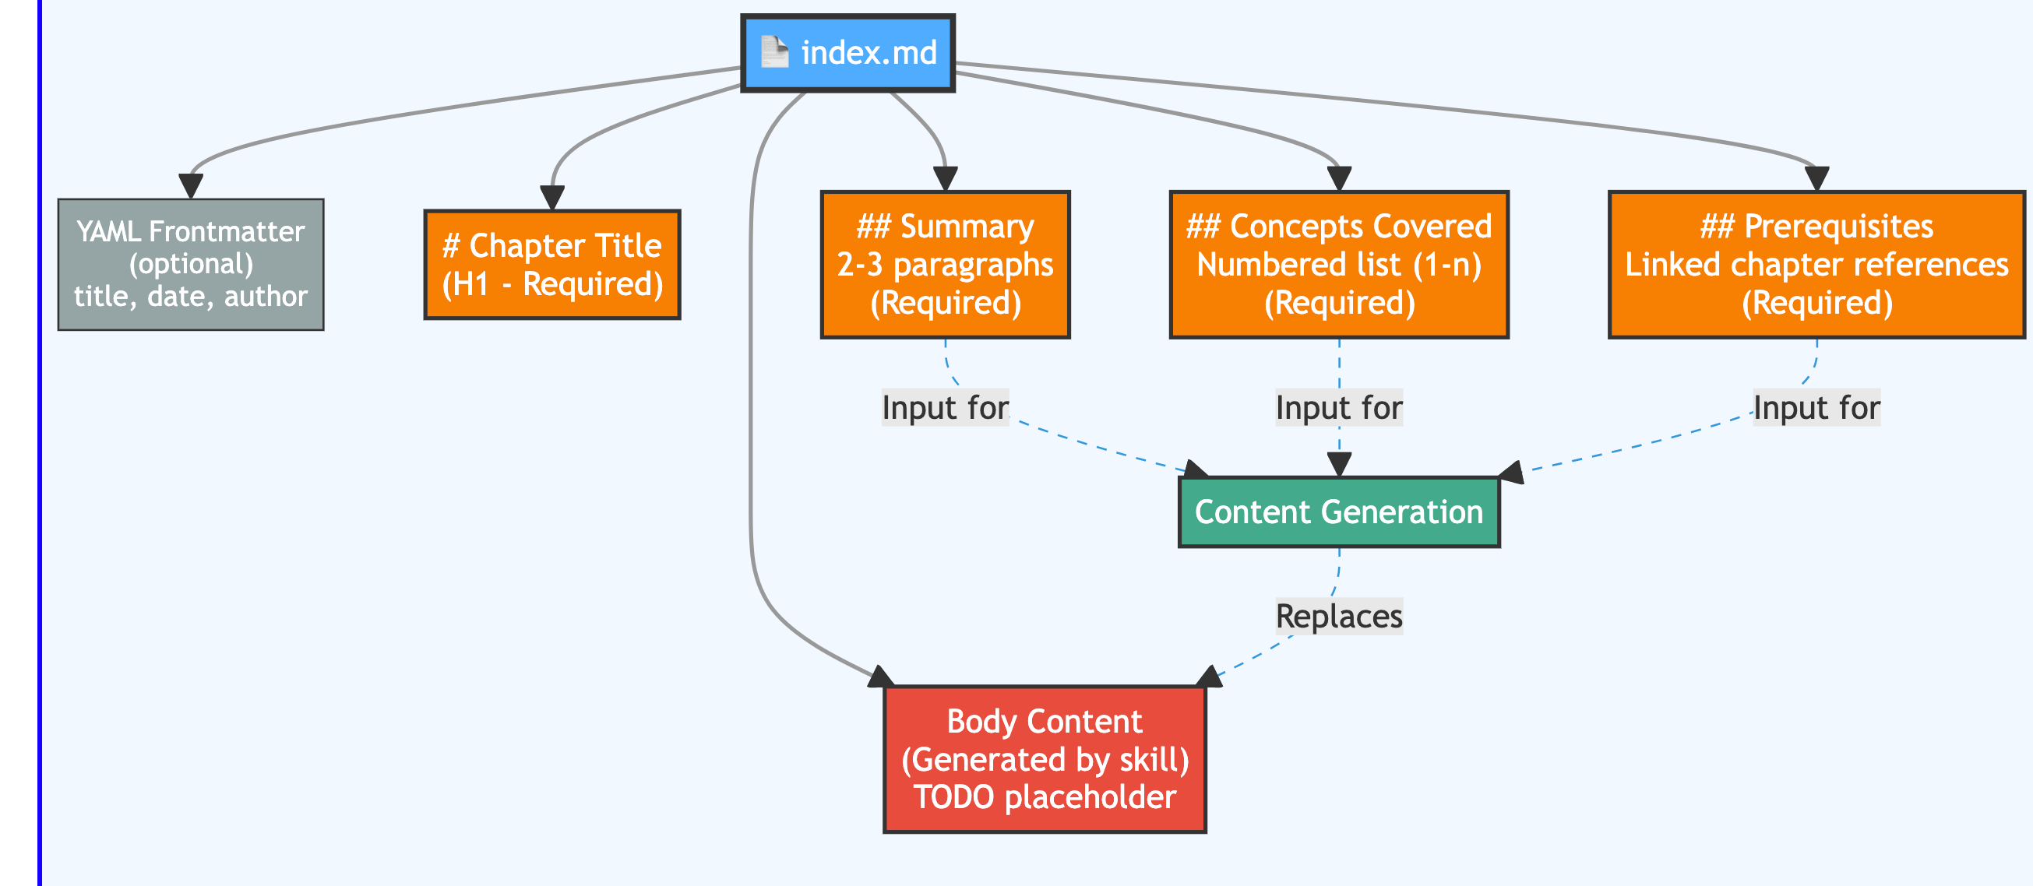
Chapter Structure

Slide 13
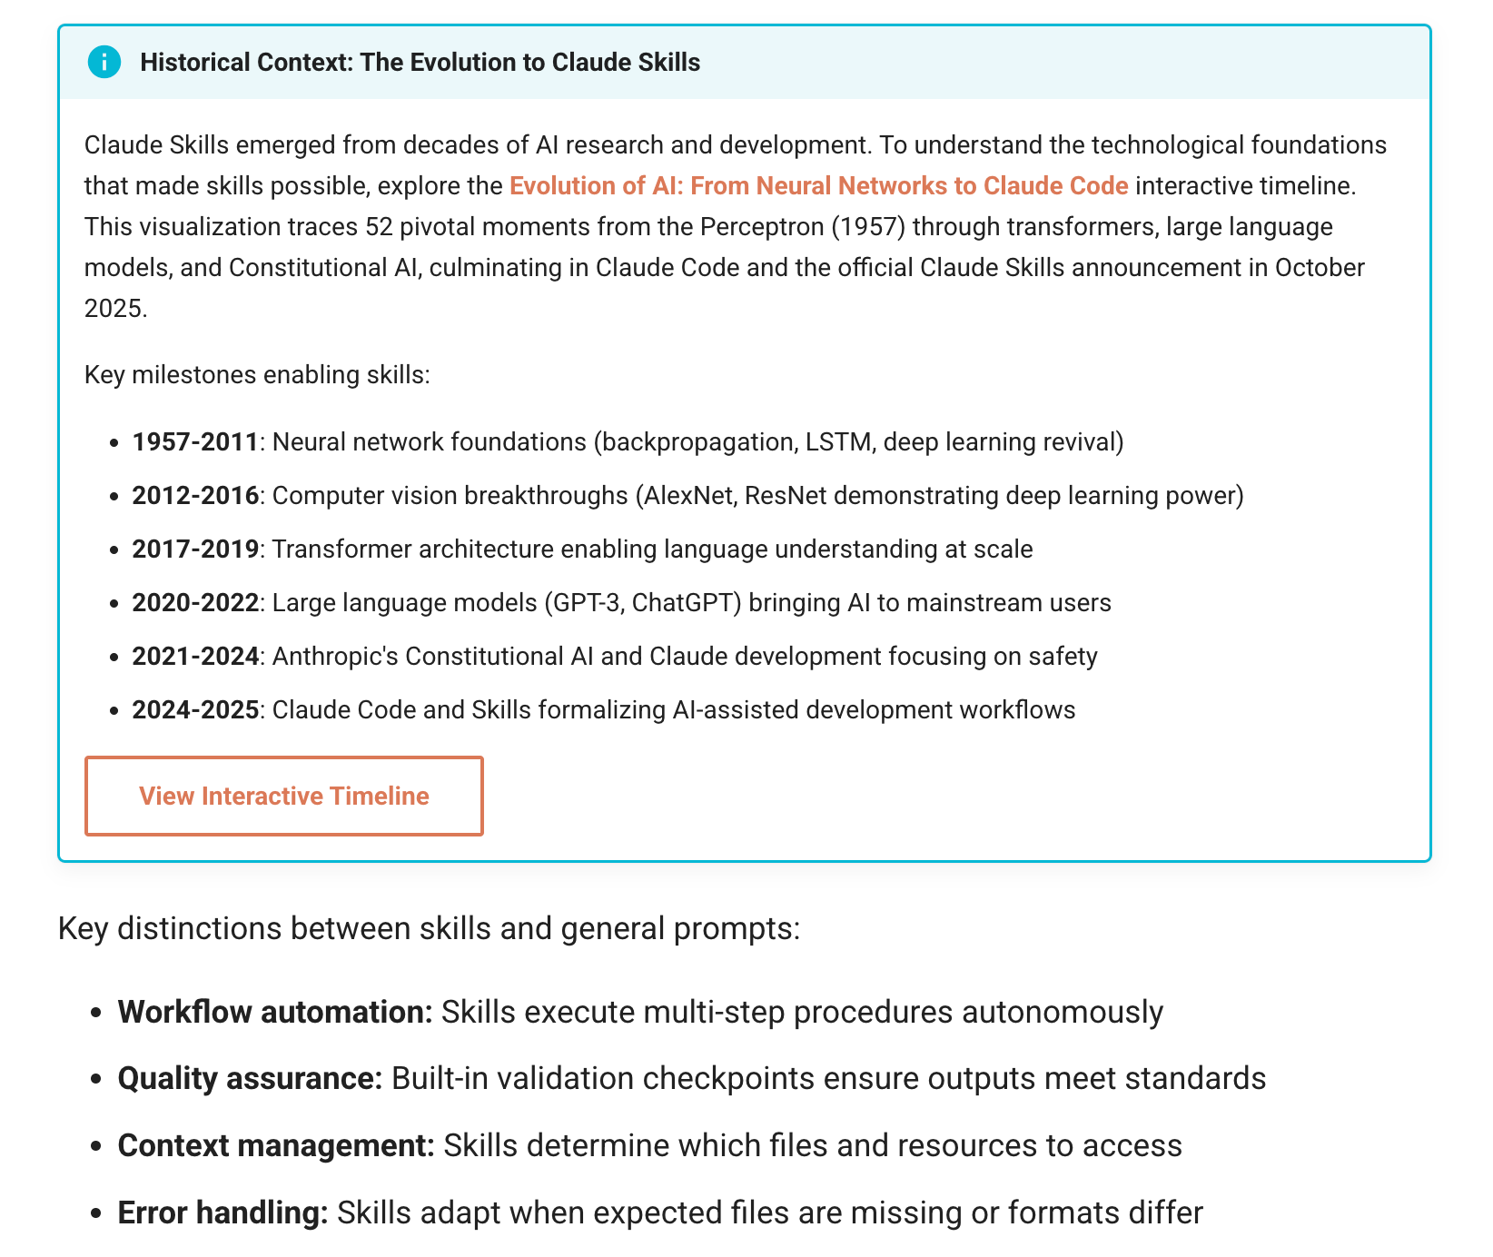
Chapter Content Generation
Rules to break up the “Wall of Text”
Placement of lists, tables, callouts, admonitions

Slide 14
Supplementary Content
Glossary
FAQ
Quizzes
References
Book Metrics
Announcements

Slide 15
Wrap Up
What did you like?
What could we have done better?
Would you like to be able to teach this workshop? Audience?

