Slide 1
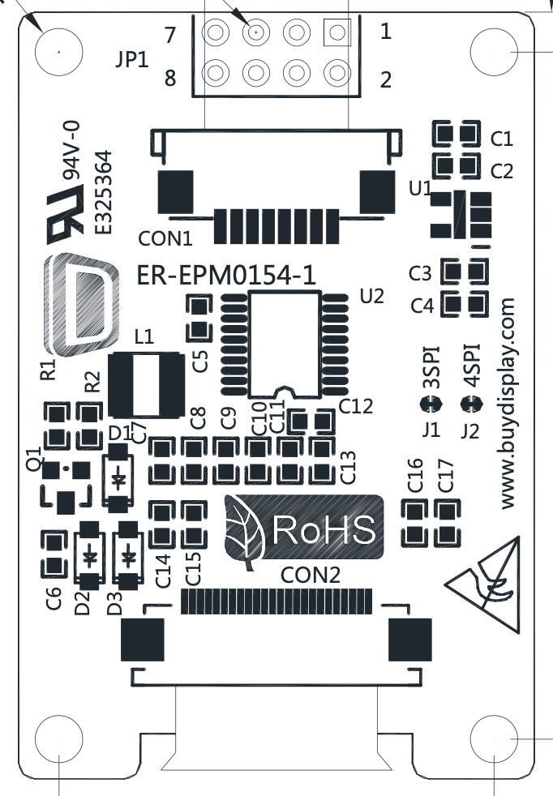
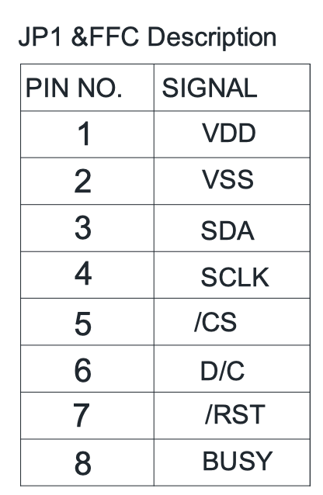
/CS
/RST
SDA
VDD (3.3 v)
5
3
VSS (GND)
4
6
SCLK
BUSY
D/C

