Slide 1
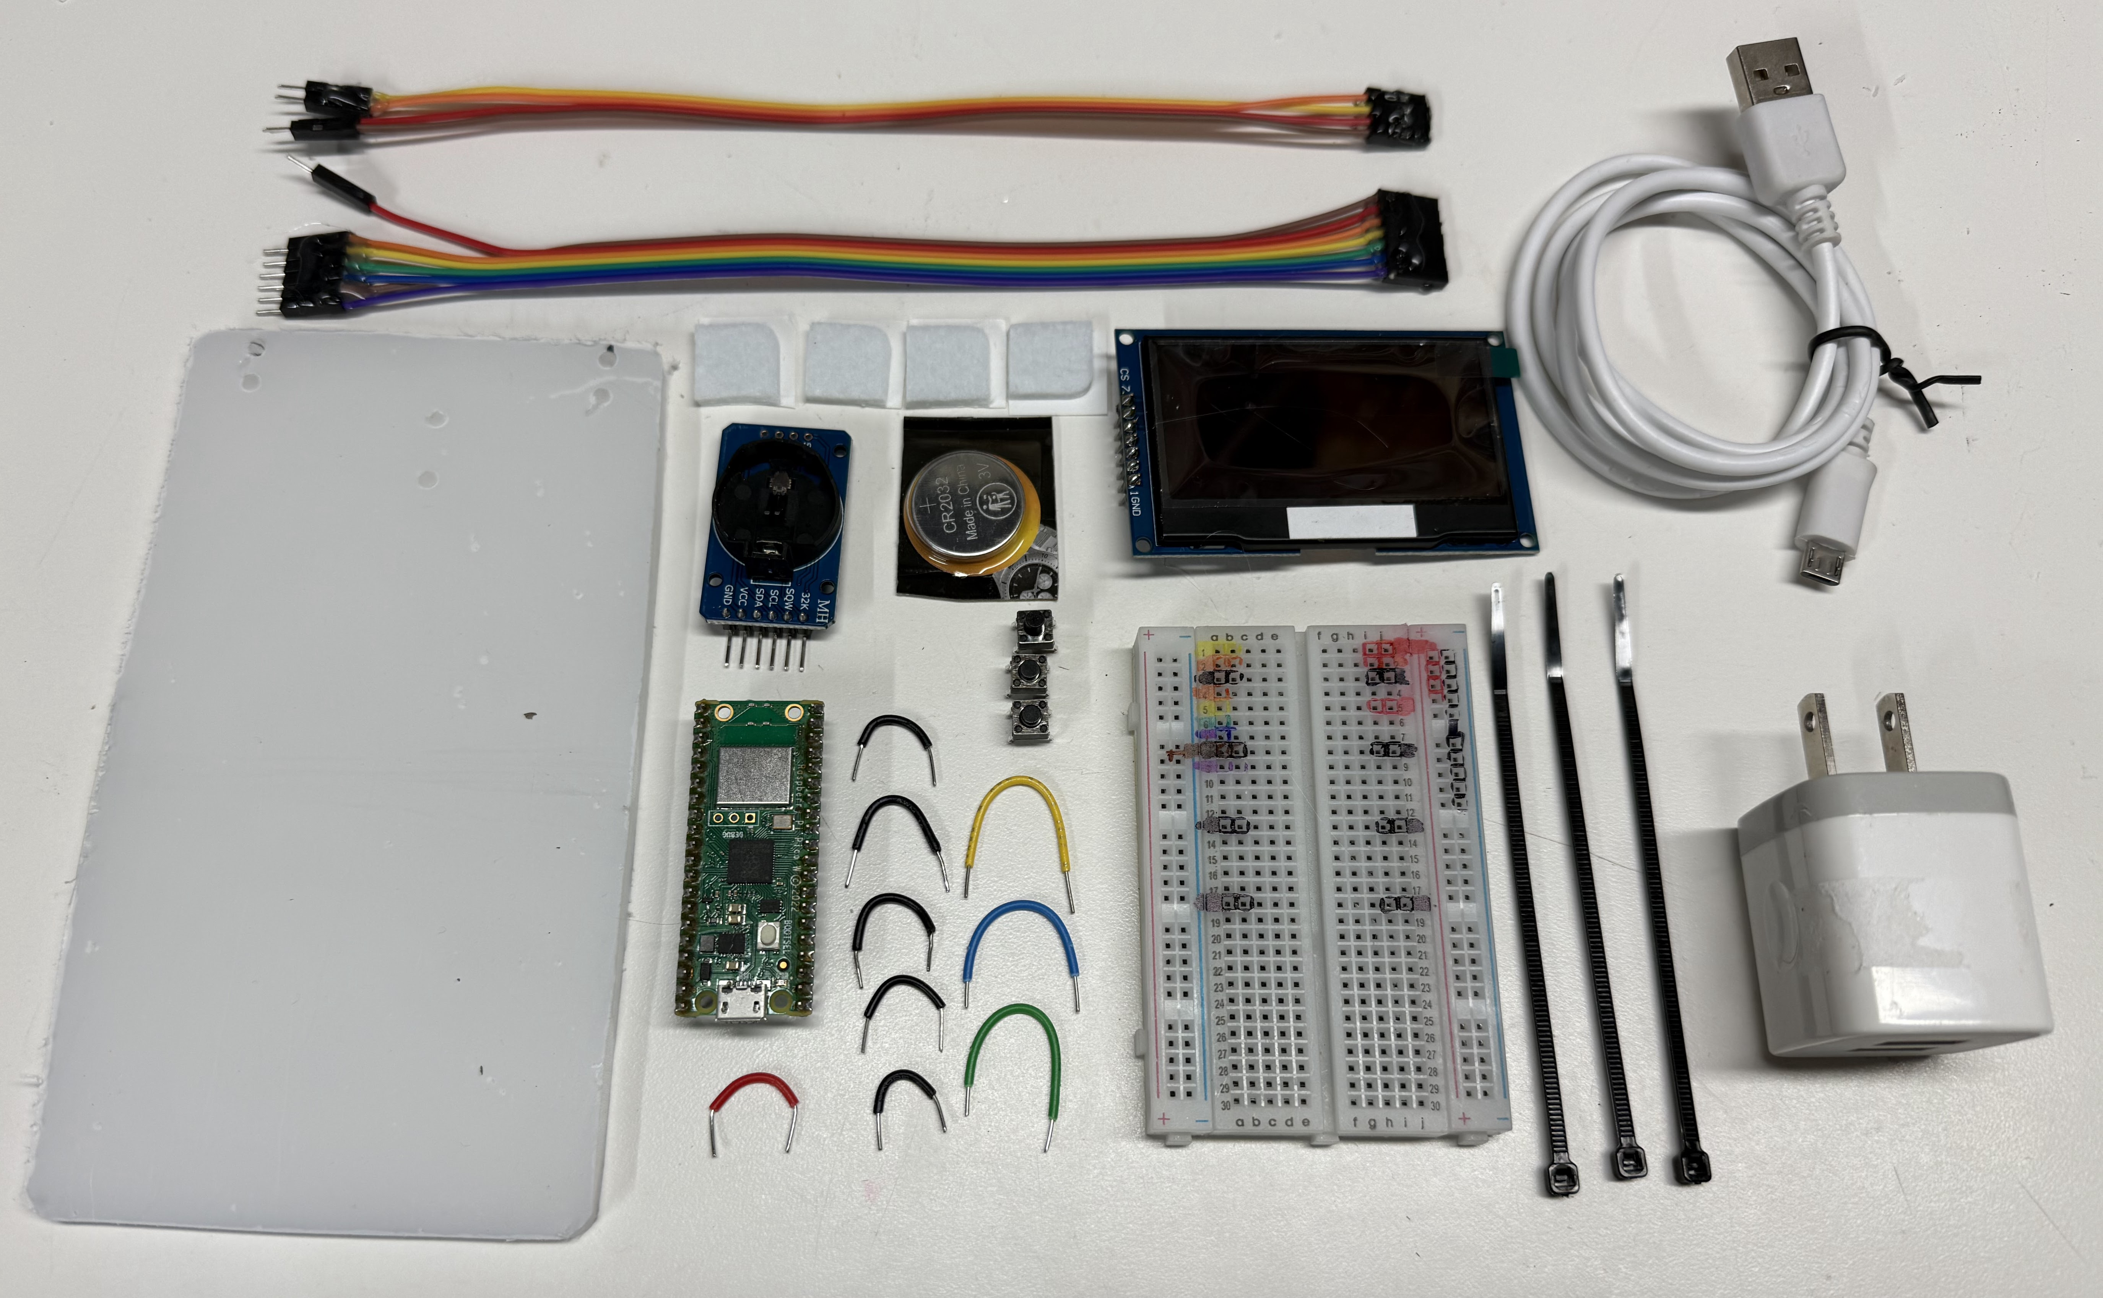
4-wire real-time-clock cable
7-wire display cable
USB Cable
Feet
Front
OLED Display
Coin
Cell
RTC
Right
Left
Buttons
Plexiglass Base
Pico
5V Wall
Adapter
Back
Jumpers
Breadboard
Cable Ties

Slide 2
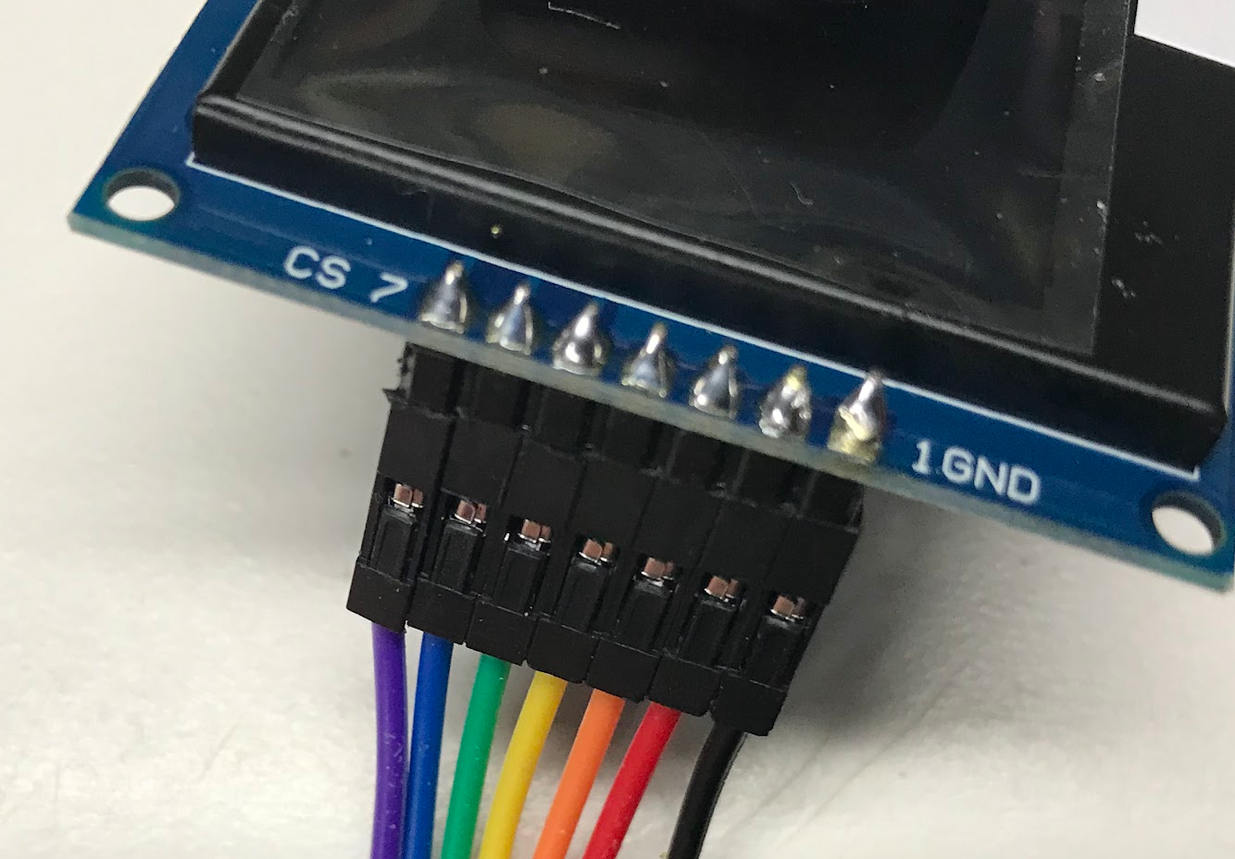
Purple CS
Black GND

Slide 3

GND
Pico

