Slide 1
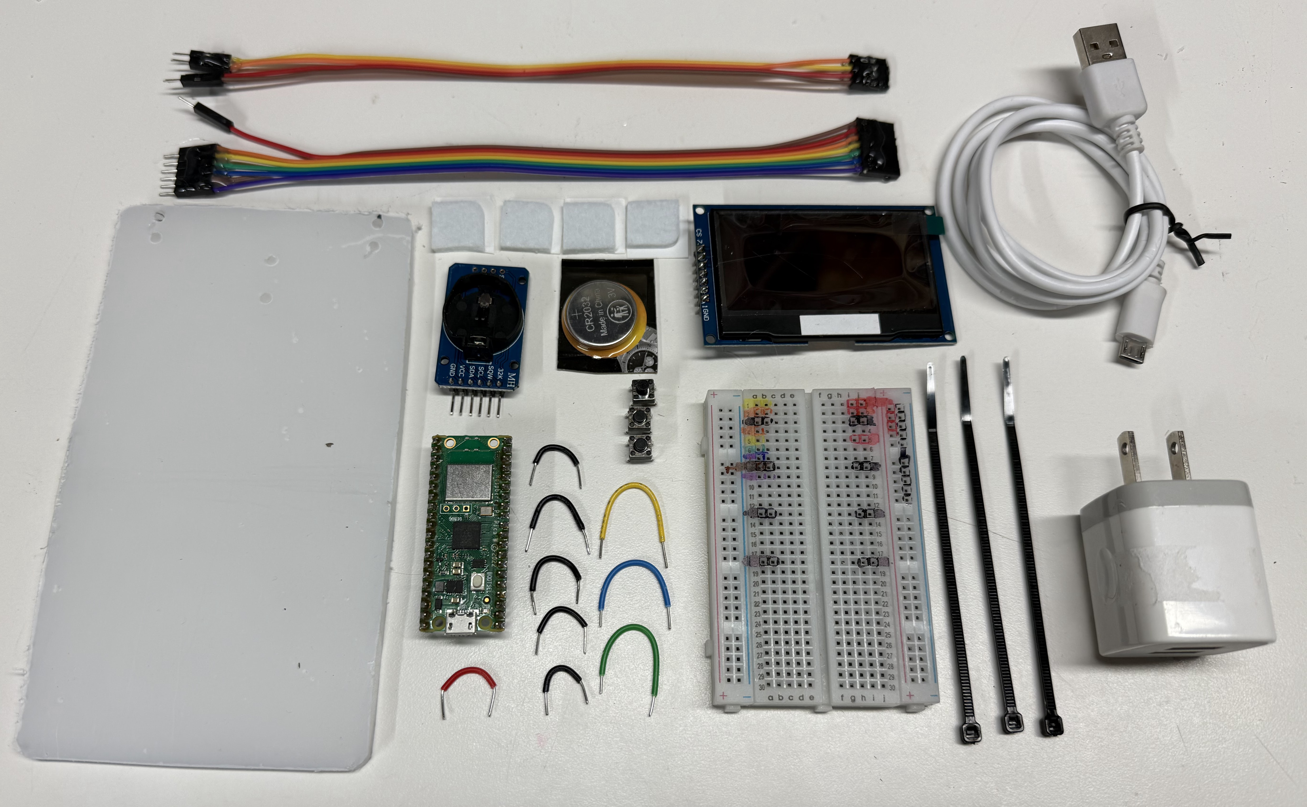
4-wire real-time-clock cable
7-wire display cable
USB Cable
Feet
Front
OLED Display
Coin
Cell
RTC
Right
Left
Buttons
Plexiglass Base
Pico
5V Wall
Adapter
Back
Jumpers
Breadboard
Cable Ties

Slide 2
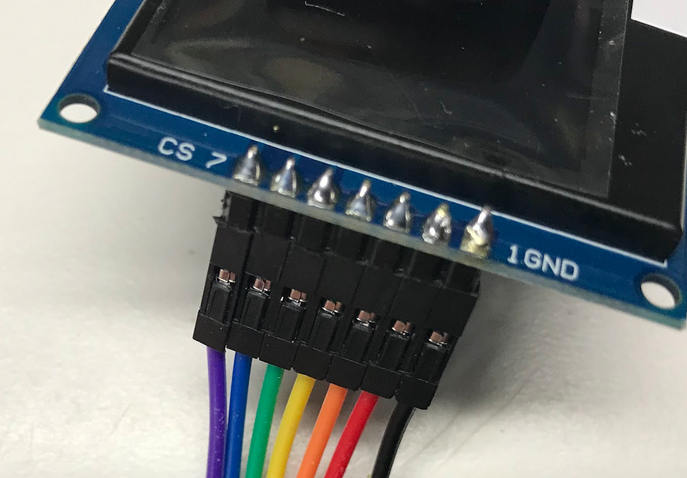
Purple CS
Black GND

Slide 3

GND
Pico

Slide 4
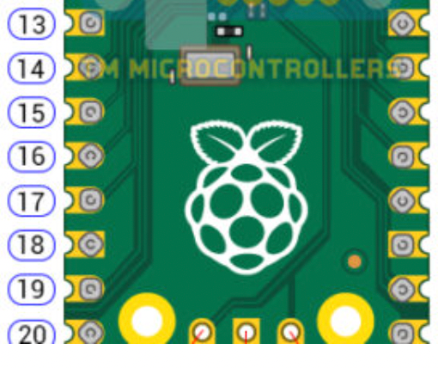
Connection Diagram
USB
Real Time Clock
DS3132
4-wire I2C
Pico
OLED Display
ROW
7-wire SPI
GPIO
GPIO12
GPIO13
GND
GPIO14
GPIO15

