Slide 1
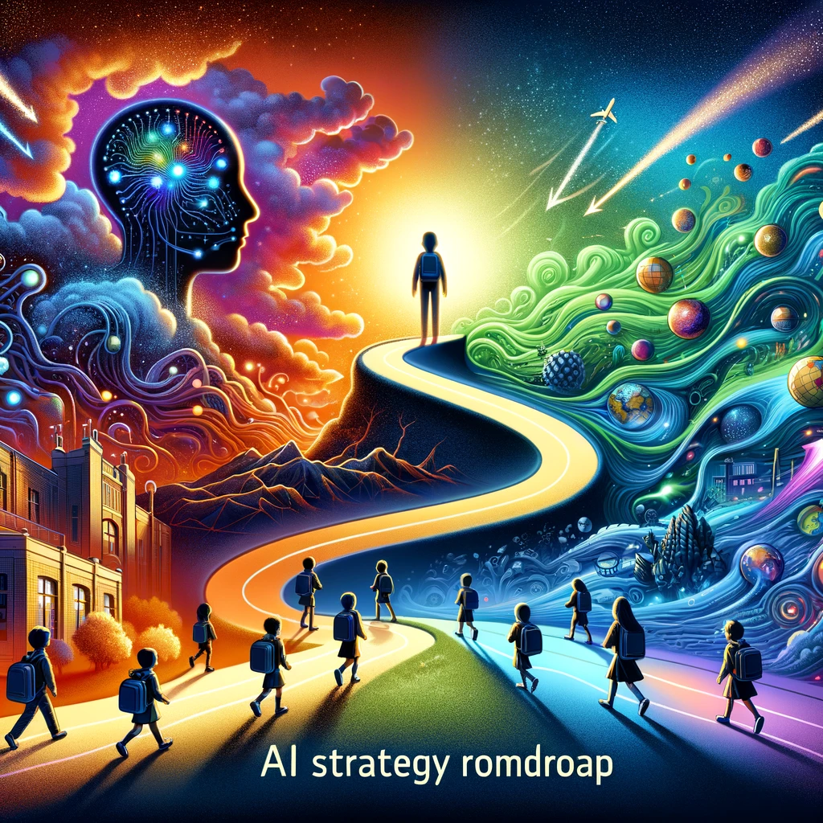
Generative AI Strategy

Slide 2
1. Simple
Prompt
2. Prompt
With Context
3. Drill Down
GenAI Strategy
Roadmap
Repeat

