Slide 1
AI Strategy
Dan McCreary
Version 2.7
Last Updated January 2024

Slide 2
Overview
A good AI strategy needs to be customized to each organization
Every organization is different and their current AI capabilities range from none to experts
We propose a process that helps all organization improve their AI capabilities based on a five-level CMM model
Preforming assessments is a first step
Generating micro-strategies that are appropriate is a next step
Evaluating the effectiveness of micro-strategies is critical

Slide 3
Overall Process
Start
Assessment
CMM Leveling
Micro-Strategies
Measure
Impact
Repeat
The process contains four main steps that are repeated
Assessments can be done on a quarterly bases
Micro-strategies can be suggested by generative AI tools

Slide 4
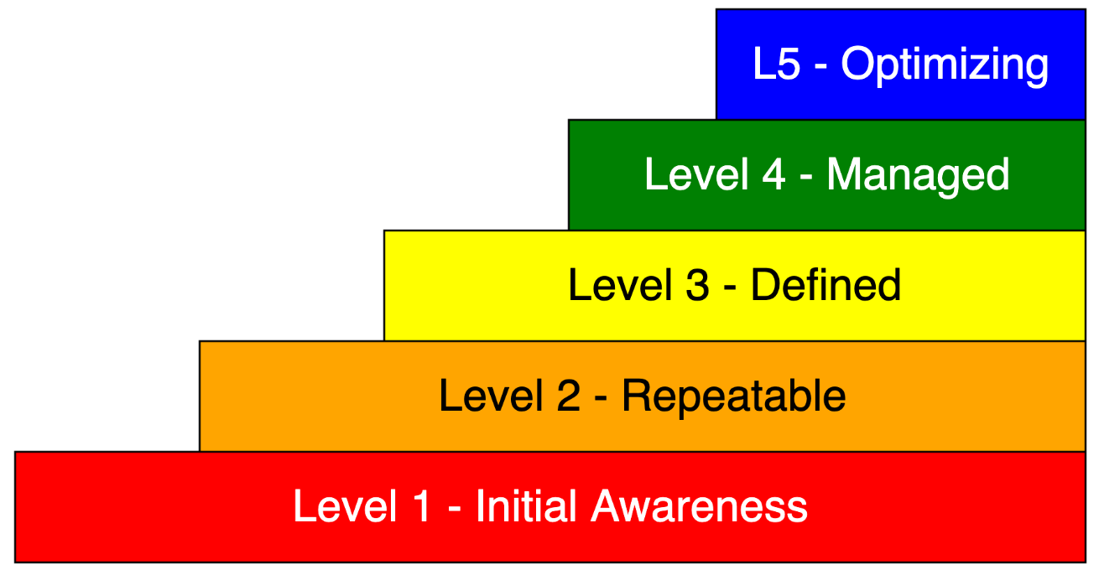
Overview of the CMM Model

Slide 5
Level 1: Initial Awareness
Initial Awareness is characteristic of processes at this level that they are (typically) undocumented and in a state of dynamic change, tending to be driven in an ad hoc, uncontrolled and reactive manner by users or events. This provides a chaotic or unstable environment for the processes.

Slide 6
Level 2: Repeatable
Repeatable is characteristic of this level of maturity that some processes are repeatable, possibly with consistent results. Process discipline is unlikely to be rigorous, but where it exists, it may help to ensure that existing processes are maintained during times of stress.

Slide 7
Level 3: Defined
Defined is characteristic of processes at this level that there are sets of defined and documented standard processes established and subject to some degree of improvement over time. These standard processes are in place. The processes may not have been systematically or repeatedly used - sufficient for the users to become competent or the process to be validated in a range of situations. This could be considered a developmental stage - with use in a wider range of conditions and user competence development the process can develop to next level of maturity.

Slide 8
Level 4: Managed
Managed is characteristic of processes at this level that, using process metrics, effective achievement of the process objectives can be evidenced across a range of operational conditions. The suitability of the process in multiple environments has been tested and the process refined and adapted. Process users have experienced the process in multiple and varied conditions, and are able to demonstrate competence. The process maturity enables adaptions to particular projects without measurable losses of quality or deviations from specifications. Process Capability is established from this level. (Example - surgeon performing an operation hundreds of times with levels of negative outcome approaching zero).

Slide 9
Level 5: Optimized
Optimized is a characteristic of processes at this level that the focus is on continually improving process performance through both incremental and innovative technological changes/improvements. At maturity level 5, processes are concerned with addressing statistical common causes of process variation and changing the process (for example, to shift the mean of the process performance) to improve process performance. This would be done at the same time as maintaining the likelihood of achieving the established quantitative process-improvement objectives.

Slide 10
Level Hopping is Not Realistic

Slide 11
Custom Strategies To Improve
Depending on where you are today,
your micro-strategies will vary.

Slide 12
Level Distribution Histogram
Number of
Organizations
at Level
VC Funded Bay
Area Organizations
State Agencies
In Minnesota
Initial
Repeatable
Defined
Managed
Optimized
80% of companies are at L2: Repeatable

Slide 13
Influence Diagram Graph
CEO
Decision Maker
CIO
Legal
HR
Sales
CFO
R&D
Product
Marketing
The color indicates their awareness of the potential of AI in your organization
The weight of the line shows their influence on the decision maker(s)

Slide 14
Assessment Methods
Automated: Write an agent that scans all company email. Classify each e-mail message on a scale of 1 to 10 to indicate if an employee shows awareness of the capabilities of AI and its impact to your products and customers. Create a weighted total giving more weight to key influencers in your organization.
Manual: Send out a survey. Ask every employee where there are on a scale of 1 to 10 on how aware they are about how AI can impact their organization. Use the same weighting technique to create a score.

Slide 15
Generating Micro-Stragegies
Sample Prompt:
Generate a list of microstrategies. A microstrategy is a small step that we can do to move forward in a strategic direction. It can often be a
simple survey, a contest, a seminar, a presentation, a laptop sticker,
an award or recognition or a prize. I work at a medium-sized company (10,000 employees).
For AI Capability Maturing Model (CMM) we are at level 2 (Repeatable)
with regard to our use of Generative AI (GenAI).
We have a few pilot GenAI projects, but we would
like to move to the next level of maturity (Defined). What microstrategies would you suggest? In the past, we have improved awareness using seminars,
hackathons and recognition awards.
Copy Text

Slide 16
Sample Result of a L2 to L3
1. AI Project Showcase Contest
2. Knowledge Sharing Webinars
3. Cross-Departmental Collaboration Groups
4. GenAI Innovation Award
5. GenAI Process Documentation Drive
6. Monthly GenAI Newsletter and best practices within the organization.
7. GenAI Training Workshops
8. Internal GenAI Consultancy Team (CoE)
Online GenAI Resource Hub
AI for Everyone' Seminar Series
11. Employee GenAI Idea Submission Platform
12. GenAI Project Peer Reviews
13. GenAI Collaboration with External Experts
14. Employee Recognition Program for GenAI Contributions
15. GenAI Use Case Repository
Interactive GenAI Strategy Workshops
Custom GenAI Laptop Stickers
18. Annual GenAI Day
19. GenAI Process Improvement Sprints
20. Feedback Surveys on GenAI Usage

Slide 17
Challenges
Capability-maturity is not really a single scalar value (1 to 5)
Dimensions of AI Maturity
Leadership knowledge of AI
Ability of leaders to create a clear vision of the future using AI
Ability of leaders to communicate this vision in a way the staff will remember the vision (storytelling)
Staff skills – can the organization create and deploy an AI solution?
Regulatory frameworks – can the organization work with legal, security and ethics committees to get their solution approved in a timely manner?

Slide 18
Summary
Creating an AI strategy is a complex process where one-size does not fit every organization
Generative AI is a great way to improve the efficiency of doing organization assessments and suggesting microstrategies
Understanding the decision makers and their influencers is a critical key to success

