Slide 1

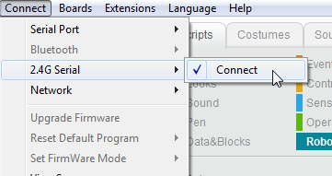
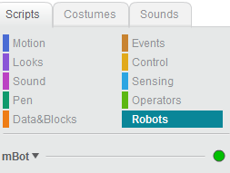

CoderDojo MBot Getting Started Guide
IR Remote
Default Mode:
LED Colors on Robot
(A) White IR Remote / [B] Green Obstacle Avoidance / (C) - Blue - Line Follow
Use numbers on remote to change motor speed (1=slow, 9=fast)
Problems?: Check both AA in robot and CR2025 batteries in remote using battery checker in tool box
Plug 2.4G connector into PC and the blue LED on the mBot daughter board should turn to solid (not blinking)
Startup the mBlock app and click Connect -> 2.4G Serial -> Connect
Verify Green circle on Scripts Tab/Robots controls panel
Run Sample program
Scratch Mode:
Instructors: please reload default mode at the end of class.
Look for Green Circle
Box Inventory:
Robot
2.4 G Dongle
IR Remote
USB Cable
Manual
Figure 8 floor map
Bluetooth Daughter Board (not for large classrooms)
4 AA extra batteries
Connect to 2.4G Serial
Quick Guide for mBlock http://learn.makeblock.com/mbot-get-started Download: http://learn.makeblock.com/mbot-resource-download
Turn LEDs Purple

