Slide 1
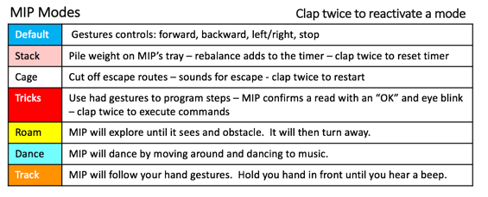
MIP Modes
Clap twice to reactivate a mode
Default | Gestures controls: forward, backward, left/right, stop
Stack | Pile weight on MIP’s tray – rebalance adds to the timer – clap twice to reset timer
Cage | Cut off escape routes – sounds for escape - clap twice to restart
Tricks | Use had gestures to program steps – MIP confirms a read with an “OK” and eye blink – clap twice to execute commands
Roam | MIP will explore until it sees and obstacle. It will then turn away.
Dance | MIP will dance by moving around and dancing to music.
Track | MIP will follow your hand gestures. Hold you hand in front until you hear a beep.
MIP Modes
Clap twice to reactivate a mode
Default | Gestures controls: forward, backward, left/right, stop
Stack | Pile weight on MIP’s tray – rebalance adds to the timer – clap twice to reset timer
Cage | Cut off escape routes – sounds for escape - clap twice to restart
Tricks | Use had gestures to program steps – MIP confirms a read with an “OK” and eye blink – clap twice to execute commands
Roam | MIP will explore until it sees and obstacle. It will then turn away.
Dance | MIP will dance by moving around and dancing to music.
Track | MIP will follow your hand gestures. Hold you hand in front until you hear a beep.

