Slide 1
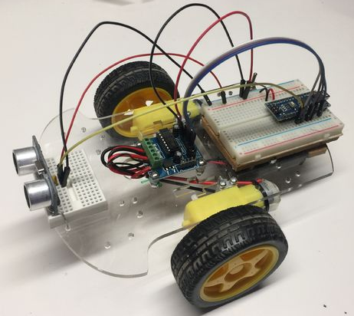
$25 CoderDojo Robot
http://instructables.com
https://bit.ly/2GXgW8I
http://CoderDojoTC.org
dan.mccreary@gmail.com
$25 CoderDojo Robot
http://instructables.com
https://bit.ly/2GXgW8I
http://CoderDojoTC.org
dan.mccreary@gmail.com
$25 CoderDojo Robot
http://instructables.com
https://bit.ly/2GXgW8I
http://CoderDojoTC.org
dan.mccreary@gmail.com
$25 CoderDojo Robot
http://instructables.com
https://bit.ly/2GXgW8I
http://CoderDojoTC.org
dan.mccreary@gmail.com
$25 CoderDojo Robot
http://instructables.com
https://bit.ly/2GXgW8I
http://CoderDojoTC.org
dan.mccreary@gmail.com
$25 CoderDojo Robot
http://instructables.com
https://bit.ly/2GXgW8I
http://CoderDojoTC.org
dan.mccreary@gmail.com
$25 CoderDojo Robot
http://instructables.com
https://bit.ly/2GXgW8I
http://CoderDojoTC.org
dan.mccreary@gmail.com
$25 CoderDojo Robot
http://instructables.com
https://bit.ly/2GXgW8I
http://CoderDojoTC.org
dan.mccreary@gmail.com
$25 CoderDojo Robot
http://instructables.com
https://bit.ly/2GXgW8I
http://CoderDojoTC.org
dan.mccreary@gmail.com
$25 CoderDojo Robot
http://instructables.com
https://bit.ly/2GXgW8I
http://CoderDojoTC.org
dan.mccreary@gmail.com

