Slide 1

Structured Search
Version 4
Dan McCreary
President
Dan McCreary & Associates
dan@danmccreary.com
(952) 931-9198

Slide 2
Presentation Description
Today most document search systems are based on simple keyword search. Their strategy is to extract a list of keywords from documents and use these keywords to match a user’s query.
But the keyword extraction process frequently discards one of the valuable pieces of document information: the context of the keyword. Context allows you to rank a keyword in a title higher than a keyword in the body of a text. This allows relevant documents to receive a higher ranking than other documents in a large document collection. Retaining document structure with keywords allows context to be preserved in the search and retrieval process and allows sub-documents to receive customized search ranking rules.
This presentation give a broad overview of structured search and describes how organizations are using document structure to create a better search experience for corporate search.

Slide 3
After This Presentation Users Will Be Able To:
Identify the differences between keyword-only and structured search
Understand the benefits and costs of structured search
Understand how structured search improves search precision and relevancy
Describe typical business situations where structured search has benefits
Describe how non-technical business users can create customized search solutions
Understand how products and vendors are implementing structured search solutions

Slide 4
Background for Dan McCreary
Enterprise data architecture consultant
Builds open source metadata registries using (ISO/IEC 11179) and US Federal XML standards (NIEM.gov)
Interested in Semantic Web technologies
Coined the term "XRX" (XForms-REST-XQuery)
Was looking for a better search tool for metadata registries
"what you can't find gets duplicated…"

Slide 5
How Many People…
Have heard of a company called "Google"?
Think that "search" is one of the most important technologies in Enterprise Information Management (EIM)?
Think that most corporations have a high-quality search on their Intranet?
Would like to go to a single web search page and perform a search on both documents and data?
Have ever heard the phrase "a little bit of semantics goes a long way"?

Slide 6
Structured Search
Definition:
A method of using the structure of a document to help users find the right documents in a large collection of documents.
But first a story……

Slide 7
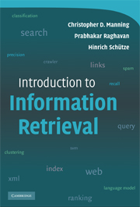
Information Retrieval Textbook
Introduction to Information Retrieval
by Christopher D. Manning, Prabhakar Raghavan and Hinrich Schütze
Cambridge University Press, 2008
http://nlp.stanford.edu/IR-book/information-retrieval-book.html

Slide 8
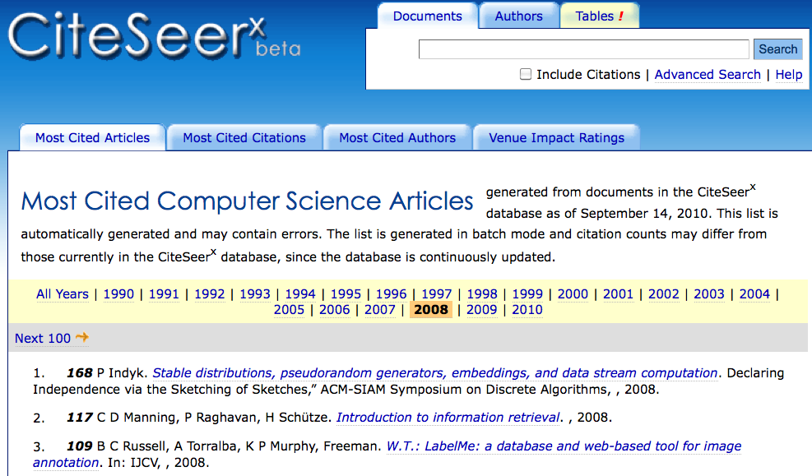
117 Citations in Computer Science
With 117 citations, the "Intro to IR" book is the second most cited Computer Science reference published in 2008.

Slide 9
Table 10.1
 | RDB search | unstructured retrieval | structured retrieval
objects | records | unstructured documents | trees with text at leaves
model | relational model | vector space & others | ?
main data structure | table | inverted index | ?
queries | SQL | free text queries | ?
XML - Table 10.1 and structured information retrieval. SQLRDB (relational database) search, unstructured information retrieval

Slide 10
Excerpt from IR Book…
There is no consensus yet as to which methods work best for structured retrieval although many researchers believe that XQuery will become the standard for structured queries.
- published 2008
- two years later…we have the answer...

Slide 11
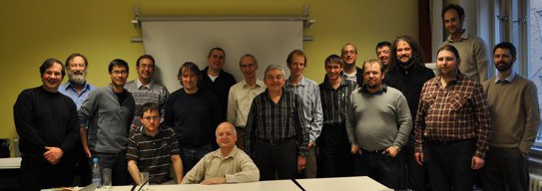
eXist Native XML Developers
eXist Meeting Prague March 12th, 2010

Slide 12
Presentation Outline
Background
Boolean (SQL) search
Keyword (Vector) search
Reverse indexes
Structured search
How it works
Benefits and challenges
How to empower non-programmers
How to setup up structured search pilot project
Resources for getting started
eXist case studies

Slide 13
Table 10.1 - Revised
 | RDB search | unstructured retrieval | structured retrieval
objects | records | unstructured documents | trees with text at leaves
model | relational model | vector space & others | XML hierarchy
main data structure | table | inverted index | trees with node-ids for document ids
queries | SQL | free text queries | XQuery fulltext
XML - Table 10.1 and structured information retrieval. SQLRDB (relational database) search, unstructured information retrieval

Slide 14
Relational DB Boolean Search
Exact match on tabular data
No "score" associated with each "hit"
Example from SQL:
SELECT * FROM PERSON
WHERE TITLE = 'manager'
ORDER BY SALARY
Note that the "order" is not the quality of a mach
but another column in a table

Slide 15
Vector Model
Your search keyword (green)
Other documents (blue)
Search score is distance measurement (red)
Keyword 1
Keyword 2
Every search query is a "vector" in keyword space
Distance from your query to documents are "scored"

Slide 16
Reverse Index
Word | Document IDs
hate | 12344, 34235, 43513,
love | 12344, 34235, 43513, 22345, 12313, 42345, 12313, 13124
For each word, a reverse index tells you what documents contain that word.

Slide 17

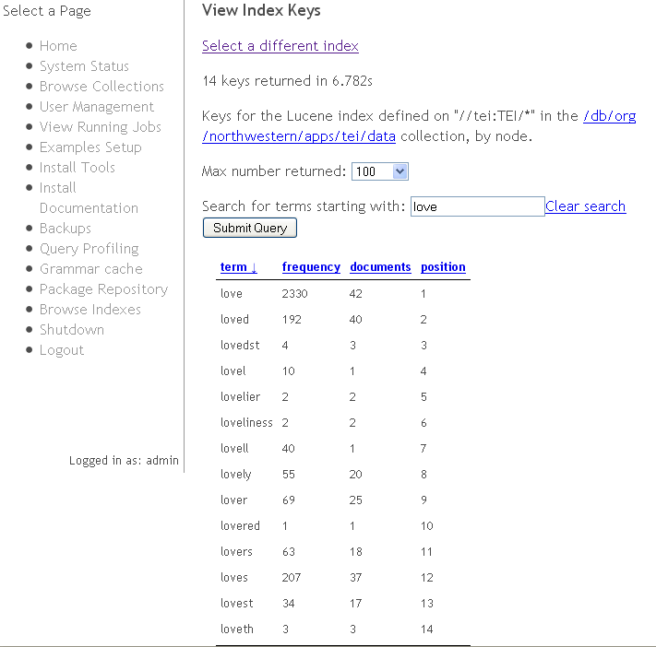
Reverse Index in eXist 1.5
Terms that
start with "love"

Slide 18

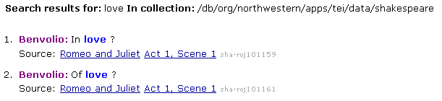
Sample Keyword Search
Keyword Search:
Resulting Hits:
Code (XQuery):
$hits := collection($data-collection)/tei:TEI//tei:l[ft:query(., $q)]
for $hit in $hits let $score := ft:score($hit) order by $score descending return <li class="hit-result">

Slide 19
Calculating Score
Count the number of times the keywords appeared in each of the documents
Calculate the size of the documents
Calculate the "density" of the keywords in the documents
this prevents longer documents from getting higher scores
Sort by the combined density numbers

Slide 20
How is "Structured Search" Different?
Most search engines today perform simple "keyword searches" and rank the scores based on keyword density
In simple "keyword search" there is no consideration about where the keywords appear in the document
There is no way to "boost" the search score if a keyword appears in a title, abstract or summary

Slide 21
Two Models
"Bag of Words"
"Retained Structure"
doc-id
keywords
keywords
'love'
keywords
keywords
'hate'
keywords
'new'
'fear'
keywords
All keywords in a single container
Only count frequencies are stored with each word
Keywords associated with each sub-document component

Slide 22
Keywords and Node IDs
document-id
Node-id
keywords
Node-id
keywords
Node-id
keywords
Node-id
keywords
Node-id
keywords
Node-id
keywords
Keywords in the reverse index are now associated with the node-id in every document

Slide 23
Subdocuments
Large documents are "decomposed" into many separate documents
Each subdocument is given its own document identifier (node-id)
Rules are set up to "score" hits on different components of the documents
But do most documents have structure?

Slide 24
Books Have Structure
Chapter 1
Title
Body
Chapter 2
Title
Body
Chapter 3
Title
Body
Book Title
Book Metadata

Slide 25


Presentations Have Structure
Title
Text
Title
Text
Title
Text
Find all slides with the word "XML" in their title

Slide 26
E-mail has structure
From: John Smith
To: All IT Staff
Subject: Findings of Search Survey
We just got the results back from our survey on intranet search effectiveness. Although some users were satisfied most users said that it took them over 15 minutes to find a documents they were looking for. That means that our firm spends over $1,000,000 each year in lost productivity due to our lack of good search tools on our internal documents….

Slide 27
Sample of XML
<PLAY> <TITLE>The Tragedy of Romeo and Juliet</TITLE> <PERSONAE> <TITLE>Dramatis Personae</TITLE> <PERSONA>ESCALUS, prince of Verona. </PERSONA> <PERSONA>PARIS, a young nobleman, kinsman to the prince.</PERSONA> <PGROUP> <PERSONA>MONTAGUE</PERSONA> <PERSONA>CAPULET</PERSONA> <GRPDESCR>heads of two houses at variance with each other.</GRPDESCR> </PGROUP> <PERSONA>An old man, cousin to Capulet. </PERSONA> <PERSONA>ROMEO, son to Montague.</PERSONA> <PERSONA>MERCUTIO, kinsman to the prince, and friend to Romeo.</PERSONA> <PERSONA>BENVOLIO, nephew to Montague, and friend to Romeo.</PERSONA> <PERSONA>TYBALT, nephew to Lady Capulet.</PERSONA>

Slide 28

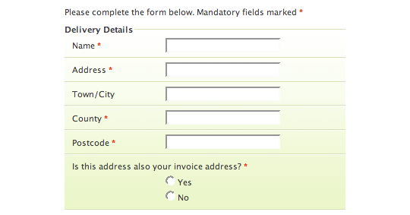
Many Objects Have Structure
Spreadsheets
Find all spreadsheets with a first row cell that contains the word "SSN"
Find all forms with a label of "Zipcode"

Slide 29

But What About Microsoft Office?
Structured search will only take off when our standardize office documents use XML…
ECMA-376
Office Open XML (also informally known as OOXML or OpenXML) is a zipped, XML-based file format developed by Microsoft for representing spreadsheets, charts, presentations and word processing documents.
File extensions: .docx, .xlsx, .pptx are zipped folders that contain XML files

Slide 30
Open Document XML Formats
.odt for word processing (text) documents
.ods for spreadsheets
.odp for presentations
.odb for databases
.odg for graphics
.odf for formula, mathematical equations

Slide 31
Benefits
Better search precision and recall
Find the documents you are looking for faster
Avoid the inclusion of documents you are not interested in
Actual
Search
Results
Missed
Document
Target documents
Other documents

Slide 32
Results from Studies
"Bag-of-words" vs. "full structure"
63% improvement in top 5 hits
39% improvement in top 10 hits
5% improvement in top 20 hits
.3% improvement in top 30 hits
Source: INEX 2003/2004

Slide 33
Tibetan Buddhist Resource Center (TBRC)
Contacts: Chris Tomlinson (Technical Lead) and
Jeffery Wallman (Executive Director)
Project: Mercury and Dharmacloud
Description:
Multi-lingual (English, Tibetan and Chinese) web presence for TBRC: http://tbrc.org.
Use of eXist and Lucene fulltext indexes
Tibetan Buddhism documents about Works, Outlines, Persons, Places, Topics etc.
Search metadata on seven million scanned pages of Tibetan texts
Searching relies on both eXist range indexes and Lucene to search both Unicode and transliterated Tibetan content in a various fields such as titles, personal names, topics, colophons etc.
Boost values placed on titles and names.
Combination of indexes (keyword and N-gram) is critical
Impact: 5 of 5
1 (low)
5 (high)

Slide 34
Woodruff Library, Emory University
Contact: Dr. Rebecca Sutton Koeser
Project: Emory University Finding Aids
Description:
Tools to help researchers find manuscripts within the library
Performs searches of Encoded Archival Description (EAD) XML documents or "Finding Aids" for archival and manuscript collections
The most relevant results are now showing up in the first few hits rather than in the first few pages
For documents like EAD, the structure and organization of the document is very significant and affects how the systems present and search the content
Having the ability to combine the power of Lucene searching in with XQuery and eXist's native XML handling makes for a potent combination
Impact: 4 out of 5
1 (low)
5 (high)

Slide 35
Challenges
Difficult to convert some documents in XML format (e.g. PDF)
What items should be returned in a search "hit"
Search rules are not easy to set up if you do not have uniform structure
Many search systems are not optimized for high-volume transactions (locking)

Slide 36
Getting Data into XML
Convert RDBMS data into XML using "data web services"
Use "Apache POI filters" to convert documents to XML
Begin with XML standards
Use existing XML Schemas
XForms
Native-XML databases

Slide 37
What to Return in a Hit
Best Practice: return the lowest level node in the document that contains a hit
Example:
Series
Book
Chapter
Section
Subsection
Conference
Presentation
Slide Group
Slide
Bullet Item
Allow searchers to specify level with search options

Slide 38
Steps in Testing Structured Search
Convert documents to a format that retains hierarchical structure (xml)
Treat each "branch" as its own sub-document
Give each branch a globally distinct type and a "node-id" or document ID
Index keywords using re-index function
Set up "weights" based on branch types
Store the node ids in the reverse index

Slide 39
Steps in Structured Search Project
ROI Analysis – costs of not finding information
Pilot Project Selection
Structure Extraction
Structure Storage
Document Consistency
Assignment of "boost" values
Tuning of boost values for precision and recall
ROI Analysis
Repeat

Slide 40
Sample Queries
//SPEECH[ft:query(., 'love')]
Find all "SPEECH"
elements
that contains
the keyword 'love'
(predicate or "WHERE" clause)

Slide 41
Near Operator
let $query := <query> <near slop="20"> <term>snake</term> <near>tongue dog</near> </near> </query>
return //SPEECH[ft:query(., $query)]

Slide 42
Skillsets Needed for Pilot Project
Users must "know their data"
Subject-matter-experts
Should be familiar with XML data types
Need about a week of training with XQuery (depending on background)

Slide 43
Predictions
Structured search…
when combined with open source tools for extracting "entities" (e.g. Apache UIMA)
and machine learning (e.g. Weka)
and carefully managed taxonomies
…will have a large impact on corporate search strategies in the next 10 years

Slide 44
Steps to Run Examples
Download XML database (eXist)
Load examples
Use "Sandbox"
Drag new XML documents into eXist WebDAV folder
Configure index file and reindex
Run XQuery

Slide 45
Sample Configuration File
<collection xmlns="http://exist-db.org/collection-config/1.0"> <index xmlns:tei="http://www.tei-c.org/ns/1.0"> <lucene> <!-- Use the standard analyzer will ignore stopwords like 'the', 'and' --> <analyzer class="org.apache.lucene.analysis.standard.StandardAnalyzer"/> <text match="//tei:TEI/*"/> <text match="//tei:title" boost="3.0"/> </lucene> </index> </collection>
Example of boost on title

Slide 46
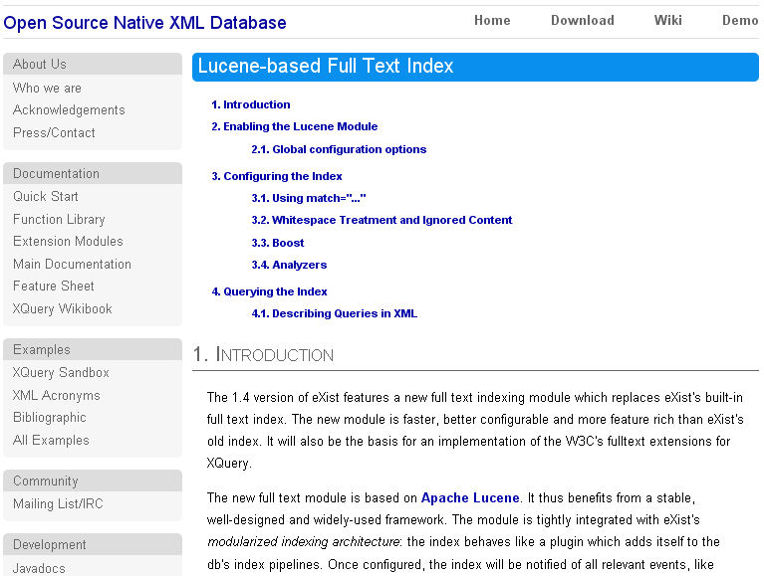

Slide 47
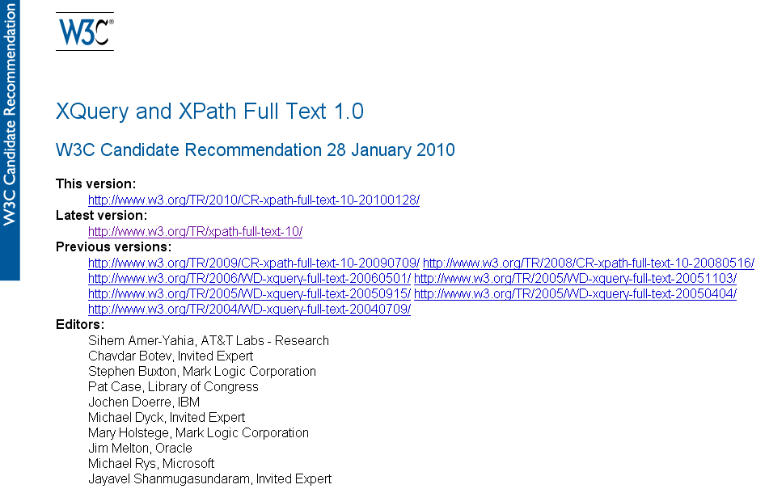
XQuery Fulltext

Slide 48
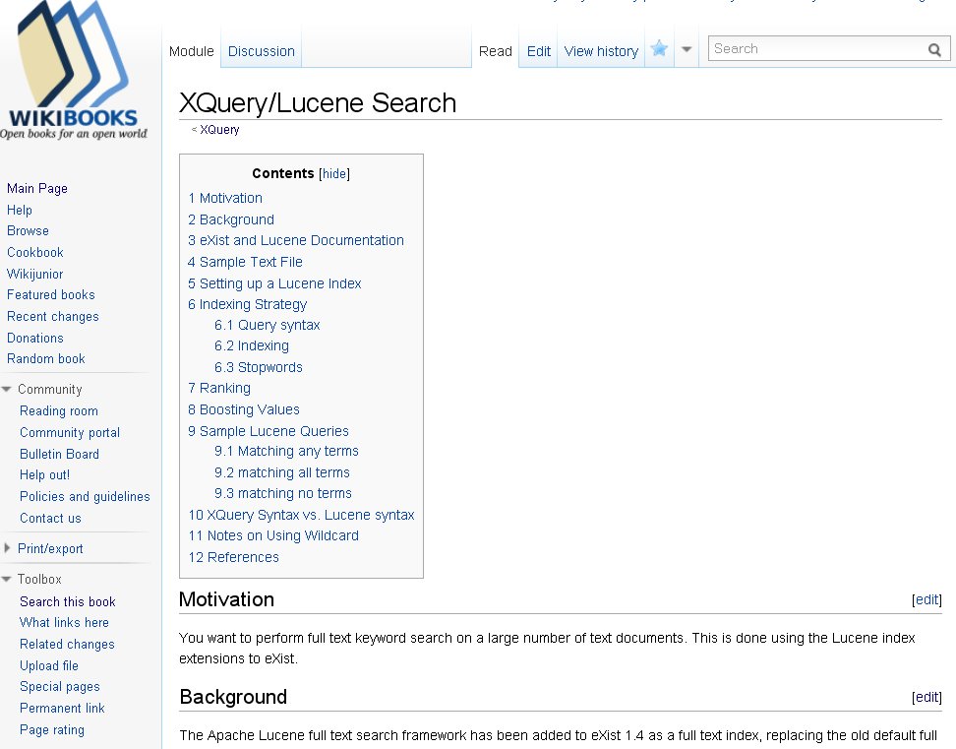
XQuery/Lucene Search Wikibook

Slide 49
Acknowledgements
Wolfgang Meier
Wrote Lucene implementation used in eXist 1.4
Dr. Joe Wicentowski
US Department of State Office of the Historian
eXist index browser (eXist 1.5 release)
Dr. Martin Mueller
Northwestern University
Supplied Shakespeare in TEI format
Ron Van den Branden
Royal Academy of Dutch Language and Literature
Wrote Wikibook "how to" article for Lucene search
eXist core development team

Slide 50
References
W3C XML standards
Intro to Information Retrieval Textbook
Lucene web site
eXist web site
XQuery Wikibook
eXist Lucene implementation
W3C XQuery
W3C XQuery/XPath Fulltext extensions
Send e-mail to dan@danmccreary.com for extended
list of "getting started" resources.

Slide 51
Questions?
Dan McCreary
President
Dan McCreary & Associates
dan@danmccreary.com
(952) 931-9198

