Slide 1
Sample Auto-generated XForms With XQuery Date: 1/17/2009
Dan McCreary
President
Dan McCreary & Associates
dan@danmccreary.com
(952) 931-9198
M
D
Metadata Solutions

Slide 2
Agenda/Objective
Demonstrate Samples of Auto-generated XForms
Simple Forms are Simple
Complex Forms are ….Complex

Slide 3

A Simple XML Schema
<xs:schema xmlns:xs="http://www.w3.org/2001/XMLSchema">
<xs:element name="simple-test">
<xs:annotation>
<xs:documentation>A simple XML Schema.</xs:documentation>
</xs:annotation>
<xs:complexType>
<xs:sequence>
<xs:element name="element1"/>
<xs:element name="element2"/>
</xs:sequence>
</xs:complexType>
</xs:element>
</xs:schema>

Slide 4
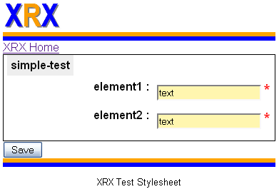
Auto-generated Form

Slide 5
Sample Source (no CSS)
<html xmlns="http://www.w3.org/1999/xhtml" xmlns:ev="http://www.w3.org/2001/xml-events" xmlns:xs="http://www.w3.org/2001/XMLSchema" xmlns:xf="http://www.w3.org/2002/xforms">
<head>
<title>XForms application generated from constraint schema.</title>
<xf:model>
<xf:instance xmlns="" id="default-instance" src="/exist/rest/db/xrx/modules/test-input-instances/01-simple-test.xml"/>
<xf:bind nodeset="//element1" required="true()"/>
<xf:bind nodeset="//element2" required="true()"/>
<xf:submission id="save" method="post" action="save-new.xq" instance="default-instance"/>
</xf:model>
</head>
<body>
<xf:group ref="/simple-test">
<xf:label class="group-label">simple-test</xf:label>
<xf:input ref="element1" class="element1">
<xf:label>element1 : </xf:label>
</xf:input>
<xf:input ref="element2" class="element2">
<xf:label>element2 : </xf:label>
</xf:input>
</xf:group>
<xf:submit submission="save">
<xf:label>Save</xf:label>
</xf:submit>
</body>
</html>

Slide 6
Omitted For Clarity
CSS Link
Header div
Breadcrumb div
Footer div

Slide 7
What Was Omitted
<link type="text/css" rel="stylesheet" href="/exist/rest/db/xrx/resources/css/style.css"/>
<div class="header">
<img src="/exist/rest/db/xrx/resources/images/xrx-logo.jpg" alt-text="XRX Logo" height="40px"/>
<div class="horiz-bar-orange"/>
<div class="horiz-bar-blue"/>
</div>
<span class="breadcrumb">
<a href="/exist/rest/db/xrx/index.xq">XRX Home</a>
</span>
<div class="footer">
<div class="horiz-bar-orange"/>
<div class="horiz-bar-blue"/>
<p class="footer-text">XRX Test Stylesheet</p>
</div>

Slide 8
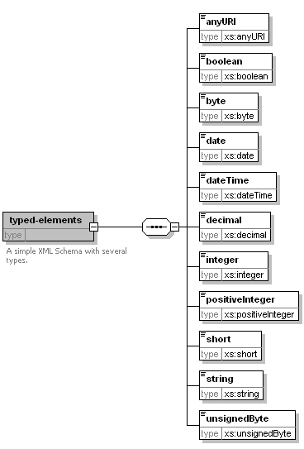
Types Simple Elements

Slide 9
Typed Elements
<xs:schema xmlns:xs="http://www.w3.org/2001/XMLSchema" elementFormDefault="qualified" attributeFormDefault="unqualified">
<xs:element name="typed-elements">
<xs:annotation>
<xs:documentation>A simple XML Schema with several types.</xs:documentation>
</xs:annotation>
<xs:complexType>
<xs:sequence>
<xs:element name="anyURI" type="xs:anyURI"/>
<xs:element name="boolean" type="xs:boolean"/>
<xs:element name="byte" type="xs:byte"/>
<xs:element name="date" type="xs:date"/>
<xs:element name="dateTime" type="xs:dateTime"/>
<xs:element name="decimal" type="xs:decimal"/>
<xs:element name="integer" type="xs:integer"/>
<xs:element name="positiveInteger" type="xs:positiveInteger"/>
<xs:element name="short" type="xs:short"/>
<xs:element name="string" type="xs:string"/>
<xs:element name="unsignedByte" type="xs:unsignedByte"/>
</xs:sequence>
</xs:complexType>
</xs:element>
</xs:schema>

Slide 10
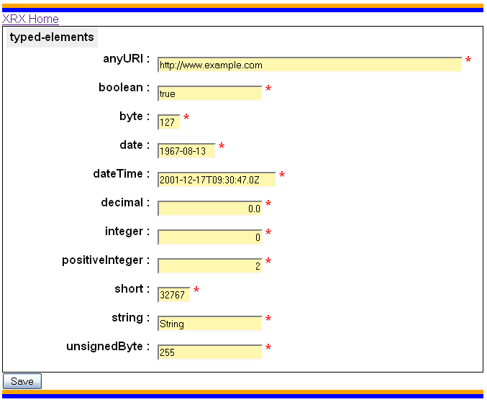
Typed Elements Form

Slide 11
Generated Elements with class Attribute
<xf:group ref="/typed-elements">
<xf:label class="group-label">typed-elements</xf:label>
<xf:input ref="anyURI" class="anyURI">
<xf:label>anyURI : </xf:label>
</xf:input>
<xf:input ref="boolean" class="boolean">
<xf:label>boolean : </xf:label>
</xf:input>
<xf:input ref="byte" class="byte">
<xf:label>byte : </xf:label>
</xf:input>
<xf:input ref="date" class="date">
<xf:label>date : </xf:label>
</xf:input>
<xf:input ref="dateTime" class="dateTime">
<xf:label>dateTime : </xf:label>
</xf:input>
<xf:input ref="decimal" class="decimal">
<xf:label>decimal : </xf:label>
</xf:input>
<xf:input ref="integer" class="integer">
<xf:label>integer : </xf:label>
</xf:input>
<xf:input ref="positiveInteger" class="positiveInteger">
<xf:label>positiveInteger : </xf:label>
</xf:input>
<xf:input ref="short" class="short">
<xf:label>short : </xf:label>
</xf:input>
<xf:input ref="string" class="string">
<xf:label>string : </xf:label>
</xf:input>
<xf:input ref="unsignedByte" class="unsignedByte">
<xf:label>unsignedByte : </xf:label>
</xf:input>
</xf:group>
Each input control has a class with an attribute that is indicative of its data type.

Slide 12
Sample CSS
/* make a URI wide for long URLs */ .anyURI .xf-value, .xs\:anyURI .xf-value {width: 60ex;}
.byte .xf-value, .xs\:byte .xf-value {width: 4ex;} .date .xf-value, .xs\:date .xf-value {width: 11ex;} .dateTime .xf-value, .xs\:dateTime .xf-value {width: 23ex;} .short .xf-value, .xs\:short .xf-value {width: 6ex;} /* align all the numerics to the right */ .decimal .xf-value, .xs\:decimal .xf-value, .integer .xf-value, .xs\:integer .xf-value, .positiveInteger .xf-value, .xs\:positiveInteger .xf-value {text-align: right;}
Stylesheets are designed to work with and without namespace prefix

Slide 13
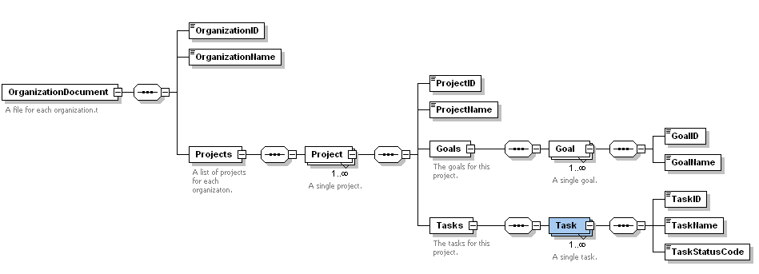
Complex XML Schemas

Slide 14
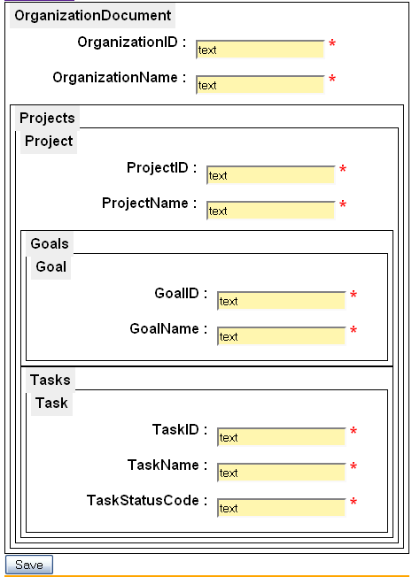
Nested Groups

Slide 15
Group with ref attribute
<xf:group ref="/OrganizationDocument">
<xf:label class="group-label">OrganizationDocument</xf:label>
<xf:input ref="OrganizationID" class="OrganizationID">
<xf:label>OrganizationID : </xf:label>
</xf:input>
<xf:input ref="OrganizationName" class="OrganizationName">
<xf:label>OrganizationName : </xf:label>
</xf:input>
<xf:group ref="/OrganizationDocument/Projects">
<xf:label class="group-label">Projects</xf:label>
<xf:group ref="/OrganizationDocument/Projects/Project">
<xf:label class="group-label">Project</xf:label>
<xf:input ref="ProjectID" class="ProjectID">
<xf:label>ProjectID : </xf:label>
</xf:input>
<xf:input ref="ProjectName" class="ProjectName">
<xf:label>ProjectName : </xf:label>
</xf:input>
<xf:group ref="/OrganizationDocument/Projects/Project/Goals">
<xf:label class="group-label">Goals</xf:label>
<xf:group ref="/OrganizationDocument/Projects/Project/Goals/Goal">
<xf:label class="group-label">Goal</xf:label>
<xf:input ref="GoalID" class="GoalID">
<xf:label>GoalID : </xf:label>
</xf:input>

Slide 16
Recursion Techniques
(: recursive test function to process all complex elements in an XML Schema :) declare function s2f:group-hier($complex-element as node(), $base as xs:string) as node() { let $element-name := concat(string($complex-element/@name), string($complex-element/@ref)) return (: if there are any complex types under this complex type - recurse:) if ($complex-element/xs:complexType) then <xf:group ref="{concat($base, '/', $element-name)}"> <xf:label class="group-label">{$element-name}</xf:label> { for $sub-element in $complex-element/xs:complexType/*/xs:element return s2f:group-hier($sub-element, concat($base, '/', $element-name)) }</xf:group> else (s2f:element-name-to-xforms-type($element-name)) };

Slide 17
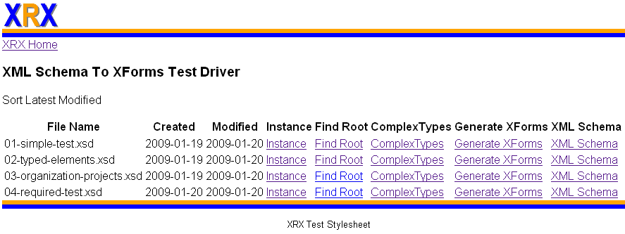
Test Driver

Slide 18
Known Issues
Finding the root element
Processing include files
Dealing with refs
Required instance generation
Using <xf:repeat nodeset=“xpath”>
when there is multiple cardinality

Slide 19
Thank You!
Please contact me for more information:
Native XML Databases
Metadata Management
Metadata Registries
Service Oriented Architectures
Business Intelligence and Data Warehouse
Semantic Web
Dan McCreary, President
Dan McCreary & Associates
Metadata Strategy Development
dan@danmccreary.com
(952) 931-9198

