Slide 1

No SQL Metadata Management
October 20th, 2010
Dan McCreary
President
Dan McCreary & Associates
dan@danmccreary.com

Slide 2
Presentation Description
Metadata, or data that describes data, is fundamentally different than data itself. The management of metadata is becoming a strategic area for many organizations and the topic of data governance is also becoming central to the data strategies for many organizations.
This presentation will look at how the requirements of enterprise metadata management dictate that new schema-free web application architectures be better suited to the task of metadata management. These new “zero translation” architectures combine some of the best aspects of document management systems and traditional tabular data management but without the complexity of traditional multi-tier architectures.
We will give examples of how these new XML-centric architectures are being used to solve metadata management challenges and how they empower non-programmers to build and maintain metadata registries.

Slide 3
Outline
Part 1
Background on NO-SQL
What is metadata?
Enterprise Metadata Management (EMM) requirements
Role of agility
Why XRX systems are agile
Part 2
Tour of a native XML system and a metadata registry
XQuery, REST and XForms
XML web services
How empower Bas and other non-programmers
How to start a pilot project
Questions

Slide 4
After This Presentation Users Will Be Able To:
Define metadata and compare and contrast metadata management with data management
Describe the high-level features of enterprise metadata management systems
Differentiate between metadata repositories and metadata registries
Understand the role of duplication in managed metadata environments
Understand the role of ISO-Standards in metadata management
Describe the major application architectures and the number of data translations used in each architecture
Define "Zero translation" application architectures
Define metadata agility and the metrics used to measure metadata agility
Describe the XRX architecture and XML search
Understand the role of native xml systems and the XQuery language
Access resource for creating a pilot metadata registry project

Slide 5
Background for Dan McCreary
Enterprise data architecture consultant based in Minneapolis
Strong interest in enterprise metadata management and semantic web
Builds metadata registries using ISO/IEC 11179 and US Federal XML standards (NIEM.gov)
Customers: CriMNet/BCA, MN Dept. of Education, MN Dept. of Revenue, Thrivent Financial, Patriot Data Systems, US Department of State, MN Historical Society, US Library of Congress, Mindware, Syntactica, Surescripts

Slide 6
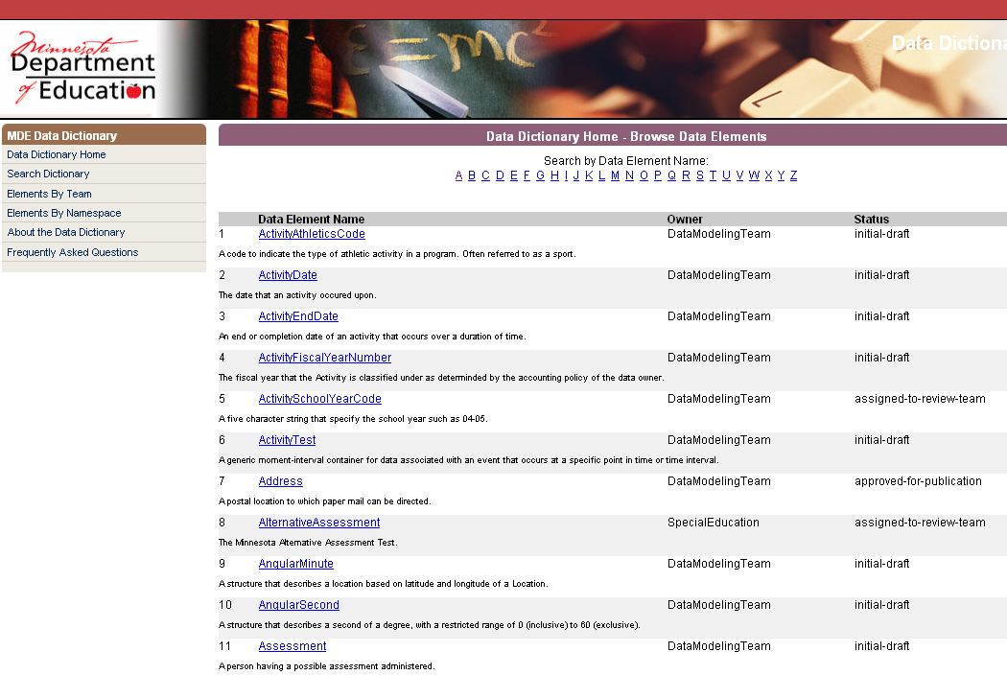
Origins: The XML Data Dictionary

Slide 7
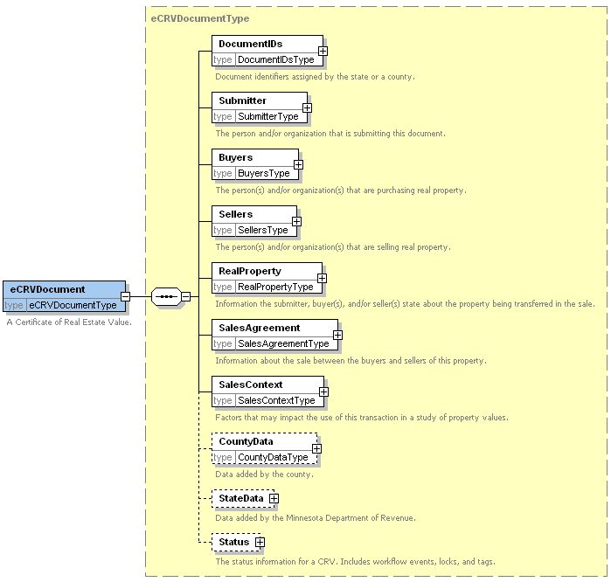
Electronic Certificate of Real Estate
Summer 2006
1 Document
= 44 SQL inserts

Slide 8
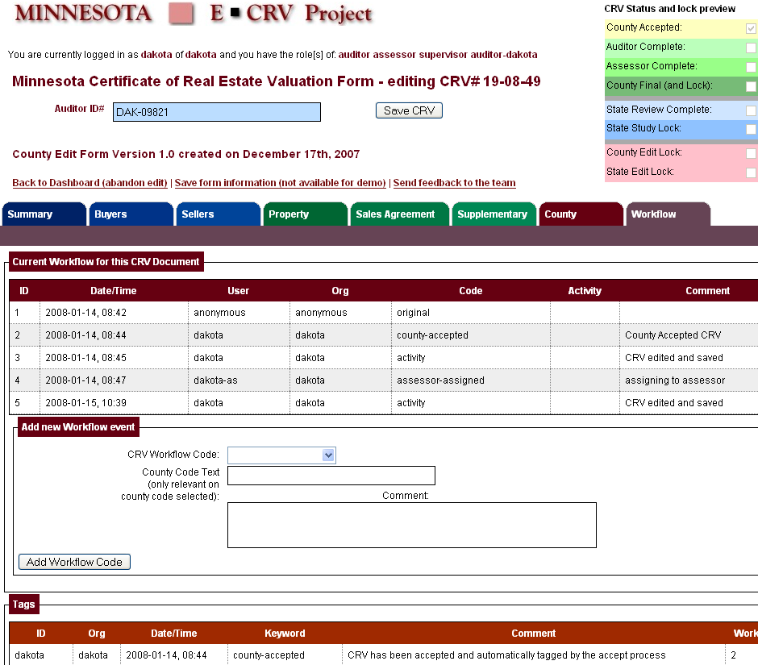
250 Data Elements
XForms
Mockup

Slide 9

Four Translations
T1
T2
T3
T4
Web Browser
Object Middle
Tier
Relational
Database
T1 – HTML into Java Objects
T2 – Java Objects into SQL Tables
T3 – Tables into Objects
T4 – Objects into HTML

Slide 10

Kurt's Suggestion
Use a
A Native XML
Database!
Web Form
Save
Web Browser
Kurt Cagle
store($collection, $file-name, $data)
eXist

Slide 11

Zero Translation
XForms
Web Browser
XML database
XML lives in the web browser (XForms)
REST interfaces
XML in the database (Native XML, XQuery)
XRX Web Application Architecture
No translation!

Slide 12
No-Shredding!
My Form
Data
Relational databases take a single hierarchical document and shred it into many pieces so it will fit in tabular structures
Native XML databases prevent this shredding

Slide 13
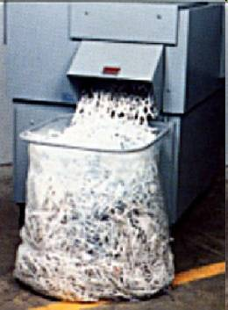
Is Shredding Really Necessary?
Every time you take hierarchical data and put it into a traditional database you have to put repeating groups in separate tables and use SQL “joins” to reassemble the data

Slide 14
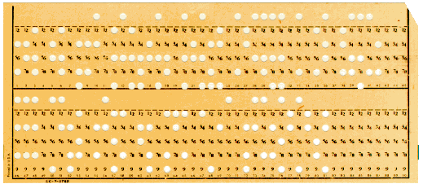
Many Processes Today Are Driven By…
The constraints of yesterday…
Challenge:
Ask ourselves the question…
Do our current method of solving problems with tabular data…
Reflect the storage of the 1950s…
Or our actual business requirements?
What structures best solve the actual business problem?

Slide 15
"Schema Free"
Systems that automatically determine how to index data as the data is loaded into the database
No a priori knowledge of data structure
No need for up-front logical data modeling
…but some modeling is still critical
Adding new data elements or changing data elements is not disruptive
Searching millions of records still has sub-second response time

Slide 16
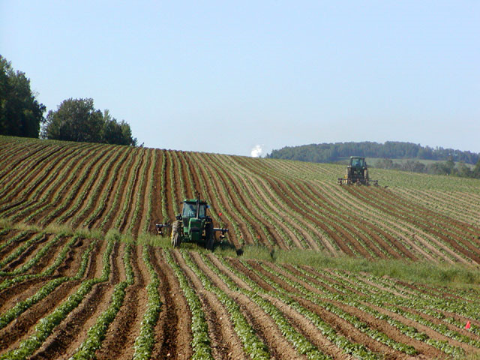
Monoculture and Mono-architecture
Image Source: Wikipedia

Slide 17
Storage Architectural Patterns
Tables
Trees
Stars
Triples

Slide 18









The NO-SQL Universe
Key-Value Stores
Document Stores
XML
Graph Stores
Object Stores

Slide 19
Finding the Right Match
Schema-Free
Standards Compliant
Mature Query Language
Use CMU's Architectural Tradeoff and Modeling (ATAM) Process

Slide 20

Architectural Summary
Four Translation
Zero Translation
T
T
web browser
T
T
web browser
XML database
database
HTML web pages
Object middle tier
RDBMS database
XForms Client
Native XML Database
Which system more agile and by how much?
How can this help us manage enterprise metadata?

Slide 21
What Is Metadata?
Data about data
Data that describes other data
Last Name | First Name | Title | Phone
Smith | John | BA | x1234
Anderson | Sue | PM | x4567
Johnson | Becky | QA | x8765
Metadata
Data

Slide 22
Data
101000101000101010010110100100010100010101001011010001010001010100101100010100010001010101001011000111011010100001110100101100010100111011010100000111010010110001010011101101010111011010
Raw data is just values without context

Slide 23
Adding Context Turns Data into Information
101111
data
47
<code>47</code>
information
<document-status-code>47</document-status-code>
<document-status-code>draft</document-status-code>

Slide 24
Two Kinds of Thinking
"In the Can"
"On The Wire"
Screen
Enterprise Service Bus
Objects
Adapter
Adapter
Publishers
Subscribers
Database
Horizontal
Publish/Subscribe
Messages
Communication of Shared Meaning (Semantics)
Good for large organizations
Vertical
Soloed
Translation-intensive
Application-centric
Good for small teams

Slide 25
Managed Metadata
The processes surrounding the creation and management of enterprise metadata and their definitions
ISO 11179: "Administered Items"
Traceability:
Who created data definitions and when and in what context for what purpose?

Slide 26
Repository vs. Registry
Metadata Repository
Metadata Registry
Were any metadata is stored
No focus on duplicate element elimination
No strict controls on removal of imprecise data elements
Function-specific data
Where carefully controlled metadata is stored
Focus on elimination of duplicate data elements
Focus on semantics
Subject area classification
Data stewardship
Follows ISO guidelines

Slide 27


Empower the Business Analysts!
Before Registry
After Registry
SUPER BA!
BA
Sorry, we have no idea what code 47 means.
Let me just search our registry…
I'll have your answer in 150 milliseconds.

Slide 28
EMM Requirements
EMM = Enterprise Metadata Management
Tools to create a "enterprise trust" in data element data definitions (Data Governance)
Tools to eliminate duplication of data elements
Powerful search
Metadata web services
Controls on who adds and updates definitions
Support for data stewardship

Slide 29
ISO/ICE 11179 Metadata Registry
Standards for managing enterprise semantics
Focus on the management of a "Library" of metadata based on subject headings (like the Dewey Decimal System)
Guidelines for creating precise data definitions
Guidelines for classification of data types

Slide 30
ISO Naming Conventions
Object Class
Property Term
niem: Person Birth Date
Namespace
Representation Term

Slide 31
Metadata Standards
UML
ISO/IEC 11179 MDR
Non-ISO schemas
XML
ISO commercial
schemas
Public Schemas
XML
Federal XML Developer’s
Guide (xml.gov)
XLink
Doc
ebXML
GJXDM
xBRL
NIEM
Federal XML Naming and Design Rules
Federal Data
Reference Model
(DRM)
UBL
MOF
XMI
Future Standards (?)
CWM
Dept Stds.
Minnesota
Data
Standards
OASIS Standards
Division Stds

Slide 32
Why is XRX More Agile?
Importing data
Querying data
Creating web services
Exporting
Publishing
(not to be confused with "Agile Development")

Slide 33
A Happy Partnership
XForms
XQuery

Slide 34
XQuery
In 1998 Jonathan Robie and Joe Lapp (then the principal architect of WebMethods) created a language called XQL
In 1998, two query languages, XQL and XML-QL got a lot of interest within the W3C and a working group for XML-based querying languages was formed
The working group selected around 90 use cases and compared the ability of seven advanced query languages to execute them
None of the seven were perfect. Each had some defects
The working we took the best part of each of the seven languages and created the XQuery standard

Slide 35



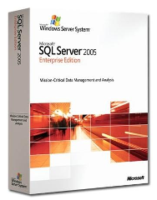

Database Vendors that Support XQuery
eXist (open source)
MarkLogic
IBM DB2 Version 9 “PureXML”
Microsoft SQL Server 2005
Oracle 10g Release 2 Enterprise Edition
+ 50 others…

Slide 36
It is Easy to Import Data
SQL
Analyze data for all parent child relationships and repeating groups
Design logical and physical ER diagrams
For each table create a Data Definition File using a data definition language (DDL)
Create indexes using DDL
Create one table for each set of repeating set of data
Run DDL on database creating tables using the appropriate data types
Create indexes
Create Insert statements
Create separate insert statements for each repeating group
Run Insert statements on primary structures in database
Use primary keys of the first data inserts as foreign keys of dependant data structures
XQuery
Drag XML files into folder

Slide 37


XML File system
XML File system – a way of storing information in XML that can be quickly searched
You can drag and drop almost any files onto this file system
You access it by using the Microsoft Windows “My Network Places” function (WebDAV)
But… You can query the file system like a relational database

Slide 38
Functional Programming
y = f(x)
Computer programs are like mathematical functions
Developers do not manipulate states and variables (things that change value), but focus entirely on constants and functions (things that never change)
Functions are treated as first class citizens
Functions that take other functions as input
Makes it very easy to build modular programs
Software written in FP languages tend to be very concise and easy to port to parallel systems
http://en.wikibooks.org/wiki/Computer_programming/Functional_programming

Slide 39
It's Easy to Query XML Data
for $r in doc(‘t.xml’)//row
where col1=1
return $r/col1, $r/col2
SELECT COL1, Col2
FROM TABLE
WHERE COL1=1
<root>
<row>
<col1>1</col1><col2>A</col2>
</row>
<row>
<col1>1</col1><col2>B</col2>
</row>
<row>
<col1>1</col1><col2>C</col2>
</row>
<row>
<col1>1</col1> <col2>D</col2>
</row>
</root>
Col1 | Col2
1 | A
1 | B
1 | C
1 | D

Slide 40
SQL is similar to XQuery
Function | SQL | XQuery
Selecting Distinct Values | SELECT DISTINCE | distinct-values($doc)
Row Restriction | WHERE COL=value | where $r/element=value
Sorting | SELECT C1, C2 FROM TABLE ORDER BY C1 | for $r in $doc/r order by $r/element

Slide 41
It is Easy to Create A Web Service
Java/JDBC/SQL
Learn Java or find a Java Developer
Install TomCat Web Server
Install Java AXIS Web Server
Write a JDBC program that sends SQL queries to a database
Get the results back in Java Result Object structures
Go through the Java Results Structues and use print statements to wrap XML tags around the strings in the result objects
Rename your class files to .jws files
Add the .jws files to the TomCat deploy folders
The WSDL files will automatically be generated
All XQuerys are web services

Slide 42
Insert/Select/Publish Comparison
SQL
logical
data
modeling
Java
Tomcat
AXIS
JDBC
SQL
XQuery
XQuery
XQuery
Insert
Query
Web Service
Total Effort

Slide 43
High Level Comparison
 | SQL | XSLT | XQuery
Query tabular data | Yes | Yes | Yes
Query hierarchical data | No | Yes | Yes
Easy for people to learn | Yes | No | Yes
The winner!
XQuery can be as easy to learn as SQL but also works with hierarchical data structures.

Slide 44
XQuery is Easier To Learn Than XSLT
Studies have shown that XQuery is much easier to learn than XSLT, especially if users have some SQL background
Usability of XML Query Languages
Joris Graaumans
SIKS Dissertation Series No 2005-16, ISBN 90-393-4065-X

Slide 45
Six Translation
Web Service
T5
T6
T1
T2
T3
T4
Web Browser
Object Middle
Tier
Relational
Database
T1 – HTML into Java Objects
T2 – Java Objects into SQL Tables
T3 – Tables into Objects
T4 – Objects into HTML
T5 – Objects to XML
T6 – XML to Objects

Slide 46
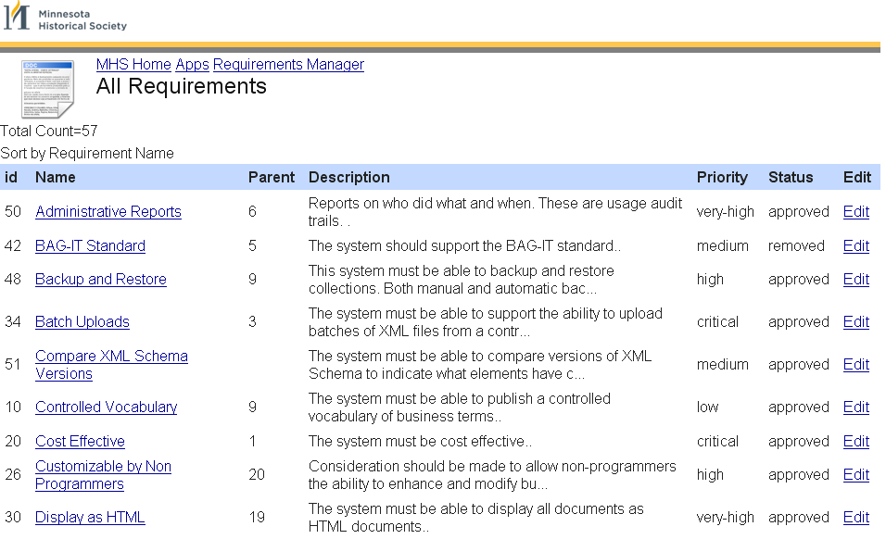
Requirement Lister
Count
Table Header
Sort
Click to View Item
Click to Edit Item

Slide 47
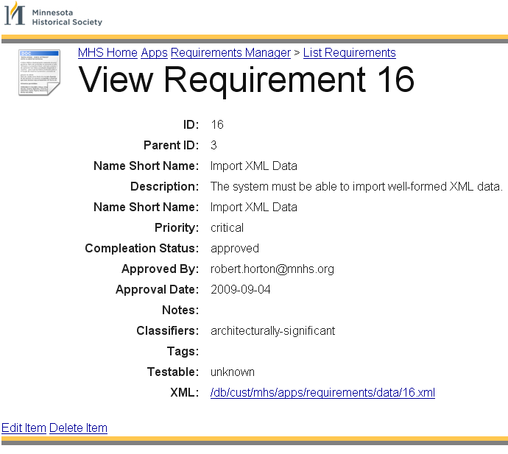
Item Viewer

Slide 48
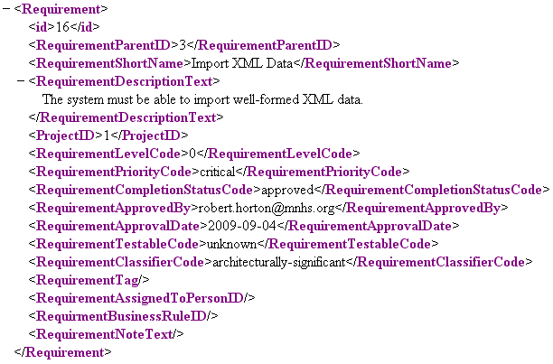
View XML Data

Slide 49
XForms
W3C Standard for web-forms processing
Allows web-forms to load and save complex XML data with many repeating sub-structures
Works very well with REST-type interfaces
Bundled with XML databases (eXist and MarkLogic)
Large library of sample applications

Slide 50
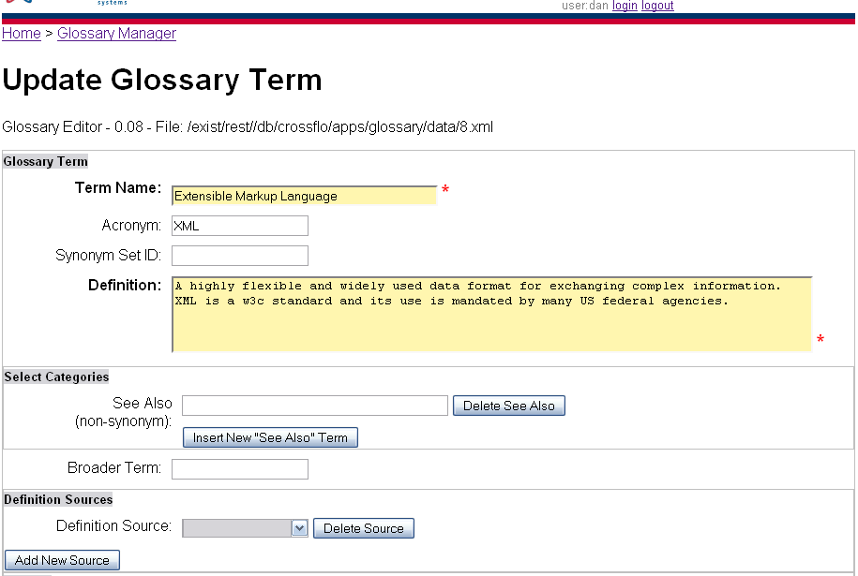
Sample XForms

Slide 51
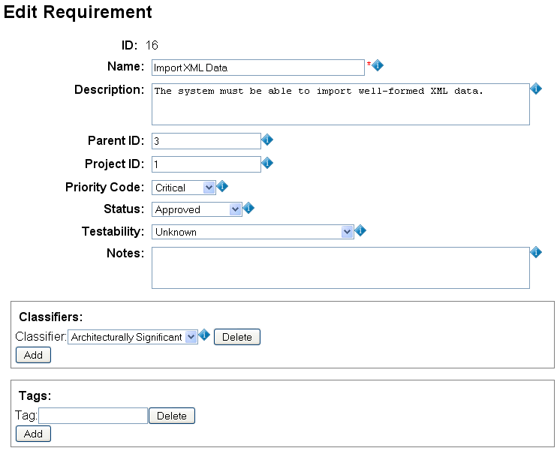
Requirements Editor
Code
Table
Selection
Lists
Repeating
Elements

Slide 52
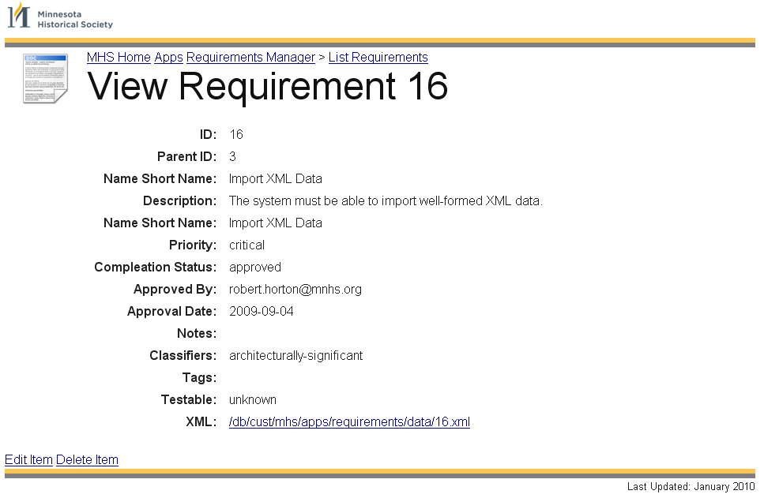
Page Components
Header
Breadcrumb
Content
Edit Controls
Footer
950 pixels wide

Slide 53
Page Assembler Function
Header
Content
Breadcrumb
Roles
Edit Controls
Footer

Slide 54
Style Module
Each non-content region of the page is generated by a server-side XQuery function
Users can change a single function and the entire site will be updated
Functions are dynamic and can take into account the page function

Slide 55
XML Stored in XForms Model
Browser
Database
model
save
update
view

Slide 56
XRX Core Process
Browser
Database
model
save/edit
update
view

Slide 57
Code Table Services
Client
Server
model
Form Data
Code Table Service
view
all-codes.xq
Code
Tables
Code tables are separated from form instance data

Slide 58
XRX Dynamic Forms Generation
Client Application
Application Server
XForms Model
Session
Form Data
Form Data
Collection
User
Team
Document
Status
Code Tables
Role
Group
Views
DataElement
Registry
Binding Rules
Required
Context
filters
Code Table Services
Read-only
Suggest Services
Data Types
Business Rules Editor
Calculations
Calculations
Inference
Submissions
Constraints
XForms View
Static Controls
XML Schema Registry
Dynamic Controls
Subschema Service
Constraint Schemas
Semantic Schemas
Design Time
Run Time

Slide 59
Model Driven
XForms enables the developer to reuse business rules encapsulated in XML Schemas (xsd) and XML Transforms (xslt)
XForms reduces duplication and ensures that a change in the underlying business logic does not require rewriting in another language
XForms
Application
XML
Schema
Meta Data
Registry

Slide 60
View and Model are Trees
The view is a tree of a presentation data element
Models are comprised of one or more trees
XForms supplies the control layer that moves data elements to and from the model
Users don’t have to worry about moving things to and from the screen
Model
Control (Bind)
View (Presentation)

Slide 61
Models and View Are Linked with "Bind"
HTML
head
xf:model
body
Person
form
Name
fieldset
label
label
first
last
input
<bind>
input
Both the model and the views are trees of data elements

Slide 62
Just “Do The Right Thing”
HTML
head
body
xf:model
Person
form
PersonCurrentOnTaxes type="xs:boolean"
fieldset
label
PersonBirthDate type="xs:date"
label
input
input
<bind>
Data types from the model just do the right thing
Boolean variables become checkboxes
Dates have date selectors

Slide 63

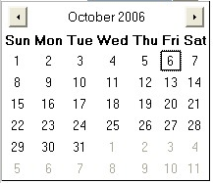
Example of Automatic UI Generation
All true/false data types (xs:boolean) automatically become a checkbox
All dates (xs:date) have a date selector to the right of the date field
All codes can be selected from lists

Slide 64
Structure of a XForms File
XForms tags are just XML tags imbedded in a standard XHTML file with a different namespace
Most HTML form tags are exactly the same but some attributes have been promoted to be full elements
Namespaces
CSS Imports (View)
Model
Constraints (Bindings)
UI (View)
Submit Controls
MyForm.xhtml

Slide 65
REST
REpresentation State Transfer
Create applications based on well designed URLs
Take advantage of web caching
Migrate toward Resource-Oriented Computing (ROC)
REST evangelists: RESTifarians

Slide 66
Five RESTFull Friends
In-resident memory cache in your browser
You local hard drive cache
Your local enterprise cache
The cache on the web server farm
The cache on the database
Please make sure to check with your RESTfull
friends BEFORE you bother the database.

Slide 67
Shallow REST vs. Deep REST
You can start taking advantage of ReST buy just doing well thought-out URL design
To take advantage of deep ReST you must consider the subtleties of the HTTP protocol
GET vs POST vs PUT
DELETE

Slide 68
Benefits of REST
Provides improved response time
Reduced server load
Improves server scalability
Requires less client-side software
Depends less on vendor dependencies
Promotes discovery
Provides better long-term compatibility
Better and evolvability

Slide 69
Terms to Services
Business
Terms
Data
Elements
XML
Schemas
Services

Slide 70
Metadata Registry Workflow Funnel
Glossary
Of Terms
Draft Data
Elements
Review
& Edit
Approve
Requirements & data needs
The registry defines the data we exchange and keeps our need for code changes to a minimum
Create the Registry
Define your glossary and data elements
Review & make changes
Approve & publish by stakeholders
Use the Registry
Generate data schemas (XML) by selecting and organizing data elements
Add new items to the registry as needs change
Notes:
Here is the process I used. It requires tools to harvest metadata and create consolidated list of terms. This is done on both structured and non-structured documents and web sites.
There are many aspects to data stewardship that this presentation does not cover.

Slide 71
Federated Search
Federation: When many different sources can return search results from a single search
Search
Business
Terms
RDMS
Columns
WebSite
Terms
Other
Standards
Data
Elements
Standards

Slide 72
Sample Data Flows
Data Element Views
Business
Terms
(SKOS)
NIEM
Data Elements
Internal
Data Elements
Customer
Data Elements
Draft
Data Elements
In Review
Data Elements
Published
Data Elements
ISO/IEC 11179
Metadata Shopper
Wantlist
subset
Constraint
Schemas
Instance
Examples
UML
Diagrams
IEPDs
Users/Roles
Security
Policy
72

Slide 73
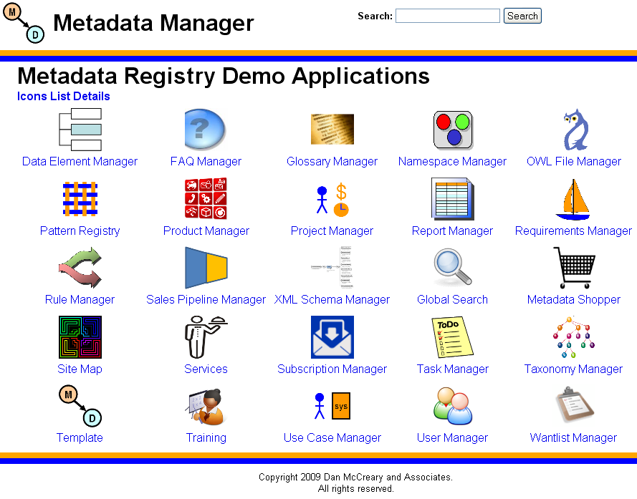
Application Modularity

Slide 74
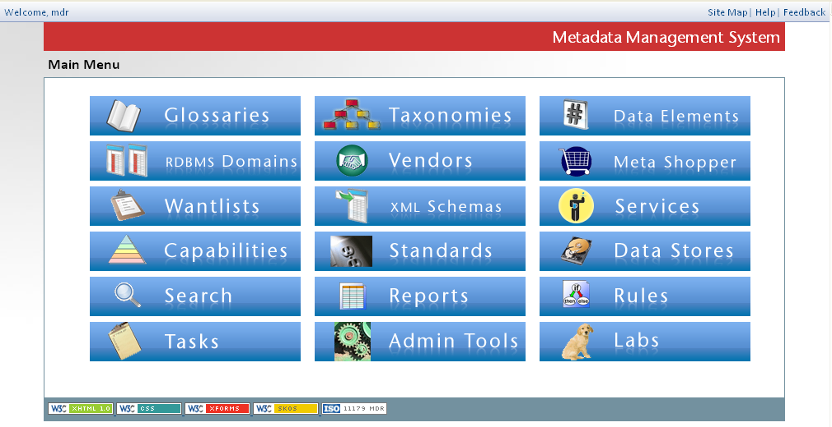
Financial Institution

Slide 75
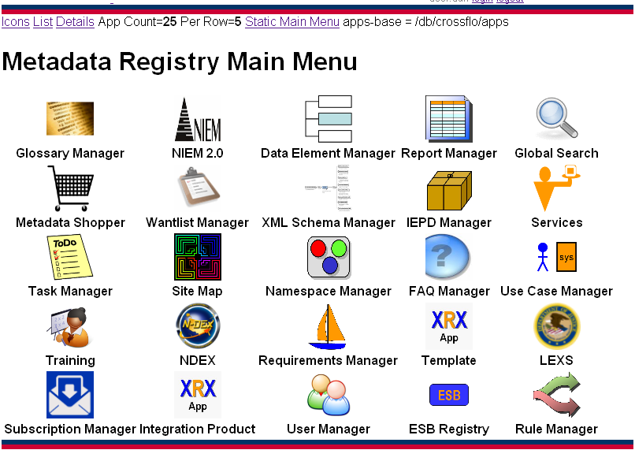
Federal Integrator

Slide 76
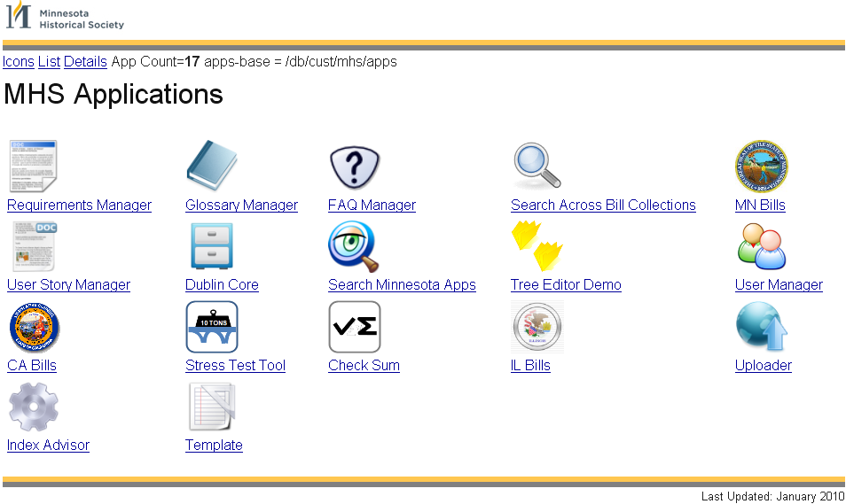
Minnesota Historical Society

Slide 77
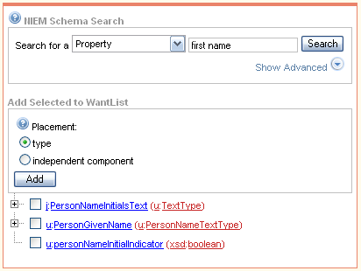
Metadata Shopping Tools
Phone
Address
FirstName
You don’t need to know about 100,000 SKUs to purchase 10 items from a grocery store
Sub-schema generation tools give you exactly what you need and nothing more
See http://niem.gtri.gatech.edu/iepd-ssgt/SSGT-SearchSubmit.do

Slide 78

Information Retrieval Textbook
Introduction to Information Retrieval
by Christopher D. Manning, Prabhakar Raghavan and Hinrich Schütze
Cambridge University Press, 2008
http://nlp.stanford.edu/IR-book/information-retrieval-book.html

Slide 79
Table 10.1
 | RDB search | unstructured retrieval | structured retrieval
objects | records | unstructured documents | trees with text at leaves
model | relational model | vector space & others | ?
main data structure | table | inverted index | ?
queries | SQL | free text queries | ?
XML - Table 10.1 and structured information retrieval. SQLRDB (relational database) search, unstructured information retrieval

Slide 80
Table 10.1 - Revised
 | RDB search | unstructured retrieval | structured retrieval
objects | records | unstructured documents | trees with text at leaves
model | relational model | vector space & others | XML hierarchy
main data structure | table | inverted index | trees with node-ids for document ids
queries | SQL | free text queries | XQuery fulltext
XML - Table 10.1 and structured information retrieval. SQLRDB (relational database) search, unstructured information retrieval

Slide 81
Two Models
"Bag of Words"
"Retained Structure"
doc-id
keywords
keywords
'love'
keywords
keywords
'hate'
keywords
'new'
'fear'
keywords
All keywords in a single container
Only count frequencies are stored with each word
Keywords associated with each sub-document component

Slide 82
Keywords and Node IDs
document-id
Node-id
keywords
Node-id
keywords
Node-id
keywords
Node-id
keywords
Node-id
keywords
Node-id
keywords
Keywords in the reverse index are now associated with the node-id in every document

Slide 83
Search is a REST Service
Every search form is a “wrapper” of a REST web service
You can call the web service from any browser or any other web service
Results can be either HTML (for humans) or XML for remote systems
Search Query
Search Parameter q=Query
Example:
http://mdr.example.com/search/search.xq?q=birth&output=xml
Search Services Collection
Output Format

Slide 84
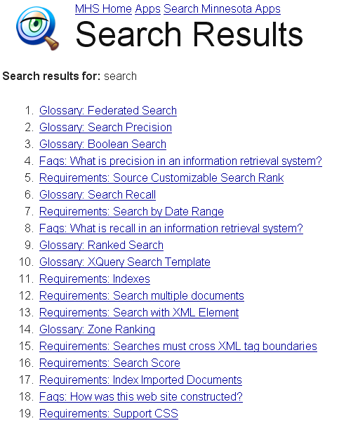
Global Search

Slide 85
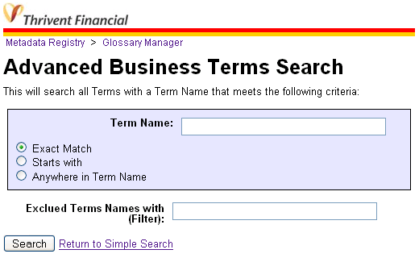
Complex Search
Exact Match
Starts with
Anywhere
Filters
Removed results

Slide 86
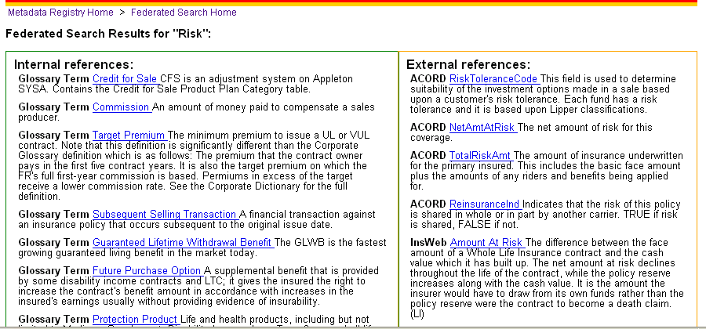
Internal vs. External Terms
Internal Data Standards
External Data Standards

Slide 87

The Heart of the Enterprise
The Metadata Registry
A metadata registry is a central location in an organization where metadata definitions are stored and maintained in a controlled method.
http://en.wikipedia.org/wiki/Metadata_registry

Slide 88
Dan's Promise to Every BA
If you are…
somewhat familiar with HTML and SQL
willing to "know your data"
willing to spend around 40 hours in training
able to use open source software
Then…
You can build and maintain your own metadata registry

Slide 89


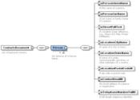
Change Where the Line is Drawn
Requirements
Requirements
SME
BAs
Developers
vs.
Graphical Requirements and Specifications
SME/BA
IT Staff
Shorten the “distance” between the business unit and the IT staff

Slide 90
Semantic Triangle
concept
“cat”
symbol
referent
Symbols can only link to referents through concepts
You can not link directly from a symbol to a referent
Wikipedia: Semiotic triangle

Slide 91
Semantic Precision in Space and Time
space: (projects, organizations)
Large
Semantic Footprint
(long lifetime systems)
world
enter- prise
dept.
team
Small Semantic Footprint
(rapid prototype)
person
time
weeks
months
years
10+ years
Notes:
Think of a semantic wave front.
If you select and existing declarative language you start out with a larger footprint.
Making an internal groups “object library” public is often not practical for security reasons.
Making data definitions is usually much more realistic.

Slide 92
Parker Projection
Relative Code Base
100%
Procedural code (Java, JavaScript, VB, C#, C++)
Declarative code (XHTML, CSS, XSLT, XForms)
Time
Source: Jason Parker, Minnesota Department of Revenue, November 2006

Slide 93
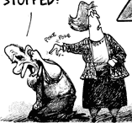
Incoming!
Has this web
thing gone away yet?
XML
web

Slide 94
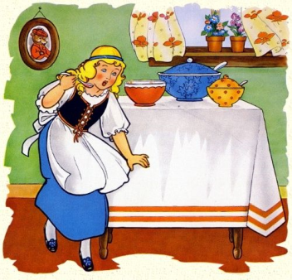
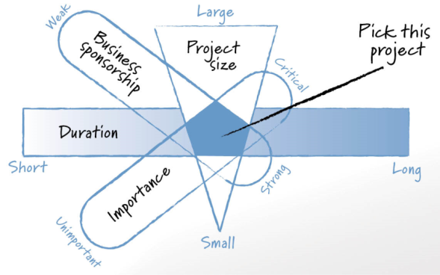
Selecting a Pilot Project
The "Goldilocks Pilot Project Strategy"
Not to big, not to small, just the right size
Duration
Sponsorship
Importance
Skills
Mentorship

Slide 95

Find A Community…
eXist Meeting Prague March 12th, 2010

Slide 96
Challenges
Minimal local talent with XQuery
XForms performance issues for large forms (over 100 fields per form)
User smaller forms
Role-based access control at the collection level

Slide 97
Words of Caution
Only use "latest stable" releases
Currently eXist 1.4
Backup your system
Put critical transactions in at least two places (transaction logs)
Avoid long-running transactions
Use locking to avoid missing updates

Slide 98


Using the Wrong Architecture
Start
Finish
Credit: Isaac Homeland – MN Office of the Revisor

Slide 99
The Problem with Layers…
It's a nightmare trying to write XQuery within SQL within PHP…
Data
PHP
SQL
XQuery

Slide 100

Using the Right Architecture
Start
Finish
Find ways to remove barriers to empowering
the non programmers on your team.

Slide 101
Six "S"s of Metadata Registries
Semantics
Search
Standards
Services
Solutions that are Customized
Super - BA

Slide 102

If You Give a Kid a Hammer…
…the whole world becomes a nail
People solve problems using familiar tools
People develop specific Cognitive Styles* based on training and experience
What are we teaching the next generation of developers?
* Source: Shoshana Zuboff: In the Age of the Smart Machine (1988)
Notes:
Zuboff studied paper mills. She looked at how technology had an impact on how people solved problems.
Her work indicated that individuals that can quickly learn to manipulate abstractions will attain more power and influence in organizations.

Slide 103



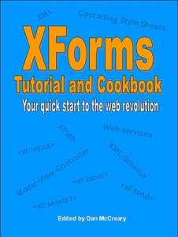

References
XForms
XQuery
XRX
A Beginner's Guide to XRX
Send e-mail to dan@danmccreary.com for extended
list of "getting started" resources.

Slide 104
Questions?
Dan McCreary
President
Dan McCreary & Associates
dan@danmccreary.com
(952) 931-9198

