Slide 1

Entity Extraction Half-day Tutorial Monday June 5th, 08:30 AM - 11:45 AM 2011 Semantic Technology Conference
Dan McCreary
President
Kelly-McCreary & Associates

Slide 2
Entity Extraction Tutorial Outline
Three approximately 50-minute sessions with 10 minute breaks
Part 1 – Overview – Non technical
Business Justification
Terminology
Short Demos/Case Studies
Entity Extraction and the Semantic Web
Entity Extraction and Business Intelligence
Simple Entity Extraction using pattern matching
Break
Part 2 – Entity Extraction: Challenges and Tools
Using Syntax to Extract Semantics
Part-of-speech analysis
Noun phrases
Entity Extraction Pipelines
Validation of Entities
POS Analysis/UIMA/Standards
Large collections/indexing
Latent Semantic Analysis and SVD
Break
Part 3 – ROI, Quality Metrics, Strategic Implications
Data Formats – XML, RDF, TEI, DocBook
Verification Tools
Today – State of the art
Entity Extraction ROI
EE and Semantic Search
Strategic Impact of Entity Extraction
Entity Extraction Mashups

Slide 3
About Dan McCreary
Data consultant from Minneapolis, Minnesota
25+ years experience in information technology (Bell Labs, Steve Job's NeXT Computer, US State Department, JPMorgan)
Focus on semantics, metadata, standards, XML, XQuery, structured search, natural language processing and annotations
W3C Invited expert on forms

Slide 4
Key Trends for 2011
Shorter Documents
More Metadata in Documents
More links and annotations within Documents
Better Open Source Entity Extraction (EE) Tools
UIMA is a full Apache project (graduated from "Incubator")
Better integration of Tools into Content Management Systems (CMS)
e.g. – OpenCalais plugins for Drupal
http://drupal.org/project/opencalais
Web-based verification and editing
TEI-annotator web annotator example
Standards
Growth of RDFa
Growth of Microformats

Slide 5
Agenda/Objective
Definition of Entity Extraction
Extracting significant items from a text document
Key Terms
Semantically precise definitions
Part of speech analysis
Probabilistic analysis and grammar rule-based
Integrating Entity Extraction in the Enterprise
Search
Data Warehouse
Business Intelligence
Mashups
Future
Standards
Customizability/Declarative Languages
Usability for non-programmers

Slide 6
Technical Complexity
very technical
Statistical Language Processing
(Statistics)
XQuery Examples
(Programming)
non technical
break
break
Part 1
Part 2
Part 3

Slide 7
What is Entity Extraction?
The process of automatically finding key items in unstructured data, usually free-form text documents (a.k.a. Named Entity Extraction)
Typical Extracted Entity Targets
People’s Names
Organizations (Businesses)
Geographical Locations
Dates, Times, Events
Products - price, category, color, size, warranty period, recommendations
Medical Charts - Medical Conditions, Symptoms, Treatments, Drugs, etc.

Slide 8
Entity Extraction and the Semantic Web
Person
Place
Date
HTML describes documents and the links between them
Documents contain link to other documents
The semantic web by contrast, can describe arbitrary links in documents to entities such as people, places and things
Documents contain links to entities (Objects)
Entity Extraction automatically finds things in documents so your documents can point to things

Slide 9
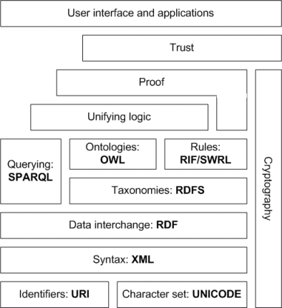
Markup and the Semantic Web Stack
Entity Extraction is about getting data out of text and putting it into XML and RDF

Slide 10
Why Use Automated Entity Extraction?
Enhanced Findability
Better search accuracy, synonyms, related terms
Statistical Analysis of Large Document Collections
Creating reports on large document collections
Alerting – documents with specific entities or entity combinations
Trending – documents that match patterns
Classification – automatic grouping of documents into taxonomies
Repurposing Documents
Creating mashups
Creating linked data from unstructured text
Document Understanding
First step in document understanding
Entities > Assertions > Facts

Slide 11
Entity Extraction Business Area
Legal
Legal search services
Thomson/Reuters
Healthcare
Automated analysis of patient charts
Mayo Clinic
Criminal Justice
Automated analysis of crime Incident Reports
Department of Homeland Security
Online Commerce
Product attributes
Prices, color, size, warranty etc.
Historians
Tagging of people/places/terms
US State Department

Slide 12
Trends
More text
HTML, Blogs, RSS/Atom, Twitter
OpenSource
Apache UIMA, OpenNLP
Markup Standards
XML, RDF, TEI, DocBook, Wiki, DITA
XQuery
Makes is easy to quickly search indexed XML
Find all geographical places in a TEI document
let $places := doc($document)//name[type='place']

Slide 13
Storage Architectural Patterns
Tables
Trees
Triples
Stars

Slide 14
Dropping Project Costs
$500K
$450K typical project costs (Crime Reports)
$70K typical project costs
using Open Source
$100K
2002
2009
time

Slide 15
Less Technical Background Required
Years
Experience
Computer Science
Linguistics
Statistics
Programming
4 years
XML
XQuery
1 year
time
2002
2011

Slide 16
Where are Entities Stored?
In documents themselves
e.g. in HTML Header <meta>
In-context <name type=“place>
External metadata
Document index
Data Warehouse
Star Schemas
Conformed Dimensions

Slide 17
As Goes Entity Extraction …so Goes the Semantic Web
Entity Extraction is adding fuel to the semantic web fire
Entity Extraction could add the critical mass we need to create large amounts of text documents with semantically-precise RDFa tags
RDFa can be converted into large triple stores
SPARQL queries perform inference

Slide 18
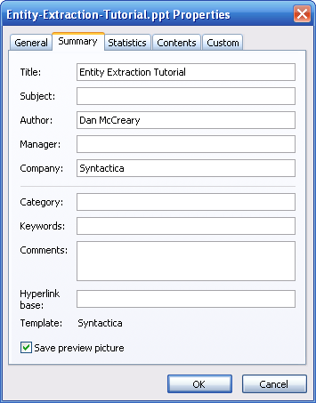
Missing Document Metadata
No subjects
No Categories
No Keywords
Notes:
Most documents today have very little metadata associated with them. Typically there is not subject, category or keyword associated with corporate documents.
Some studies show that it costs between $5 and $15 dollars per document to correctly classify many documents.

Slide 19
Cost for Adding Metadata
Manual Metadata Coding
Typically $3 to $15 per document depending on quality concerns
Automated Metadata Coding
$1 to $5 per document per document depending on quality concerns
Costs Factors
Number of documents
Complexity of categories and keywords
Findability of entities
Controlled vocabulary with entity IDs
Precision of extractions

Slide 20
Key Terms
Information Extraction
Named Entity Extraction
Document Classification
Noun Phrase
Search Precision and Recall
Keywords
F-Measure
Reference Corpus
Tagged Dataset
Statistical Natural Language Processing
N-Grams
Grammar Rule Processing
Domain specific vocabulary
Taxonomy
RDF
OWL

Slide 21
User Interface Examples
Go to the demos…
Gnosis FireFox Plugin
Thomson-Reuters
Apache UIMA
OpenSource Java Framework for Unstructured Information Management
Many Others…

Slide 22
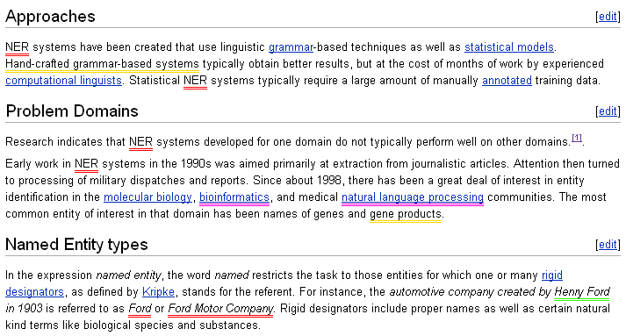
ClearForest Gnosis

Slide 23
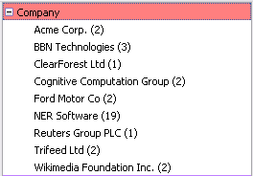
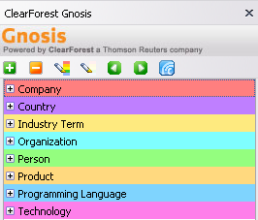
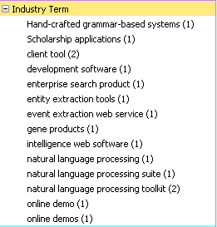
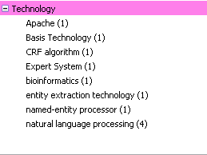
Gnosis Sidebar

Slide 24
Typical Controls
Highlight All
Highlight None
Expand All
Process Current Page
Collapse All
Previous Word
Next Word

Slide 25

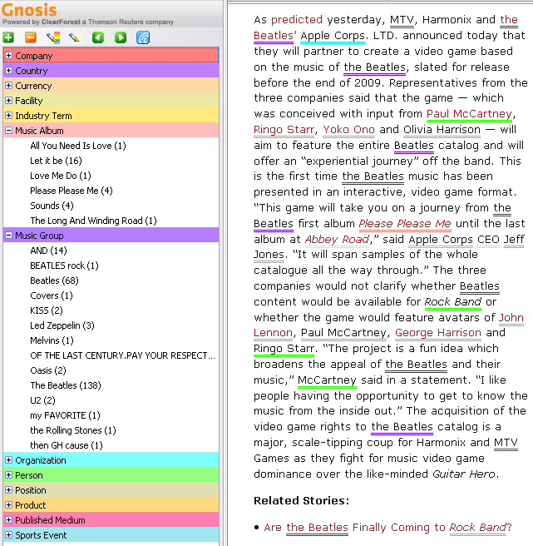
Music Albums and Groups
Link to
Rolling Stone
Article

Slide 26
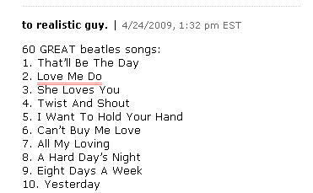
Note that lists of songs are recognized
Most entity extractors do not recognized lists
Without the full sentence syntax around an entity it is difficult to infer part-of-speech and semantics
Comments are typically difficult to analyze

Slide 27
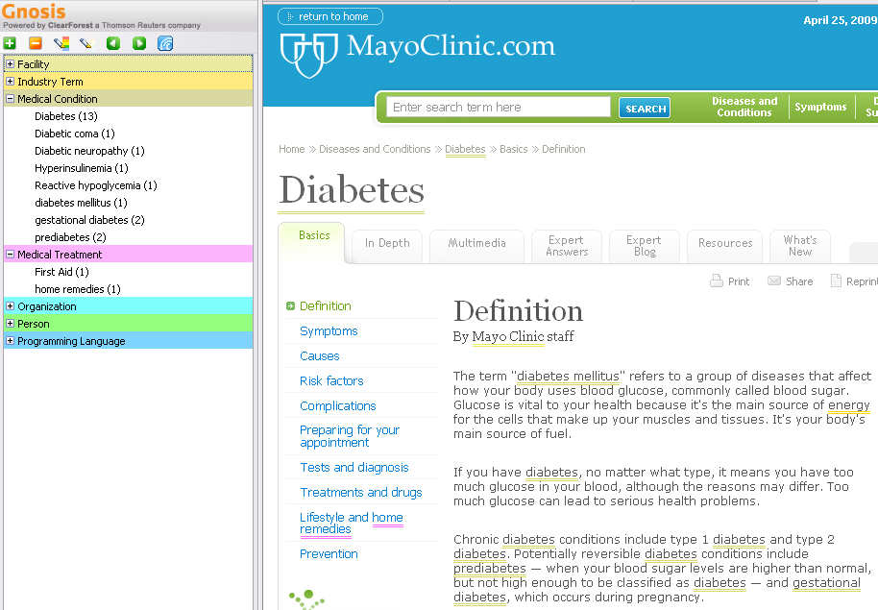
Healthcare

Slide 28
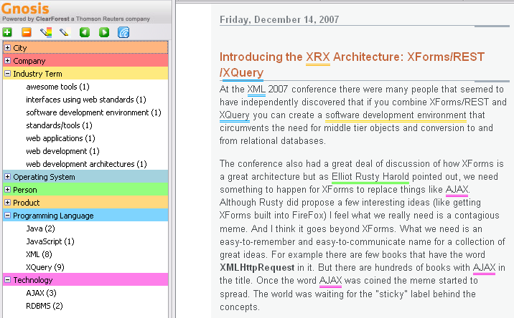
Software Development

Slide 29
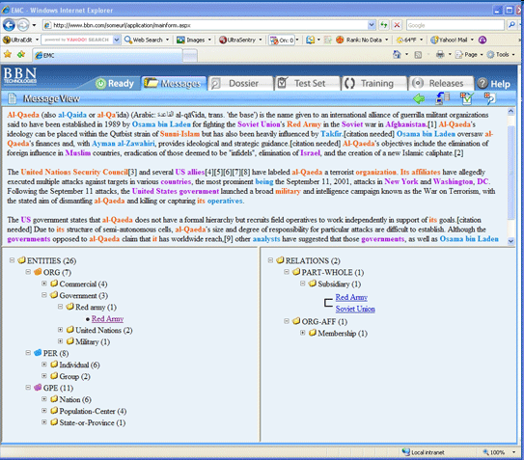
BBN Identifinder

Slide 30
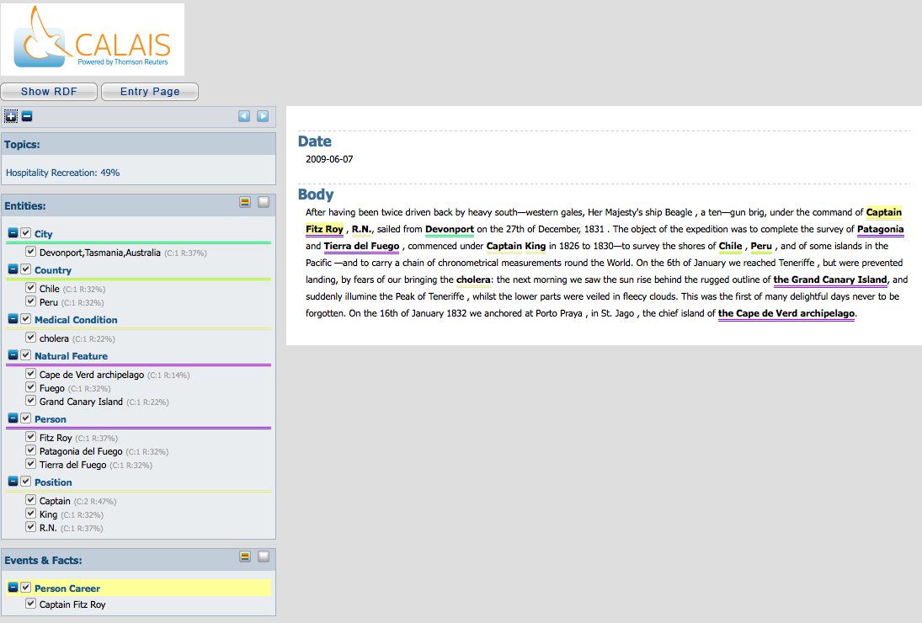
Open Calais

Slide 31
Typical Entity Extraction Process
Harvest
Analysis
Enrich
Integrate
Entity
Recognizer
Document
Updater
Search Index
Data Warehouse
Document
Collection
Mashups
Entity extraction is done in stages
Simple systems have 4-6 processes
Complex systems have 30+ stages

Slide 32
Part of Speech Analysis
Use part-of-speech analysis to determine what role each word plays in a sentence
Example
#1: We saw a Robin on the grass.
#2: Robin came to pick up the car.
Syntax can tell you sentence #1 has a bird in it and #2 is a reference to a person
Copyright 2011 Kelly-McCreary & Associates

Slide 33
Part of Speech Example
Input:
The quick brown fox jumps over a lazy dog.
Output
<words> <word pos="x">The</word> <word pos="a">quick</word> <word pos="a">brown</word> <word pos="n">fox</word> <word pos="v">jumps</word> <word pos="x">over</word> <word pos="x">a</word> <word pos="a">lazy</word> <word pos="n">dog</word> <word pos=".">.</word> </words>
POS Key:
a=adjective
n=noun
v=verb
x=stopword

Slide 34
Word Stemming & Lemmatization
Remove the word suffix (“s” for plural, “ed” for past tense etc.)
<output> <token posTag="at" stem="The">The</token> <token posTag="jj" stem="quick">quick</token> <token posTag="jj" stem="brown">brown</token> <token posTag="nn" stem="fox">foxes</token> <token posTag="vb" stem="jump">jump</token> <token posTag="in" stem="over">over</token> <token posTag="at" stem="the">the</token> <token posTag="jj" stem="lazi">lazy</token> <token posTag="nn" stem="dog">dogs</token> <token posTag="." stem=".">.</token> </output>

Slide 35
Noun Phrases
Groups of words that describe a single object
The quick brown fox jumps over the lazy dog.
Look for groups of adjectives before nouns
"quick brown fox"
"lazy dog"
Find the “root words” or “head noun”
fox
dog

Slide 36
Noun Phrases
Groups of Nouns
…the Space Shuttle…
…the University of Minnesota Department of Computer Science…
Determiners
Small words that co-exist in and around noun phrases
Examples
Articles (the, a)
Demonstratives (this, that)
Numeric modifiers (two, five)
Possessives (my, our, their)

Slide 37
Noun Phrases (continued)
Adjectives Modify Nouns
…the big red ball
…the ball that was big and red
Complements (Prepositional Phrases)
…my software
…the program that we wrote
Complements complete the meaning
Modifiers
Pre-modifiers – before the noun
Post-modifiers – after the noun
Modifiers are optional
Missing Nouns
"The Great One"

Slide 38
Multi Word Units (MWUs)
The seminar on semantic web technologies will be held at <e:organization>the University of Minnesota Department of Computer Science</e:organization> on <e:date>September 12th, 2010</e:date>.
A sets of consecutive words used to describe a single named entity
Entity Extraction is the process of finding MWUs and associating them with a controlled vocabulary

Slide 39
Using Regular Expressions
A rule-based matching system where the specification of the matching rules is stored using a highly compact notation
\d for digit
\D for a non-digit
\s for any whitespace (space, tab, newline)
\S for any non-whitespace
Can be run without formal part-of-speech and sentence structure understanding

Slide 40
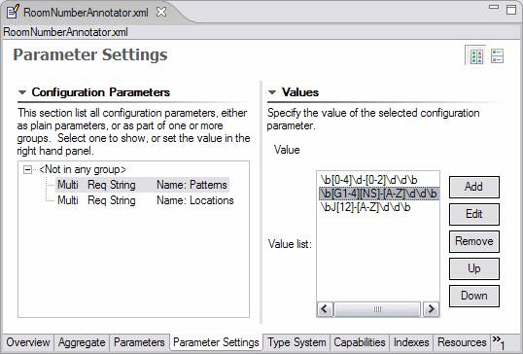
Example: UIMA Regex Parameters
Patterns Set
(implicit or)
Example of conference room number extractor (Eclipse User Interface)

Slide 41
Example: Social Security Numbers
^\d{3}-\d{2}-\d{4}$
Finding a pattern of
Three digits \d{3}
Dash
Two digits \d{2}
Dash
Four digits \d{4}
Matches: 123-45-6789
Does not match 12-456-7890

Slide 42
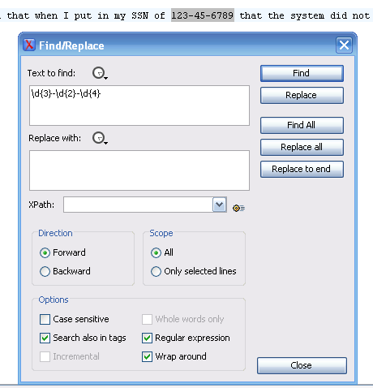
Testing with IDE (oXygen)

Slide 43
Regular Expression Matching
Some entitles such as dates can be recognized with high precision by looking for patters of numbers and letters:
Examples
January 7th, 2010
Feb. 2nd, 2010
9-12-1980
2010-06-31
Thanksgiving 2010
All of the above can be found by setting up regular expression and small dictionaries

Slide 44
Recognizing E-mail Address
Finding valid E-mail addresses can be done by a single regular expression
Example:
[A-Za-z0-9](([_\.\-]?[a-zA-Z0-9]+)*)@
([A-Za-z0-9]+)
(([\.\-]?[a-zA-Z0-9]+)*)\.([A-Za-z]{2,})
See Regex.org

Slide 45
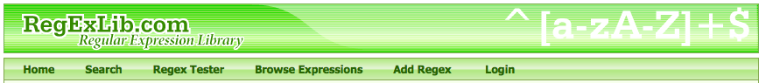
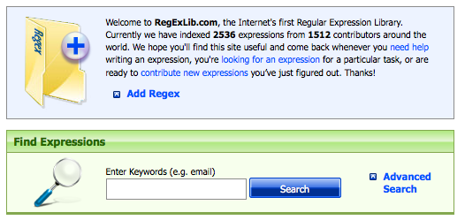
RegExLib.com

Slide 46
Names
Scan for adjacent words that start with upper-case letters. Look for name prefixes (Mr., Ms., Dr.) and suffixes (Jr., III)
John Smith Jr.
Ms. Jane Doe
George Washington (when not inside of George Washington University)
Many exceptions:
Megan O’Brian
Baron von Brown
Dr. Smith lives on Maple Dr.

Slide 47
Some Challenges
Some entities are very difficult to recognize without contextual knowledge
Example:
some companies like Intel and Microsoft
some companies like Procter and Gamble
Sometimes “and” joins two entities
Sometimes “and” is part of the name of a single entity

Slide 48
Part 2: Entity Extraction Tools
Know your tools
Use the right tools for the right job
Entity Extraction has many tools…

Slide 49

Extraction Strategies
if (condition)
then (action)
Statistical Approach
Rule Approach
Statistical Approaches
Requires a training “corpus”
Language independent (if you have the corpus)
Rule-based (Grammar) Approaches
Understand the rules of grammar
Language dependant
Combination
Blend the best of both rules

Slide 50
Statistical Approach
Requires a large body of precisely annotated text (Corpus)
English Parts of Speech: Brown Corpus
Corpus-based computational linguistics
Tools analyze these text and create probabilistic models of word frequency
Frequency tables are used to analyze new text
Veterbi Algorithm

Slide 51
Example: Brown Corpus
Developed at Brown University in the mid-1960s
It consists of about 1,000,000 words of running English prose text
500 samples from many different publications in 15 categories
Each sample is 2,000 or more words
1,014,312 total words

Slide 52
Brown Corpus Sample
A. PRESS: Reportage (44 texts)
B. PRESS: Editorial (27 texts)
C. PRESS: Reviews (17 texts)
D. RELIGION (17 texts)
E. SKILL AND HOBBIES (36 texts)
F. POPULAR LORE (48 texts)
G. BELLES-LETTRES - Biography, Memoirs, etc. (75 texts)
H. MISCELLANEOUS: US Government & House Organs (30 texts)
J. LEARNED (80 texts)
K. FICTION: General (29 texts)
L. FICTION: Mystery and Detective Fiction (24 texts)
M. FICTION: Science (6 texts)
N. FICTION: Adventure and Western (29 texts)
P. FICTION: Romance and Love Story (29 texts)
R. HUMOR (9 texts)

Slide 53
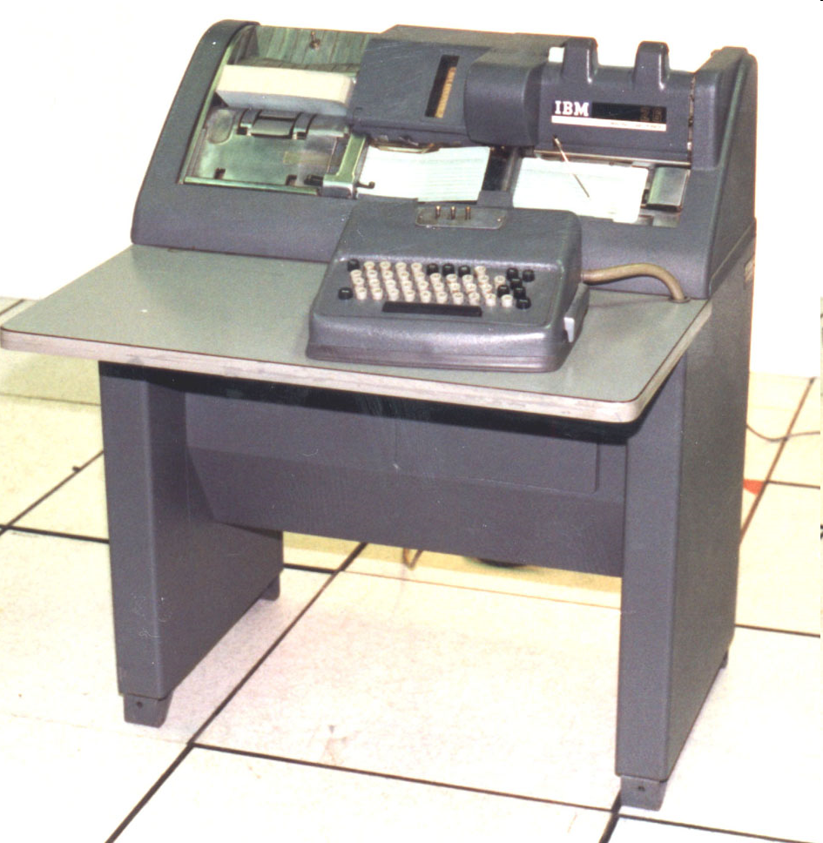
Problems with Old Corpuses
The Brown Corpus was created in the 1960s on a keypunch
Many modern words are not in the Corpus
“Google” is not in the corpus as a noun or a verb
The cost of creating and checking a large new corpus is very expensive!
Keypunch (note, no shift key)

Slide 54
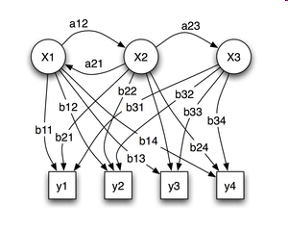
States and Transitions
Language can be thought of as a series of states (in a state diagram) with probabilities that one word is followed by another
When you look at a sentence the parts of speech (noun, verb, adjective) are hidden and must be inferred
This is called a Hidden Markov Model (HMM)
Observations
Predictions

Slide 55
Verterbi Algorithm
Compute the triple (prob, v_path, v_prob)
for each possible next state.
The total probability of a given next state total, is obtained by adding up the probabilities of all paths reaching that state.

Slide 56
Word Transition Probabilities
What is the probability that word X is followed by word Y?
A simple grammar:
[John|Sue] [likes|hates] [cookies|chocolate]
start
0.3
John
0.7
likes
0.5
cookies.

Slide 57
Forward Verterbi Algorithm (Python)
def viterbi(obs, states, start_p, trans_p, emit_p): T = {} T[state] = (start_p[state], [state], start_p[state]) for output in obs: U = {} for next_state in states: total = 0 argmax = None valmax = 0 for source_state in states: (prob, v_path, v_prob) = T[source_state] p = emit_p[source_state][output] * trans_p[source_state][next_state] prob *= p v_prob *= p total += prob if v_prob > valmax: argmax = v_path + [next_state] valmax = v_prob U[next_state] = (total, argmax, valmax) T = U total = 0 argmax = None valmax = 0 for state in states: (prob, v_path, v_prob) = T[state] total += prob if v_prob > valmax: argmax = v_path valmax = v_prob return (total, argmax, valmax)

Slide 58
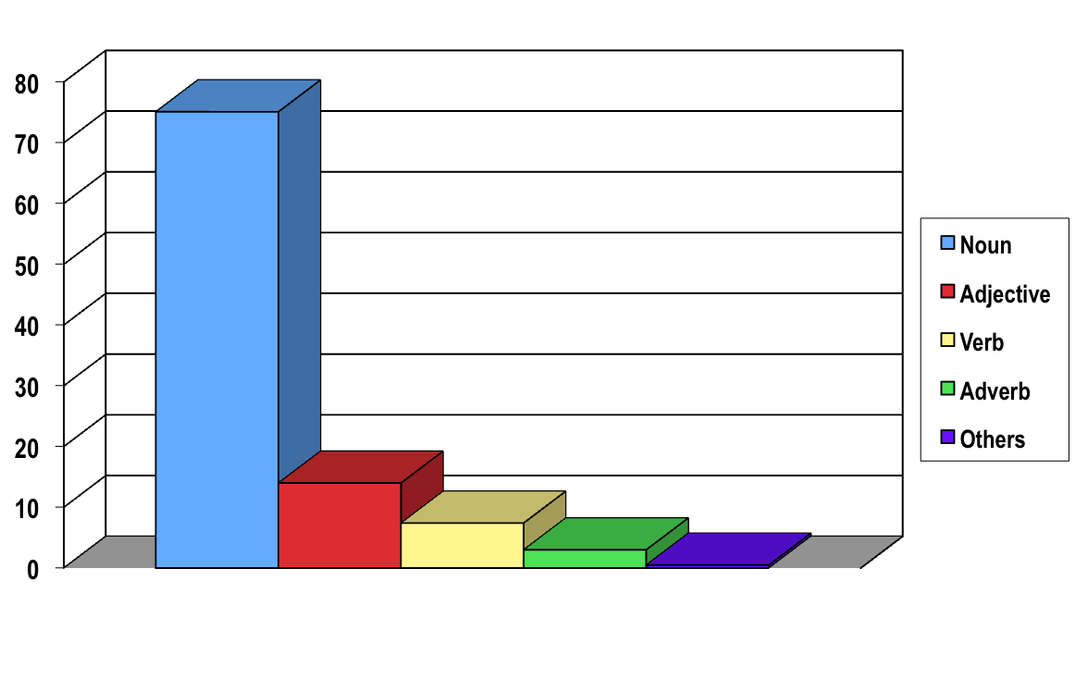
Percent of Words for each Part of Speech
75% of English words are nouns (WordNet)

Slide 59
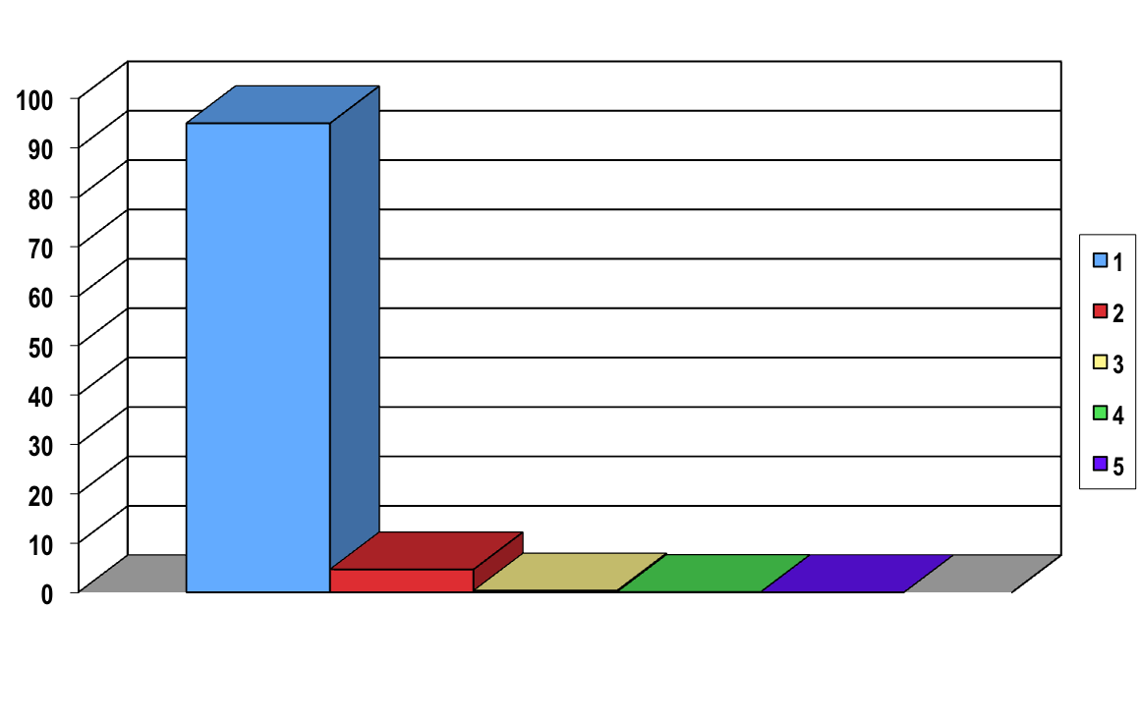
Number of Possible Parts of Speech
(WordNet)
95% of English words can only take one part of speech

Slide 60
Example: Run
Context
tally
"the Yankees scored a run in the bottom of the 9th"
test
"The experiment ran for over an hour"
footrace
"she broke mile run record"
18 noun
"senses"
streak
"her run of luck was just starting"
play
"the football 3rd down play was a run"
…
"13 other noun meanings…"
"run"
move fast
"the kids ran to the store"
scat
"I would run from a ticking bomb."
41 verb
"senses"
go
"The path runs up the hill."
operate
"you need training to run this machine."
has form
"the movie plot runs like this."
Source: WordNet at http://wordnet.princeton.edu/
…
"36 other verb meanings…"

Slide 61
Entity Extraction Pipeline
Document
Tokenization
Sentence
Analysis
POS
Analysis
Enriched Document
Date
Analysis
Place
Analysis
Person
Analysis
Top pipes are the foundation that other analysis engines are built upon

Slide 62
Types of Tags
External Tags
Out of context tags
e.g.: Tags in the HTML header “meta”
Body Tags
Inline tags that markup the body of a document
Preserve the context of the entity in the document
Use markup (XML) to store entity information

Slide 63
Annotation Types
Formatting annotations
bold, italic, highlights
Data Type Annotations
dates, numbers, percent, ticker symbols
Controlled Vocabulary Annotations
Person
Eg: <person id="p123">Fred Jones</person>
Geo-location
Glossary Term

Slide 64
Entity Extraction Formats
HTML – Standard web markup
Semantic HTML – extensive use of CSS
XML – eXtensible Markup Language
RDF, RDFa – Resource Description Format
TEI – Text Encoding Initiative
DocBook – XML format for book publishing
DITA – Darwin Information Type Architecture
Wiki – standard and Semantic Wiki
Semantic Wiki – adding link types

Slide 65
HTML Meta Tags
<html
<head>
<meta name="keywords" content="computing, computer studies, computer">
<meta name="description" content="Cheap widgets for sale">
<meta name="author" content="John Doe">

Slide 66
Semantic HTML
Use presentation-neutral tags
<div class="person">John Doe</div>
<span class="date" xs:date="2010-06-14">June 14th, 2010</span>
Use a Cascading Style Sheet (CSS) to control how the tags are displayed

Slide 67
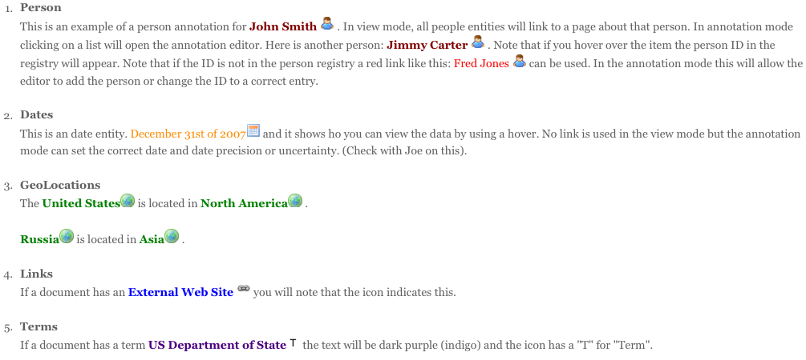
Annotation Markup

Slide 68
Zotero Bibliographic Extraction
Zotero is a FireFox extension that is used to automatically extract bibliographic metadata from text documents
Zetero supports a wide variety of document metadata formats including the Dublin Core standards, BibTex and RDF
See http://www.zotero.org

Slide 69
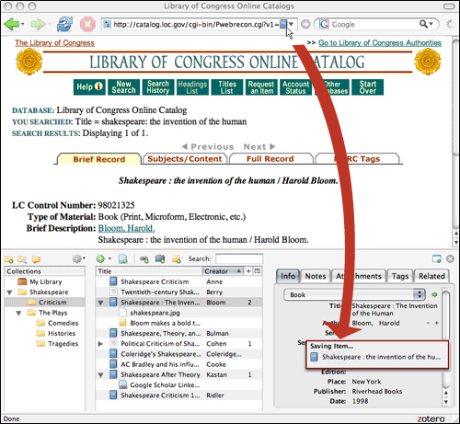
Example: Library of Congress -> Zotero

Slide 70
RDF and RDFa
RDF = Resource Description Format
RDF is the w3c standard for encoding metadata in directed graphs
RDA uses URIs (a special type of URL) to link concepts together, even if the content is on different web pages

Slide 71
RDFa
RDFa is a format for storing entity types in HTML attributes (RDF attributes)
Example
<div class="Person”>John Doe</div>
RDFa is designed as a way to enrich current HTML documents with a small set of metadata
Non-disruptive evolution

Slide 72
TEI
Text Encoding Initiative
Used in humanities and historical documents
Precise markup standards for historical and humanities documents
People
Dates
Locations
Extensible architecture

Slide 73
Sample TEI Formats
Person:
<persName refer=”darwin-charles" type="person">Darwin, Charles</persName>
Place Names (GeoCoding):
<name key="name-200836" type="place">Falkland Islands</name>
Dates:
<date when="1831-12-27">27th of December, 1831</date>

Slide 74
Sample TEI Queries
XPath Examples
Return all people named entities
//tei:perName
Count named entities
count(//tei:perName)

Slide 75
Person and Geopolitical Tagging
I must be here allowed to return my most sincere thanks to the Reverend Professor <e:person>Henslow</e:person>, who, when I was an undergraduate at <e:gpe>Cambridge</e:gpe>, was one chief means of giving me a taste for Natural History, who, during my absence, took charge of the collections I sent home, and by his correspondence directed my endeavours, and who, since my return, has constantly rendered me every assistance which the kindest friend could offer.

Slide 76
DocBook
DocBook is an XML markup format used commonly for articles and book publishing
Publishers frequently accept books in DocBook format
DocBook supports many in-line elements for marking up text such as a glossary term or a term that should appear in the back-of-the-book index
Entity Extraction can be used to identify items that should appear in a glossary or the back of a book index

Slide 77
Glossary and Back-of-Book Indexes
Glossary terms are new terms introduced in a text, frequently placed in bold font and are listed in a glossary at the end of a chapter or at the end of a book
Index terms are terms that should appear in the index at the end of a book
Manual indexing is a slow and closely process
DocBook has markup tags that identify when a term is a glossary term on an index term
The ability of <glossterm linkend=”xquery">XQuery</glossterm> to quickly search indexed text has allowed fast searching of terabyte XML data sets.
XQuery is a <indexterm>functional programming language</indexterm> that places and emphasis on transformation of data rather then state management.

Slide 78
DITA
Darwin Information Type Architecture
XML standard for creating reusable content fragments
XML standards for workflow and task management
Used extensively in technical publishing
Entity extraction systems can be configured to work on a shared library of DITA fragments

Slide 79

Microformats
Instead of waiting for a single standard to be developed, create many smaller standards that can be quickly added to HTML
Allow market forces to dictate which standards get the most attention

Slide 80
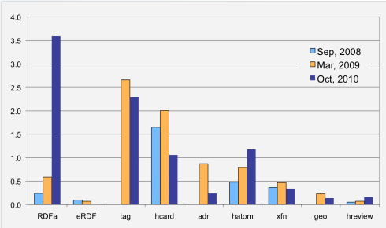
Growth of RDFa and Microformats
Microformats and RDFa deployment on the Web (% of all web pages)
http://tripletalk.wordpress.com/2011/01/25/rdfa-deployment-across-the-web/

Slide 81
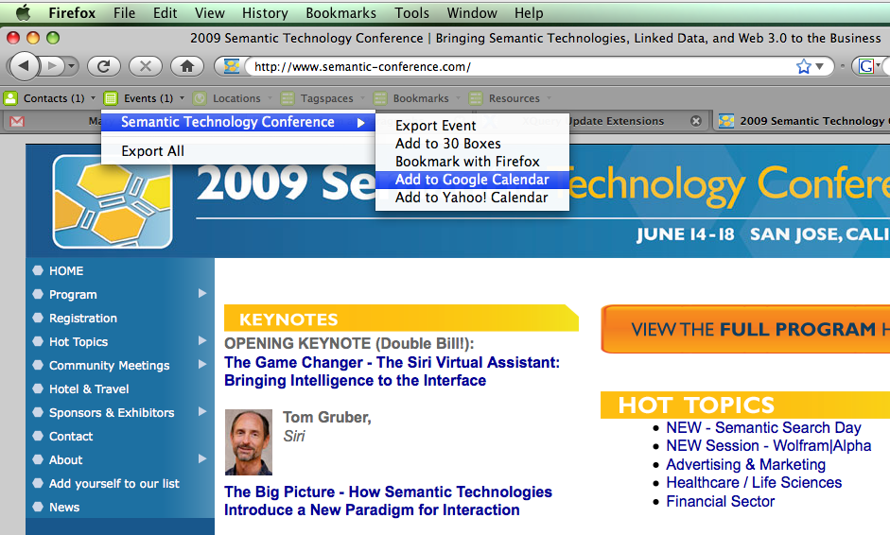
Operator FireFox Extension

Slide 82

GoodRelations Ontology
The Web Ontology for e-Commerce
A standardized vocabulary for product, price and many other areas
Includes "store hours" markup
http://www.heppnetz.de/projects/goodrelations/

Slide 83
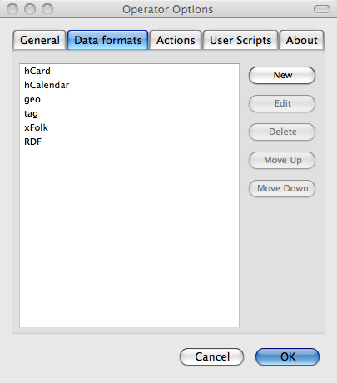
FireFox Extension "Operator"
Calendar entries
Business cards
Geographic tags
RDF

Slide 84
Entity Extraction and BI
Review BI concepts
Data Warehouse
Star Schema
Fact Tables
Dimensions
Conformed Dimensions

Slide 85
Star Schema
Facts
fact
Dimension
fact
Dimension
fact
fact
fact
fact
fact
fact
fact
fact
fact
fact
Dimension
Dimension

Slide 86
Entity Fact Storage Costs
Term ID
Document ID
Entity Type ID
Frequency Count
Term ID: 16 bits – (2 bytes) (up to 2¹⁶⁼65,536 terms in controlled vocabulary)
Document ID: 32 bits – (4 bytes) (up to 2³²⁼4,294,967,296 documents)
Entity Type ID: 16 bits (2 bytes) – 2¹⁶ 65,536 entities types tracked
Frequency Count: 16 bits (2 bytes) 65,536 entity counts per document
Total: 80 bits (10 bytes) per entity fact
Disk space = $100 per Terabyte
$100/10¹² bytes = $1 per 10¹⁰ bytes = 10⁻¹⁰ $/byte = 10⁻⁹ $/entity
@100 entities per document = $10⁻⁸ per document
You can store entities for 1,000,000 documents for under $10

Slide 87
Star Schema
Extracted Entity
word, doc, entity, count
word, doc, entity, count
Document
word, doc, entity, count
Entity
word, doc, entity, count
word, doc, entity, count
word, doc, entity, count
word, doc, entity, count
word, doc, entity, count
word, doc, entity, count
word, doc, entity, count
word, doc, entity, count
word, doc, entity, count
Time
Source

Slide 88
Entity Fact Table
Term
term-id
Entity Facts
Document
fact-id
document-id
term-id
document-id
Entity
entity-id
entity-id
count
Key is to be able to quickly be able to create sums and averages of counts for various dimensions

Slide 89
Time Dimension
Entity Facts
fact-id
Document Dimension
document-id
document-id
entity-classification-code
document-creation-date-time
entity-text
document-update-date-time
harvest-date-time
Time Dimension
time-id
All times are stored as references to a time dimension

Slide 90
Kimball’s Conformed Dimensions
Sales Location
Extracted Entity
Customer
Channel
Process
Date
Product
Customer Service Calls
Customer Service E-mail
Purchase History
Product Management
Customer Correspondence
Customer Satisfaction
Training Management
Call Center Logs
Focus Groups

Slide 91
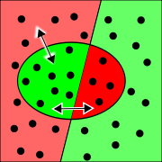
Quality Measurements
False positive – an item was marked as an entity but it was not
Missed entity – items that were not found
Precision - a measurement of fidelity
Relevancy – a measurement of completeness
recall
precision

Slide 92
Document Search Definitions
Precision: the number of relevant documents retrieved by a search divided by the total number of documents retrieved by that search
Recall: the number of relevant documents retrieved by a search divided by the total number of existing relevant documents which should have been retrieved

Slide 93
Entity Extraction Definitions
Precision: the number of relevant entities found divided by the total number of entities found in a collection
Recall: the number of relevant entities found divided by the number entities which should have been found in a collections

Slide 94

F-Measure
F-measure is a precise number that can help you gauge the quality of entity extractions
The weighted harmonic mean of precision and recall
F-Score

Slide 95
Return on Investment (ROI) Analysis
Process
Determine hard total costs without Entity Extractions
Estimate soft costs
Determine hard costs with Entity Extraction
Estimate soft costs
Sample spreadsheet
Low, medium and high soft cost estimates
Per document costs, enterprise total

Slide 96
Soft Costs: Search
What is the cost of not finding a document?
How much time do people spend looking for documents?
How often is the document you a looking for buried under 100 non-relevant documents?
How often do non-relevant documents get a high ranking in your search results?
What if relevant documents were higher on the search results?

Slide 97
Strategic Implications
Winners and Losers
Who will benefit from Terabytes of Linked Data?
What if the “Semantic Shadow Web” becomes a reality?
What if every document has a list of “similar documents”?
What will be the implications for site stickiness and search?

Slide 98
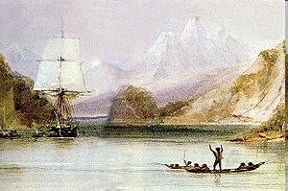
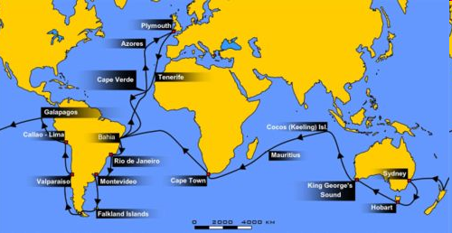
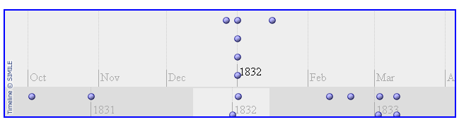
Sample XQuery Labs
Voyages of the Beagle
Document
Timeline
Map

Slide 99
Text Mining References
Note on dropping costs of text analytics:
http://www.b-eye-network.com/view/9720
LEX, LEX++
Locating Complex Named Entities in Web Text
Downey, Broadhead et el
Univ of Washingtol

Slide 100
BI/DW References
Mondrian. Mondrian OLAP Server. Available at:
http://mondrian.sourceforge.net
Ralph Kimball , Margy Ross, The Data Warehouse Toolkit: The Complete Guide to Dimensional Modeling, John Wiley & Sons, Inc., New York, NY, 2002

Slide 101
Thank You!
Questions
Dan McCreary
Kelly-McCreary & Assocaites
dan@danmccreary.com

