Slide 1

Common Warehouse Metamodel An Executive Overview For IT Strategy Developers and Data Architects January 2006
Dan McCreary
President
Dan McCreary & Associates
dan@danmccreary.com
(952) 931-9198
Managed Metadata Solutions

Slide 2
Agenda
Overview of Common Warehouse Metamodel (CWM)
Purpose of CWM
Structure of the CWM
Describe how to represent a business intelligence "cube" using the Common Warehouse Metamodel (CWM)
Understand how CWM is used to capture relational database and analytical database structures
Part of presentation required understanding of XML Schemas and XMLSpy™ schema notation
CWM and Java Metadata Interface (JMI) Standard
Strategies to avoid lock-in
References

Slide 3
Data Warehouse Metadata
We would like to have a semantically precise, vendor-neutral way to exchange data with a centralized metadata registry that is used for analytical processing
We would like it expressed in a OS-neutral and programming language-neutral structures like XML and XML Schema
We would like structures that could be used by many different tools involved in the Business Intelligence (BI) process (ETL, Relational, Analysis, Building Cubes, and Presentation) to use dimensional data consistently
We want to prevent metadata vendor lock-in

Slide 4
History of CWM
The first semantically precise metadata standards expressed in XML for data warehouse
Developed around 2000
Promoted by vendors that want to “get data out” of other systems

Slide 5
CWM Supporters
IBM
Unisys
NCR
Hyperion
Oracle
UBS AG
Genesis Development Corporation
Dimension EDI
(note that Cognos and Microsoft are missing from this list)

Slide 6
CWM is Built on XMI
XML is XML Metadata Interchange
XMI uses XML files and XML Schema to describe metadata
XML is built on another OMG standard called (MOF)
CWM extends a simplified subset of XMI and adds new metadata elements

Slide 7
CWM and Java
CWM implementations are all Java
Sample implementations are all Java
XMI has a Java API (called Java Metadata Interface)
Class libraries are all Java
Microsoft is not a CWM supporter

Slide 8
Learner Assumption
Understand basics of dimensional analysis and the structure of a “cube”
Dimensions classify data into “buckets”
Measures are summed and averaged
Understand XML Schemas and XMLSpy™ schema notation
Model types
Cardinality
Optional
Types

Slide 9
Dimensions “Classify” Data
Shape “Dimension”
Color “Dimension”
Note that classifications are hierarchical

Slide 10
Measures
Measures are data elements that you can “do math” on.
-
X
+
%
/
sum
average

Slide 11
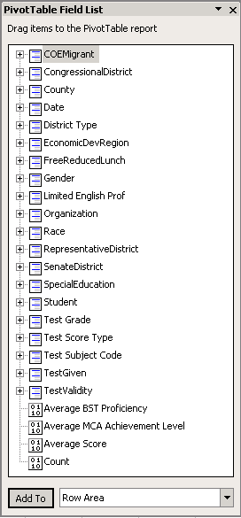
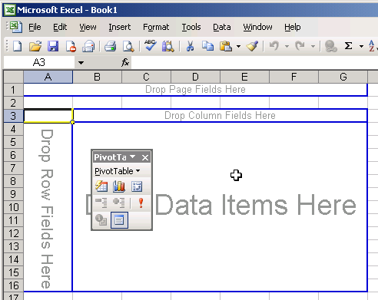
View From the Excel Pivot Tables
Just Drag and Drop!

Slide 12
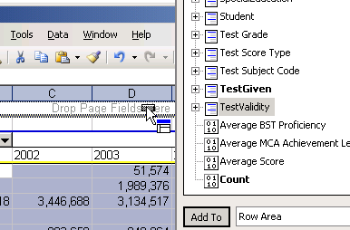
Cubes have Dimensions and Measure
Dimensions
Measures

Slide 13
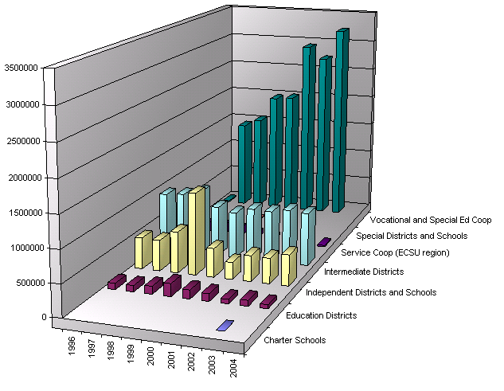
3D Bar Chart (Microsoft BI Portal)
Measures
Total
Expense
Dimension
(Organization Type)
Dimensions
(Fiscal Year)

Slide 14
XMLSpy™ Schema Notation
PersonMiddleName
Required Element
Sequence – elements in order
PersonMiddleName
Optional Element
Element Models
Choice – only one of the elements
All – elements in any order (avoid)
PersonGivenName
Typed element
1 . . ∞
Cardinality – 1 to many
PersonGivenName
Referenced element

Slide 15
CWM is an OMG Standard
OMG – Object Management Group
Started when CORBA was in vogue
Now more that just “Objects”
Reputation for building complex, non-human readable specifications
(UML, XMI)
CWM is built upon “simplified” UML and XMI standards

Slide 16
22 Packages in CWM
Warehouse
Process
Warehouse
Operation
Management
Transformation
OLAP
Data
Mining
Information
Visualization
Business
Nomenclature
Analysis
Object
(Core+ Behavioral+
Relationships)
Relational
Record
Multi-
Dimensional
XML
Resource
Business
Information
Data
Types
Expressions
Keys
Index
Type
Mapping
Software
Deployment
Foundation
Core
Behavioral
Relationships
Instance
Object Model

Slide 17
Focus on Four Packages + Base
Warehouse
Process
Warehouse
Operation
Management
Transformation
OLAP
Data
Mining
Information
Visualization
Business
Nomenclature
Analysis
Object
(Core+ Behavioral+
Relationships)
Relational
Record
Multi-
Dimensional
XML
Resource
Business
Information
Data
Types
Expressions
Keys
Index
Type
Mapping
Software
Deployment
Foundation
Core
Behavioral
Relationships
Instance
Object Model

Slide 18
Process
Learn about CWM concepts
Use tools (e.g. Cognos Framework Manager) to build a cube
Demonstrate how to export model from tool in CWM XML format (e.g. MyCube.cwm.xml)
Convert xml instance data into XML Schemas (e.g. CWM.xsd)
Study output, note differences, create GAP analysis
Create XML transforms directly from the Data Dictionary in CWM format that validates against these XML Schemas

Slide 19
Data Warehouse Metadata
Operational Source Systems
Data Staging
Area
Data Presentation Area
Data Access
Tools
Expenses
Extract
Financial Datamart
Services:
Load
Access
Services:
Standardize, clean, combine, transform,
conform
Standard Reports, Ad Hoc Query,
Report Writers, Analytic Applications,
Trend Analysis,
Data Mining,
Compliance Reporting, District Reports, School Reports
Income
Extract
Datamart
Bus
Person Datamart
Customer
Sales
Restrictions:
Load
Access
Extract
No user query service
Datamart
Bus
Operations
Extract
Organization Datamart
Features:
Load
Access
Consistent user of data, consistent user interface
ETL Tool
Metadata
Registry
Access
Tool

Slide 20
Review of Cube Building Process
Data Staging
Area (Physical)
Data Presentation Area (Logical)
Financial Datamart
RDB
Table
Load
RDB
Table
Product Datamart
Load
RDB
Table
RDB
Table
Service Datamart
Load

Slide 21
Cube to RDBMS Mapping
Cube
Relational Database
RDB
Table
Fact
RDB
Table
Dimension
RDB
Table
Dimension
RDB
Table
A cube is created by mapping RDB physical tables to a logic view of facts and dimensions. This is a many to many mapping.

Slide 22
CWM File Structure
XMI File
XMI:Header
Documentation, Metadata…
XMI:Content - Catalog
OLAP Schemas (logical)
Mappings of each table
Column to each cube Dimensions
RDB Schemas (physical)
Listing of all
Tables and columns

Slide 23
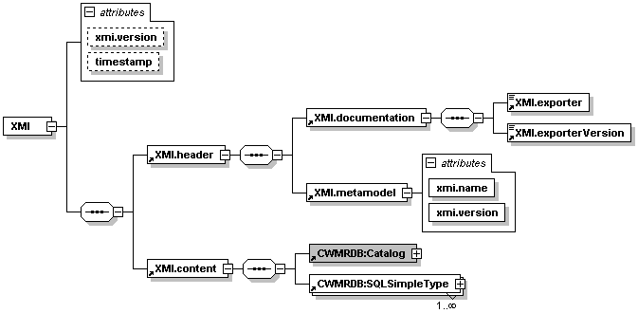
XMI Schema Structure
Source: CWM_XMI.xsd
Namespace: org.omg.CWM1.0
Namespace Prefix: CWM

Slide 24
The Name Spaces and Prefixs
xmlns:CWM="org.omg.CWM1.0" xmlns:CWMRDB="org.omg.CWM1.0/Relational" xmlns:CWMOLAP="Olap" xmlns:CWMTFM="Transformation"

Slide 25
CWM Base Types
CWM:Attribute
CWM:UniqueKey

Slide 26
Typical CWM Attributes
name – the name of the component (required)
xmi.id – the XML node id of the data element
xmi.idref – a pointer to another node in the XML file
visibility – is this data element visible to systems outside of the data element namespace?
schema – the schema the data element is associated with (usually optional)
namespace – the namespace of the data element (usually optional)
Note that by default attribute names are unqualified but do sometimes use a dot notation:
xmi.id, xmi.idref
name

Slide 27
OLAP Elements
CWMOLAP:Cube
CWMOLAP:CubeDimensionAssociation
CWMOLAP:Dimension
CWMOLAP:Hierarchy
CWMOLAP:HierarchyLevelAssociation
CWMOLAP:Measure
CWMOLAP:MemberSelection

Slide 28
RDB Elements
CWMRDB:Catalog
CWMRDB:CheckConstraint
CWMRDB:Column
CWMRDB:ForeignKey
CWMRDB:PrimaryKey
CWMRDB:Procedure
CWMRDB:Schema
CWMRDB:SimpleType
CWMRDB:DistinctType
CWMRDB:SQLIndex
CWMRDB:SQLIndexColumn
CWMRDB:Table
CWMRDB:Trigger
CWMRDB:UniqueConstraint
CWMRDB:View
Of the 15 RDB Elements, only 8 are used with great frequency.

Slide 29
Transformation Elements
CWMTFM:ClassifierMap
CWMTFM:FeatureMap
CWMTFM:TransformationMap

Slide 30
Basic Structure of CWM Cube File
<?xml version="1.0" encoding="UTF-8"?>
<XMI>
<XMI.header>
<XMI.documentation>…OMITTED FOR CLARITY…</XMI.documentation>
<XMI.metamodel xmi.name="CWM" xmi.version="1.0"/>
</XMI.header>
<XMI.content>
<CWMRDB:Catalog xmi.id="_4" name="Model">
<CWM:Namespace.ownedElement>
<CWMOLAP:Schema xmi.id="_5" name="Logical">
…LINK MAPPINGS OMITTED FOR CLARITY…
</CWMOLAP:Schema>
<CWMRDB:Schema xmi.id="_14" name="Physical">
…PHYSICAL TABLE DEFINITIONS OMITTED FOR CLARITY…
</CWMRDB:Schema>
<CWMOLAP:Schema xmi.id="_14" name="Physical">
… PHYSICAL TABLE DEFINITIONS OMITTED FOR CLARITY…
</CWMOLAP:Schema>
</CWM:Namespace.ownedElement>
</CWMRDB:Catalog>
</XMI.content>
</XMI>
Visibility="public" attributes omitted for clarity

Slide 31
Venn Diagram of Cube
RDB:Catalog Model
OLAP:Logical
RDB:Physical
Table
Index
Table
Index
Dimension
Index
Table
Dimension
Link Maps
Dimension
Link Maps
Link Maps
RDB:Physical
Table
Index
Table
Index
Table
Index

Slide 32
Sample Physical Table
<CWMRDB:Table xmi.id="_15" name="MyTableName" > <CWM:Classifier.feature>
<CWMRDB:Column xmi.id="_16" name="myPrimaryKeyID" precision="4" type="_17" />
<CWMRDB:Column xmi.id="_18" name="myForeignKey1ID" precision="4" type="_17" />
<CWMRDB:Column xmi.id="_19" name="myForeignKey2ID" precision="4" type="_17" />
<CWMRDB:Column xmi.id="_20" name=" myForeignKey3ID" precision="4" type="_17" />
<CWMRDB:Column xmi.id="_21" name="description" length="200" type="_22" />
</CWM:Classifier.feature>
<CWM:Namespace.ownedElement>
<CWMRDB:ForeignKey xmi.id="_23" name="unnamed_23" namespace="_15" feature="_19" uniqueKey="_24"/>
</CWM:Namespace.ownedElement>
</CWMRDB:Table>
Pointer to
List of types

Slide 33
General Column Options
xmi.id="XML_Node_ID"
name="MyColumnName"
isSystem="false" | "true"
isTemporary="false" | "true"
visibility="public"
namespace="XML_Node_ID_Ref"
owner=" XML_Node_ID_Ref"
isNullable="columnNoNulls" | "columnNullable"

Slide 34
Numeric Column Attributes
length="integer"
characterMaximumLength="integer"
precision="integer"
numericPrecision="integer"

Slide 35
Column Simple Data Types
<CWMRDB:SQLSimpleType
xmi.id="_22"
name="VARCHAR2"
visibility="public" characterMaximumLength="200"
characterOctetLength="1"
typeNumber="12"
/>

Slide 36
Link Maps in Detail
Map
<CWMTFM:TransformationMap xmi.id="7">
<CWM:Namespace.ownedElement>
<CWMTFM:ClassifierMap>
<CWMTFM:ClassifierMap.source>
<CWM:Classifier xmi.idref="SOURCE_COLUMN_ID_1"/>
<CWM:Classifier xmi.idref=" SOURCE_COLUMN_ID_2 "/>
<CWM:Classifier xmi.idref=" SOURCE_COLUMN_ID_3 "/>
<CWM:Classifier xmi.idref=" SOURCE_COLUMN_ID_4 "/>
<CWM:Classifier xmi.idref=" SOURCE_COLUMN_ID_5 "/>
</CWMTFM:ClassifierMap.source>
<CWMTFM:ClassifierMap.target>
<CWM:Classifier xmi.idref="TARGET_DIMENSION_XML_ID"/>
</CWMTFM:ClassifierMap.target>
</CWMTFM:ClassifierMap>
</CWM:Namespace.ownedElement>
</CWMTFM:TransformationMap>
My Logical Dimension
Classifier 1
Classifier 2
Table
Classifier 3
Column 1
Column 2
Column 2
Link Maps have a physical column source for each attribute of the dimension

Slide 37
Sample Dimension Mapping
<CWMOLAP:Schema xmi.id="_5" name="Logical" visibility="public" namespace="_4">
<CWMOLAP:Schema.dimension>
<CWMOLAP:Dimension xmi.id="_6" name="Assessment Summary" visibility="public" schema="_2">
<CWM:Namespace.ownedElement>
<CWMTFM:TransformationMap xmi.id="7" visibility="public" namespace="_6">
<CWM:Namespace.ownedElement>
<CWMTFM:ClassifierMap xmi.id="_8" name="unnamed_8"
visibility="public" namespace="7" transformationMap="7">
<CWMTFM:ClassifierMap.source>
<CWM:Classifier xmi.idref="_9"/>
<CWM:Classifier xmi.idref="_10"/>
<CWM:Classifier xmi.idref="_11"/>
<CWM:Classifier xmi.idref="_12"/>
<CWM:Classifier xmi.idref="_13"/>
</CWMTFM:ClassifierMap.source>
<CWMTFM:ClassifierMap.target>
<CWM:Classifier xmi.idref="_6"/>
</CWMTFM:ClassifierMap.target>
</CWMTFM:ClassifierMap>
</CWM:Namespace.ownedElement>
</CWMTFM:TransformationMap>
</CWM:Namespace.ownedElement>
</CWMOLAP:Dimension>
</CWMOLAP:Schema.dimension>
</CWMOLAP:Schema>
Pointers to DB Columns

Slide 38
Namespace Containers
Catalog
<CWMRDB:Table
xmi.id="_70"
name="Primary Score"
namespace="_14">
<CWMOLAP:Schema
xmi.id="_14"
name="Physical"
visibility="public"
namespace="_4">
<CWMRDB:Catalog
xmi.id="_4"
name="Model"
visibility="public">
Schema
Table
The namespace of this table
The namespace of this schema
The namespace of this Catalog
Note that the catalog's name is "Model"

Slide 39
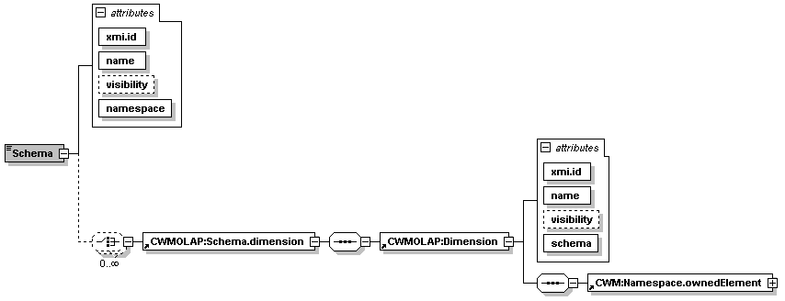
An OLAP Schema in CWM
An OLAP Schema has many dimensions, each dimension has many elements.
Source: CWM_OLAP.xsd
Namespace: org.omg.CWM1.0
Namespace Prefix: CWMOLAP

Slide 40
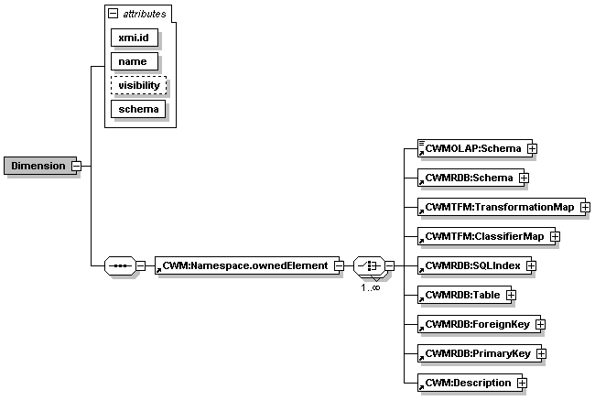
The Dimension XML Schema
A dimension has many elements, each of which
is one of the types at the right.
Source: CWM_OLAP.xsd
Namespace: org.omg.CWM1.0
Namespace Prefix: CWMOLAP

Slide 41
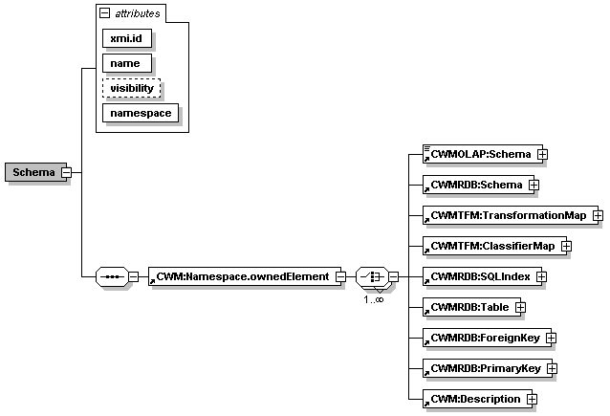
Database Schema in CWM
Source: CWM_Relational.xsd
Namespace: org.omg.CWM1.0/Relational
Namespace Prefix: CWMRDB

Slide 42
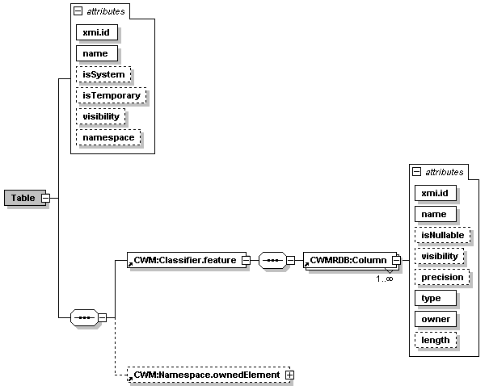
CWM Table
Source: CWM_Relational.xsd
Namespace: org.omg.CWM1.0/Relational
Namespace Prefix: CWMRDB

Slide 43
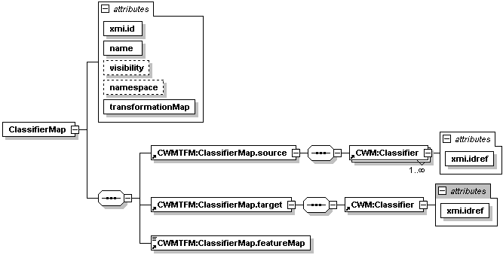
Classifier
Source: CWM_Transform.xsd
Namespace: Transform
Namespace Prefix: CWMTFM

Slide 44
Java Metadata Interface
Q: What is an XML-speciation an API?
When you publish it!
Class libraries available from vendors
Built on XMI, not CWM

Slide 45
JMI Overview
JMI…enables the implementation of a dynamic, platform-independent infrastructure to manage the creation, storage, access, discovery, and exchange of metadata
(Note: no reference to CWM)
JMI is based on the Meta Object Facility (MOF) specification from the Object Management Group (OMG), an industry-endorsed standard for metadata management.
The MOF standard consists of a set of basic modeling artifacts described using UML
Models of any kind of metadata (called metamodels) can be built up from these basic building blocks.
JMI defines the standard Java interfaces to these modeling components, and thus enables platform-independent discovery and access of metadata.
JMI allows for the discovery, query, access, and manipulation of metadata, either at design time or runtime
The semantics of any modeled system can be completely discovered and manipulated
Provides for metamodel and metadata interchange via XML by using the industry standard XML Metadata Interchange (XMI) specification.
Source: JMI web site

Slide 46
Recommendations
Avoid getting locked-in into a single-vendor’s metadata management strategy
CWM can be a valuable tool to prevent vendor metadata lock-in strategies
Many vendors say they “support” CWM
Try before you buy
Many vendors import, but do not export all CWM data elements
Use 3rd party tools to extract CWM if the vendors export tools are not adequate

Slide 47
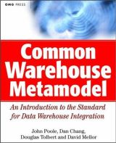
CWM Standard
Published November 15, 2001
Discusses layered architecture of CWM and MOF
Introduction to the standard for non-programmers
Requires knowledge of XML, and UML
Describes relationship to OMG family of standards (MOF, MDA etc)

Slide 48
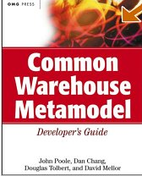
CWM Developer’s Guild
Published in 2003
Detailed technical guide for programmers
Many Java code samples
Some Microsoft ADO code samples
Extensive discussion of Java Metadata Interface (JMI) specification

Slide 49
References
CWM Standard
http://www.omg.org/cwm/
CWM Forum
http://www.cwmforum.org/
(Not current – last update 2000)
Java Metadata Interface
http://java.sun.com/products/jmi

Slide 50
Thank You!
Please contact me for more information:
Metadata Management Services
Web Services
Service Oriented Architectures
Business Intelligence and Data Warehouse
Metadata Registries
Semantic Web
Dan McCreary, President
Dan McCreary & Associates
Metadata Strategy Development
dan@danmccreary.com
(952) 931-9198

