Slide 1

Twin Cities Hadoop User Group NoSQL Use Cases
Stores and Lessons Learned
Dan McCreary
Nov. 14th, 2013

Slide 2
NoSQL and Hadoop
Data Architecture Patterns
Transformation at Scale
NoSQL
Hadoop
Graphs
MapReduce
Semantics
HBase
Schema free
HDFS
Agility
Distributed Computing
Many, but not all topics overlap

Slide 3
Before NoSQL
Relational
Analytical (OLAP)
Copyright Kelly-McCreary & Associates, LLC
3

Slide 4
After NoSQL
Relational
Analytical (OLAP)
Key-Value
key
value
key
value
key
value
key
value
Column-Family
Graph
Document
4

Slide 5
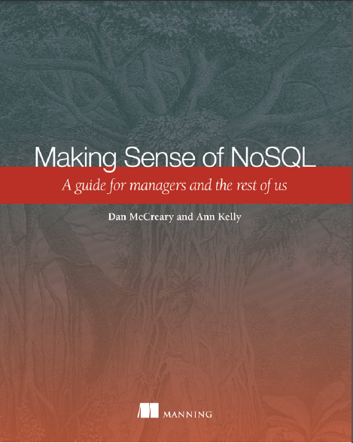


Making Sense of NoSQL
Authors of Manning book on NoSQL
Guide for managers and architects
Focus on NoSQL architectural tradeoff analysis
Basis for 40 hour course on database architectures
http://manning.com/mccreary

Slide 6
8 Stories That Help Us Remember
Property Tax Forms (MN)
LiveJournal (Memcache)
Financial Glossaries – NoSQL for metadata (MN)
Vehicle Telemetry on SQL (MN)
Digi International - Wireless Sensors on Cassandra (MN)
Secure Search - MarkLogic
HVAC Equipment Monitoring with a Column-Store (MN/WI)
ATAM – objective database selection – (CMU)
Some of the stories that we learn the most from don't have happy endings!

Slide 7

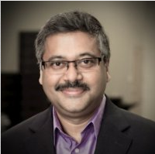
Story #1: Property Tax Forms
Alex Bleasdale
In 2006 a state agency in Minnesota wanted like to standardize property tax records across 87 counties
Based data elements on National Models
A story about standards
XML, XML Schema, XForms, XQuery, NEIM
A story about agility
A story about new technology adoption
Arun Batchu

Slide 8
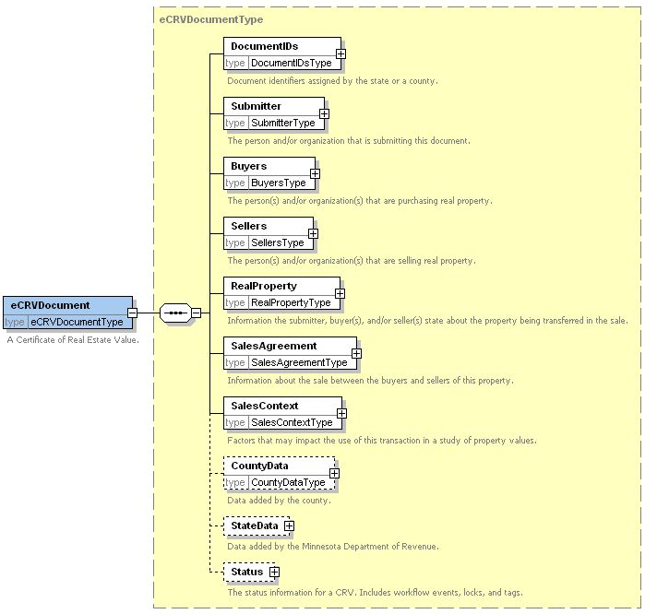

Slide 9
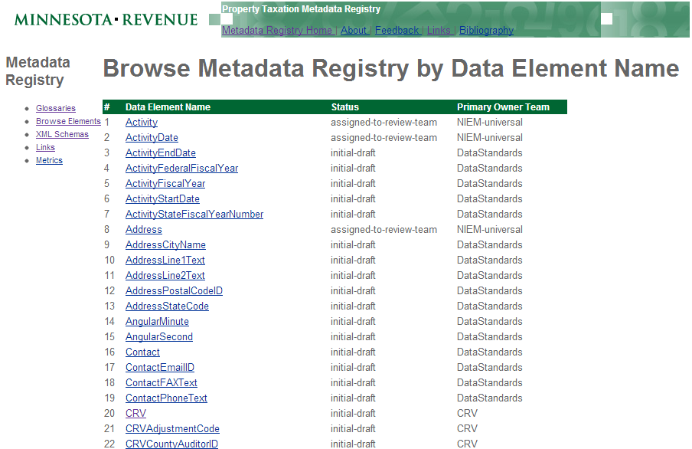

Slide 10
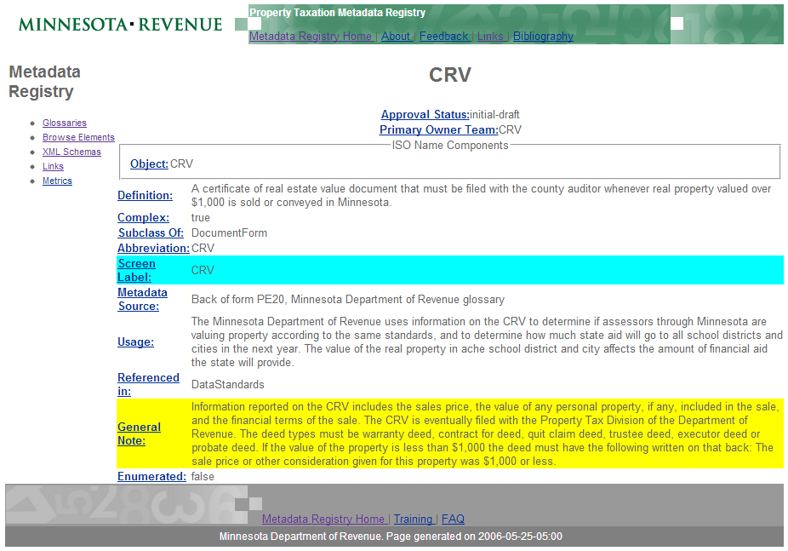

Slide 11
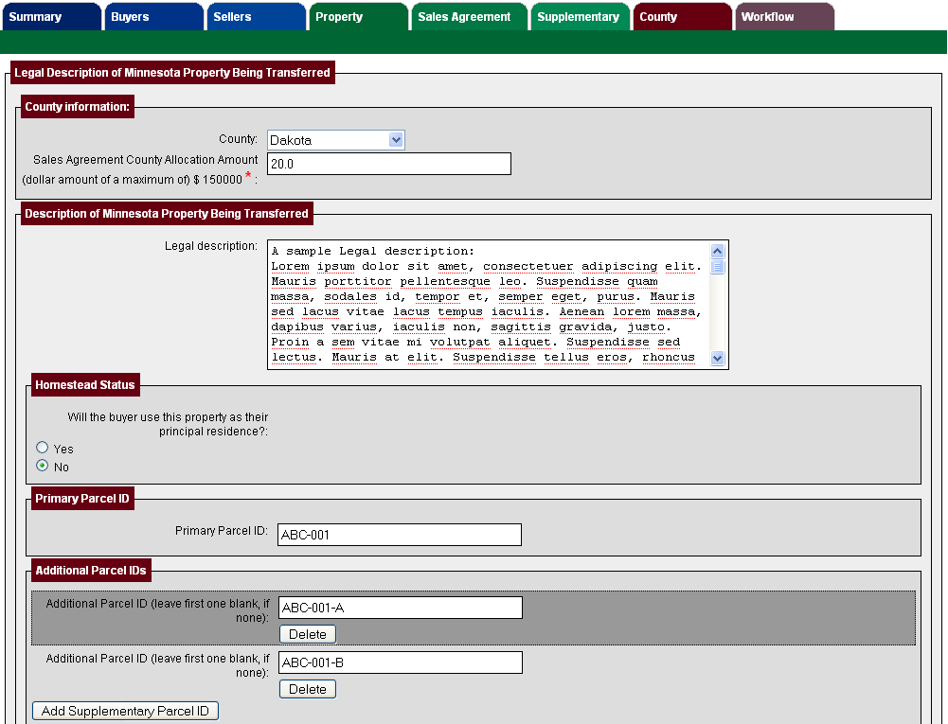
XForms from XML Schema!

Slide 12
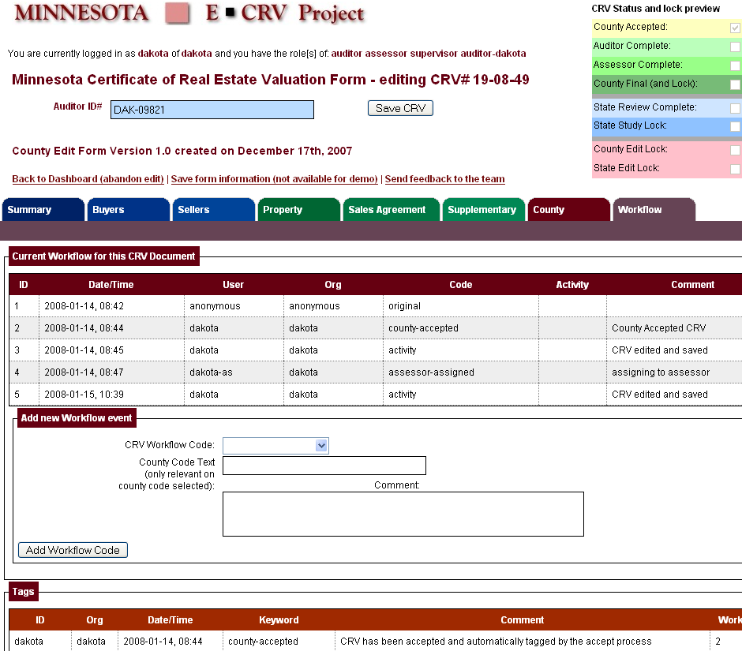

Slide 13

Four Translations
T1
T2
T3
T4
Web Browser
Object Middle
Tier
Relational
Database
T1 – HTML into Java Objects
T2 – Java Objects into SQL Tables
T3 – Tables into Objects
T4 – Objects into HTML

Slide 14

Kurt's Suggestion
Use a Native XML Database!
Web Browser
Web Form
Kurt Cagle
Save
eXist-db
store($collection, $file-name, $data)
Equivalent of 45 SQL inserts in 1 line of code!

Slide 15

Zero Translation
XForms
Web Browser
XML database
XML lives in the web browser (XForms)
REST interfaces
XML in the database (Native XML, XQuery)
XRX Web Application Architecture
No "impedance mismatch", No translation!
Department tried it and then went back to HTML, Java and SQL
…but I was forever changed

Slide 16

Parker Projection
Relative Code Base
100%
Procedural code (Java, JavaScript, VB, C#, C++)
Declarative code (XHTML, CSS, XSLT, XQuery, XForms)
Time
Source: Jason Parker, Minnesota Department of Revenue, November 2006

Slide 17
Lessons Learned
For many business forms
Standards rock
XML, XML Schema, XQuery, XForms
The model (XML Schema) continually evolves
Transform the model to forms
Store form data into schema-free NoSQL
Tables suck, trees rock!
2006 was too early for a state agency to adopt radically new and innovative technology

Slide 18

Story #2: LiveJournal and Memcache
A story about sharing information in a distributed computing environment
A story about hashing, caching, APIs, open source …and standards

Slide 19


2003 - Memcache
Originally developed by Brad Fitzpatrick for LiveJournal as a "side-cache"
Allowed databases to put data in a "RAM Cache" in front of a SQL server to speed up read-mostly operations
Dramatically lowers load on backend SQL server
Ideal "front end" to database system to increase performance
Brad Fitzpatrick

Slide 20
Same query -> Same hash value
Web Server 1
Anybody got this result?
SELECT * FROM CUST WHERE CID = '123'
md5($query) = 'c5506c1e5967eaa63ce10a06ee262347'
SELECT * FROM CUST WHERE CID = '123'
I have a copy!
Web Server 1
Same query, same hash of query, same result!

Slide 21
Partition Select and Updates
memcachedb
memcachedb
Select
memcachedb
Sync with memcached protocol
Insert
Update
Delete
SQL "System of
Record"
Most frequently read data always stays in RAM
Complex update transactions go directly to the database
Example of separation of concerns

Slide 22
Lessons Learned
Database speed is all about
Hashing queries
Caching query results
Sharing data between servers
web servers AND database servers
Open source
Standards

Slide 23


Story #3: Financial Semantics
Matt Steele
A 2007 story about the meaning of data
A story about "spreadmarts" – 100,000 spreadsheets
A story about learning and having a good attitude and an open mind
Hired to build a business intelligence systems
Each business unit had their own business terms, rules and definitions
Jeremy Sutton

Slide 24
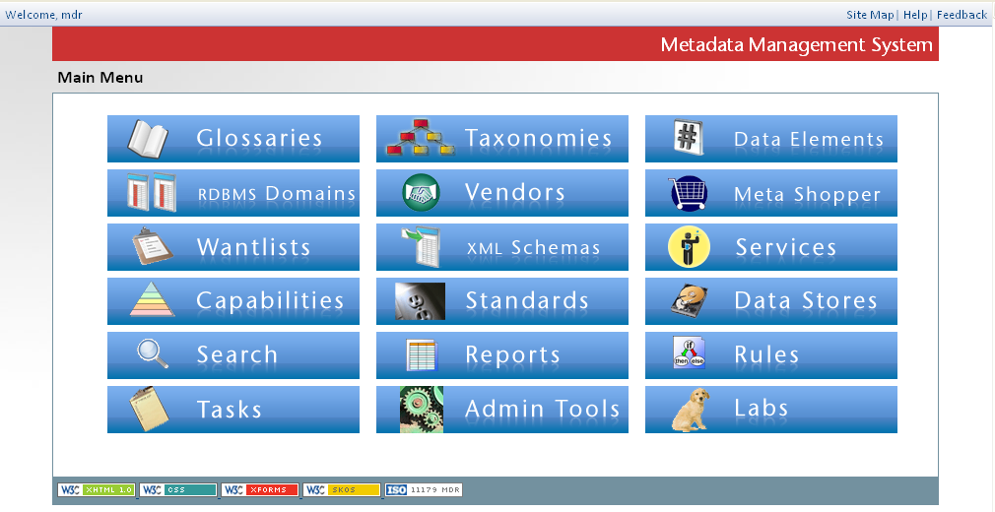
XRX Metadata Applications

Slide 25
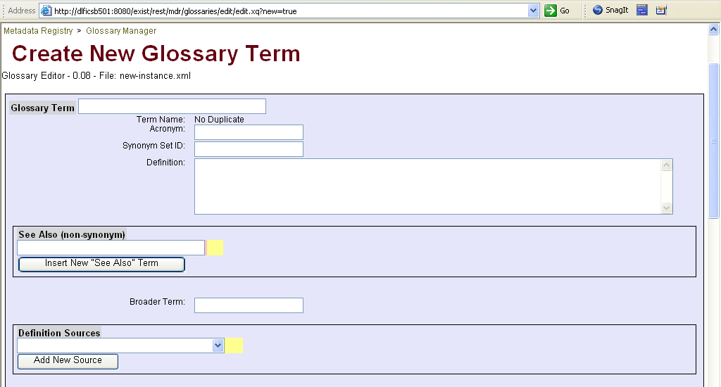
Business Glossary Forms

Slide 26
Lessons Learned
Single source of the truth for terms, rules and definitions
18 Applications created in under one year
No SQL, just forms and a XML database
Two interns
recent St. Johns graduates (Matt and Jeremy)
no fear of new technology
High priced consultants get let go…(me)
but interns keep the systems going
Still in use today!

Slide 27
Case Study #4
Minnesota company that puts vehicle tracking hardware in trucks
Allows fleets to be easily monitored
Saves customers time and money
Monitors 100s of parameters!
location, speed, accelerating, breaking, engine wear….
Data sent over wireless networks every 15 minutes

Slide 28
What Database Did They Use?
Their data
SQL
immutable data stream
need to continually add customers
some data has high-priority (engine temperature too high)
Need for analytic summaries across all data
designed for ACID transactions with updates
SQL server does not scale well over clusters of 100s of nodes
no easy way to prioritize messages
no OLAP cubes

Slide 29
Challenges
CIO had no experience with NoSQL
Staff had no experience with NoSQL
Local contractors could not provide low-cost developers with NoSQL
No other local companies had sufficient experience with NoSQL
The story continues….

Slide 30
Story #5: Digi International
Organizations that used to just provide hardware can now provide a complete solution
solution = hardware + software
Setting up your own cluster is expensive
Hardware companies can grow if they adopt new technologies

Slide 31

Digi International Backgrond
M2M = Machine to Machine
Pioneers in serial communication (modems)
Large player in the wireless monitoring space
Example:
Customer purchases 10,000 devices to monitor ice machine health across the US
Question: where to put the data?

Slide 32
Data Type
Immutable data streams of event logging data
Little need for updates
Need to be able to add nodes to cluster
Need for high availability

Slide 33
Master-Slave vs. Peer-to-Peer
Master-Slave
Peer-to-Peer
requests
requests
Used only if primary master fails
Master
Standby
Master
Node
Node
Node
Node
Node
Node
Node

Slide 34

Solution
Cassandra cluster
Linear scalability
Supports high write throughput
Cassandra has no single point of failure (peer-to-peer)
Looking for local Cassandra developers
Mike.Zarns@digi.com
VP Cloud Platforms

Slide 35
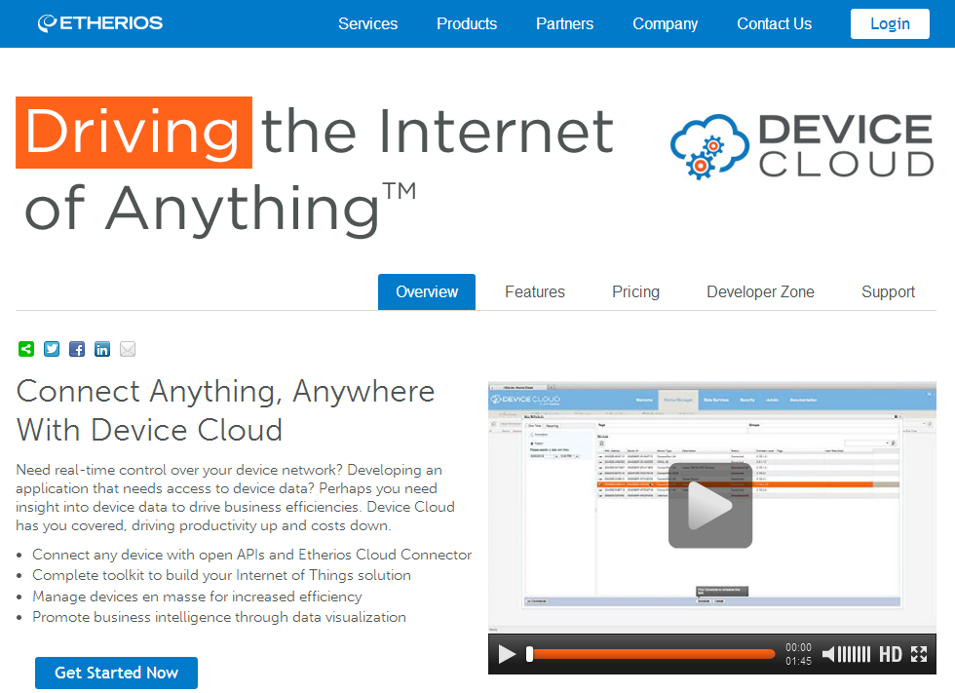

Slide 36
Case Study #6: Secure Search - MarkLogic
You have thousands of people working on highly classified documents
Many groups need to be able to access only parts of some documents
You need one secure database that supported XML, XQuery, RDF and SPARQL
You need strong encryption and audit

Slide 37
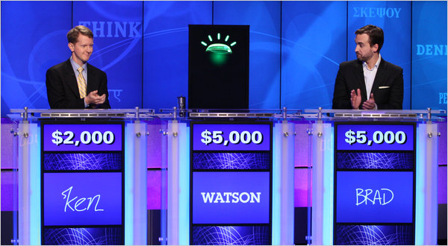
Natural Language Query
You want real-time high precision search with a "Watson Jeopardy like" natural language search over text with semantic annotations (dates, people, places, products,terms)

Slide 38
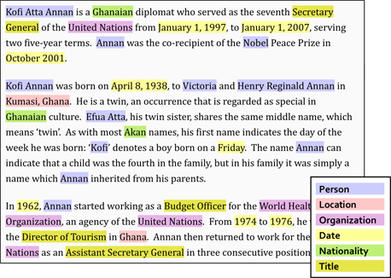
Documents are Collections of Nouns
http://www.basistech.com/entity-extractor/

Slide 39
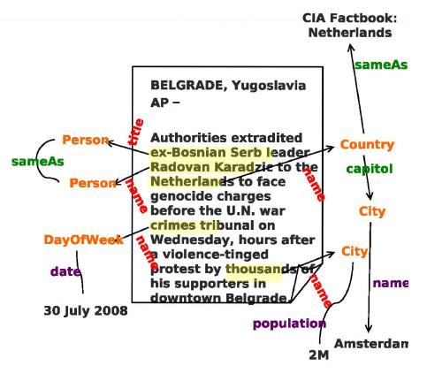
Extracting Facts From Text
Person
Places
Dates
Relationships
http://publicintelligence.net/wp-content/uploads/2012/04/dni-entityextraction.png

Slide 40
MarkLogic 7
Search
XQuery
1 TB Documents
SPARQL
facts
100 Node Cluster
Needs to work with Hadoop
Needs distributed queries
Distributed queries and "joins" need distributed statistics
Looking forward: Apache Drill

Slide 41
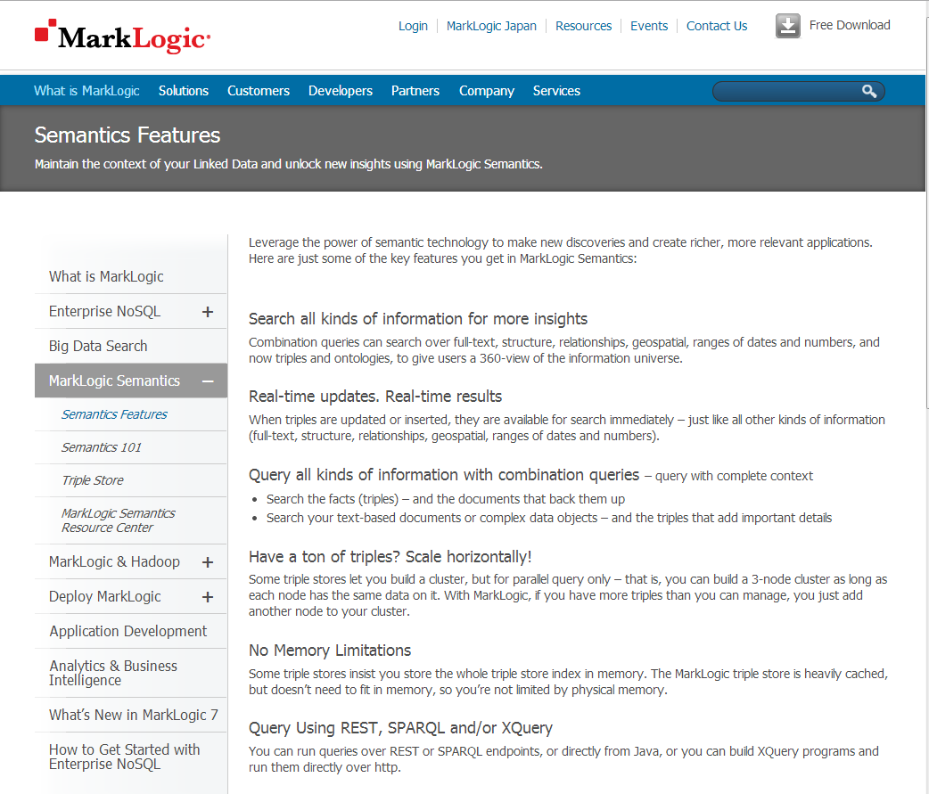
Secure Queries on Documents and Graphs

Slide 42

Case Study #7: HVAC Monitoring
Company designs and builds HVAC hardware
Need to monitor hardware and feed time series data
SQL system was not scaling so an outside expert was called in
Michael Krouze
Chief Technology Officer at Charter Solutions
"You don't have a database problem, you have architecture problem!"

Slide 43
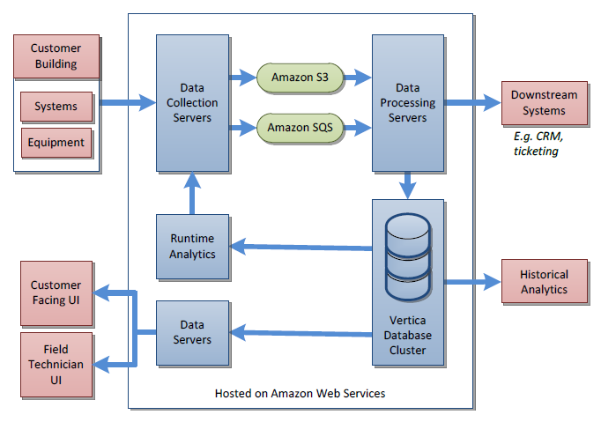
Solution

Slide 44
Lessons Learned
It is hard to write a service that scales well has 11 nines write guarantees
Using multiple cloud services to capture and process data is a great way to separate concerns

Slide 45
Case Study #8: CMU's ATAM
Problem – need an objective way to evaluate various architectures
Introduced to me by Howard Dodd
director at Prime Therapeutics

Slide 46
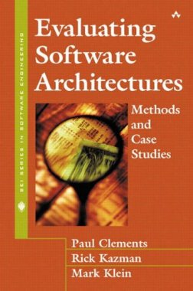
Key Book for ATAM
Evaluating Software Architectures: Methods and Case Studies
by Paul Clements, Rick Kazman, and Mark Klein
Addison-Wesley, 2001
We need "Evaluating Database Architectures"!

Slide 47

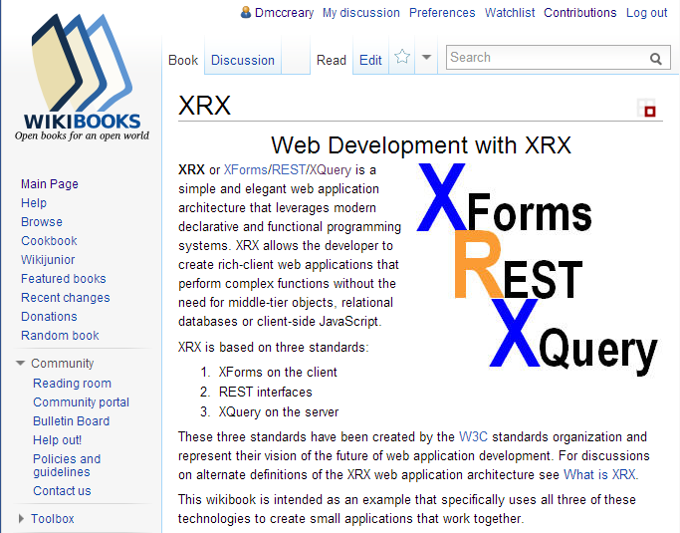

Anger, Wiki, Conference, Book
2011, 2012, 1013

Slide 48
ATAM Process Flow
Business
Drivers
Quality
Attributes
User
Stories
Analysis
Architecture Plan
Architectural
Approaches
Architectural
Decisions
Tradeoffs
Impacts
NoSQL Patterns
Sensitivity
Points
Non-Risks
Distilled info
Risk Themes
Risks

Slide 49
Sample Utility Tree
Availability
Each topic (Quality Attribute) helps focus the discussion of a selection team
Topics and subtopics are ranked on both importance to a topic and overall difficulty
The topics vary from project to project
Big Data projects focus on "Scalability" and "Findability" etc.
Objective ranking of requirements before you begin talking about architecture alternatives
Scalability
Maintainability
Affordability
Interoperability
Sustainability
Security
Portability
Findability

Slide 50
Using Quality Trees to Communicate Risk
Availability
A solid green border indicates no problems – our architecture and product meet the requirements of the project
Scalability
This quality has been ranked as a medium level of importance to the project but the architecture has low portability to other databases
The highest warning rolls up to each parent node
Maintainability
Portability
Alternate DBs
Code can be ported to other databases (M, L)
Affordability
A dashed red line indicates architectural risk
This quality has been ranked as a high level of importance to the project, but the implementation being considered has been evaluated as a low compliance. This helps us rank project risks.
Interoperability
Sustainability
Authentication
Authorization
Only some roles can update some records (H, L)
Security
Audit
Encryption

Slide 51
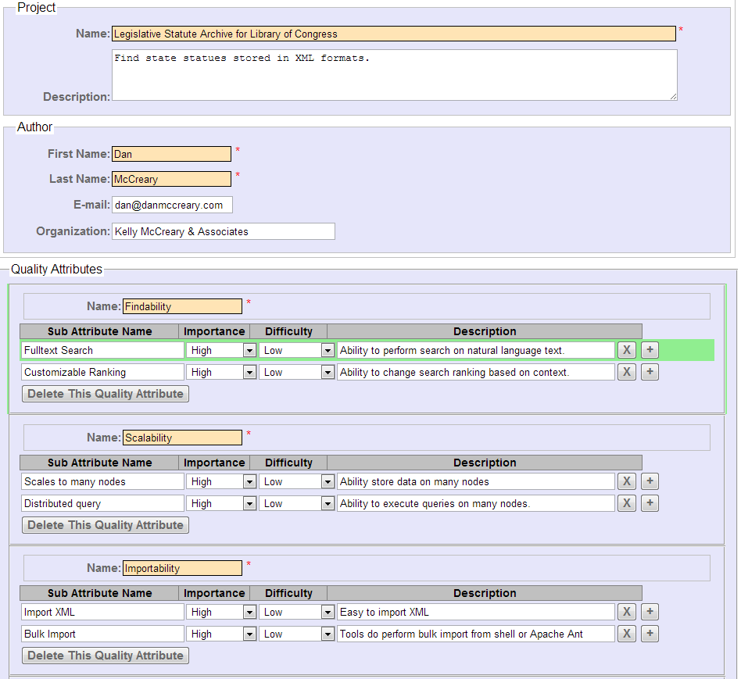
XForms Quality Attribute Utility Tree

Slide 52
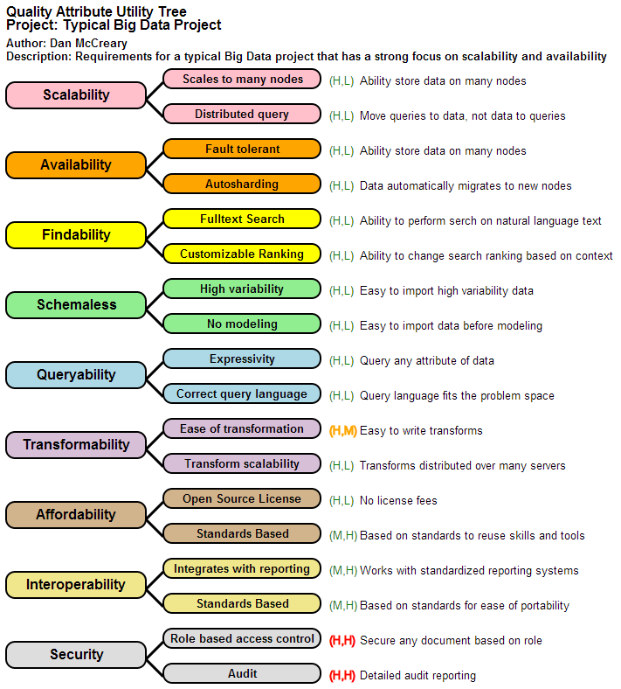
Sample SVG
Report

Slide 53


Concluding Remarks

Slide 54
Summary
Timing is critical in new technology adoption
Technology moves from organization to organization through people, not the internet
We need to create local groups that helps nurture new technology adoption and innovation to keep Minnesota companies globally competitive
Downloading is easy, gaining acceptance is hard
Picking the right pilot project is critical

