Slide 1

Graph Embeddings
November 5th, 2020
Dan McCreary
Distinguished Engineer
Advanced Technology Collaborative
Notes:
Hi – my name is Dan McCreary. I am a Distinguished Engineer working in the Advanced Technology Collaborative. I am leading the graph technologies initiative within the Optum Advanced Technology Collaborative. Our goal is to build a collaborative community the use graph technology to lower the cost of healthcare and give Optum a competitive advantage in the marketplace.

Slide 2
Talk Description
Today, many enterprise analytics functions are being created by manually creating low-level rules. But what if our analytics systems automatically mapped every customer, purchase and recommendation into 200-dimension mathematical space that allowed for ultra-fast (100 millisecond) queries of similar items? We could just select a few customers, products or features and request “more like these”. This is the promise of graph embeddings, one of the most exciting areas that combines knowledge graph and machine learning. This session will review the latest in enterprise knowledge graphs and show how new combinations of machine learning and knowledge graphs will transform analytics.

Slide 3
Agenda
What are graph embeddings?
Why are they important for analytics?
What is a distributed native property graph?
What are HTAP systems?
Why are graphs closely connected to AI and machine learning?
What is graph embedding?
What is GQL?
How do I explain graphs to my management?
Why are current CISC processors inappropriate for cost-effective graph algorithms?
The future of Enterprise Knowledge Graphs – Emergence!
Notes:
This is a high-level agenda of what we want to cover in this session. We are going to start out with some external forces in the database market happening outside of Optum. We will focus on how companies in the Bay Area, like Google, Facebook and LinkedIn have created a competitive advantage using graph technology. We will then explain what a graph databases is and how it is different than a traditional relational database. Next we will discuss graph use cases in healthcare and some of the standards and vendors in the marketplace today. We will then wrap up with some issues around training and resource for you to learn more about graph technologies.

Slide 4

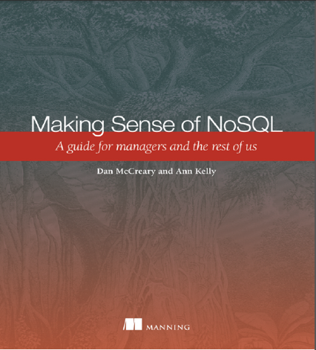
Hello, my name is
Dan
Distinguished Engineer in AI and Graph Technologies
Co-founder of "NoSQL Now!" conference
Author of "Making Sense of NoSQL" (w. Ann Kelly)
17+ years of working with NoSQL
Worked with Brian Kernighan (Bell Labs) and Steve Jobs (NeXT)
Background in solution architecture, metadata management, NLP, semantics, text analytics and knowledge representation for AI
Active in STEM and robotics volunteering
Co-founder of AI Racing League
Disclaimer: Opinions are my own and do not represent the views of my employer
dan.mccreary@optum.com
Notes:
My background is a solution architect. I have spent most of the last 20 years understanding how to objectively match business problems to the appropriate technologies. My focus has been on the fast-evolving area of NoSQL databases. I have also had a strong interest in AI, semantics, natural language process and search. I have been working on challenges problems in C360 and Benefit Search for over four years within Optum.

Slide 5
The World is “Not Only SQL” (a.k.a. NoSQL)
Relational
Analytical (OLAP)
Key-Value
key
value
key
value
key
value
key
value
Column-Family
Graph
Document
See Chapter 1: https://www.manning.com/books/making-sense-of-nosql
5
Notes:
OK, now lets take a step back and take a more structure look at where these tools fit into our business processes.
There are six main database architecture patterns we use when we think of a business problem.
Relational or row-stores
Analytical or OLAP
Key-Value stores – one of the simplest but most extensible data architectures
Column-family stores
Graph stores
and Document stores
Graph is just one of these six. Graph stores are often most closely related to document stores. Both Graph and document stores have the ability for new data to be added to structures without needing to remodel the data. We call these systems schema-free or schema agnostic. They are a key driver for highly agile systems.
Your systems may often draw on two or more of these systems. Databases that support multiple data models are called multi-model databases. They prevent us from having to store the same data over in multiple systems for transactions, search and analytics. Multi-modal systems that integrate graph technologies are also an emerging trend.

Slide 6
Encourage Systems Thinking
Enterprise Knowledge Graph Solutions
Subject
Matter
Experts
Data
Science
Graph
Hardware
The four pillars of support for enterprise knowledge graphs!
We need specialists and systems thinking!

Slide 7
Enterprise Knowledge Graph
Definition: A single graph database that connects all your organization’s information.
Defect
Data Quality
Skill
Software
Service
Employee
Training
Metadata
Career Goal
Employee
Purchase
Product
Customer
Call Center
Training
Product
Recommendation
Call
E-mail
Call Center
Agent
Reviews
NPS

Slide 8
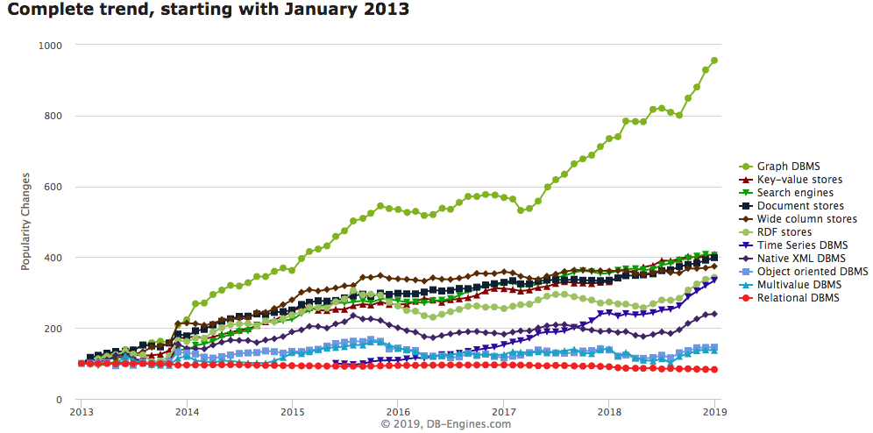
Graph Databases are HOT!
Graph Databases
https://db-engines.com/en/ranking_categories
Notes:
This chart shows the relative change in popularity of graph databases compared to other technologies according to DB Engines. DB Engines has web crawlers that regularly harvest an classify data related to databases. You can see that Graph Database popularity is the fasting growing database technology. This trend started in 2013 and it is continuing strong in 2018. Note that is is not absolute popularity. This is the change is popularity. Popularity also does not imply suitability. However, with these disclaimers aside you can clearly see a sustainable trend. Let’s see what other evidence we have about the rise of graph technologies.

Slide 9

Executive Summary
Graph analysis is possibly the single most effective competitive differentiator for organizations pursuing data-driven operations and decisions ...”
https://www.gartner.com/doc/2852717/it-market-clock-database-management
Notes:
Lets start with a summary. There is clear evidence that graph technologies provide a significant product differentiation in the marketplace. If we take a close look at Google, Facebook and LinkedIn they have all use graph technologies to differential them from their competition. If would be difficult to complete in many areas without understanding how fast relationship traversal is impacting their solutions.
Right now, we don’t have a huge amount of graph technology within UHC and Optum. After understand the impact of graph technology on business we think we can make a compelling case that we can’t be left behind in this area.
Although the Gartner quote uses the work Graph analysis, graph transactional systems are also having a similar impact.

Slide 10
Graph Technologies
Graph Technologies
Graph Databases
Graph Analytics
Graph Visualization
Graph Discovery
Notes:
So when we talk about graph technologies, we are really talking about four different things:
Real-time graph databases support ACID transactions and high-availability clusters. Some of them also have robust role-based access control.
Graph analytics are looking for specific known patterns in a graph or are running specific cluster analysis algorithms such as page rank. Some of these systems are highly tuned for use cases like fraud detection.
Graph visualization is how we present complex graphs to users (colors, patterns, labels). Web-based graph visualizations tools and desktop tools like Gephi are good examples of the UI components of graphs.
Lastly, there are a new generation of tools built around Graph Discovery. We use these tools is when you don’t know what we are looking for but we want to be notified if there are unexpected variations in our data.

Slide 11
Relational vs. Graph
Relational (row store)
Graph
ID
NAME
DATE
AMOUNT
Atomic unit of storage is a row of a table and data is appended to a table one row at a time
All columns within a table must have the same structure and no variations within a table are allowed
Table structures are fixed after design – all rows have the same structure
Relationship traversal is done via JOINs at runtime using log(N) search’s calculated at query time
Difficult to distribute over a cluster of 100+ nodes
Atomic unit of storage are nodes and edges
Each node and edge may have independent properties that are determined at run time (schema agnostic)
Joins between nodes and edges are computed at load time and are stored as memory pointers
Relationships traversal is done using pointer hopping – each core can evaluate 2M hops per second
Distributed graph products are new
Notes:
Now lets do a side-by-side comparison of both the traditional Relational row-store and compare some key facts. With a row store, the atomic unit of work is adding a single row at a time to a table. The key is that all the datatypes in each column must be the same. If there are dates in the third column and decimals in the fourth column all your data must conform to this standard. The table column structures and datatypes are fixed when you design your database. Once you have a million rows loaded into each table and 10,000 reports created it becomes challenging to modify the database.
Relational database also use the SQL language and they use join operations to dynamically calculate relationships each time the query is run. These calculations are based on binary search algorithms that run in log(N) time where N is the number of rows in each table. As the table grows the searches sale as the log of the number of rows.
Graph databases on the other hand allow you to add any number of nodes and and relationships into your graph database. Each node and relationship has it own properties but there are usually few overarching rules about what datatypes these structures can contain. Graph databases also used fixed memory pointers to store relationships between each node. As a result the queries over relationships are fast and there is no slow-down as the number of verticies gets bigger.

Slide 12
Property-based Similarity Example
Target
Population
Used to find the most similar items in a graph by comparing properties and structure
Ideal when you a can compare individual features of an item numerically
Algorithms return a ranking of similarity between a target an a population based on the counts and weights of properties that are similar

Slide 13
Vector Similarity
last
y
Target
1st
Population
x
Vectors are similar in two dimensional space if they have the same length and direction
Compare all the “x” lengths and the “y” lengths and rank by the sum of the totals of the difference

Slide 14
Vector Representation
x=8
y=10
16
16
8
6
4
3
7
9
-4
6
-4
6
-12
-8
Target Vector
Population Vectors
Each item can be represented by a series of “feature” vectors
The numbers are scalers

Slide 15
Graph to Vector
Target Customer Graph
Key Features
Vector Representation
Gender_Code
Age
Rural_Urban_Score
LTR_Score
Lifetime_Value
CohortCode1
CohortCode2
ProductGroup1
ProductGroup2
ProductGroup3
…200…features
1
47
4
8
9
2
8
18
13
67
…200…integers
Purchases
Extract
Convert
NPS
Demographics
Recommendations
Features should represent both the properties and structure of your customer’s graph

Slide 16
Example: Customer Similarity
Target Customer Vector
Sample Population Vectors
0
43
2
137
1
8
18
13
67
…
…
…
1
45
4
8
9
3
8
15
13
45
…
…
…
1
22
4
3
9
2
8
18
12
32
…
…
…
0
47
4
8
9
2
8
18
13
67
…
…
…
Cosine similarity
Similarity Score:
.80
.85
.92
Graph Similarity algorithms allows graph databases to quickly compare current items with many other items
For any given customer, we can use a fast, in-memory similarity algorithm to compare the key features of any patients to a larger population
Cohort codes can be pre-calculated to quickly narrow the sample population to a smaller group
This calculation is considered a “embarrassingly parallel” query and could be accelerated by adding more nodes to a cluster
Specialized graph hardware such as GPUs and FPGAs can dramatically accelerate these calculations

Slide 17
The Curse of Dimensionality
…various phenomena that arise when analyzing and organizing data in high-dimensional spaces (often with hundreds or thousands of dimensions) that do not occur in low-dimensional settings such as the three-dimensional physical space of everyday experience.
https://en.wikipedia.org/wiki/Curse_of_dimensionality
https://en.wikipedia.org/wiki/Dimensionality_reduction

Slide 18
Serial vs. Parallel Graph Algorithms
Serial Graph Algorithms
Parallel Graph Algorithms
Task
Start
Task
Task
Task
End
Start
Task
End
Task
One task cannot begin before the prior task is complete
Task order is important
Serial Algorithms cannot easily be optimized on FPGAs
Many tasks can be done independently
Task order in not relevent
Tasks can usually be done faster on FPGAs

Slide 19
Does the Human Brain do Serial or Parallel Computation?
The following slide photos of two people
One is a famous actor
The other is a synthetically generated image of a person (generated by a GAN)
Shout out “Left” or “Right” as soon as you can tell which is the famous actor

Slide 20

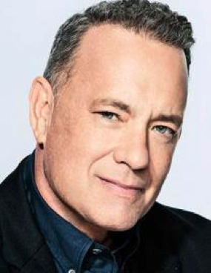

Slide 21
What just happened
The visual cortex received the images as electrical signals from your eyes
Your brain identified key features of each face from the images - in parallel
Your brain sent these features as electrical signals to your memories of people’s faces
Your brain compared these features to every memory you have of a person’s face – in parallel
Your brain sent their recognition scores to a control center of your brain
Your brain’s speech center vocalized the word “right” – in series
Answer: The human brain, comprised of around 84B neurons, does both parallel and series calculations
Two Key Questions:
How does the brain know to pay attention to specific features of a face?
What portions of real-time recommendation systems can be done cost effectively in parallel at low cost?

Slide 22
The Product Recommendation Challenge
A customer comes to your web site
You have information on their prior purchases and they view new products
How quickly can you generate a real-time recommendation based on 10 products and 1 million product reviews?
How much detail can you take into account and return the best match in 100 milliseconds?
How quickly can we compare a given customer and their purchases to 1 million other customers and their purchases?
What comparison tasks can be done in parallel?

Slide 23
The Rise of Automatic Graph Feature Engineering
Recent years have seen a surge in approaches that automatically learn to encode graph structure into low-dimensional embeddings.
The central problem in machine learning on graphs is finding a way to incorporate information about the structure of the graph into the machine learning model.
From Representation Learning on Graphs: Methods and Applications by Hamilton et. El.

Slide 24
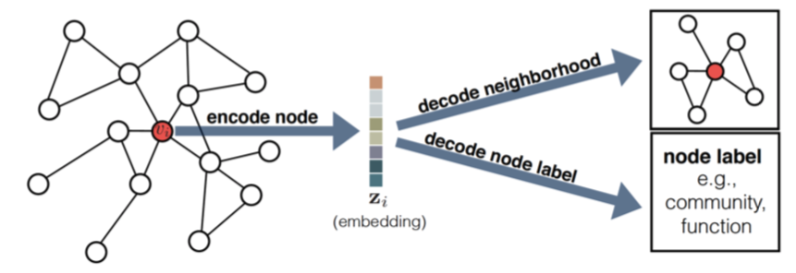
Example of Graph Embedding – Encode and Decode
From Representation Learning on Graphs: Methods and Applications by Hamilton et. El.

Slide 25
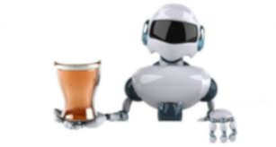
The Deep Learning Bartender
Can I Recommended a Drink?

Slide 26

Explainable AI Models Leverage Graphs
Today
Task
Why did you do that?
Why not something else?
When do you succeed?
When do you fail?
When can I trust you?
How to I correct an error?
Training
Data
Machine
Learning
Process
Learned
Function
Decision or Recommendation
Explainable AI
Task
I understand why
I understand why not
I know when you succeed
I know when you fail
I know when to trust you
I know why you erred
Training
Data
New
Machine
Learning
Process
Explanation
Interface
Explainable Model
https://www.darpa.mil/program/explainable-artificial-intelligence
Notes:
Explainable AI is a key
https://www.darpa.mil/program/explainable-artificial-intelligence

Slide 27

Three Eras of Computing
1) Procedural Era
Data
Programs
Answers
Procedural Code (Rules)
Explanations (Why)
2) Machine Learning Era
Data
Machine
Learning
Rules (10M weights)
Answers
3) Graph Era
Data
Knowledge
Answers
Machine
Learning
Explanations (Why)

Slide 28
Onward to the Hardware Graph!
Algorithmic
Richness
Enterprise
Knowledge
Graph
Hardware
Graph
Single Node
Graph
Data Hub
Data Lake
Scale out

Slide 29

Emergence
Can we predict what new insights we will find when we connect systems that have never been connected together before?
What is “the Edge of Chaos”?
Introduction to the Theory of Complex Systems
Peter Klimek, Rudolf Hanel, and Stefan Thurner

Slide 30



Dan.McCreary@optum.com
https://www.linkedin.com/in/danmccreary
https://medium.com/@dmccreary
@dmccreary

