Slide 1
Minnesota Department of Education Metadata Registry Case Study Date: October 31st, 2008
Dan McCreary
President
Dan McCreary & Associates
dan@danmccreary.com
(952) 931-9198
M
D
Metadata Solutions

Slide 2
Background
Goals
Create consistent data definitions for No Child Left Behind reporting
Make data definitions consistent across time and across multiple organizations
Early Learning, K-12, Math, Science, Reading, Writing, English Language Learners, Special Education, State and Federal Reporting
Examples
What is the definition of “graduation rate”?
What is the definition of “proficiency”

Slide 3
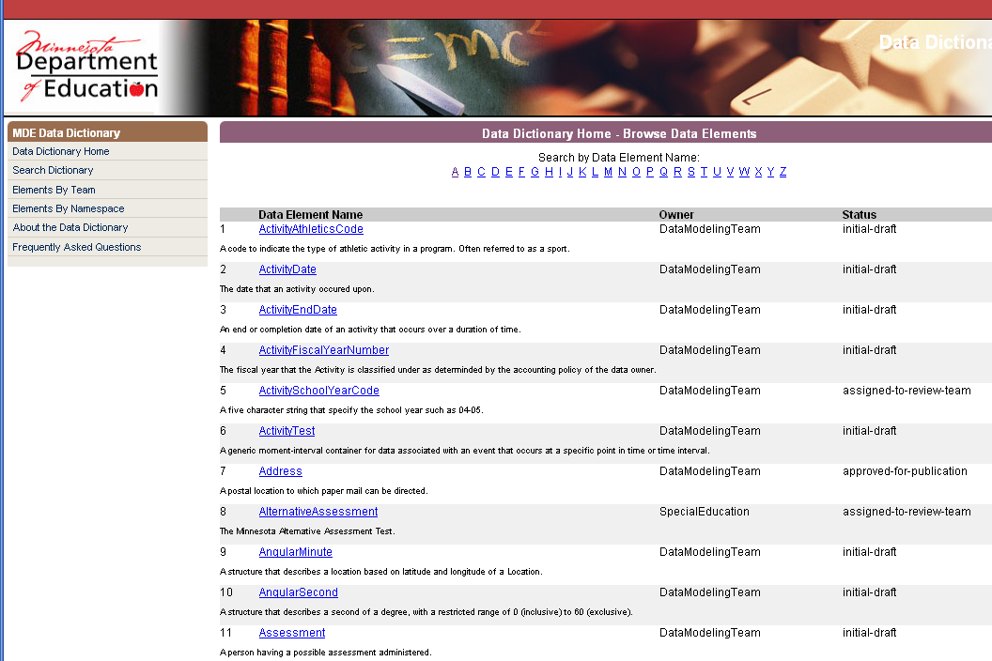
Data Elements (A-Z)

Slide 4
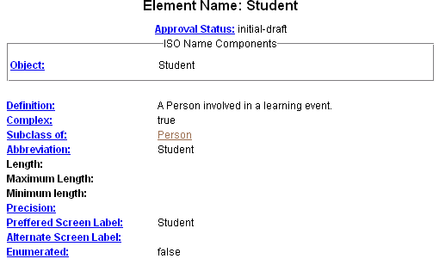
Student – Subclass of Person

Slide 5
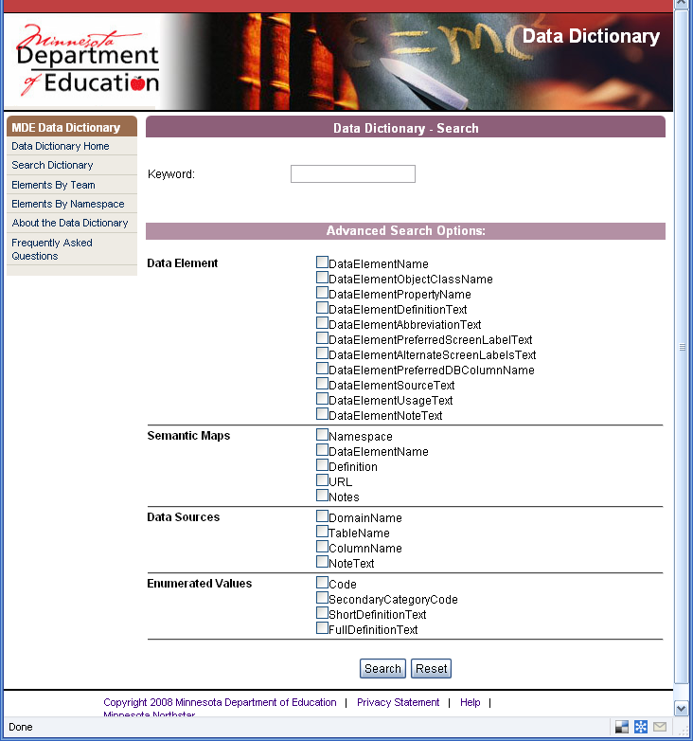
Data Element Search

Slide 6
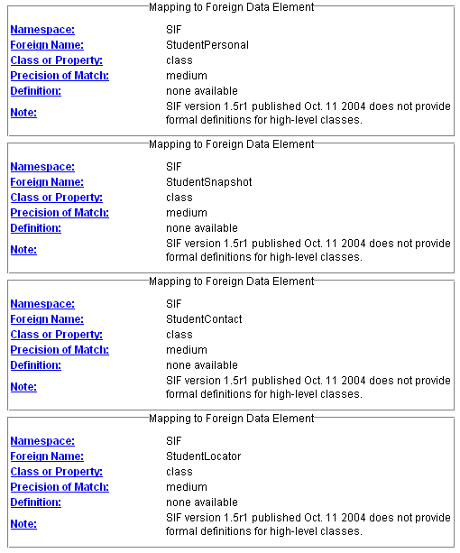
Semantic Mapping

Slide 7
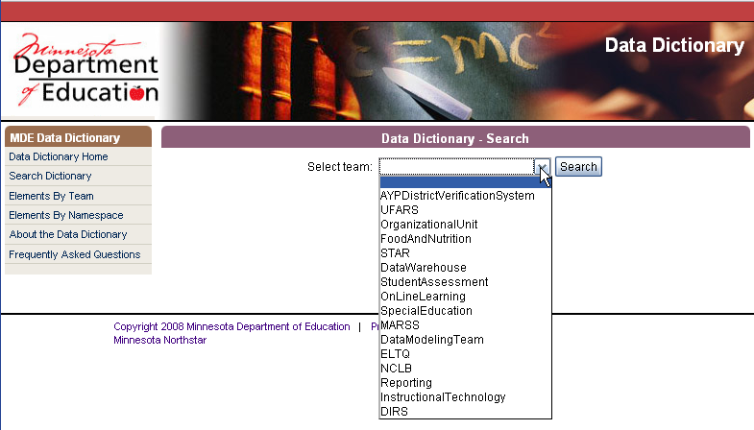
Search by Team

Slide 8
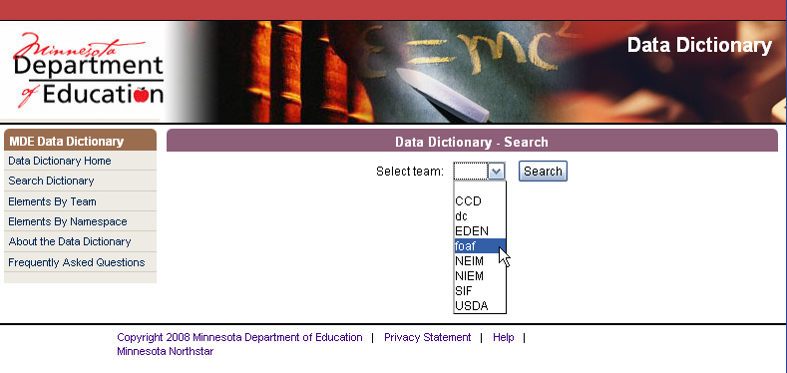
Search by Namespace

Slide 9
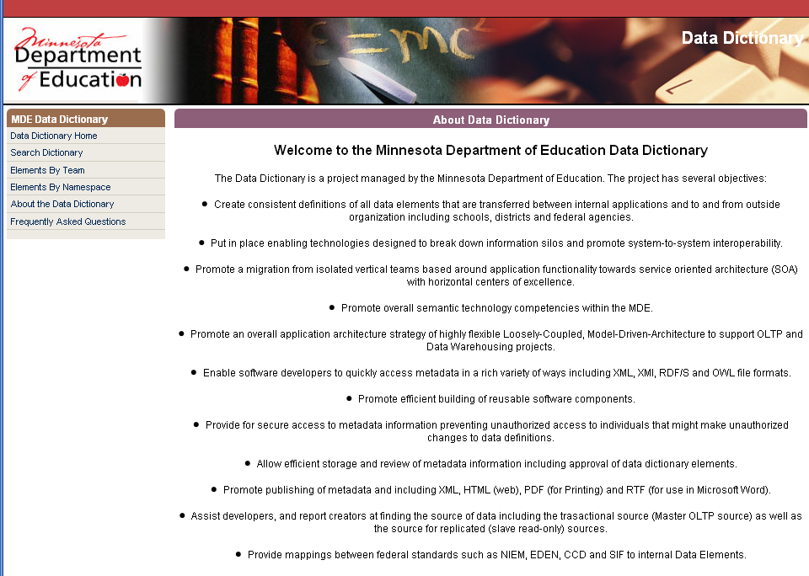
About the Dictionary

Slide 10
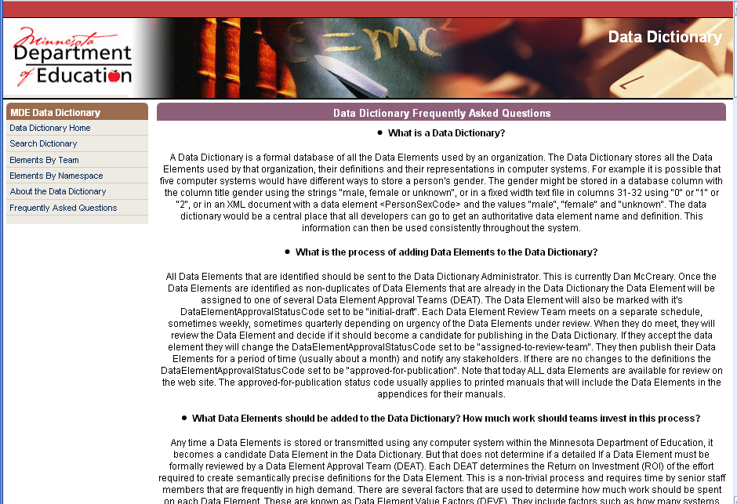
FAQs

Slide 11
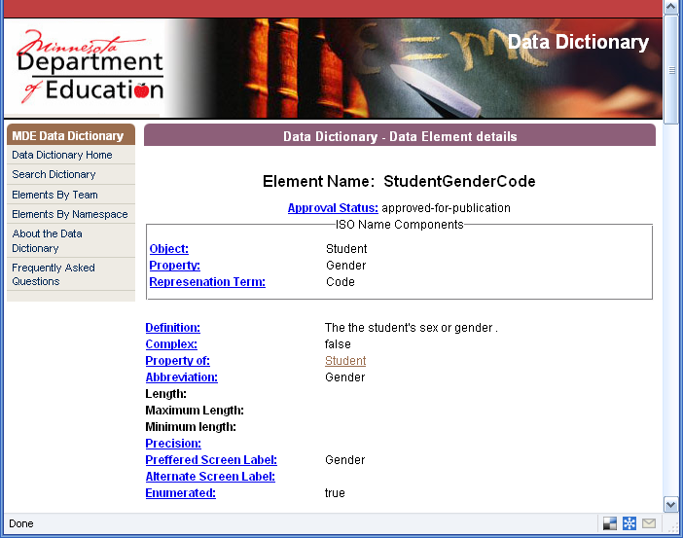
Data Element Properties (page 1)

Slide 12
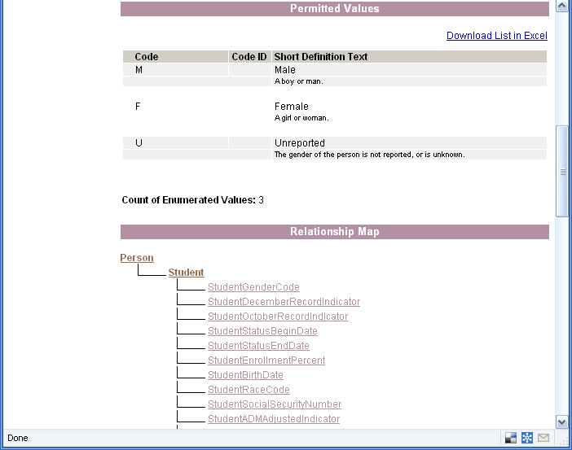
Data Element Properties (page 2)

Slide 13

Data Element Properties (page 3)

Slide 14
Thank You!
Please contact me for more information:
Native XML Databases
Metadata Management
Metadata Registries
Service Oriented Architectures
Business Intelligence and Data Warehouse
Semantic Web
Dan McCreary, President
Dan McCreary & Associates
Metadata Strategy Development
dan@danmccreary.com
(952) 931-9198

