Slide 1
XRX: XForms, REST and XQuery Simple, Elegant, Disruptive OTUG Presentation 10/21/2008
Dan McCreary
President
Dan McCreary & Associates
dan@danmccreary.com
(952) 931-9198
M
D
Metadata Solutions

Slide 2
Agenda
Overview of XRX (60 minutes)
Break (10 minutes)
Case Studies (20 minutes)
Project Management
Metadata Management
Questions

Slide 3
To Run Demos On Your Laptop
This file:
http://www.danmccreary.com/presentations/xrx/otug.ppt
You will need:
Java JKD (not just the JRE)
http://java.sun.com/javase/downloads
eXist
http://www.exist-db.org/downloads
xrx-class.zip
http://www.danmccreary.com/training/xrx/xrx-class.zip

Slide 4
Overview of XRX
What is XRX?
The “no-translation” architecture
How is XRX different from traditional three-tier architecture backed by a relational database?
The evolution of computer languages
migrating to declarative and functional languages
Overview of XForms
Overview of XQuery
Overview of REST
Impact on Web Application Development

Slide 5
Board Definition and Specific Definition
Acknowledgement of semantic ambiguity
Broad Definition
XML on the client
ReST interfaces
XML on the server
Specific Definition
XForms on the client
ReST interfaces
XQuery on the server

Slide 6
Terminology
Declarative Languages
a.k.a. Domain-specific languages
Languages that capture “what” not “how”
High-level abstractions
XForms
Functional Languages
Languages that transform but do not change data
SQL “Select” statements (exclude insert, update, delete)
Google’s MapReduce
XQuery (without updates)

Slide 7
The App Gap
Spreadsheets
as Databases
Full Web Application
Many creators without any formal software development training
One users at a time can assess the data
No way to bookmark a row
No easy way to generate reports
No way to see who changed what and when
Only IT staff have the skills to create and maintain web applications
Difficult to import data using a drag-and-drop to a folder
Some applications have smart URLs
Need to use complex reporting tools
Difficult to create web-based reports
XRX should be as easy to use as a spreadsheet but more powerful than traditional web applications

Slide 8
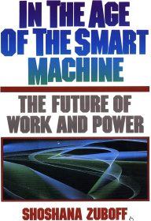
Cognitive Styles
The way we solve problems is dependant on the tools we know how to use.
Shoshana Zuboff (1988)
In the Age of the Smart Machine
Technology creates:
- new ways of thinking
- new ways of approaching and solving problems
- new sets of "Cognitive Styles"
It is only if we share these cognitive styles that we will be able to create a coherent technology strategy that everyone understands
XRX is a new way of solving problems – a new Cognitive Style
(Note: this is actually the most important slide in the presentation)

Slide 9
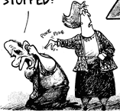
Incoming!
Has this web
thing gone away yet?
XML
web

Slide 10
A Happy Partnership
XForms
XQuery

Slide 11
No-Shredding!
My Form
Data
Relational databases take a single hierarchical document and shred it into many pieces so it will fit in tabular structures
Native XML databases prevent this shredding

Slide 12
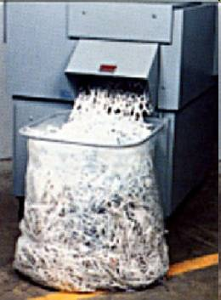
Is Shredding Really Necessary?
Every time you take hierarchical data and put it into a traditional database you have to put repeating groups in separate tables and use SQL “joins” to reassemble the data

Slide 13
How to Store with XQuery
let $store-status := store($collection, $file, $data)
This single line will automatically save and do fulltext indexing on all of your form data
Each element is immediately available for fast querying
You can also do this by dragging an XML file into a WebDAV folder

Slide 14
Unnecessary Shredding Is Bad
Shredding is the process of taking a single XML document and inserting different repeating sections into tables of a relational database
Case Study: Real Estate Property Data
Many Buyers
Many Sellers
Many People
Many Organizations
Many Counties
Many Parcels
Many Appraisals
Many Property Types (Residential, Industrial, Farm, Commercial)
Many Use Classifications
Many Agricultural Programs
Many Agricultural Programs Types
Many Tax Classifications
Many Taxable Values…
Etc
One Form = 45 distinct insert statements with SQL

Slide 15
The Translation “Pain Chain”
Name:
Street:
City:
Zip:
Web Forms
Mid-Tier Objects
RDBMS
From web forms…to objects…to SQL inserts…to SAL selects…to objects and back to web forms
Many format translations…

Slide 16


XRX: Elegant Simplicity
trees on
the client
trees on
the server
Symmetry

Slide 17
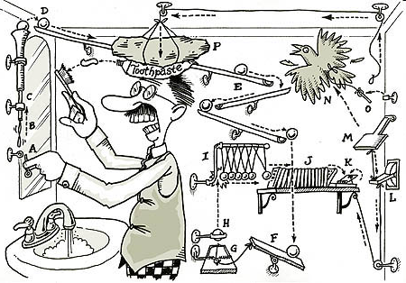
Rube Goldberg Architecture
RDBMS and object layers may represent possible unnecessary complexity

Slide 18
Four Translations: The Language Metaphor
English
German
Spanish
Imagine a text processing system where the input and output was in English
The middle-tier had to be represented in German
The words could only be stored in Spanish

Slide 19
Translations are Seldom Perfect
Four score and seven years ago our fathers brought forth on this continent, a new nation, conceived in Liberty, and dedicated to the proposition that all men are created equal.
English to German
German to Spanish
German to English
Spanish to German
Score six fifty-six years ago our fathers came to this continent a new nation, conceived in liberty and dedicated to the idea that all men are created equal.

Slide 20
The XRX Process
XForms stores form data in native XML format in a browser-hosted model (MVC) architecture
browser
html
Database
head
body
model
input
Person
label
FirstName
LastName
Roles
Projects
Project

Slide 21
XRX Core Process
Browser
Database
model
save/edit
update
view

Slide 22
Code Table Services
Client
Server
model
Form Data
Code Table Service
view
all-codes.xq
Code
Tables
Code tables are separated from form instance data

Slide 23
XRX Dynamic Forms Generation
Client Application
Application Server
XForms Model
Session
Form Data
Form Data
Collection
User
Team
Document
Status
Code Tables
Role
Group
Views
DataElement
Registry
Binding Rules
Required
Context
filters
Code Table Services
Read-only
Suggest Services
Data Types
Business Rules Editor
Calculations
Calculations
Inference
Submissions
Constraints
XForms View
Static Controls
XML Schema Registry
Dynamic Controls
Subschema Service
Constraint Schemas
Semantic Schemas
Design Time
Run Time

Slide 24


Evolution Metaphors
Specialization of Languages
Generalization of Languages
XForms: Specialized
Java: General
Notes:
One of our fundamental metaphors we will be using is that of the forces of evolution.
Evolution causes some animals to have specialized functions, like the beak of a finch.
Evolution causes some animals to evolve features that allow them to adapt quickly to changing environment.

Slide 25
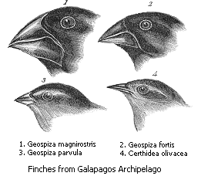
Evolution: Specialization
Darwin’s Galapagos Finches
Beaks are highly adapted to different food sources
Finches adapted to specific ecological "niches“ over millions of years of isolated evolution
Similar to domain-specific declarative languages
See Wikipedia "Darwin's Finches"
Notes:
From a single species of finch almost a dozen individual species evolved.
Inspired Darwin to think of the theory of evolution.
The most curious fact is the perfect gradation in the size of the beaks in the different species of Geospiza, from one as large as that of a hawfinch to that of a chaffinch.

Slide 26
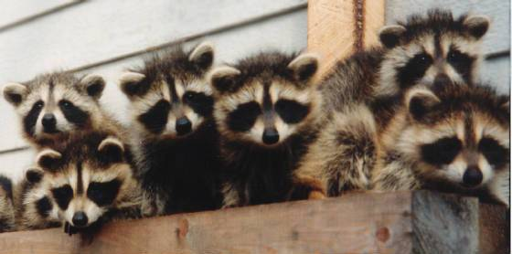
Evolution: Generalization
Generalization: The Raccoon
The world has a higher population of raccoons today due to their ability to quickly adapt to changing urban environments
Similar to highly adaptive procedural languages
Notes:
Raccoons have unusual thumbs, which though not opposable, enable them to open many closed containers such as garbage cans and doors. Raccoons are omnivores with a reputation for being clever and mischievous; their intelligence and dexterity equip them for survival in a wide range of environments and in the presence of humans.
See http://en.wikipedia.org/wiki/Racoon

Slide 27
The Software Development Process
Declarative Languages
Requirements
(BA)
Test
(QA Staff)
Build
(Programmer)
Design
(Architect)
Requirements are about “What”
Design and Build is about “How”

Slide 28
XForms: 21 Elements
Bind
Case
Input
Instance
Group
Help
Hint
Label
Load
Output
Message
Model
Repeat
Secret
Select
Select1
Switch
Submission
Submit
Textarea
Trigger
Color coding limited vocabularies can increase the speed of pattern matching.
Look for advanced text editors to provide custom element coloring.

Slide 29
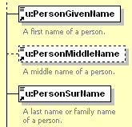


What Is Declarativeness for A Context?
Efficiency at capturing the testable business requirements in a semantically precise and concise manner
Example: Is a field optional? Will validation of the data fail if the field is missing?
Ability of each data element to have precise meaning over time and within organizations
Schema Drawing Tool
XML Schema File (.xsd)
XForms
xf|input:required
{font-weight: bold;}
xf|input:required .xf-value
{background-color:#fff6af;}
*:required::after
{font-weight:bold;
font-size:1.5em;
content: "*"; color: red; }
XForms CSS tags

Slide 30
Computer Science Abstractions
Higher abstractions
Declarative
<xf:input>
<xf:label>
Object
Class MyClass(
Method MyMethod
Structured
Fortran
Function(A, B)
Assembly
FOR I = 1 TO 10 DO
1010001010
time

Slide 31
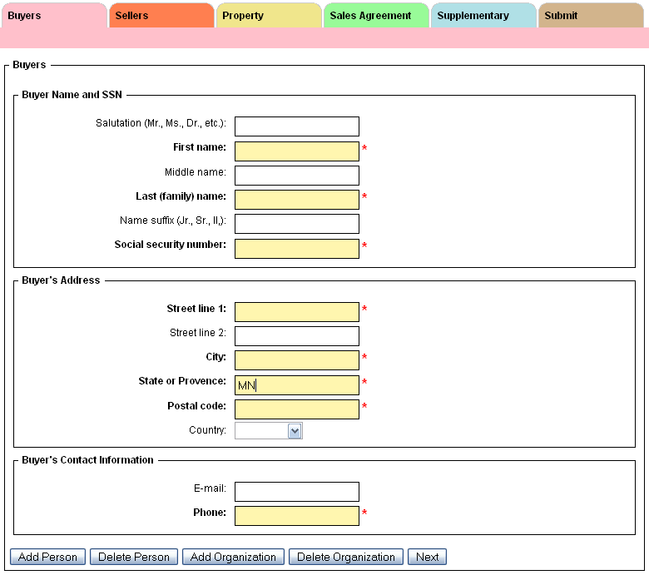
Use Case: Electronic Forms
User fills out a web-based form
Typical requirements may include listing of data to be gathered, data types, validation codes and data repetition patterns
Examples:
HTML Forms
XForms
InfoPath™
Notes:
Screen image of Certificate of Real Estate Valuation.

Slide 32
Four Display Options
Browser Support
Browser Plug-in
MyForm.xhtml
Download JavaScript Patchs
Server
Side
Processing

Slide 33











Many Forms Players
<html>
<head>
<xf:model>
<xf:/model>
<head>
<body>
<xf:input>
</xf:input>
</body>
</html>
XForms Extension
Mobile Client
Netfront Mobile
MyXForm.xhtml
specification
Forms Server
Rendered Form
See Wikipedia “XForms”
XForms “Players”
Notes:
See the excellent Wikipedia article.

Slide 34

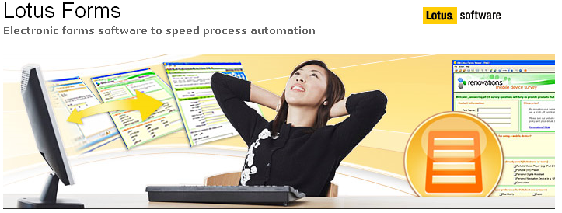
IBM Workplace Forms
Enterprise application/forms/workflow built entirely around XForms and native XML databases
http://download.boulder.ibm.com/ibmdl/pub/software/dw/workplace/overview-wp-forms.pdf

Slide 35
Semantically Precise Vocabularies
Standard | Domain
Atom/RSS | Syndication/Notification
ACORD | Insurance Industry Forms Data
FpML | Financial Products Markup Language
FixML | Banking (Financial Information eXchange)
HL7 | Healthcare (now using XML)
MISMO | Mortgage Industry
NIEM | National Information Exchange Model (registry)
OTA | OpenTravel Alliance (Travel industry)
SIF | School Interoperability Framework
GJXDM | US Department of Justice (registry)
XBRL | XML Business Reporting Language
See: http://en.wikipedia.org/wiki/Category:XML-based_standards

Slide 36
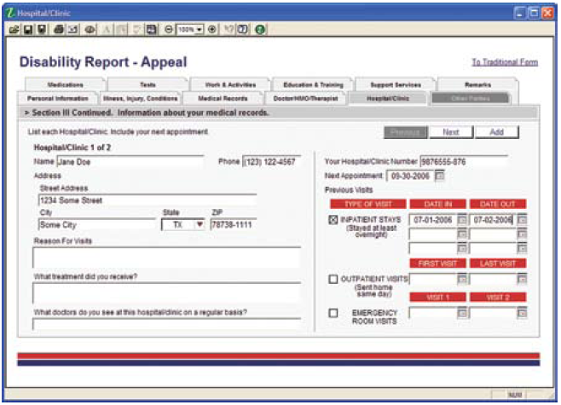
Pre-Built Using Industry Standards
Vertical
Integration
Healthcare
Government
Insurance
Banking
Manufacturing
Travel

Slide 37
Model Driven
XForms enables the developer to reuse business rules encapsulated in XML Schemas (xsd) and XML Transforms (xslt)
XForms reduces duplication and ensures that a change in the underlying business logic does not require rewriting in another language
XForms
Application
XML
Schema
Meta Data
Registry

Slide 38
View and Model are Trees
Model
The view is a tree of a presentation data element
Models are comprised of one or more trees
XForms supplies the control layer that moves data elements to and from the model
Users don’t have to worry about moving things to and from the screen
Control (Bind)
View (Presentation)

Slide 39
XForms Input Control
<xf:instance xmlns=“">
<data>
<name>John Doe</name>
</data>
</xf:instance>
<xf:input ref=“name">
<xf:label>Name:</xf:label>
</xf:input>

Slide 40
Models and View Are Linked with "Bind"
HTML
head
xf:model
body
Person
form
Name
fieldset
label
label
first
last
input
<bind>
input
Both the model and the views are trees of data elements

Slide 41
Just “Do The Right Thing”
HTML
head
body
xf:model
Person
form
PersonCurrentOnTaxes type="xs:boolean"
fieldset
label
PersonBirthDate type="xs:date"
label
input
input
<bind>
Data types from the model just do the right thing
Boolean variables become checkboxes
Dates have date selectors

Slide 42

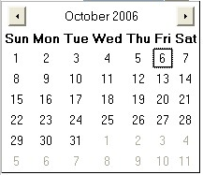
Example of Automatic UI Generation
All true/false data types (xs:boolean) automatically become a checkbox
All dates (xs:date) have a date selector to the right of the date field
All codes can be selected from lists

Slide 43
Structure of a XForms File
XForms tags are just XML tags imbedded in a standard XHTML file with a different namespace
Most HTML form tags are exactly the same but some attributes have been promoted to be full elements
Namespaces
CSS Imports (View)
Model
Constraints (Bindings)
UI (View)
Submit Controls
MyForm.xhtml

Slide 44
Declarative Spectrum
General Purpose
Narrow Purpose
Less Abstract
More Abstract
C#
Apache Ant
HTML
CSS
Assembly Language
C
C++
Java
Python
XSL
XQuery
XML Schema
JavaScript
Groovy
XUL
XForms
XPath
perl
Ruby
XQuery Update
SQL
For any given context different “languages” have different levels of “declarativeness”
General purpose languages are less abstract but can solve a wide variety of problems
Declarative languages have a more narrow purpose and target a specific problem like styling a web page or selecting data

Slide 45
XQuery
I was immediately attracted to XQuery because it has an intuitive syntax that I enjoy using and stretching to its limits. Having spent many years using SQL, XQuery feels familiar, yet much more powerful.
Priscilla Walmsley
http://www.stylusstudio.com/priscilla_walmsley.html

Slide 46
Brief History of XQuery
In 1998 Jonathan Robie and Joe Lapp (then the principal architect of WebMethods) created a language called XQL
In 1998, two query languages, XQL and XML-QL got a lot of interest within the W3C and a working group for XML-based querying languages was formed
The working group selected around 90 use cases and compared the ability of seven advanced query languages to execute them
None of the seven were perfect. Each had some defects
The working we took the best part of each of the seven languages and created the XQuery standard

Slide 47
Functional Programming
y = f(x)
Computer programs are like mathematical functions
Developers not manipulate states and variables (things that change value), but focus entirely on constants and functions (things that never change)
Functions are treated as first class citizens
Functions that take other functions as input
Makes it very easy to build modular programs
Software written in FP languages tend to be very concise
http://en.wikibooks.org/wiki/Computer_programming/Functional_programming

Slide 48
XQuery is a “Functional” Language
All variables are “immutable” – they can be set but never changed:
Invalid: let $x := $x + 1
Side-effect free system
All variables are “final” in Javaspeak
Order of operations on sequences is not guaranteed
Allows XQuery to easily scale to many CPUs
The trick is to visualize trees in and trees out
Think Google’s MapReduce
Note that the XQuery 1.0 specification does not specifically require a system to be able to pass functions as arguments but eXist allows this

Slide 49



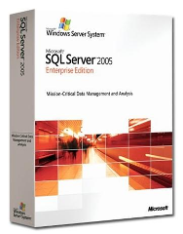

Database Vendors that Support XQuery
eXist (open source)
MarkLogic
IBM DB2 Version 9 “PureXML”
Microsoft SQL Server 2005
Oracle 10g Release 2 Enterprise Edition
+ 50 others…

Slide 50
XQuery is Easier To Learn Than XSLT
Studies have shown that XQuery is much easier to learn than XSLT, especially if users have some SQL background
Usability of XML Query Languages.
Joris Graaumans.
SIKS Dissertation Series No 2005-16
ISBN 90-393-4065-X

Slide 51
XQuery and SQL
Many believe that XQuery is the logical “successor” to SQL
SQL returns only tabular data
XQuery returns either tabular or hierarchical data sets
XQuery is a w3c standard with a large library of compatibility tests
eXist has passed over 97% of the w3c’s compatibility tests

Slide 52
High Level Comparison
 | SQL | XSLT | XQuery
Query tabular data | Yes | Yes | Yes
Query hierarchical data | No | Yes | Yes
Easy for people to learn | Yes | No | Yes
The winner!
XQuery can be as easy to learn as SQL but also works with hierarchical data structures.

Slide 53


The XML File system
XML File system – a way of storing information in XML that can be quickly searched
You can drag and drop almost any files onto this file system
You access it by using the Windows “My Network Places” function
But - You can query the file system like a relational database

Slide 54
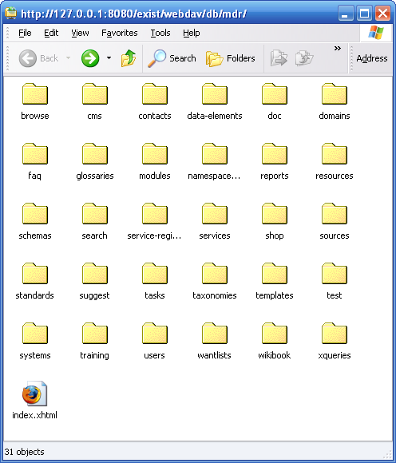
XML File System (continued)
Native XML file systems have folders within folders to help you organize your information
Most file operations are the same (copy, rename, delete etc.)

Slide 55
XQuery and Web Services
XQuery is a new way to query structured information and turn these into services
XQuery allows non-programmers to quickly create XML web services from almost any machine-readable sources
Total Effort = Time to Import + Time to Query + Time to Publish

Slide 56
It is Easier to Import Data Complex Data
SQL
Analyze data for all parent child relationships and repeating groups
Design logical and physical ER diagrams
For each table create a Data Definition File using a data definition language (DDL)
Create indexes using DDL
Create one table for each set of repeating set of data
Run DDL on database creating tables using the appropriate data types
Create indexes
Create primary insert statements
Create separate insert statements for each repeating group
Run Insert statements on primary structures in database
Use primary keys of the first data inserts as foreign keys of dependant data structures
XQuery
Drag XML files into folder

Slide 57
It is Easy to Query XML Data
for $r in doc(‘t.xml’)//row
where col1=1
return
$r/col1, $r/col2
SELECT COL1, Col2
FROM TABLE
WHERE COL1=1
COL1 | COL2
1 | A
1 | B
1 | C
1 | D
<root>
<row>
<col1>1</col1><col2>A</col2>
</row>
<row>
<col1>1</col1><col2>B</col2>
</row>
<row>
<col1>1</col1><col2>C</col2>
</row>
<row>
<col1>1</col1> <col2>D</col2>
</row>
</root>

Slide 58
SQL is similar to XQuery
Selecting Distinct Values | SELECT DISTINCT | for $r in distinct-values($doc)
Row Restriction | WHERE COL=value | where $r/element=value
Sorting | SELECT C1, C2 FROM TABLE ORDER BY C1 | for $r in $doc/r order by $r/ele

Slide 59
Steps to to Create A Web Service
Java/JDBC/SQL
Learn Java or find a Java Developer
Install TomCat Web Server
Install AXIS Java Framework
Write a JDBC program that sends SQL queries to a database
Get the results back in Java Result Object structures
Go through the Java Results Structures and use print statements to wrap XML tags around the strings in the result objects
Rename your class files to .jws files
Add the .jws files to the TomCat deploy folders
The WSDL files will automatically be generated
Use WSDL tools to query the web service
XQuery
All XQuerys are web services

Slide 60
Insert/Select/Publish Comparison
SQL
SQL
Java
Tomcat
AXIS
JDBC
XQuery
SQL
XQuery
XQuery
Insert
Query
Publish
XML Web Service
XQuery
Total Effort

Slide 61
XQuery FLOWR Expressions
XQuery is based on FLOWR expressions
For
Let
Order (optional)
Where (optional - predicates are faster)
Return (required)
One of these is required

Slide 62
Sample XQuery
xquery version "1.0";
(: Get all terms in the data collection :)
<terms>{
(: select only xml documents with “term” as the root element :)
for $term in collection($collection)/term
return
<term>{$term/name/text()}</term>
}
</terms>

Slide 63
XQuery’s Nested Structure
XQuery
Processor
XML
Processor
XQueries have a alternating nested structure
Interleave actual XML output and XQuery instructions

Slide 64
Example of Nested Structure
XQuery version “1.0”;
let $collection := ‘/db/mycollection’
return
<html>
<head><title>My Report</title></head><body><table>
{for $i in collection($collection)/item
return
<tr>
<td> </td>
<td> </td>
</tr>
{$i/name/text()}
{$i/defintion/text()}
}
</table></body></html>
Note that the inner blue XQuery areas always start and end with curly braces { }

Slide 65
REST
REpresentation State Transfer
Create applications based on well designed URLs
Take advantage of web caching
Migrate toward Resource-Oriented Computing (ROC)
REST evangelists: RESTifarians

Slide 66
Five RESTFull Friends
In-resident memory cache in your browser
You local hard drive cache
Your local enterprise cache
The cache on the web server farm
The cache on the database
Please make sure to check with your RESTfull
friends BEFORE you bother the database.

Slide 67
Shallow REST vs. Deep REST
You can start taking advantage of ReST buy just doing well thought-out URL design
To take advantage of deep ReST you must consider the subtleties of the HTTP protocol
GET vs POST vs PUT
DELETE

Slide 68
Benefits of REST
Provides improved response time
Reduced server load
Improves server scalability
Requires less client-side software
Depends less on vendor dependencies
Promotes discovery
Provides better long-term compatibility
Better and evolvability

Slide 69
Challenge: Build Intelligent URIs
URIs should not reflect the internal structure of your application or your database structure
URIs should be permanent
URIs should be bookmarkable
URIs become an API
Organizations must make an institutional commitment to Permanent URIs (URNs and PURLs)

Slide 70


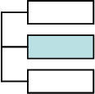





Gathering Requirements
Notepad
MS-Word
MS-Excel
XML Files
XML Schema
WSDL XML Files
BPEL XML Files
XHTML Files
XForms Files
XML Bind statements
XPath Expressions
UML in XMI (complex)
XML Metadata
Data Element
Business Rules in
Schematron
PowerPoint
MS-Visio
Non-Machine Readable Models
Used To Capture Requirements
Machine Readable Models
Used To Capture Requirements
Requirements can be expressed in two ways:
Use non-machine readable models – easy to create – hard to verify correctness automatically - but fine for non-testable requirements with no measurable quality metrics
Use machine-readable models – need tools and training but are easy to verify for correctness and consistency with a metadata registry. Required if you desire the ability to measure requirements gathering quality and plan to use continuous improvement processes

Slide 71


Precision Requirements
Requirements
Requirements
SME
BAs
Developers
vs.
Graphical Requirements and Specifications
SME/BA
IT Staff
Goal: Shorten the semantic “distance” between the business unit and the IT staff

Slide 72

Many Small vs. One Large
CSS
XForms
Binding Rules
XPath
vs.
Requirements
XQuery
XML Schema
Schematron
It is easier to build an architecture around many small, precise languages than a single large language

Slide 73
Parker Projection
100%
Relative Code Base
Procedural code (Java, JavaScript, VB, C#, C++)
Declarative code (XHTML, CSS, XSLT, XQuery, XForms)
Source: Jason Parker, Minnesota Department of Revenue, November 2006
Time

Slide 74




Machine Readable Model Spectrum
PowerPoint
Proprietary
Models
Notepad
MS-Visio
XHTML
BPMN/BPEL
XML Schemas
High
Effort
Effort required to test for correctness
Low
Effort
Different file types have vastly different ability to be queried by a metadata/model registry infrastructure
Can the document be transformed into XML?
Can it be sent through a program to clean up the tags (HTML tidy)
How verbose is the file format?
Is there documentation available?

Slide 75
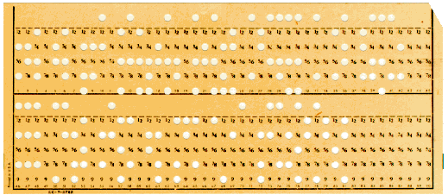
Many Processes Today Are Driven By…
The constraints of yesterday…
Our challenge:
Ask ourselves the question…
Do our current method of solving problems with tabular data…
Reflect the storage of the 1950s…
Or our actual business requirements?
What structures reflect the actual business problem?

Slide 76
Model-Driven Development
model
Rapid Transforms
program
program
model
model
program
model
program
All aspects of a system are derived by transformations of specifications captured in models to working code
Specifications are stored in complex hierarchical models
XQuery allows complex hierarchical models to be quickly transformed into new services that can be used to dynamically generate program artifacts (XForms fragments)
Temptation to “cheat” the MDA process (copy and paste code) is minimized by team of developers who can rapidly transform models

Slide 77
Sidebar: The Semantic Web
Subject
Predicate
Object
Node
Node
Node
Node
Node
Node
Note that the semantic web infrastructure is based on graphs, not trees (technically graphs inside XML trees)
Each node in the graph can be a URL
External web sites can be used to create “joins” based on a URIs

Slide 78
When Will This Take Off?
Never confuse a clear view for a short distance.
- Paul Saffo, Futurist
There are as of yet, no real XRX frameworks available (but we are working on them) (Ruby vs Rails)
Many large software vendors have little to gain and a lot to lose of XRX succeed
How will Microsoft shareholders benefit from a GREAT web user interface experience?
Don’t confuse the desired with the likely

Slide 79
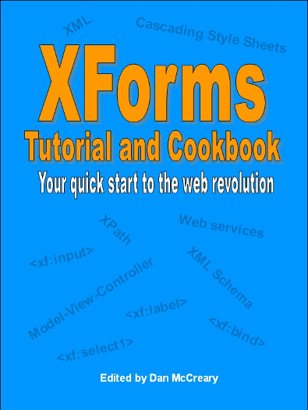
XForms Wikibook
http://en.wikibooks.org/wiki/XForms
Over 90 working XForms example programs
Example code in GoogleCode available via Subversion download

Slide 80
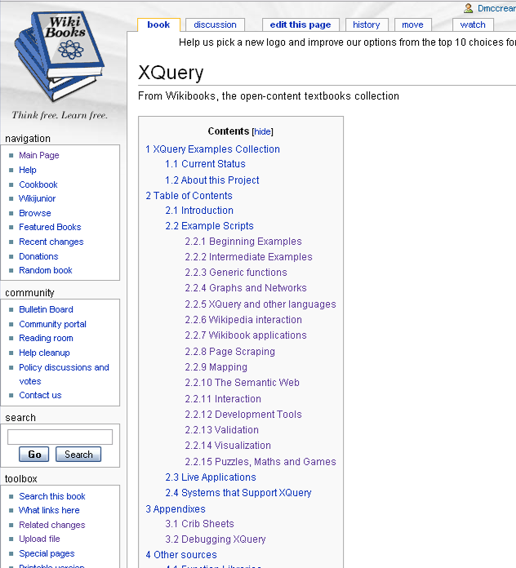
XQuery Wikibook

Slide 81
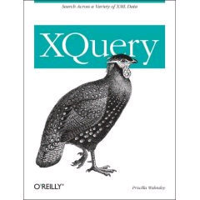
XQuery by Priscilla Walmsley
Paperback: 510 pages
Publisher: O'Reilly Media, Inc. (March 30, 2007)
ISBN-10: 0596006349
ISBN-13: 978-0596006341

Slide 82

RESTful Web Services
by Leonard Richardson and Sam Ruby
446 pages
O'Reilly Media, Inc.
May 8, 2007
ISBN-10: 0596529260
ISBN-13: 978-0596529260

Slide 83
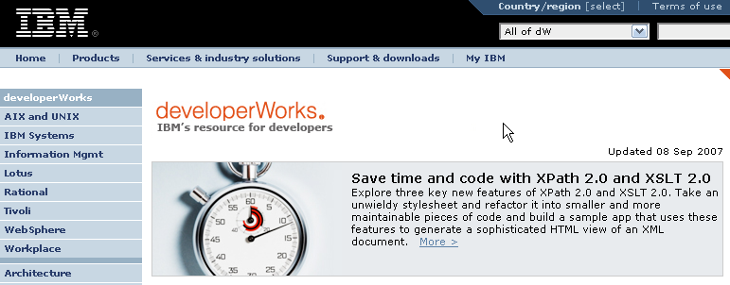

IBM Resources
IBM DeveloperWorks
Keywords: XForms, XQuery, PureXML

Slide 84
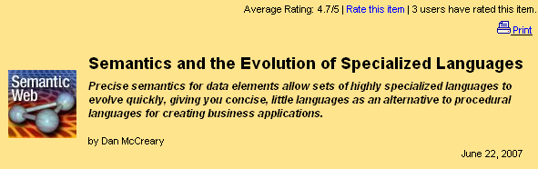
Devx Article
Semantics and the Evolution of Specialized Languages
http://www.devx.com/semantic/Article/34805

Slide 85
Thank You!
Please contact me for more information:
Metadata Management
Metadata Registries
Service Oriented Architectures
Business Intelligence and Data Warehouse
Semantic Web
XRX architecture
XRX training
Native XML Databases
Dan McCreary, President
Dan McCreary & Associates
Metadata Strategy Development
dan@danmccreary.com
(952) 931-9198

