Slide 1
Hidden Coins in a Forest
A story of fraud detection
Dan McCreary

Slide 2
Our challenge
How do we get an intuitive understanding of how graph databases are better at finding fraudulent activities than other models?
How does graph structure help us find fraud?
How do we explain these concepts to non-programmers?
How do we create a compelling story that is easy for people to remember?

Slide 3

Scene 1: One the Edge of a Dark Forest
Imagine you are walking on the edge of an immense deep and dark forest. The forest contains hidden dangers, and you can only safely walk on the edge of the forest and peer between the trees.

Slide 4

Scene 2: Hidden gold coins
Hidden within the forest are a set of valuable gold coins. Some of these coins are near the edge and easy to see. Others are buried deep within the forest and are not visible to you.

Slide 5
Scene 3: Easy coins on the edge
As you move along the edge you can easily spot the coins near the edge. You can reach in and pick them up without any danger and put them in your pocket. Let’s call these “easily observable” coins.

Slide 6
Scene 4: Coins deep in the woods
?
?
?
?
?
But you are told there are many other coins that are deeper in the woods, farther away from the edge where you are safe. We call these coins “difficult to observe” coins. How can we find these coins?

Slide 7
A Model for Fraud
The Observability Path
Now let’s create a simple model for fraud that is similar to our coins in the forest. The trees are all the items in our dataset. Every person, transaction or any observable event. The coins are the fraudulent events we want to discover.

Slide 8
The Distribution of Fraudulent Events
Frequency of Events
Land of Easy Flat Rules
Land Complex
Structural Rules
Difficulty of Observability
Unfortunately, most fraudulent events are not easy to observe. If they are easy to observe, our systems could detect them with simple deterministic rules. Fraudsters know this. So, they deliberately bury most fraudulent events deep in the forest where they are hard to find.

Slide 9
The Easy “Impossible Day” Rule
Claim: 45 minutes
Claim: 45 minutes
Claim: 45 minutes
Claim: 45 minutes
Claim: 45 minutes
Claim: 45 minutes
Claim: 30 minutes
Claim: 45 minutes
Claim: 45 minutes
Claim: 45 minutes
Claim: 30 minutes
Claim: 45 minutes
Claim: 30 minutes
Claim: 30 minutes
Claim: 45 minutes
Claim: 45 minutes
Claim: 30 minutes
Claim: 45 minutes
Claim: 30 minutes
Claim: 30 minutes
Claim: 45 minutes
Claim: 30 minutes
Claim: 30 minutes
Claim: 30 minutes
Claim: 45 minutes
Claim: 45 minutes
Claim: 45 minutes
Claim: 30 minutes
Claim: 30 minutes
Claim: 45 minutes
Claim: 45 minutes
Claim: 45 minutes
Claim: 45 minutes
Claim: 45 minutes
Claim: 45 minutes
Claim: 45 minutes
Claim: 30 minutes
Claim: 45 minutes
Claim: 45 minutes
Claim: 45 minutes
Claim: 30 minutes
Claim: 45 minutes
Claim: 30 minutes
Claim: 30 minutes
Claim: 45 minutes
Claim: 45 minutes
Claim: 30 minutes
Claim: 45 minutes
Claim: 30 minutes
Claim: 30 minutes
Claim: 45 minutes
Claim: 30 minutes
Claim: 30 minutes
Claim: 30 minutes
Claim: 45 minutes
Claim: 30 minutes
Claim: 30 minutes
Claim: 45 minutes
Claim: 45 minutes
Claim: 60 minutes
A Normal Day: 10 claims under 8 hours: Pass
An Impossible Day: 50 claims over 8 hours: Fail
A fraudster steels a provider credential and files many fake medical claims on behalf of that provider for a given day. The total time it would take to perform these procedures easily triggers a simple rule and the claims are rejected. Sometimes investigations are opened on these findings. Note that we could not detect this fraud by looking at a single claim in isolation. We must look at multiple claims to know that their might be fraud. We are looking for patterns within many claims.

Slide 10
A Graph Model For Fraud
Now let’s represent our forest as a graph of connected events. Our job is to not just look at a single claim at a time, but look for specific patterns within the graph. Our job is to look deep into the forest for patterns.

Slide 11
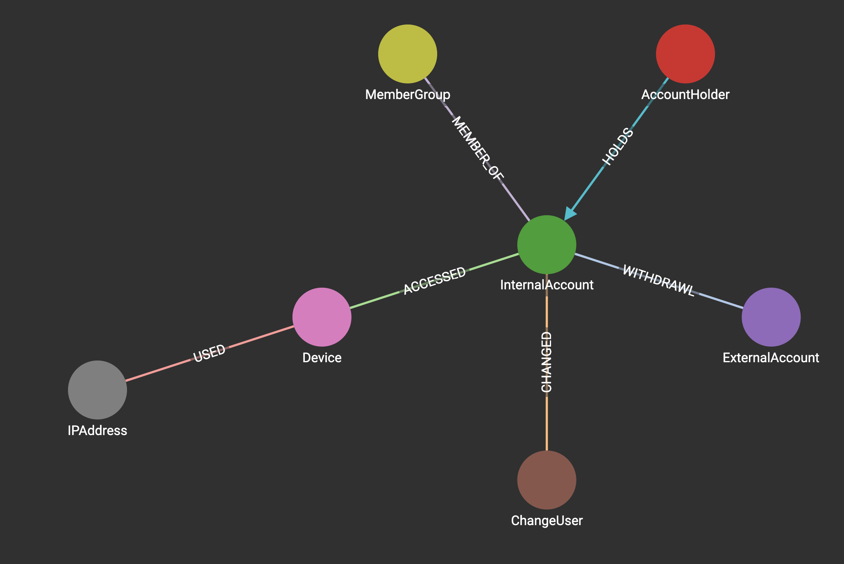
Sample Graph Model of Banking System
Here is a real-world banking model we have used to detect fraudlent banking transactions.

Slide 12
How to We Increase Observability?
We write queries that go deeper into our graph to look for patterns
The deeper into our queries go, the more fraud we find
Coins buried deep in the forest are equivalent to deep multi-hop graph queries
Graph are the only way to find many times of fraud because they look for specific patterns within a graph
Graph contain structure that is lost when we flatten our data

