Slide 1
Personal Finance Figures

Slide 2
Logo:
$

Slide 3
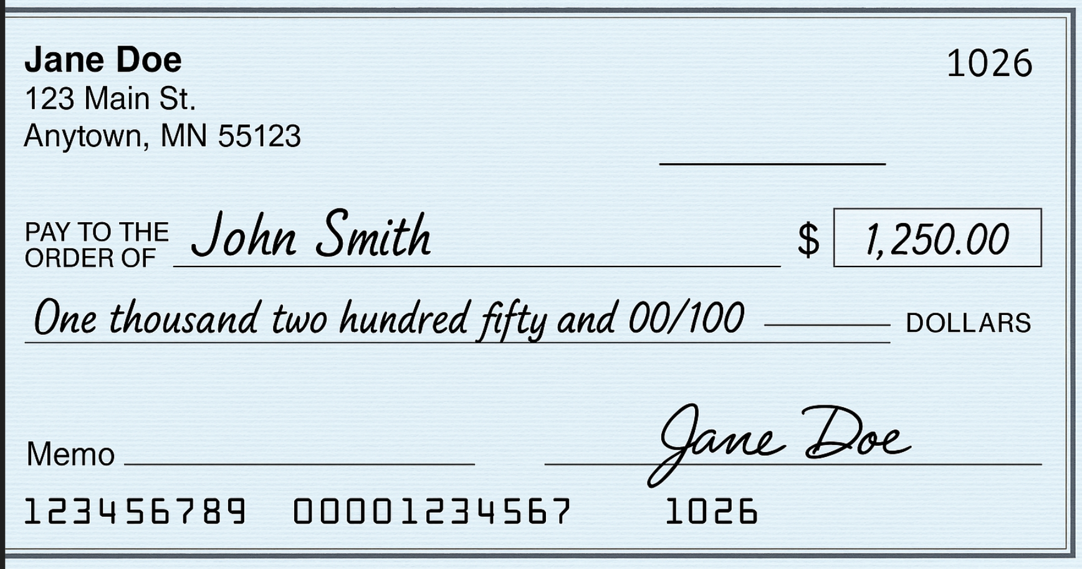
Check
Number
Payee
Name
Date:
March 29, 2025
Numeric
Amount
Written
Amount
Acme Bank
Optional
Memo
April Rent
Signature
Line
Bank Routing Number
Account
Number

